Slide 1
Proposed Revisions
to the
Magnuson-Stevens Act
National Standard 1, 3, & 7 Guidelines
National SSC Meeting
February 23-25, 2015

Slide 2
Proposed Rule Next Steps
Published on January 20, 2015.
Accepting comments until June 30, 2015.
Proposed rule was widely distributed.
Upcoming Presentations – all are open to public
Council Coordination Committee (February).
National Scientific & Statistical Committee Meeting (February).
Silver Spring (March).
Council Meetings (March and April).
MAFAC (April).
Council Coordination Committee follow-up in June.

Slide 3
Background
The Magnuson-Stevens Fishery Conservation and Management Act (MSA) includes 10 National Standards which guide all fisheries management actions (see Appendix A for complete list).
National Standard 1 (NS1) states that conservation and management measures shall prevent overfishing while achieving, on a continuing basis, the optimum yield (OY) from each US fishery.
The NS1 guidelines were last updated in 2009 following passage of the MSA Reauthorization Act of 2006.
The 2009 NS1 guidance addressed new MSA requirements for annual catch limits (ACLs) and accountability measures (AMs) to end and prevent overfishing.

Slide 4
Need/Basis for Action
Address experience gained and concerns raised during the implementation of ACLs and AMs.
Based on input from a wide range of perspectives:
Advanced notice of proposed rulemaking and extensive comment period (May to Oct. 2012)
Managing Our Nation’s Fisheries (May 2013)
National Research Council study (Sept. 2013)
Marine Fisheries Advisory Committee Recreational Fishing Workgroup (Dec. 2013)
Commission on Saltwater Recreational Fisheries Management (Feb. 2014)
Council Coordination Committee meetings (2013 – 2014)

Slide 5
Overall Considerations
Does not establish new requirements or require Councils to revise their current management plans; rather, it offers additional clarity and potential flexibility in meeting current MSA mandates.
Maintains requirement that stocks in need of conservation and management must have ACLs, AMs, and other reference points.
May address some of the topics being raised by Congress regarding MSA reauthorization.
In application of proposed flexibilities, the NS2 requirement to use “best scientific information available” applies.

Slide 6
7 Major Elements (will focus on 4 elements)
Increase flexibility in rebuilding programs within statutory limits.
Improve management of data limited stocks.
Clarify guidance on which stocks require conservation and management.
Enhance ecosystem approaches to management.
Provide more stability in annual catch limits.
Define depleted stocks.
Improve the routine review of management plans.

Slide 7
E1: Increase Flexibility in Rebuilding Programs
Proposed Revisions:
Calculating Tmax
Adequate progress
Interim measures
Extending rebuilding timelines
Discontinuing rebuilding plans

Slide 8
Rebuilding: Maximum Time to Rebuild (T_{max})
Flexibility in Rebuilding Time calculations for stocks requiring more than 10 years to rebuild.
Current NS1 guidelines for stocks requiring more than 10 years to rebuild need to specify a maximum time to rebuild (Tmax):
T_{min} + Generation time
T_{min} is the time to rebuild with no fishing; Generation time is essentially the average age of the spawning population.
The proposed revisions provide two additional methods, which may be preferable based on the quality of available data for the stock
2 * T_{min}
Time needed to rebuild Bmsy when fished at 75% of MFMT (F_{msy})

Slide 9
Rebuilding: Comparison of T_{max} Calculations

Slide 10
Rebuilding: Adequate Progress
How to measure adequate progress?
MSA 304(e)(7) requires the Secretary to determine if adequate progress toward rebuilding is being made. The current NS1 guidelines do not provide guidance in how to determine adequate progress.
Proposed guidance:
Secretarial review of adequate progress can include:
Recent stock assessments
Comparison of catches to the ACL
Other appropriate performance measures.
Adequate progress is not being made if:
Catch > F_{rebuild} or associated ACL, and AMs are not effective, or
Rebuilding expectations significantly change – e.g. new assessment significantly increases the rebuilding target biomass

Slide 11
Rebuilding: Interim Measures
Using interim measures to reduce, but not necessarily end, overfishing.
MSA 304(e)(6) provides that under certain circumstances, interim (emergency) measures may be implemented to reduce, but not necessarily end, overfishing.
Proposed guidance:
Such interim measures should rarely be used.
Three criteria – all should be met:
Unanticipated and significantly changed understanding of stock status.
Ending overfishing immediately would result in severe social and/or economic impacts.
Biomass must increase during the interim measure.

Slide 12
Rebuilding: Extending Timelines
Proposed guidance on modifying rebuilding plans, including when it is necessary to extend rebuilding timeframes:
Unless adequate progress is not being made, it is not necessary to routinely modify rebuilding plans.
Not required to revise T_{target}, T_{max}, and F_{rebuild} throughout the course of the plan.
Primary objective is to maintain F < F_{rebuild}.
The rebuilding time provides the basis for determining the appropriate Frebuild.
These values are expected to fluctuate due to scientific uncertainty.

Slide 13
Rebuilding: Discontinuing plans
Can rebuilding plans be discontinued under some circumstances?
Currently, once a stock enters a rebuilding program, it remains in rebuilding until it is determined to be rebuilt.
The 2012 National Research Council Rebuilding Report found:
Biomass estimates are uncertain
30% of rebuilding stocks they reviewed were later discovered to have never been overfished.
Propose: A rebuilding plan may be discontinued if both of the following criteria are met:
The Secretary determines the stock was never overfished, as originally thought.
The biomass of the stock is above the MSST (it is not currently overfished).

Slide 14
E2: Improve Management of Data Limited Stocks
Clarifies that alternative approaches to setting status determination criteria for data-limited stocks are allowed when maximum sustainable yield can not be calculated.
The alternative approaches must promote sustainability. Some example approaches include:
Fish Density Ratio Control Rules
Only Reliable Catch Stocks (ORCS)
Restrepo’s Sustainable Average Catch
Depleted Correction Adjusted Catch (DCAC)
Data-limited stocks still require overfishing and overfished thresholds and related reference points like ABC, ACL, etc.
Emphasizes use of assessed indicator stock(s) for management of data limited stock complexes

Slide 15
E4: Ecosystem Approaches to Management & OY
Clarify the concept of aggregate maximum sustainable yield (MSY) and how it can be used as an optional tool in fisheries management.
Can be estimated using models that account for multi-species interactions or other factors.
Can be used as a basis to specify OY for a fishery.
Clarify the guidance on OY and better describe the relationship between OY and annual catch limits.
Annualized expression of OY = ACL, similar to MSY = OFL.
Clarify that qualitative analysis of economic, ecological and social factors are permissible when quantitative analysis is not possible.

Slide 16
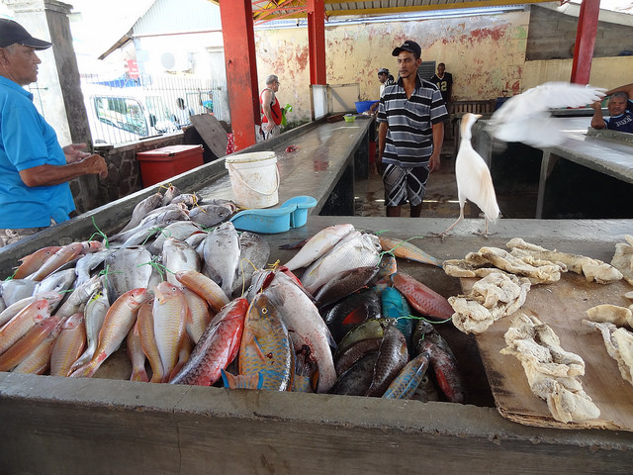
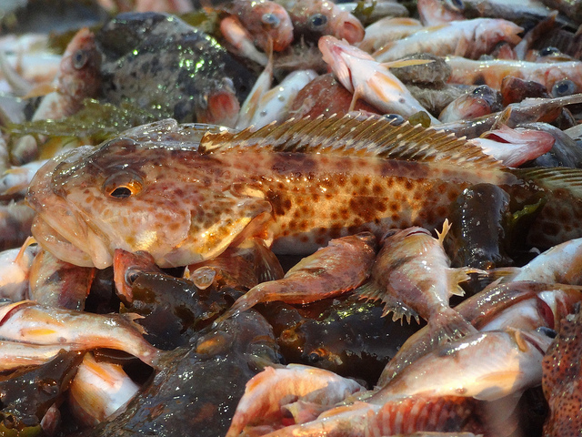
E5: Provide for More Stable Catch Levels in Fisheries
Multi-year overfishing definitions
Status determinations
Phase-in of stock assessment results
Reacting to stock assessment information
Carryover unused portion of the ACLs
Assessment projections & safety at sea

Slide 17
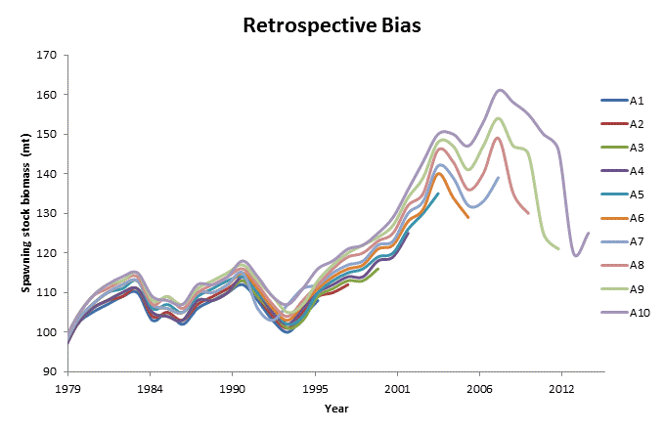
Stable Fisheries: Issues with Uncertainty

Slide 18
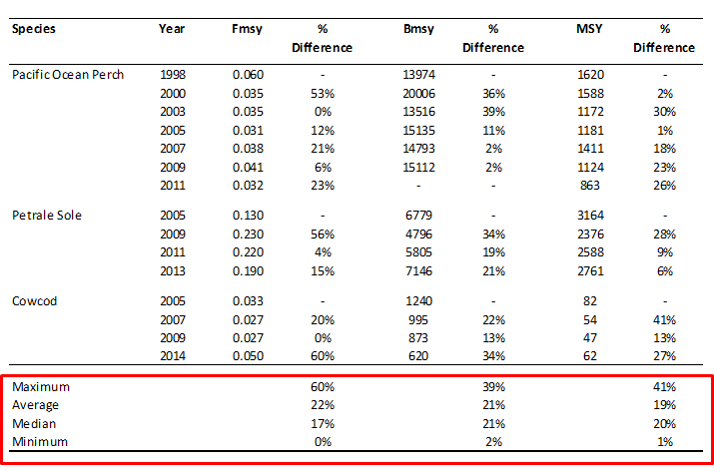
Stable Fisheries: Issues with Uncertainty

Slide 19
Stable Fisheries: Multi-year Overfishing
Current guidelines specify single year determinations – usually the last data year in an assessment.
Minimize false negative and false positive stock assessment findings.
Proposed guidance on the option to use of multi-year overfishing determinations.
May not exceed 3-years
Must document how the approach will not jeopardize the capacity of the stock to produce MSY.

Slide 20
Stable Fisheries: Multi-year Overfishing Example
Snowy grouper
F₂₀₁₀₋₂₀₁₂/F_{msy} = 0.59

Slide 21
Stable Fisheries: Phase-in ABC Control Rule
A tool for minimizing the dramatic shifts in catch that can occur with new stock assessments.
Used in the past by the International Pacific Halibut Commission and European Union.
Proposed guidance on phasing in results (catch increases or decreases) from new stock assessments.
Phase-in may not exceed 3-years
Must provided a comprehensive analysis of how the phase-in control rule prevents overfishing and when control rule can and cannot be used.

Slide 22
Stable Fisheries: Phase-in Example

Slide 23
Stable Fisheries: Carryover ABC Control Rule
Traditionally used in Catch Share fisheries to address safety at sea issues.
Propose:
Allow carry-over of all or some unused portion of the ACL to a subsequent year as long as overfishing is prevented.
Assessed every 3 years, with biomass projections
Normal ABC control rule = 85% OFL = ACL
Annualized survival rate = 0.82, if M (instantaneous natural mortality) = 0.2
OFL₁ | ABC₁ | Actual Catch | Difference (ABC₁ – Actual Catch) | Increase to OFL₂ = (ABC-Actual catch)*0.82 | OFL₂ | ABC₂
200,000 | 170,000 | 169,500 | 500 | 410 | na | na
205,000 | 174,250 | n/a | n/a | n/a | 205,410 | 174,598

Slide 24
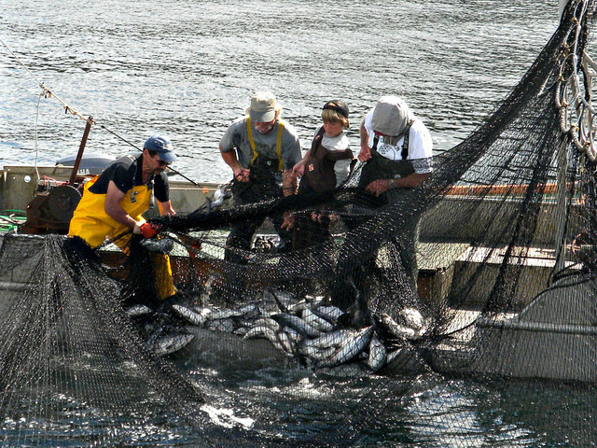
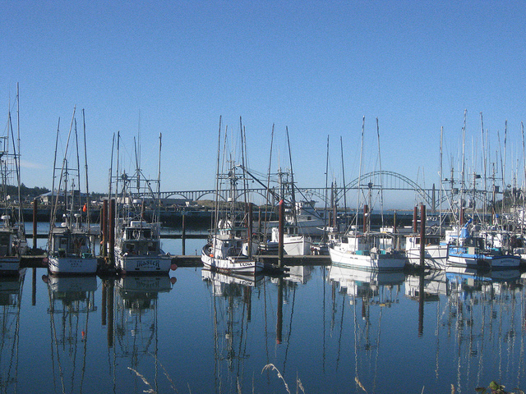
Summary
Proposed revisions:
Improve, clarify, and streamline the NS1 Guidelines.
Provide additional flexibility within current MSA statutory requirements.
Specifically address input received by the Councils, commercial and recreational fishing industry, environmental organizations, National Research Council, and NOAA Fisheries.
Will result in better managed and more sustainable fisheries.

Slide 25
Questions?
For additional information go to:
http://www.nmfs.noaa.gov/sfa/laws_policies/national_standards/ns1_revisions.html

Slide 26
Backup Slides

Slide 27
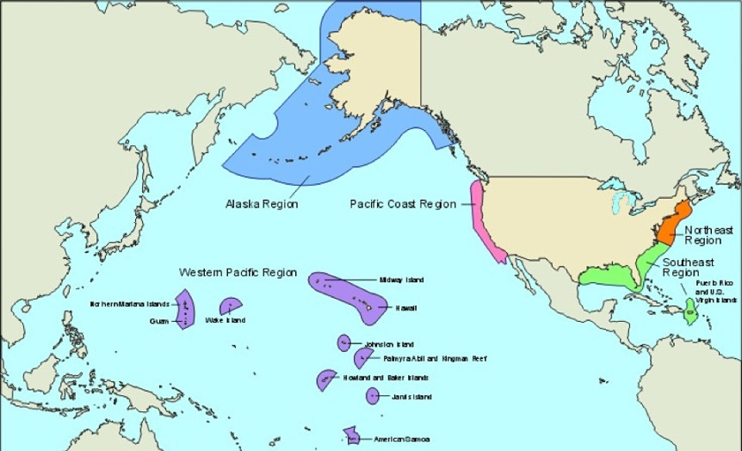
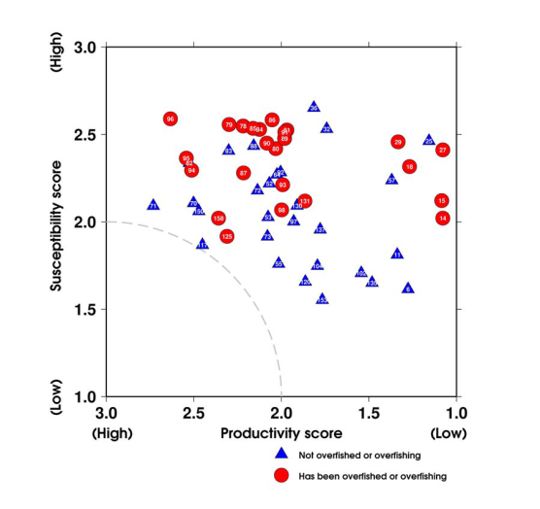
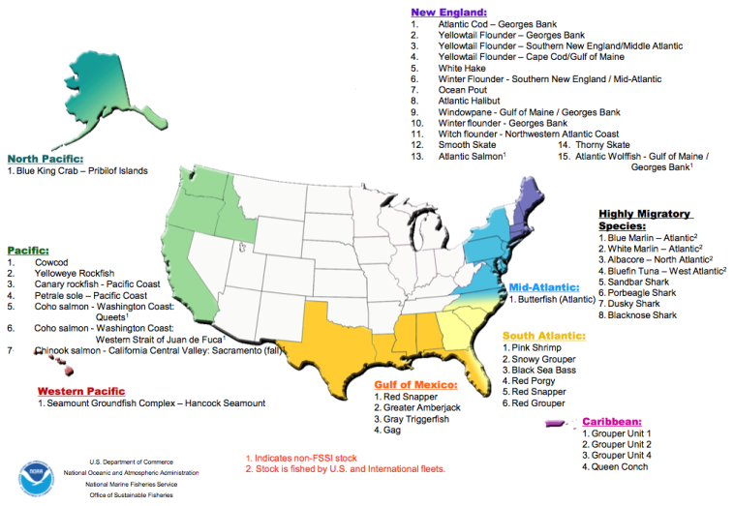
E3: Stocks that Require Conservation & Management
Proposes that a stock requires conservation and management if the following two criteria are met:
Predominantly caught in Federal waters; and
Overfished or subject to overfishing, or likely to become overfished or subject to overfishing.
Proposes 10 additional factors that may lead to determination that a stock requires conservation and management (next slide)

Slide 28
Conservation & Management: Other Factors
Other factors to consider in determining the need for conservation and management:
(i) The stock is an important component of the marine environment.
(ii) The stock is caught by the fishery.
(iii) Whether an FMP can improve or maintain the condition of the stocks.
(iv) The stock is a target of a fishery.
(v) The stock is important to commercial, recreational, or subsistence users.
(vi) The fishery is important to the Nation and to the regional economy.
(vii) The need to resolve competing interests and conflicts among user groups and whether an FMP can further that resolution.
(viii) The economic condition of a fishery and whether an FMP can produce more efficient utilization.
(ix) The needs of a developing fishery, and whether an FMP can foster orderly growth.
(x) The extent to which the fishery could be or is already adequately managed by states, by state/Federal programs, by Federal regulations pursuant to other FMPs or international commissions, or by industry self-regulation, consistent with the policies and standards of the Magnuson-Stevens Act.

Slide 29
Conservation & Management: Categories
Current guidelines describe categories of “stocks in the fishery” and “ecosystem component species.”
Proposed categories include:
Stocks that require conservation and management
Need SDCs, ACLs, AMs, etc.
Equivalent to “stocks in the fishery”
Stocks not in need of conservation and management
Don’t need SDCs, ACLs, AMs, etc.
Equivalent to “ecosystem components species”
Other managed stocks
SDCs, ACLs, AMs, etc. are specified in another FMP. Managements measure consistent with primary FMP.

Slide 30
E6: Define Depleted Stocks
An overfished stock or stock complex is considered depleted when:
Declined below MSST
it has not experienced overfishing at any point over a period of two generation times of the stock, or
Overfished stock
when a rebuilding stock or stock complex has reached its targeted time to rebuild, and the stock’s biomass has shown no significant signs of growth - despite being fished at or below catch levels that are consistent with the rebuilding plan.
Must still prevent overfishing and rebuilding plans would still be required for depleted stocks.
Councils may identify or recommend habitat improvement and other environmental mitigation.

Slide 31
E7: Improve the Routine Review of FMPs
Recommend that Councils:
Reassess the objectives of their fisheries on a regular basis to reflect the changing needs of the fishery over time.
Consider the management objectives of their plans and their management framework to determine the relevant factors to determine OY.
Periodically review their plans and determine if stocks are appropriately identified.
Sweetclipart.com

