Slide 1
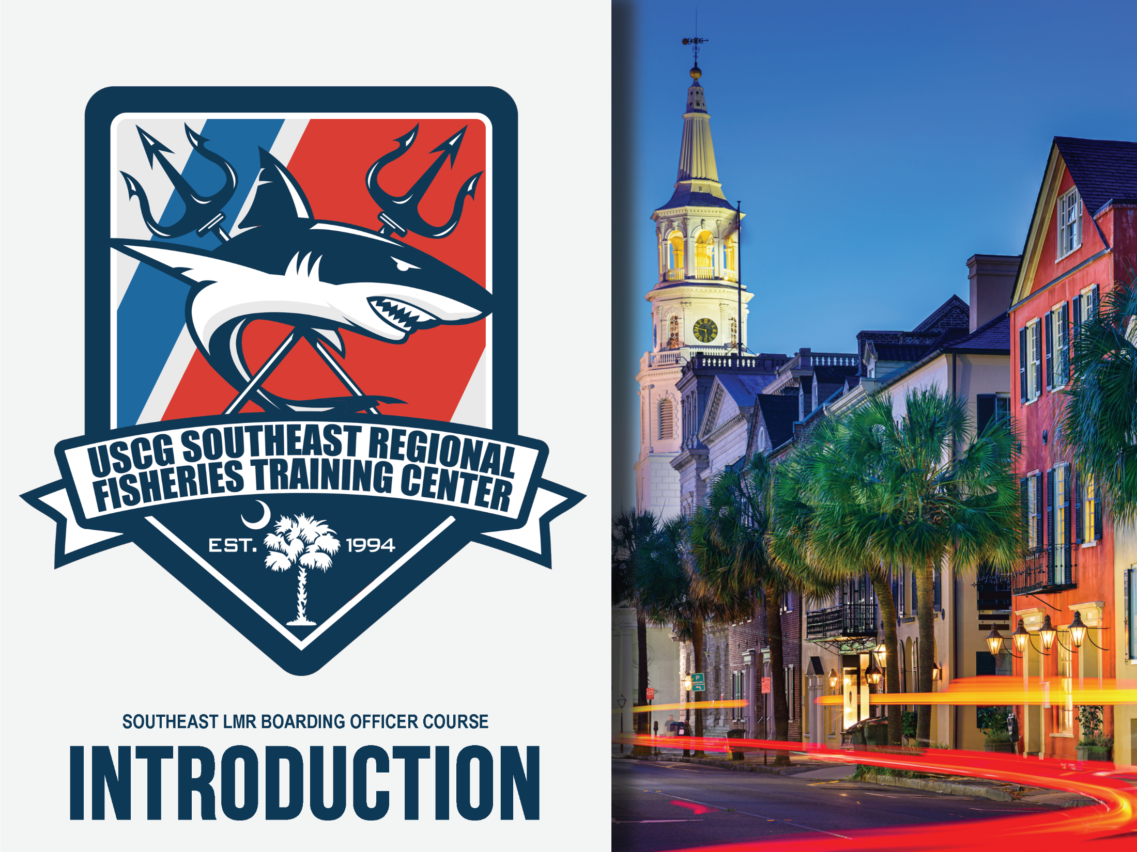

Slide 2
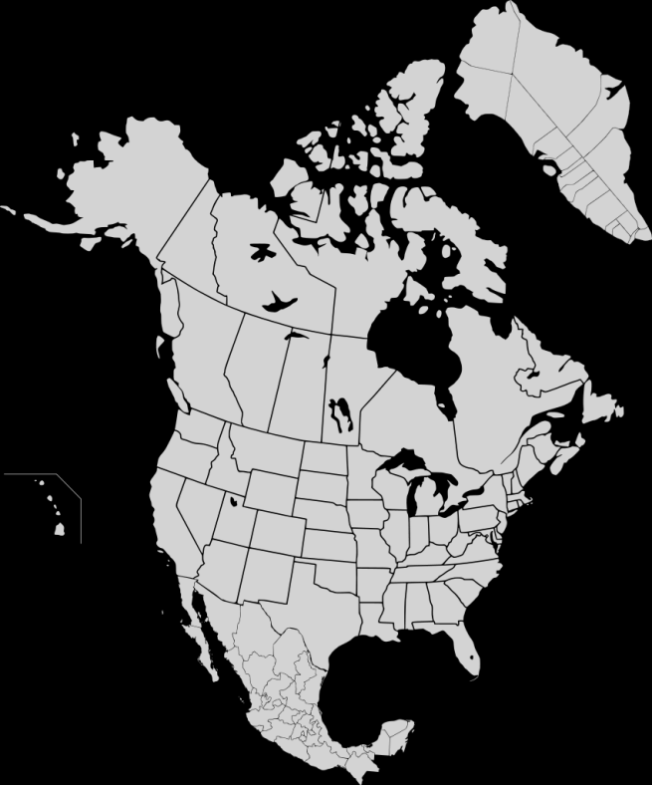
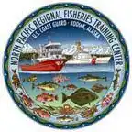
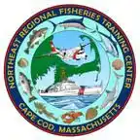
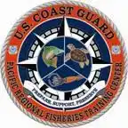
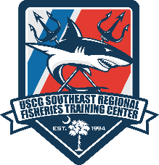
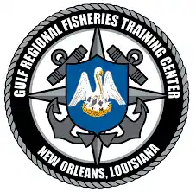
Southeast Regional Fisheries TRACEN
Established 1994
1 of 5 RFTC’s
Congressionally Mandated
Support D1, D5, and D7
Courses:
  Southeast LMR BO
  Caribbean LMR BO
  Mission Manager

Slide 3
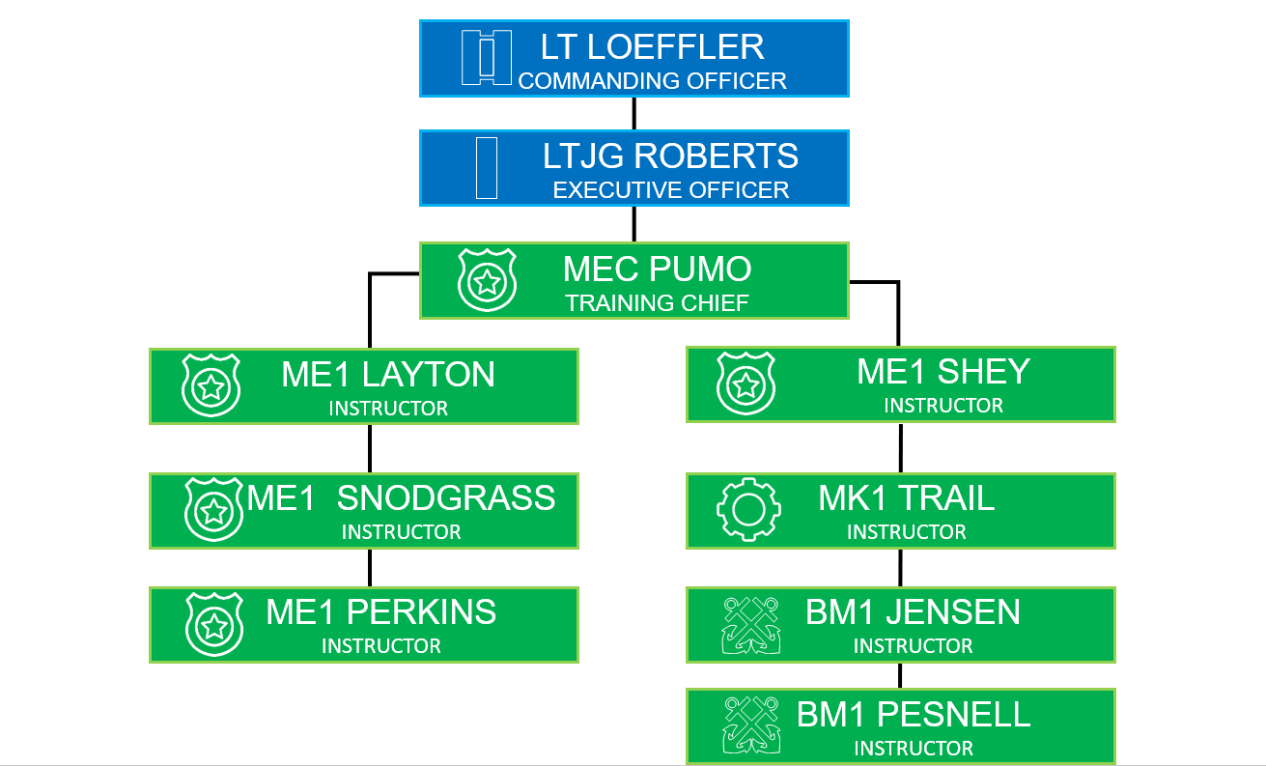

STAFF
Notes:
Have students turn to boarding tab

Slide 4
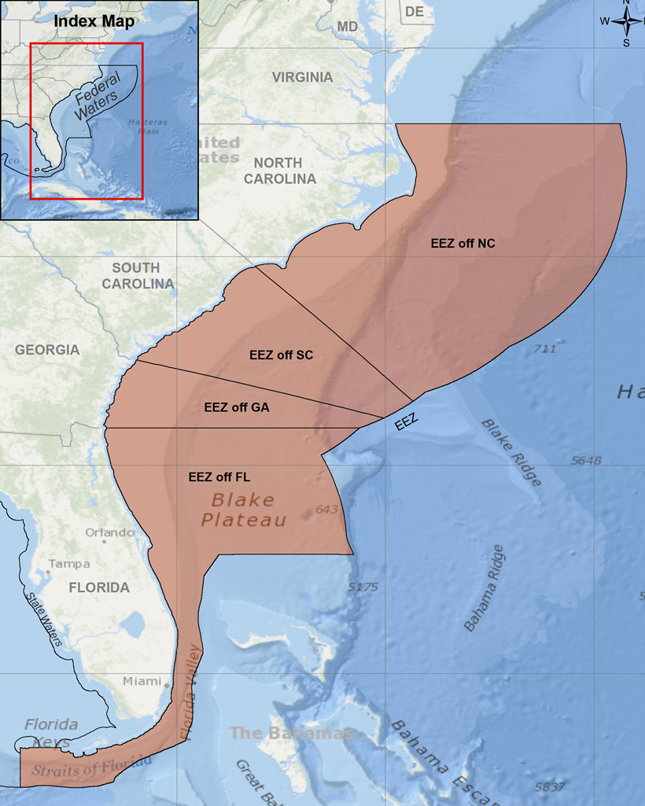
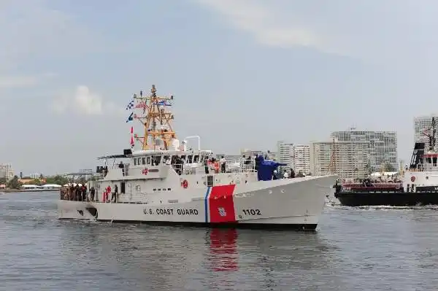
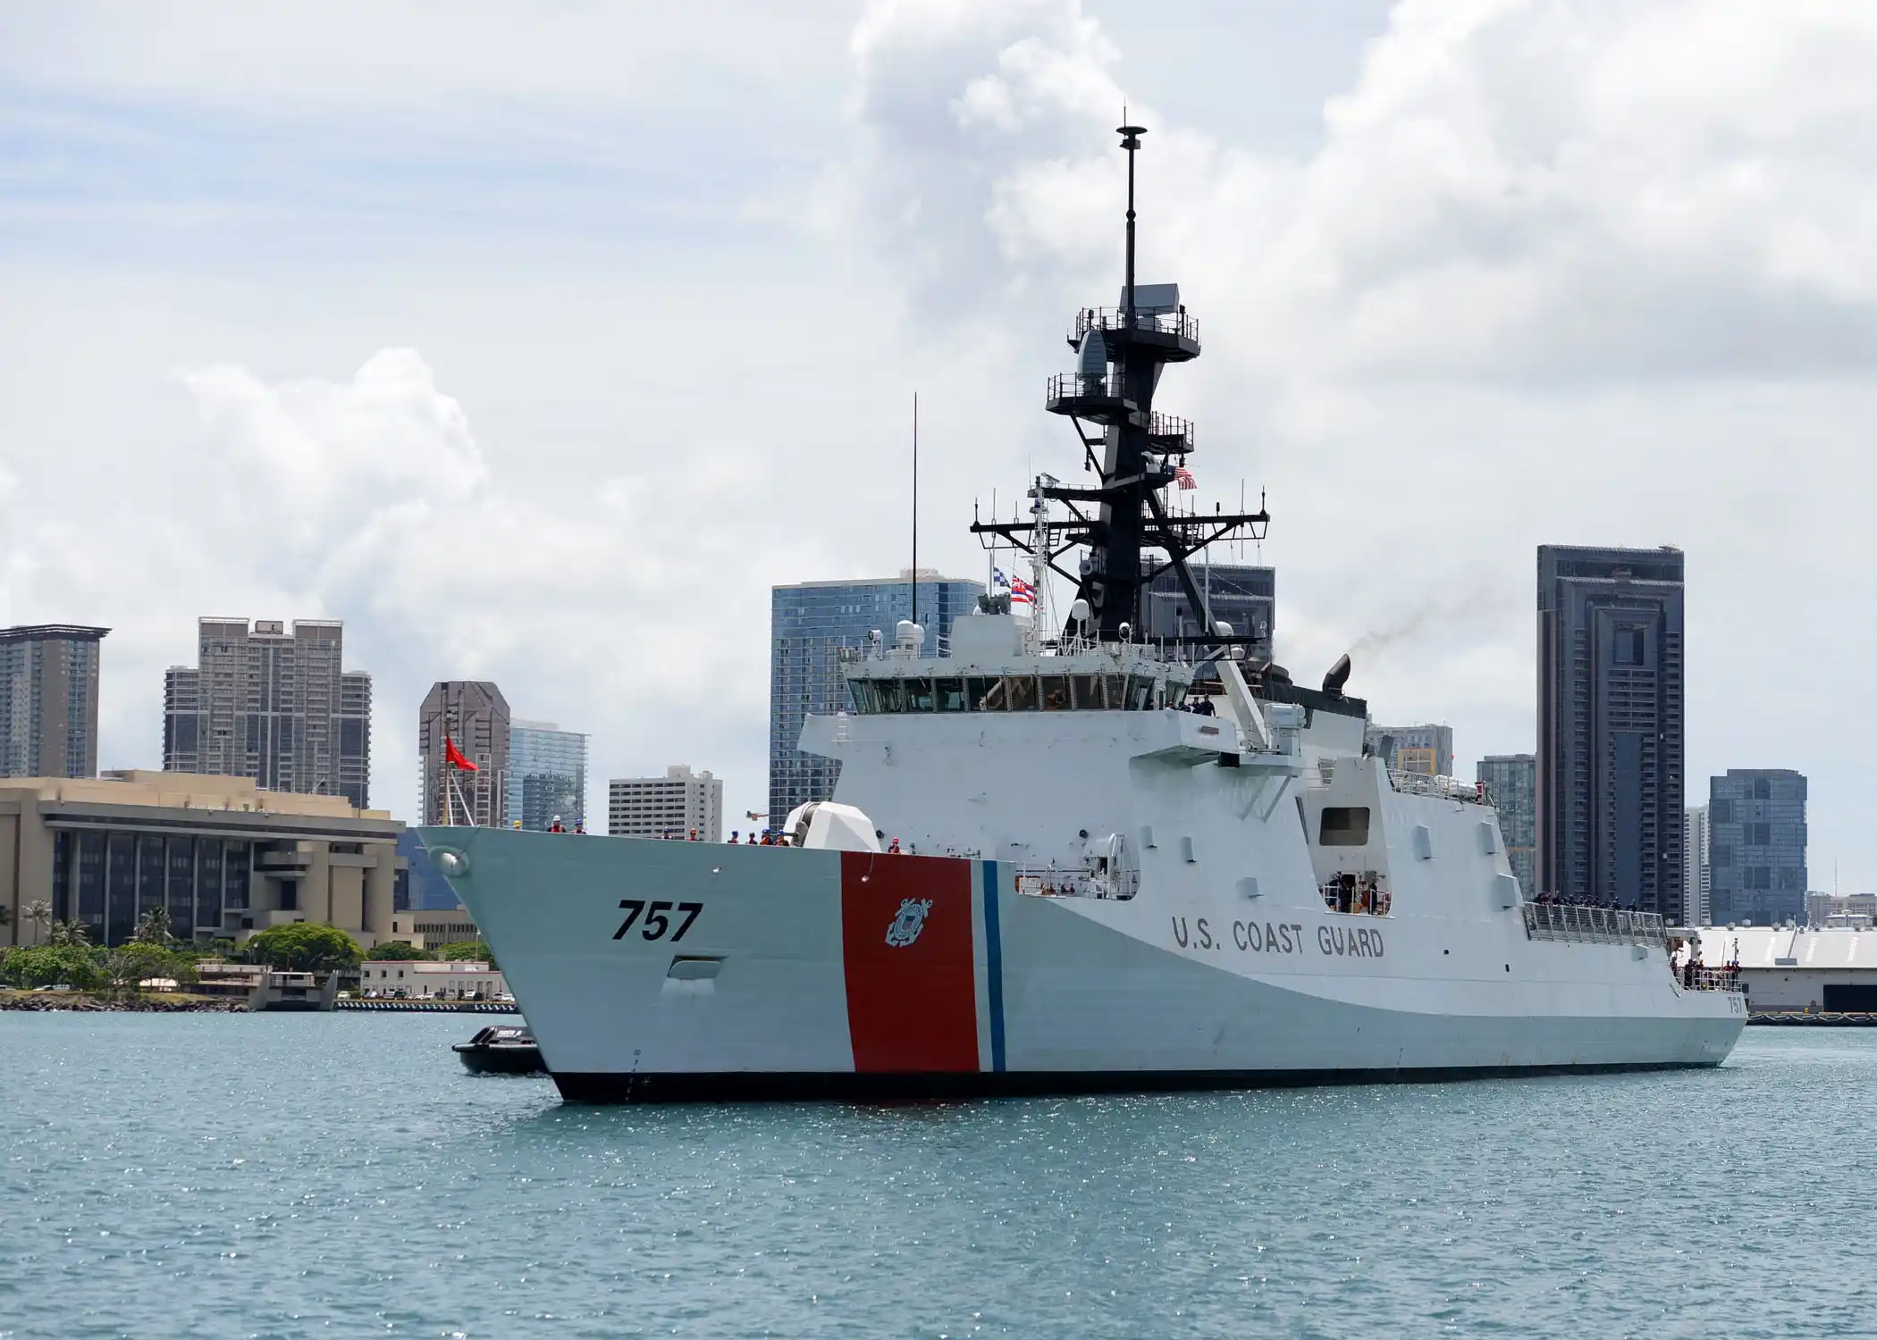
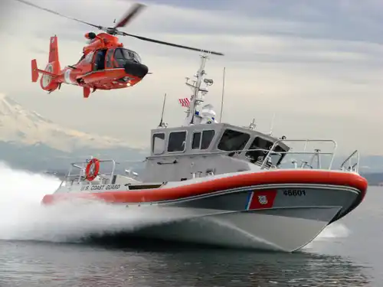
AREA OF RESPONSIBLITY
Notes:
GO EMBARKATION. Then, use next slides to go OVER EACH SECTION WITH STUDENTS

Slide 5
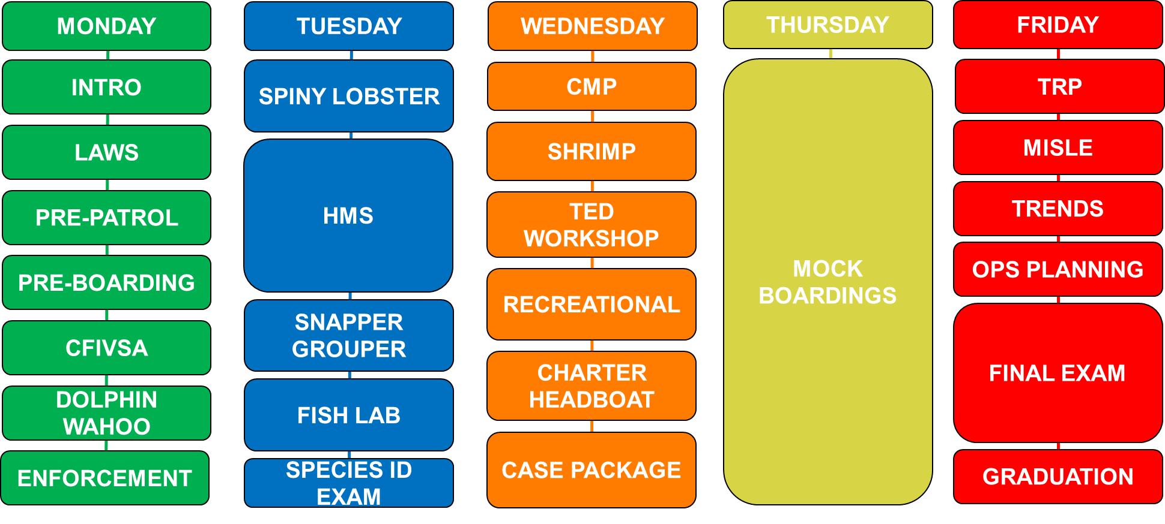
Class Schedule

Slide 6
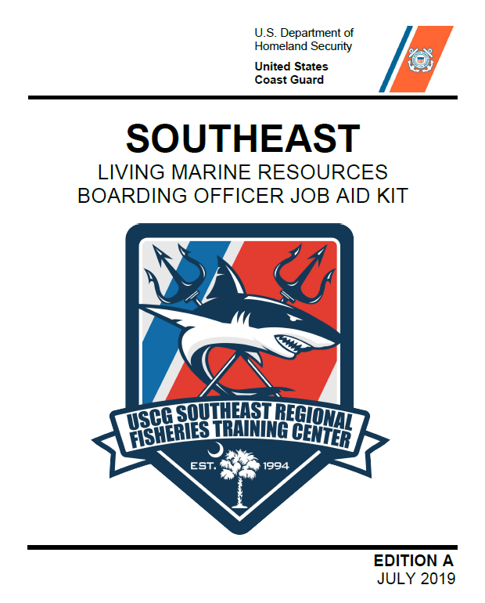
LMR BOARDING PROCESS
PRE-PATROL
PRE-BOARDING
BOARDING
POST-BOARDING
Notes:
GO EMBARKATION. Then, use next slides to go OVER EACH SECTION WITH STUDENTS

Slide 7
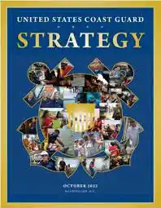
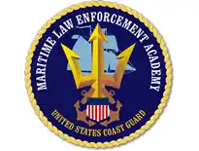
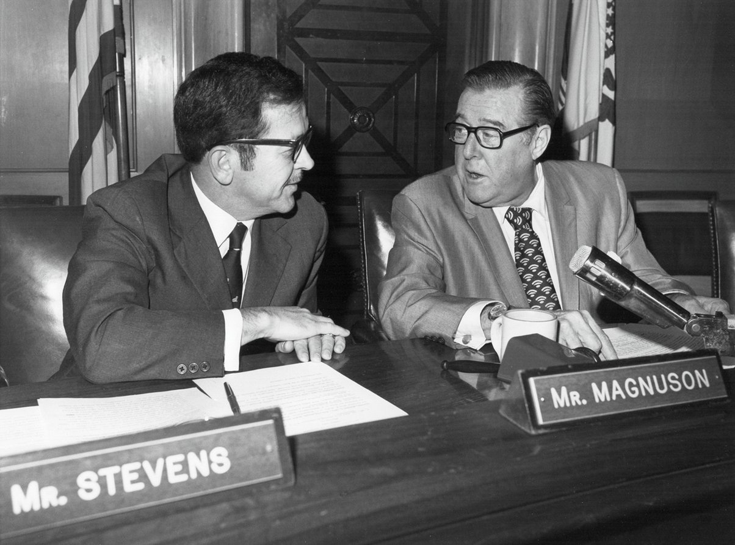
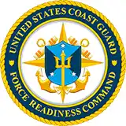
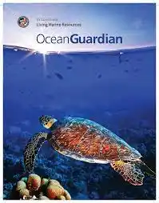
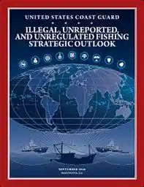
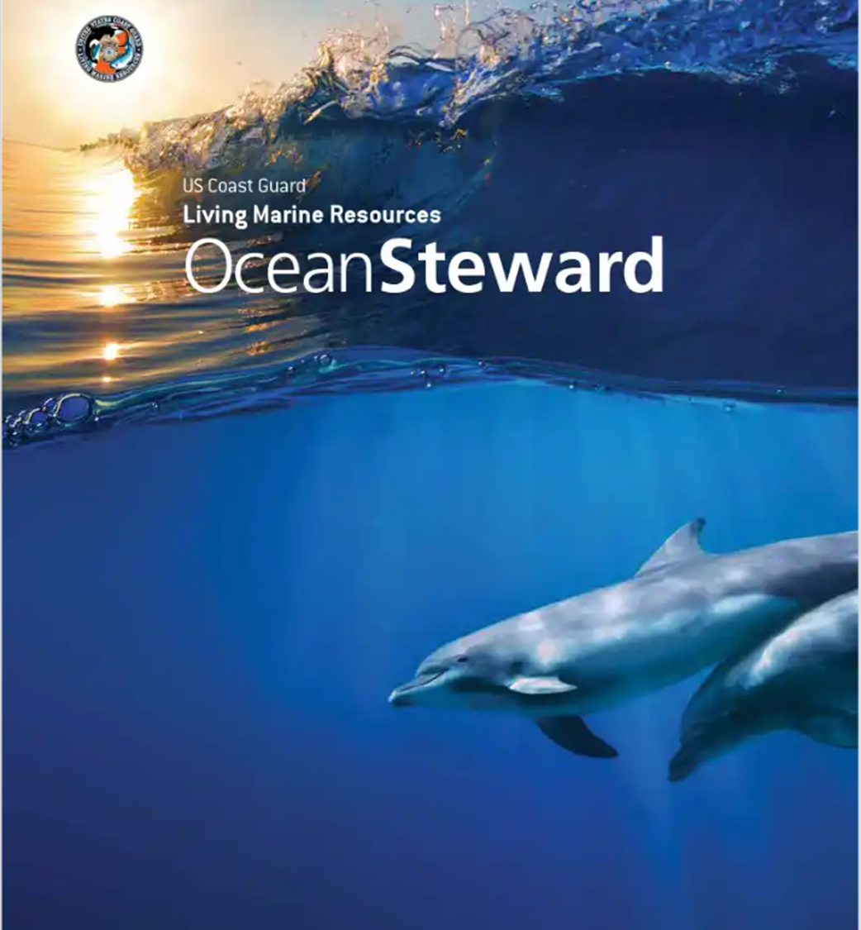
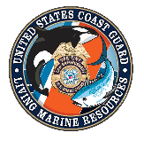

GOVERNING DOCUMENTS

Slide 8
MANAGEMENT PLANS
SNAPPER/GROUPER
COASTAL MIGRATORY PELAGIC
PENEAID & ROCK SHRIMP
GOLDEN CRAB
CORAL
DOLPHIN/WAHOO
SPINY LOBSTER
HIGHLY MIGRATORY SPECIES

Slide 9
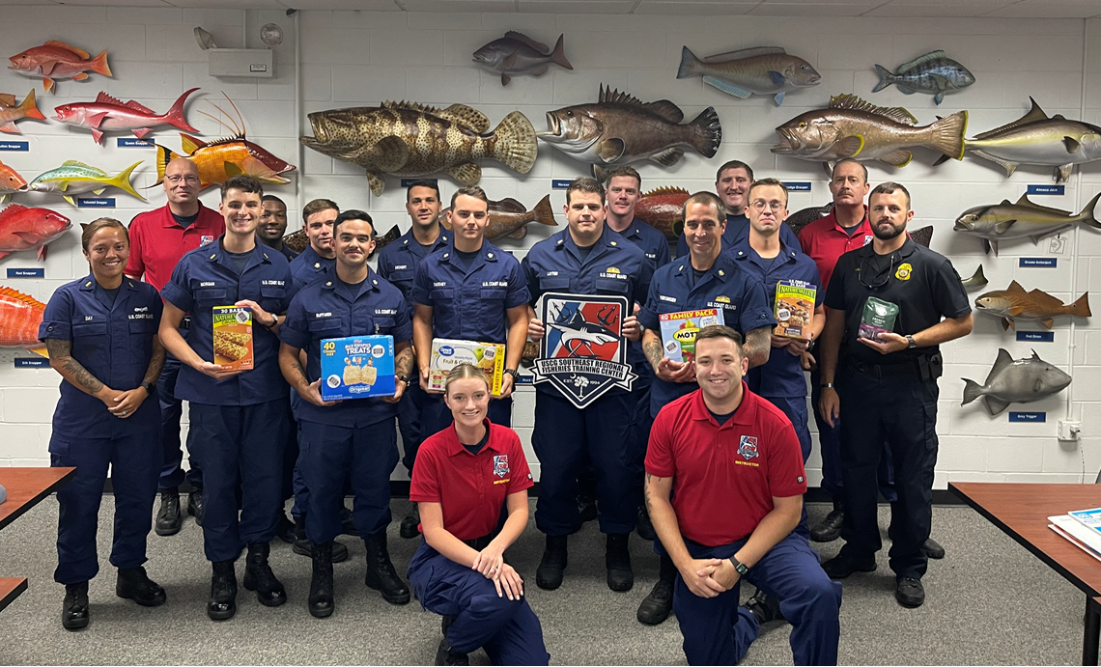
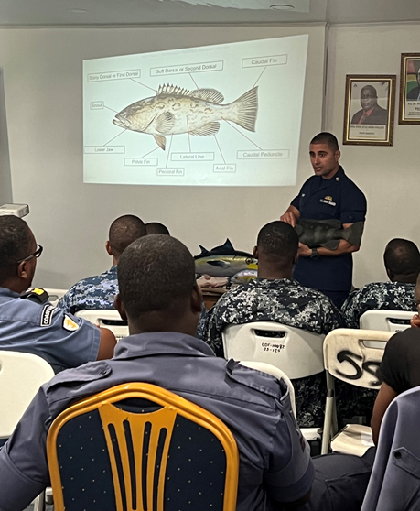
Southeast Regional Fisheries TRACEN
Unit Details
Training Initiatives/Field Advisories
Recent:
South FL - Spiny Lobster
FL - Snapper/Grouper
Upcoming:
NC - Tuna
USVI - Conch
FL – Illegal Charters
10 member staff
$60K budget
Support D1, D5, D7
5 Sectors
33 cutters
22 Stations
150 Student Output Annually
IUU - HSBI Training
Open scope of training to Boarding Team Members
Mission Manager Course build
Key External & Political Partnerships
Outreach Opportunities
International Partners
SAFMC Meeting
Congressional Staff
International Boarding
Officer Course
Saltwater Team (NOAA/ DNR)
School engagements (Ashley Hall)
Community (SEWE)
Any Recommendations?

