Slide 1
Potential New Alternatives for Regulatory Amendment 16
LAPP/DM
Southeast
Regional
Office
SAFMC Meeting
June 2015
Key West, FL

Slide 2
ALTERNATIVE 11: Hybrid of Alternatives 4 and 8a
NOVEMBER 1-30 and APRIL 1-30: Alternative 8a
DECEMBER 1 – MARCH 31: Alternative 4
Rationale: To provide more protection than Alternative 8a during time period calves are most prevalent in the SEUS while still affording fishing opportunities for pot gear during the winter.
Pro: High level of protection Dec-Mar for calving whales
Con: Dynamic closure with changing spatial boundaries

Slide 3
ALTERNATIVE 12: Midway between Alts 4 and 8a
NOVEMBER 1 – APRIL 30
Rationale: To provide more protection than Alternative 8a during time period calves are most prevalent in the SEUS while still affording fishing opportunities for pot gear during the winter.
Pro: Stable throughout winter, no shifting boundaries
Con: Slightly less protective during Dec-Mar period

Slide 4
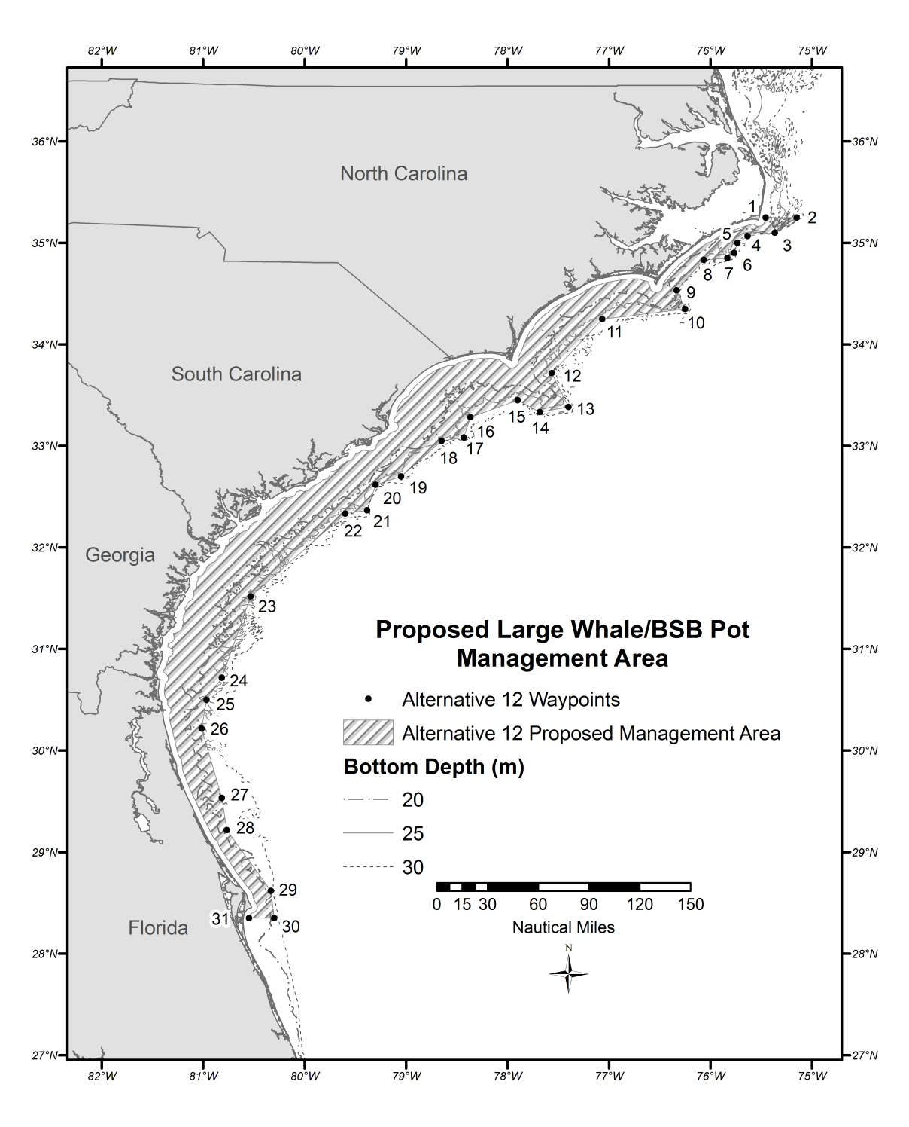
Alternative 12
Midway between Alternative 4 and Alternative 8
Roughly follows 27 m contour

Slide 5
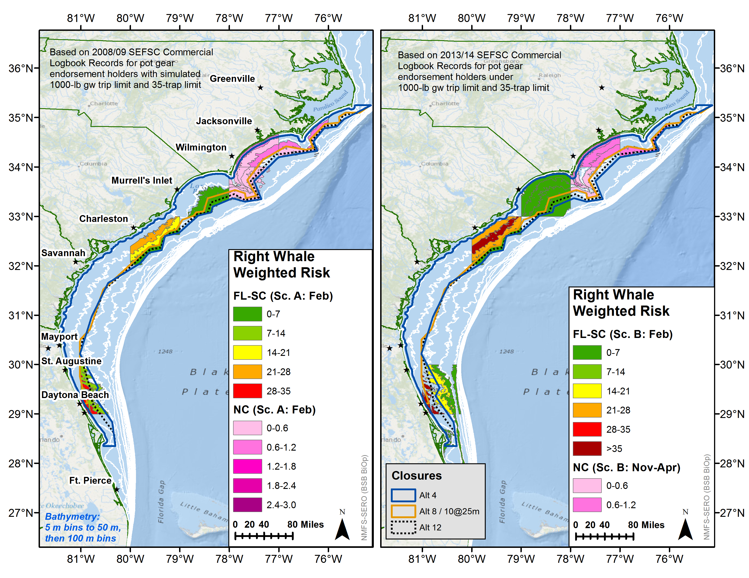

Slide 6
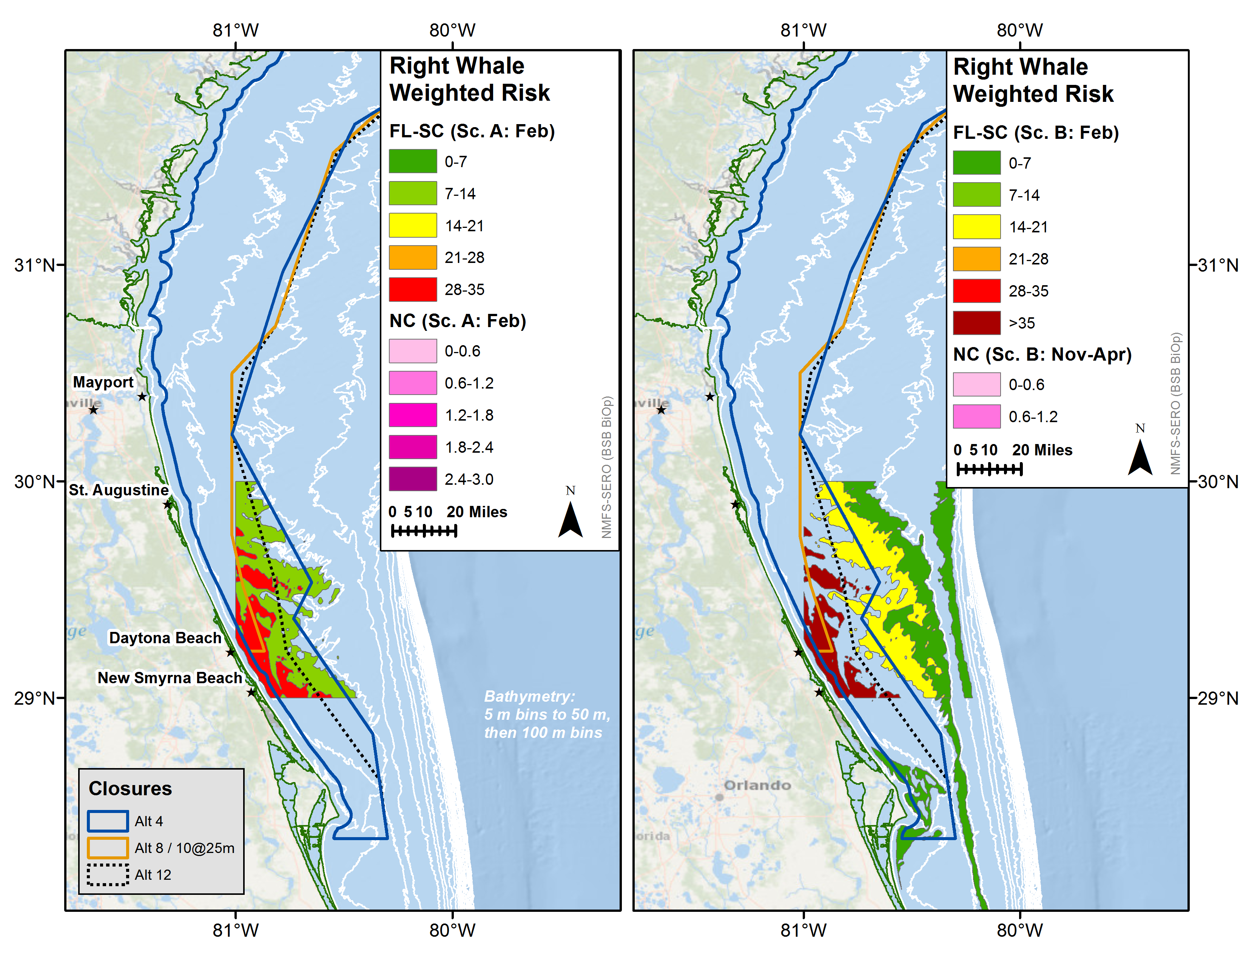
FL
Relatively “High” risk area not covered by Alt 8a
Relatively “High” risk area not covered by Alt 8a

Slide 7
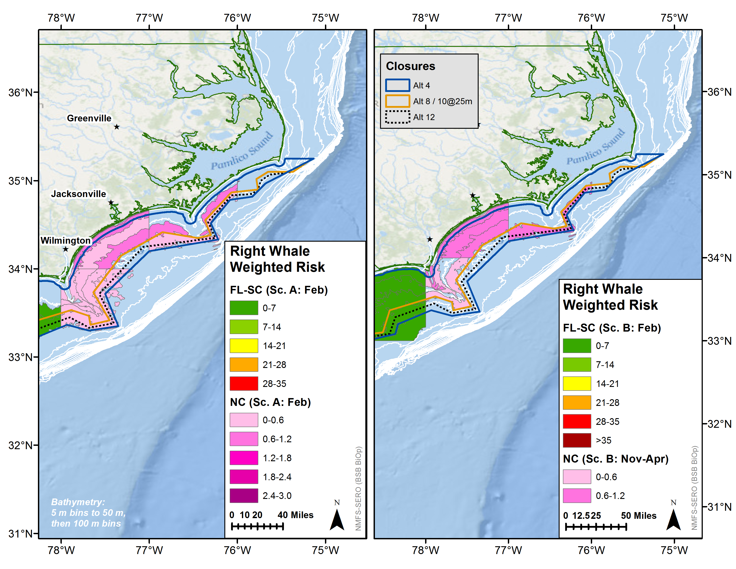
NC
Relatively “Low” risk area not covered by Alt 8a, partially covered by Alt 12, fully covered by Alt 11
Relatively “Moderate” risk area not covered by Alt 8a, partially covered by Alt 11, fully covered by Alt 12

Slide 8
Projected Closure Dates
Alternative 4: Dec 7-30
Alternative 8a: Oct 20 – Dec 12
Alternative 11: Dec 3-28
Alternative 12: Nov 21 – Dec 23

Slide 9
Relative Risk of Reg-16 Alternatives
NORTH CAROLINA |  |  | SOUTH CAROLINA-FLORIDA
NC RISK | MIN | MAX | FL-SC RISK | MIN | MAX
Alt 2 | 100 | 100 | Alt 2 | 100 | 100
Alt 3 | 10 | 26 | Alt 3 | 16 | 52
Alt 4 | 2 | 8 | Alt 4 | 0 | 3
Alt 5 | 1 | 2 | Alt 5 | 11 | 58
Alt 6 | 2 | 8 | Alt 6 | 0 | 0
Alt 7a | 69 | 74 | Alt 7a | 77 | 96
Alt 7b | 77 | 89 | Alt 7b | 70 | 106
Alt 7c | 75 | 97 | Alt 7c | 67 | 100
Alt 8a | 6 | 26 | Alt 8a | 12 | 58
Alt 8b | 51 | 68 | Alt 8b | 61 | 89
Alt 9a | 26 | 51 | Alt 9a | 30 | 72
Alt 9b | 61 | 87 | Alt 9b | 67 | 94
Alt 10 | 55 | 75 | Alt 10 | 62 | 89
Alt 11 | 2 | 15 | Alt 11 | 0 | 13
Alt 12 | 3 | 15 | Alt 12 | 2 | 9

Slide 10
Sum of Risk Units from FL-SC and NC Models, by Reg-16 Alternative

Slide 11
NARW Protection | Alternative
Most Protective | 1: no relative risk of entanglement (0 RRU)
 | 6: low increase in relative risk off NC (+2-8 RRU); no additional risk off FL-SC (0 RRU).
 | 4: low increase in relative risk off NC (+2-8 RRU); low increase in relative risk off FL-SC (+0-3 RRU).
 | 11: low increase in relative risk off NC (+2-15 RRU); low increase in relative risk off FL-SC (+0-13 RRU).
 | 12: low increase in relative risk off NC (+3-15 RRU); low increase in relative risk off FL-SC (+2-9 RRU).
 | 5: low increase in relative risk off NC (+1-2 RRU); low to high increase in relative risk off FL-SC (+11-58 RRU).
 | 3: low to moderate increase in relative risk off NC (+10-26 RRU); low to high increase in relative risk off FL-SC (+16-52 RRU).
 | 8a: low to moderate increase in relative risk off NC (+13-36 RRU); low to high increase in relative risk off FL-SC (+13-64 RRU).
 | 9a: moderate to high increase in relative risk off NC (+26-51 RRU); moderate to high increase in relative risk off FL-SC (+30-72 RRU).
 | 7a: high increase in relative risk off NC (+69-74 RRU); very high increase in relative risk off FL-SC (+77-96 RRU).
 | 8b: high increase in relative risk off NC (+51-68 RRU); high to very high increase in relative risk off FL-SC (+61-89 RRU).
 | 10: high to very high increase in relative risk off NC (+55-75 RRU); high to very high increase in relative risk off FL-SC (+62-89 RRU).
 | 9b: high to very high increase in relative risk off NC (+61-87 RRU); high to very high increase in relative risk off FL-SC (+67-94 RRU).
 | 7c: high to very high increase in relative risk off NC (+75-97 RRU) and off FL-SC (+67-100 RRU).
 | 7b: very high increase in relative risk off NC (+77-89 RRU); high to very high increase in relative risk off FL-SC (+70-106 RRU).
Least Protective | 2: very high increase in relative risk off NC (+100 RRU over status quo) and off FL-SC (+100 RRU).
Risk Classification | 1-25 RRU = low, 26-50 RRU = moderate, 51-75 RRU= high, 76-100+ RRU = very high
Notes:
Table 3
The Alternatives proposed in Reg-16 differ in their abilities to maintain protection (i.e. prevent or minimize an increase in relative risk of entanglement) for ESA-listed whales in the South Atlantic Region. All alternatives, excluding Alternative 1 (the No Action Alternative), result in an increase in relative risk of entanglement to right whales.
Alternative 1 best maintains protections for ESA-listed whales in the South Atlantic region because it maintains the seasonal closure to trap gear fishing, resulting in no increased risk of vertical line entanglement for large whales from black sea bass trap gear. Under Alternative 1, no quota closure was projected. Alternative 1 was projected to catch 97% of the ACL while maintaining the six-month seasonal closure to pot gear fishing and providing no increased risk of vertical line entanglement for right whales. Under Alternative 2, a quota closure date was projected for 4 Aug-2 Oct.
Alternative 2 increases relative right whale risk by 100 RRU over status quo.
Under Alternative 3, a quota closure date was projected for 4 Oct-5 Dec. Alternative 3 results in a low to moderate increase in relative right whale risk off NC (+10-26 RRU) and a low to high increase in relative right whale risk off FL-SC (+16-52 RRU).
Under Alternative 4, a quota closure date was projected for 7-30 Dec. Alternative 4 results in a low increase in relative right whale risk off NC (+2-8 RRU) and a low increase in relative right whale risk off FL-SC (+0-3 RRU). Under Alternative 5, a quota closure date was projected for 1-24 Dec.
Alternative 5 results in a low increase in relative right whale risk off NC (+1-2 RRU) and a low to high increase in relative right whale risk off FL-SC (+11-58 RRU).
Under Alternative 6, a quota closure date was projected for 7-29 Dec. Alternative 6 results in a low increase in relative right whale risk off NC (+2-8 RRU) and no additional right whale risk off FL-SC (0 RRU). Under Alternative 7a, a quota closure was projected for 18 Aug-12 Oct.
Alternative 7a results in a high increase in relative right whale risk off NC (+69-74 RRU) and very high increase in relative right whale risk off FL-SC (+77-96 RRU).
Under Alternative 7b, the ACL was projected to be met between 17-30 Dec. Alternative 7b results in a very high increase in relative right whale risk off NC (+77-89 RRU) and a high to very high increase in relative right whale risk off FL-SC (+70-106 RRU).
Under Alternative 8a, a quota closure was projected for 17 Oct-11 Dec. Alternative 8a results in a low to moderate increase in relative right whale risk off NC (+13-36 RRU) and a low to high increase in relative right whale risk off FL-SC (+13-64 RRU). Under Alternative 8b, the ACL was projected to be met late in the fishing season (18 Dec or later).
Alternative 8b results in a high increase in relative risk off NC (+51-68 RRU) and a high to very high increase in relative risk off FL-SC (+61-89 RRU).
Under Alternative 9a, a quota closure was projected for 15 Sept-9 Nov. Alternative 9a results in a moderate increase in relative right whale risk off NC (+26-51 RRU) and moderate to high increase in relative right whale risk off FL-SC (+30-72 RRU).
Under Alternative 9b, the ACL was projected to be met as early as 14 Dec. Alternative 9b results in a high to very high increase in relative right whale risk off NC (+61-87 RRU) and high to very high increase in relative right whale risk off FL-SC (+67-94 RRU).
Alternative 10 falls between Alternatives 8b and 9b, with a projected closure date as early as 16 Dec, a moderate to high increase in relative right whale risk off NC (+55-75 RRU) and high to very high increase in relative right whale risk off FL-SC (+62-89 RRU).

Slide 12
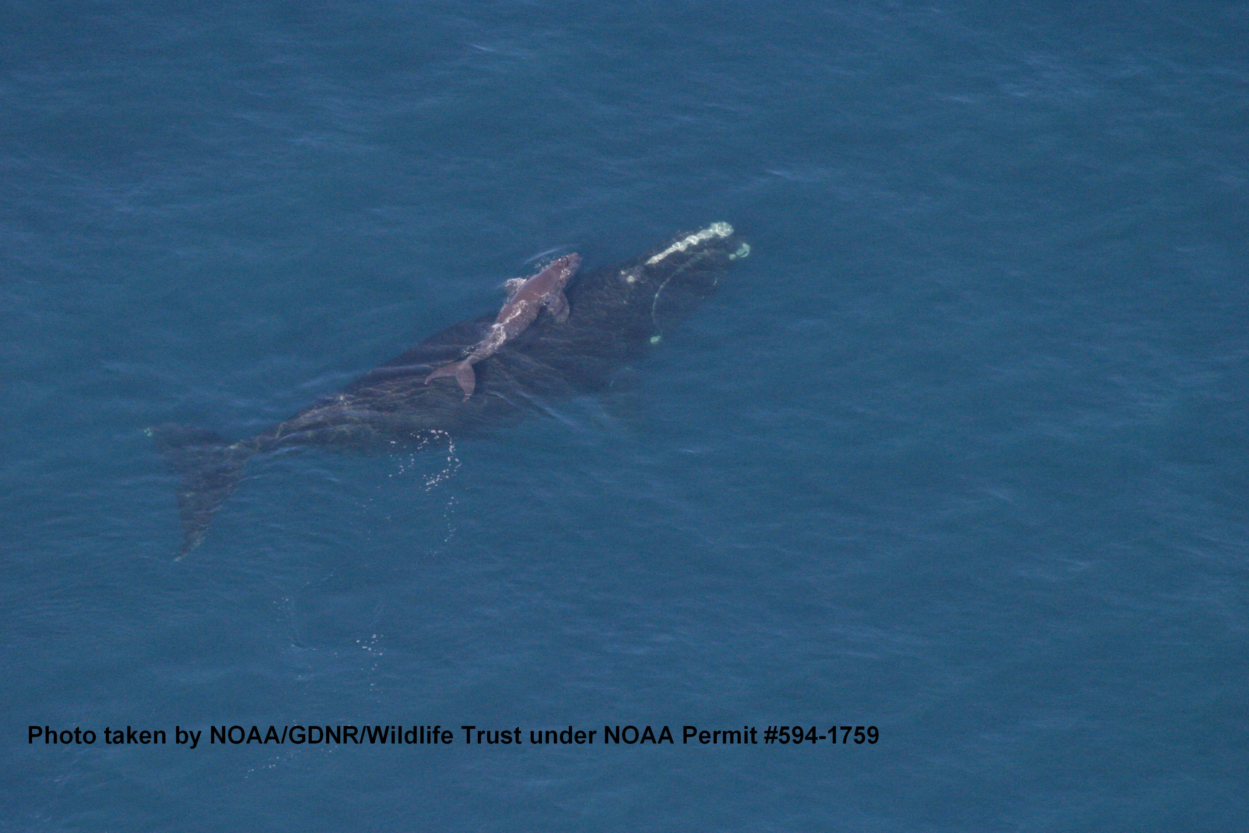
QUESTIONS?

Slide 13
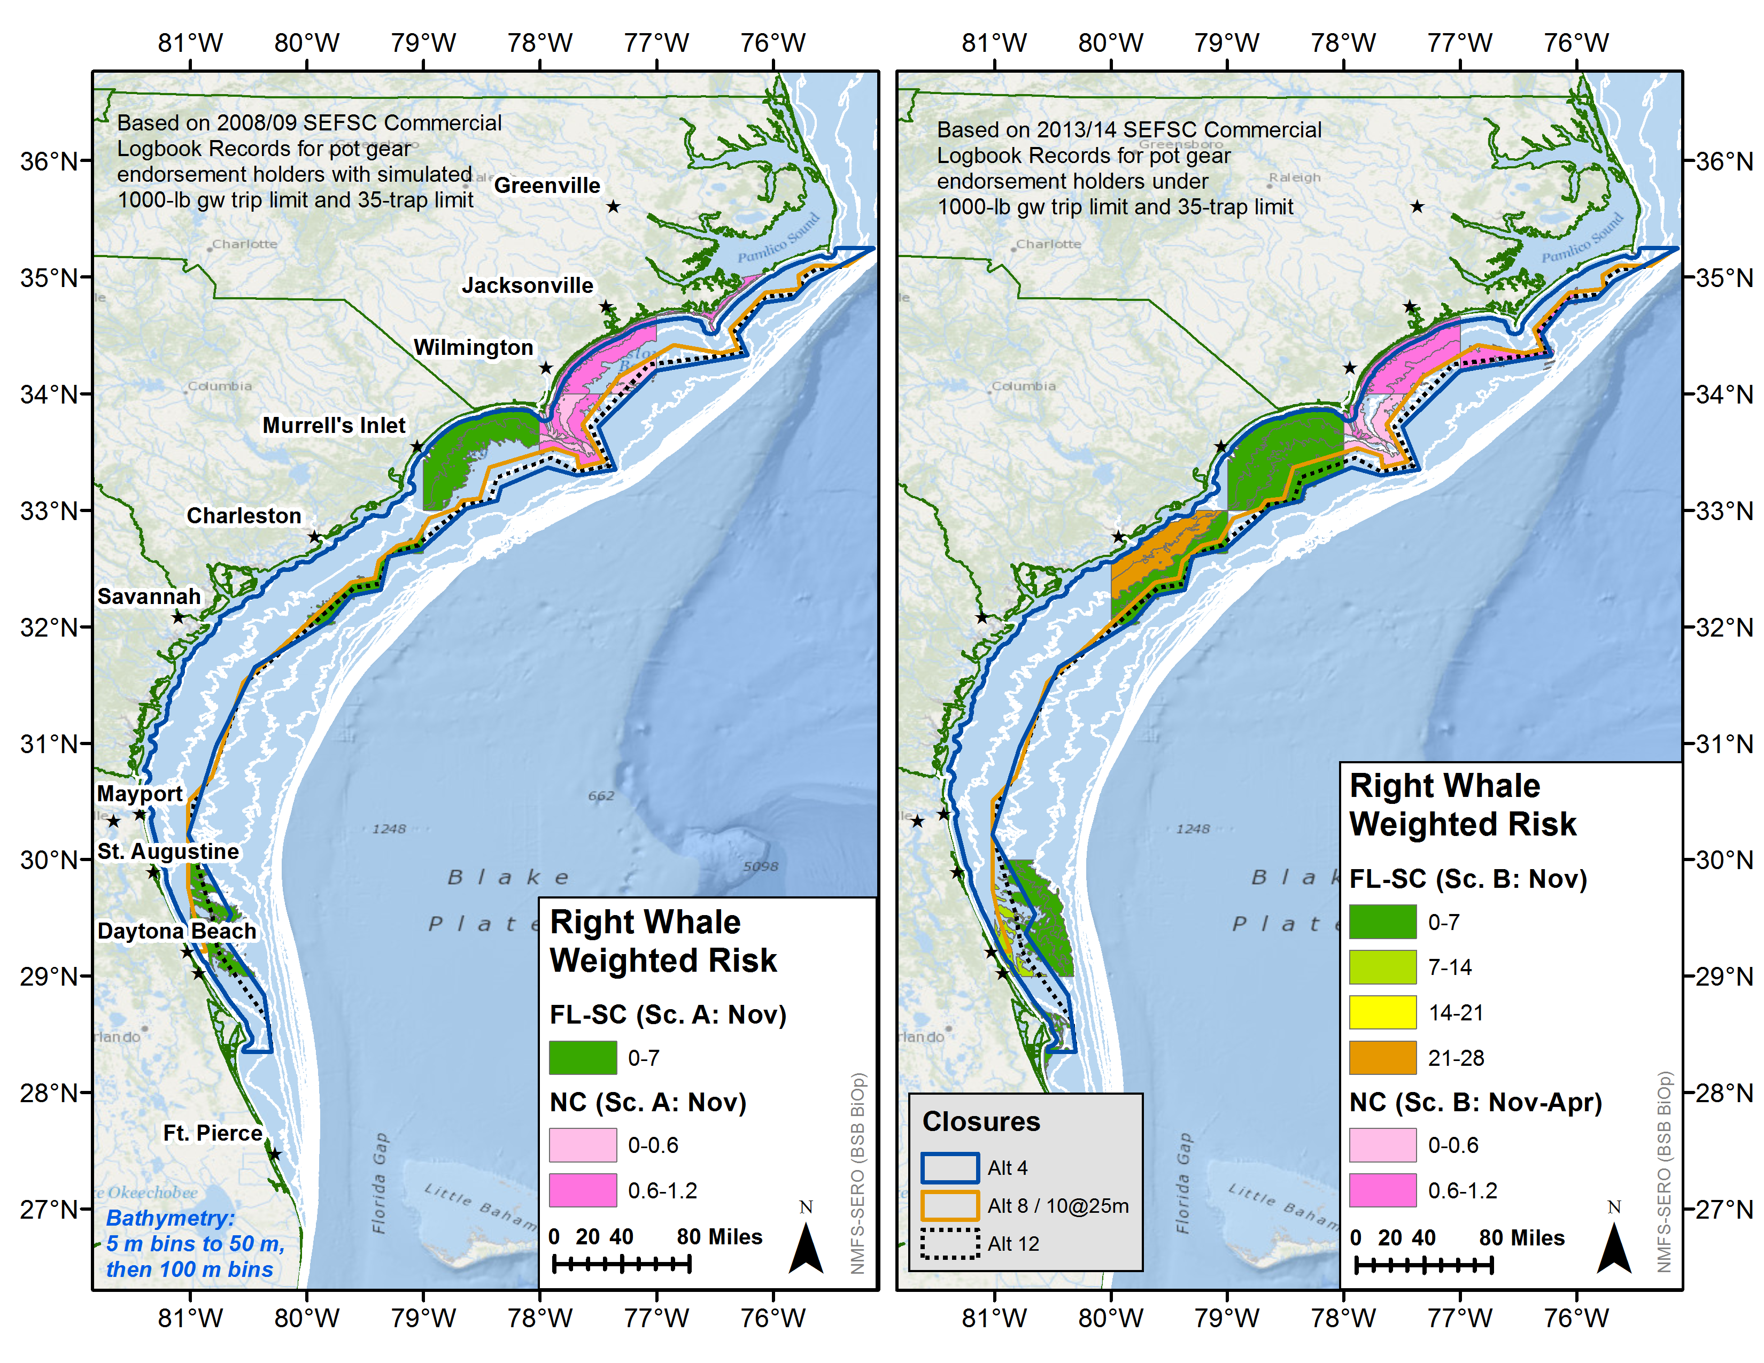

Slide 14
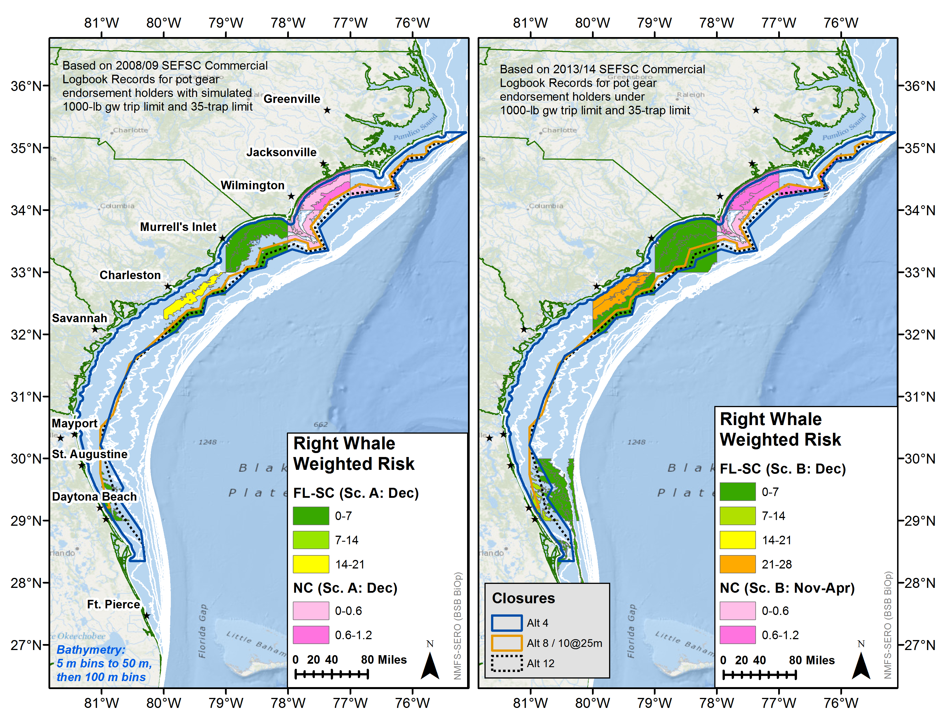

Slide 15
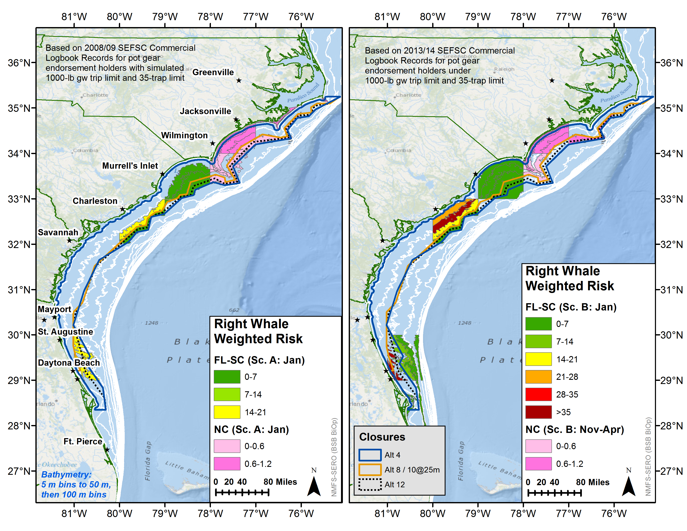

Slide 17


Slide 18
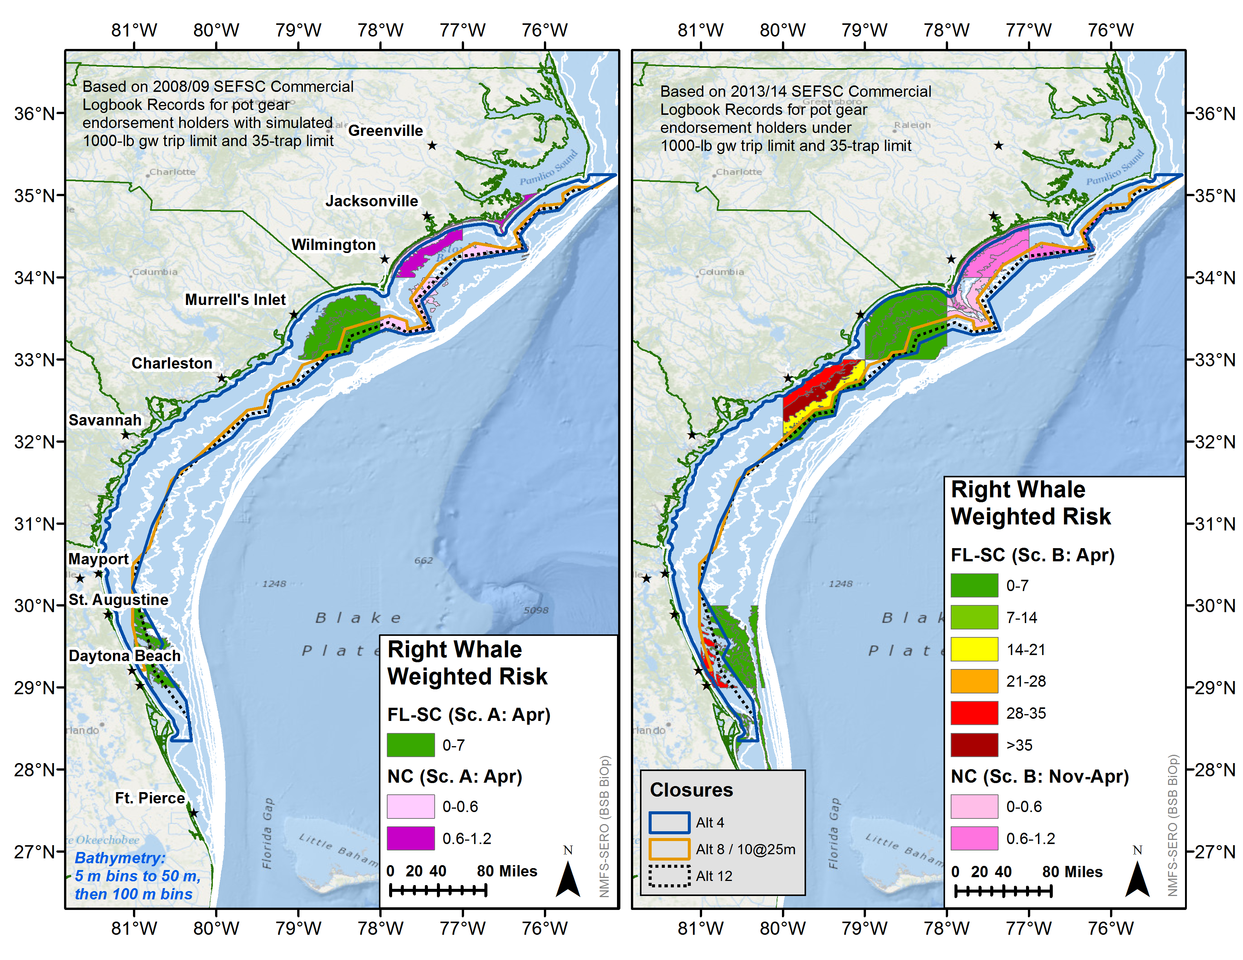

Slide 19
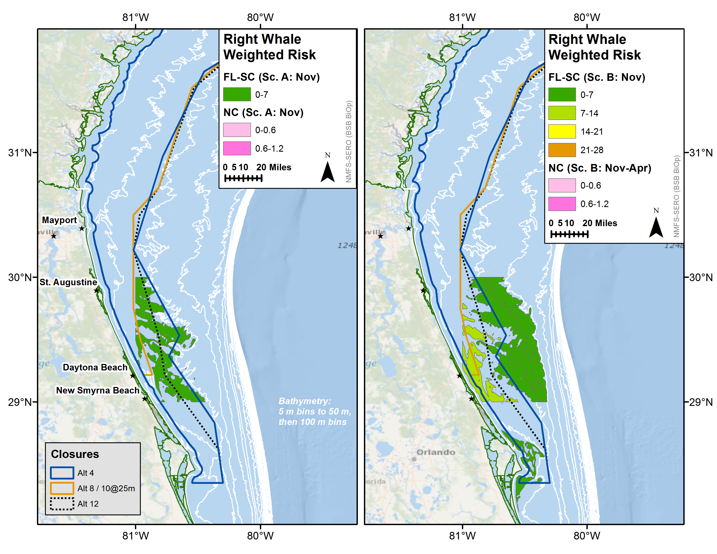
FL
Relatively “Low” risk area not covered by Alt 8a / Alt 11, partially covered by Alt 12
Relatively “Medium/Low” risk area not covered by Alt 8a / Alt 11, partially covered by Alt 12

Slide 20
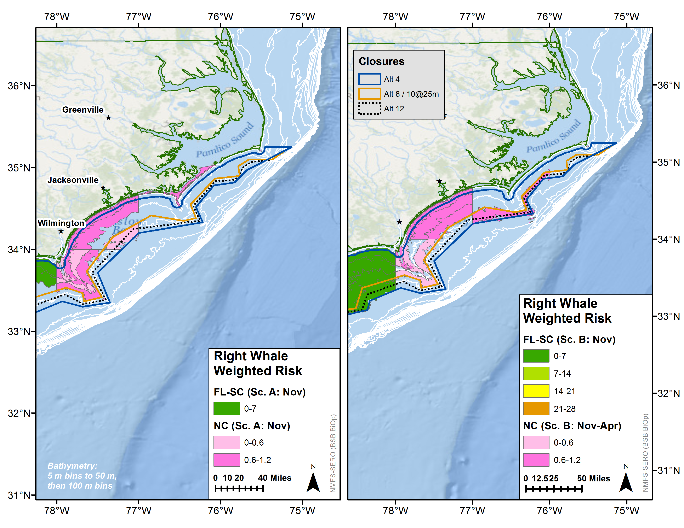
NC
Relatively “Moderate” risk area not covered by Alt 8a / Alt 11, partially covered by Alt 12
Relatively “Low” risk area not covered by Alt 8a / Alt 11, partially covered by Alt 12

Slide 21
FL
Relatively “High” risk area not covered by Alt 8a
Relatively “High” risk area not covered by Alt 8a

Slide 22
NC
Relatively “Low” risk area not covered by Alt 8a, partially covered by Alt 12, fully covered by Alt 11
Relatively “Moderate” risk area not covered by Alt 8a, partially covered by Alt 11, fully covered by Alt 12

Slide 23
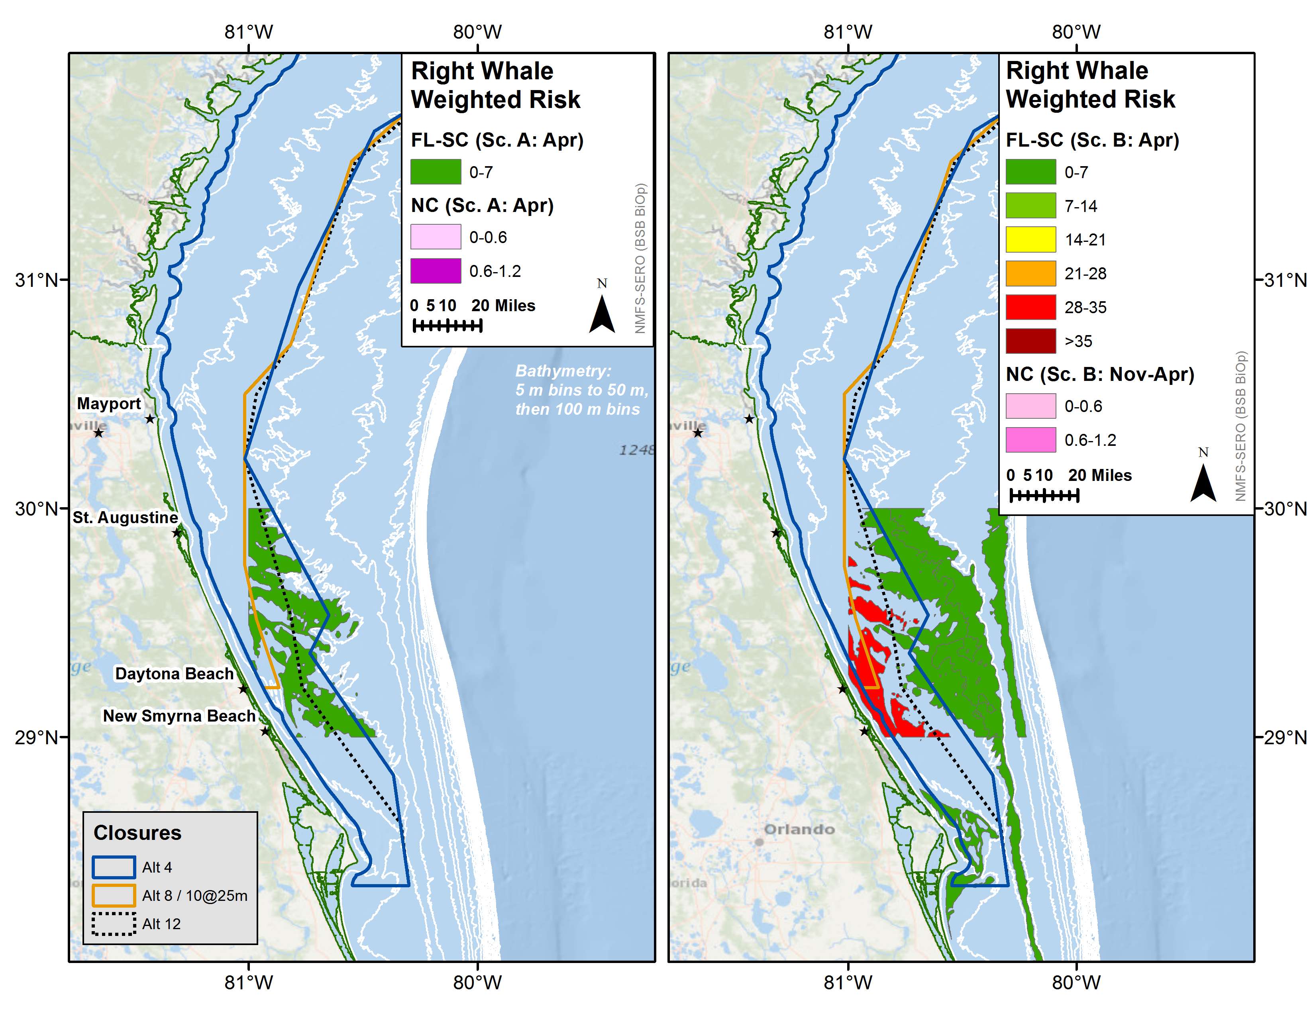
FL
Relatively “High” risk area not covered by Alt 8a / Alt 11, mostly covered by Alt 12
Relatively “Low” risk area not covered by Alt 8a / Alt 11

Slide 24
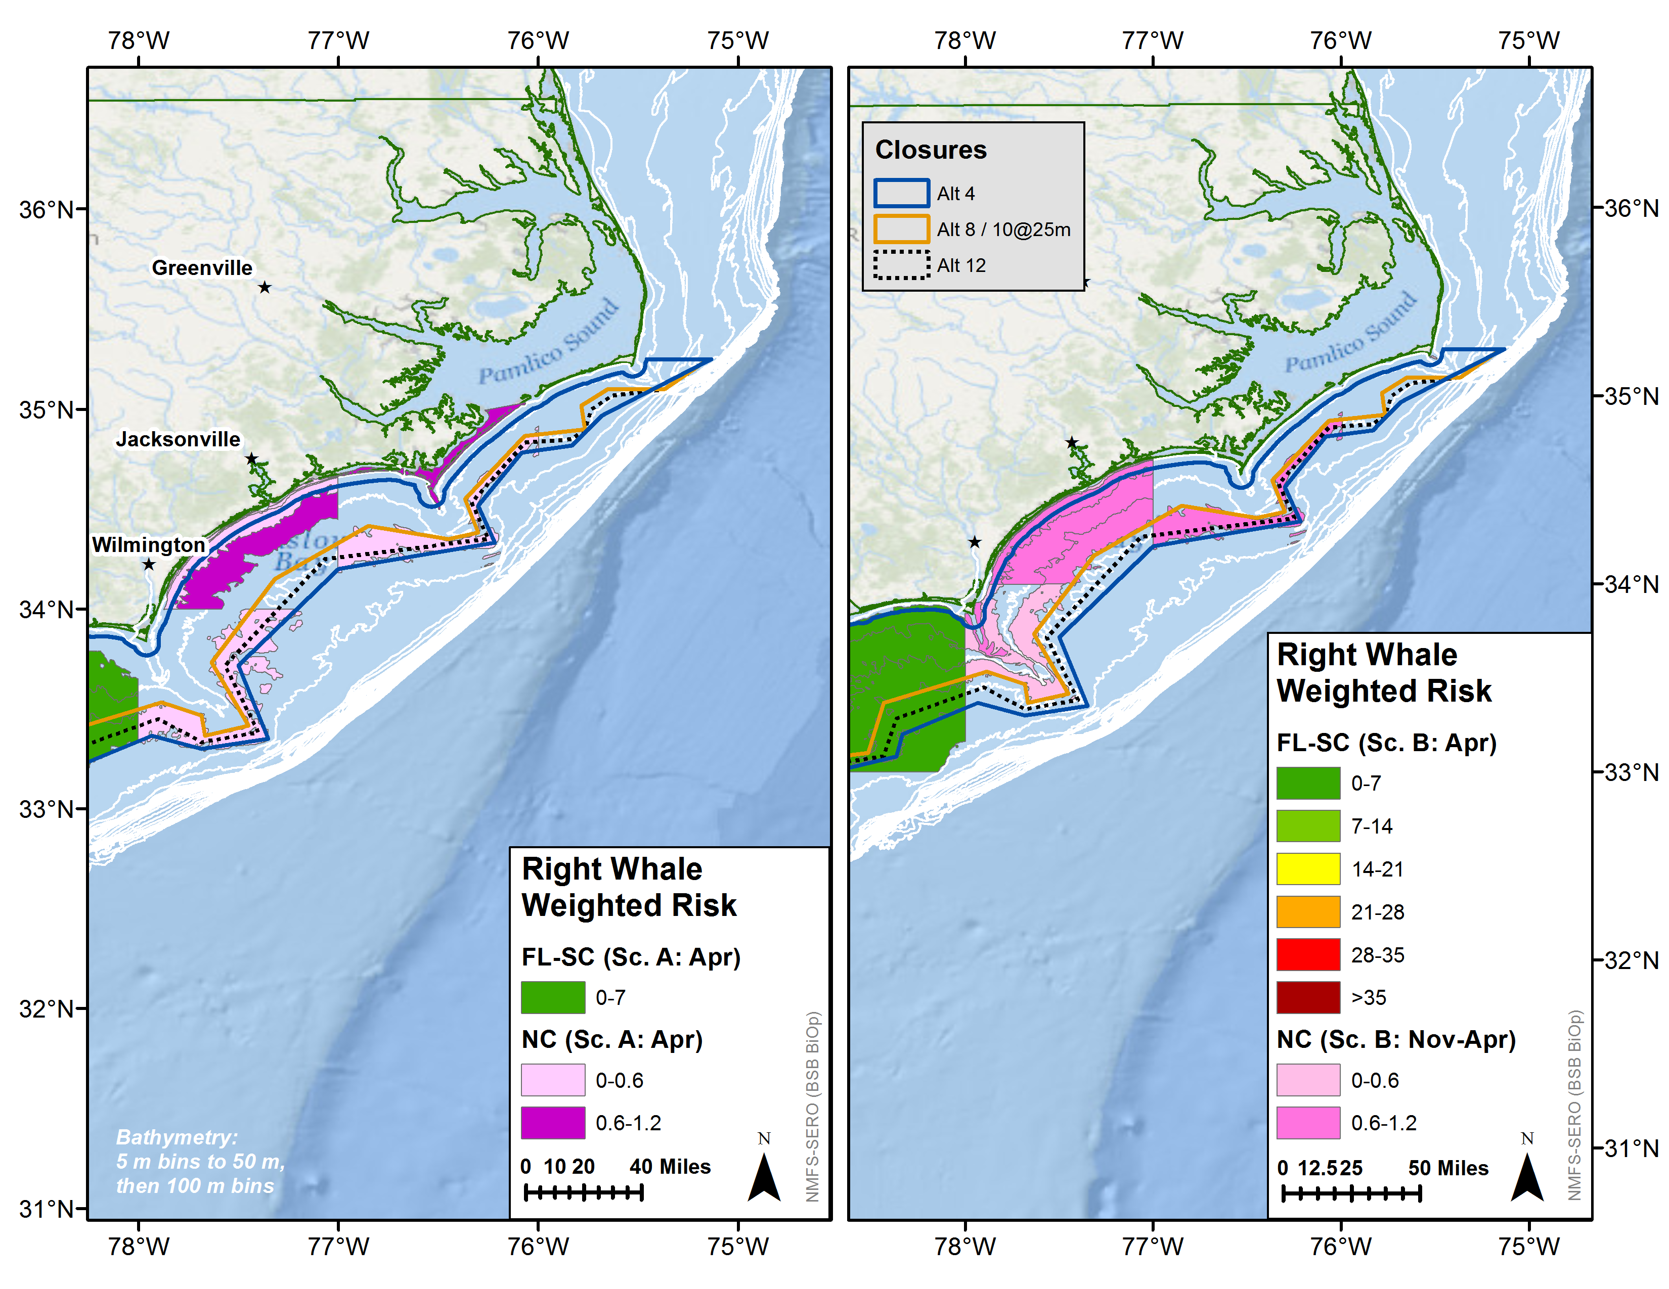
NC
Relatively “Low” risk area not covered by Alt 8a / Alt 11, partially covered by Alt 12
Relatively “Moderate” risk area not covered by Alt 8a / Alt 11, partially covered by Alt 12

