Slide 1
Prioritizing Fish Stock Assessments
Collaborative Implementation Throughout the Southeast Region
September 2015
Richard D. Methot
NOAA Senior Scientist for Stock Assessments

Slide 2
Take Home Messages
NMFS initiated the prioritization project to assure efficient use of limited assessment capacity
Strong push from OMB, GAO, Congress
Designed to be implemented in collaboration with Councils; factors considered will not be unfamiliar
Designed to assess every managed stock at a sufficient, and objectively determined, level and frequency
Produces a ranking that is strong advice, but not prescriptive

Slide 3
Overview
History of prioritization project
Prioritization goals
Process overview
Roles for NMFS, SEDAR, Councils

Slide 4
Prioritization Timeline
2011: Initiate development in response to budget process
2013: Appears in proposed MSA reauthorization
Feb 2014: Draft process presented to CCC and open for public comment
June 2014: Public comments summarized for CCC
Sept 2014: GAO report endorses draft plan
June 2015: Revised process presented to CCC
Aug 2015: Prioritization document release; implementation initiated

Slide 5
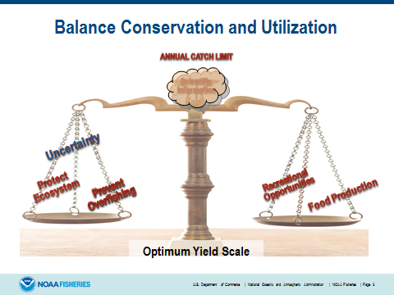
Why Prioritize?
Data and capacity limit the number and complexity of assessments that can be completed each year
All stocks need some level of assessment at some frequency, but
Diminishing returns; Perfection is not an option
Notes:
All managed stocks need some level of assessment
Some stocks need higher level or more frequent assessments
Costs may exceed benefits for some low-value stocks

Slide 6
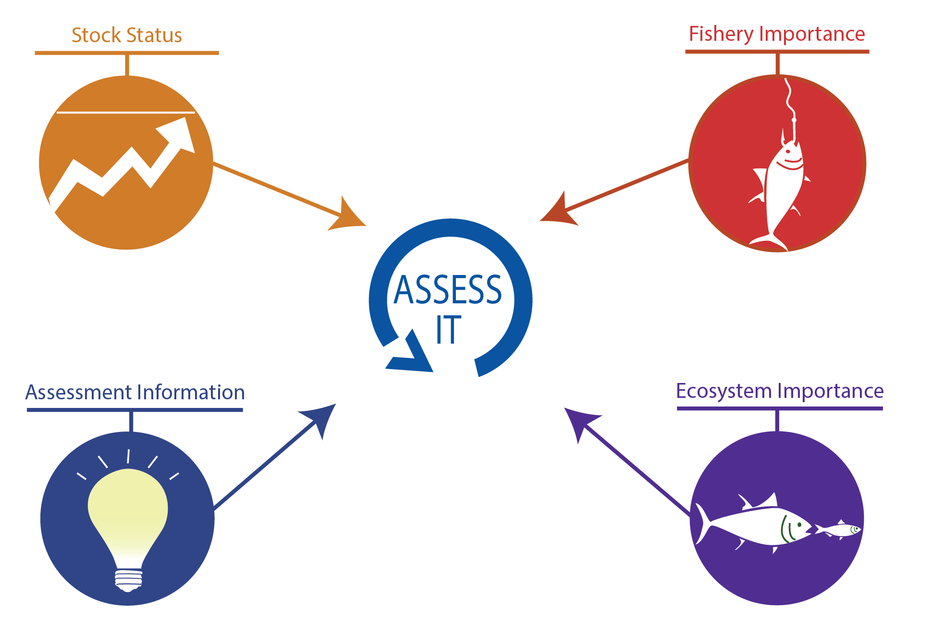
Which Stocks Need Assessment?

Slide 7
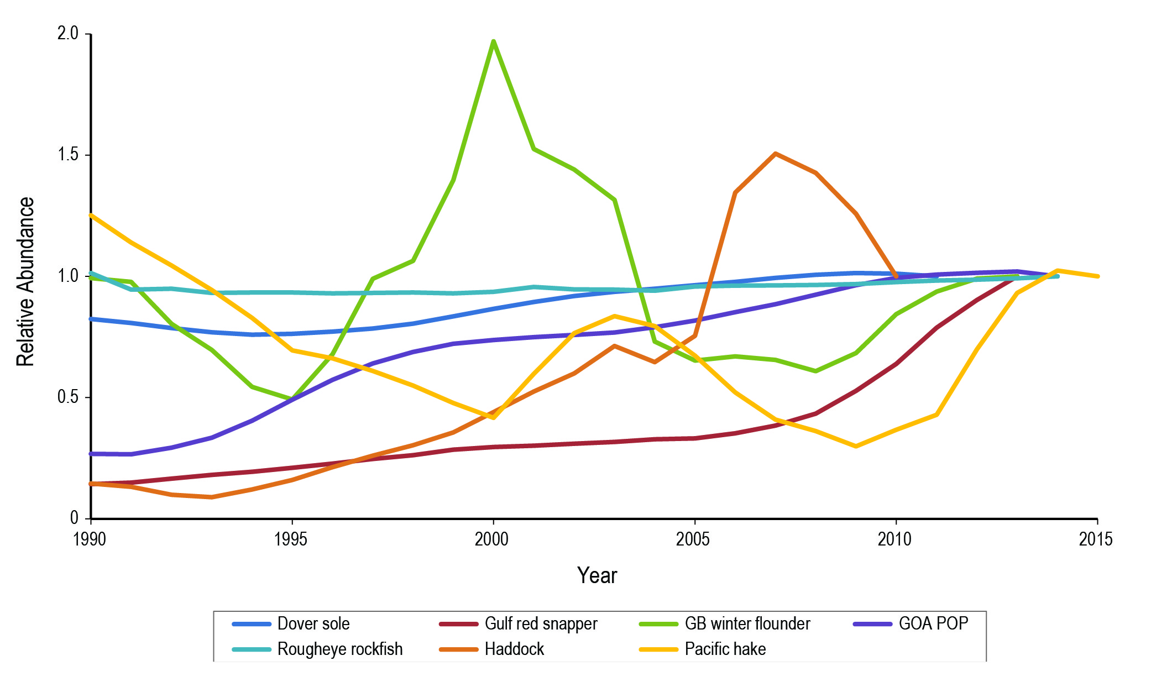
Assess Variable Stocks More Frequently

Slide 8
Importance: Range of Commercial Values
*FSSI = Fish Stock Sustainability Index; data are for stocks with annual catch limits

Slide 9
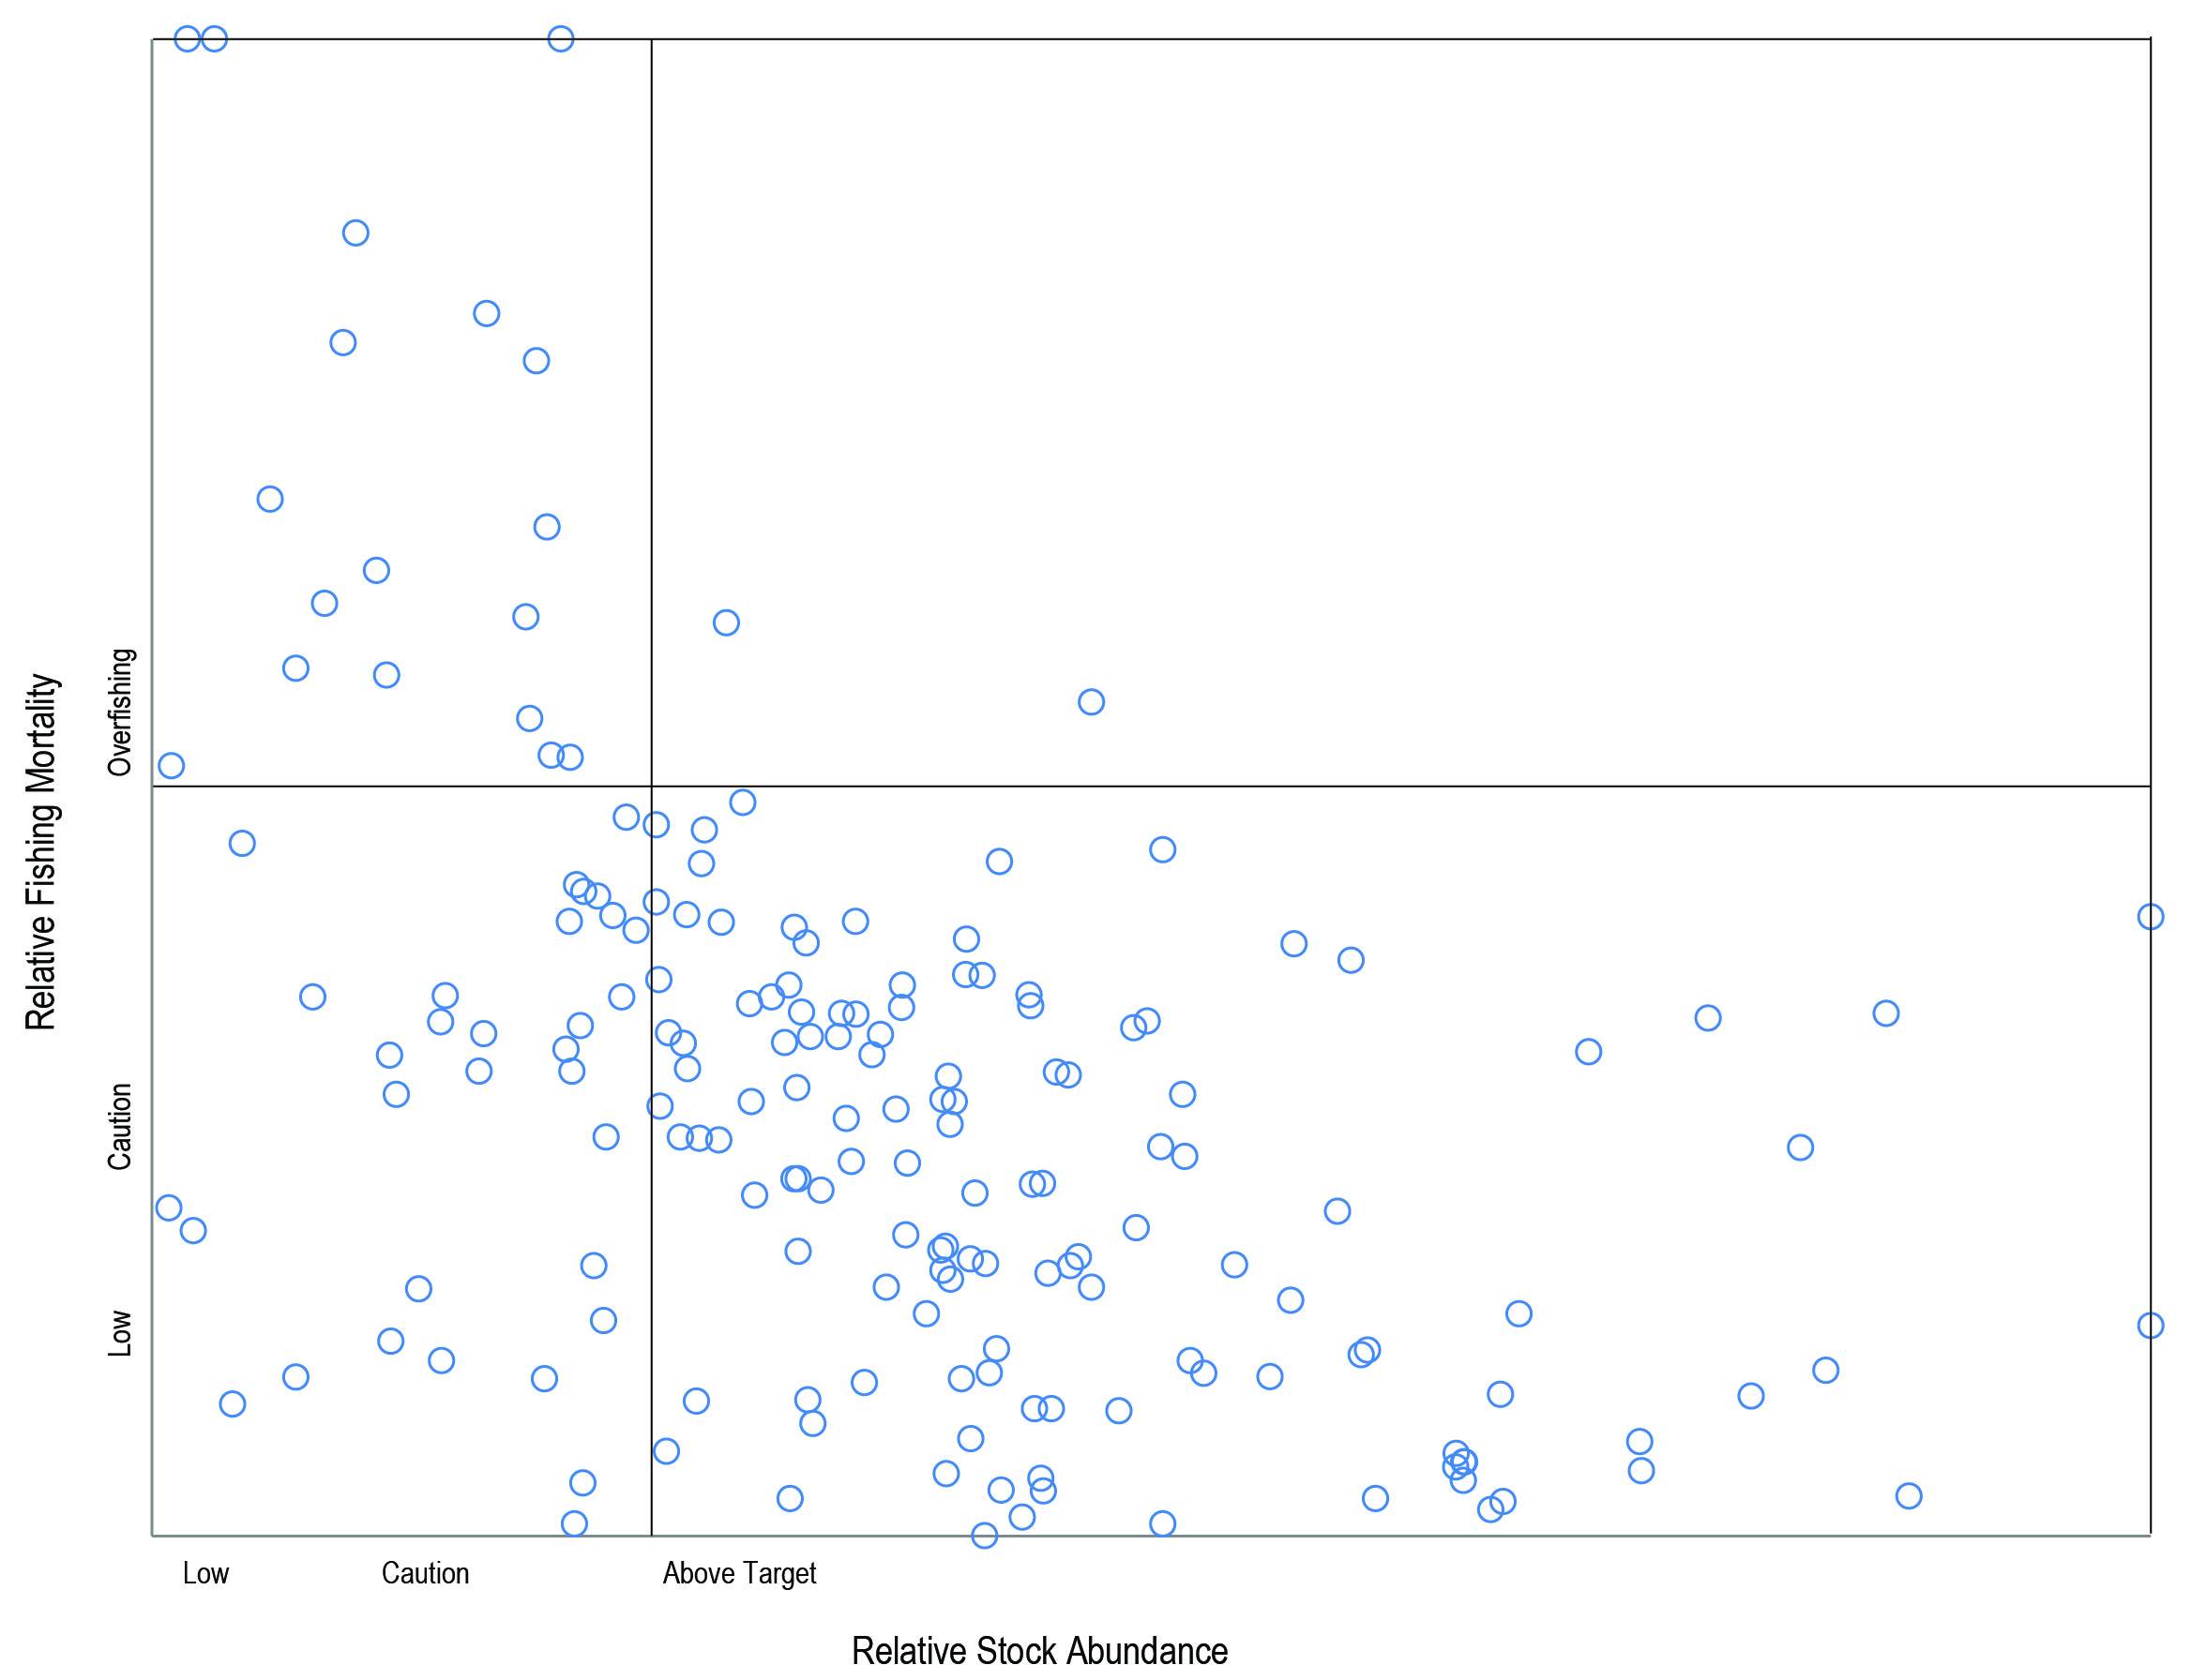
Status: Which Stocks are Pushing Limits?
Most recent status for an assessed stock
Target

Slide 10
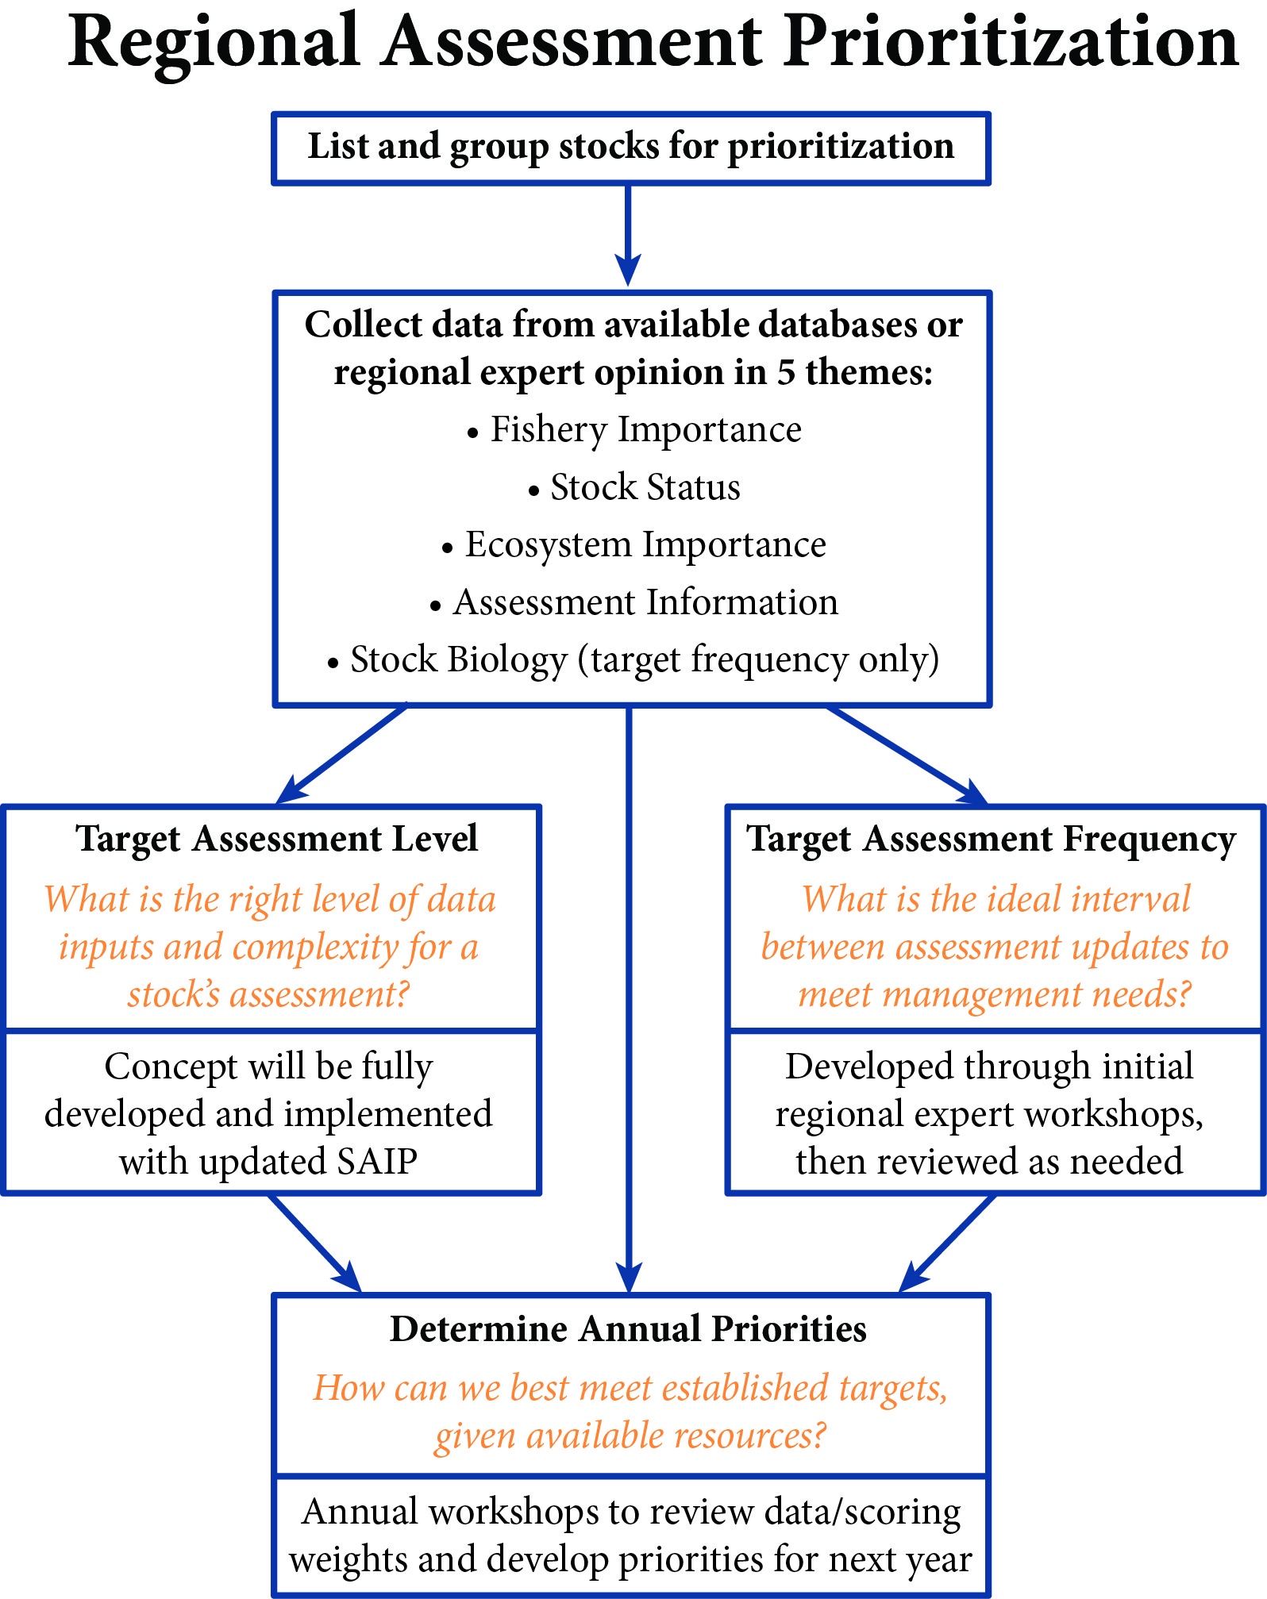
Prioritization Process
Collaborative activity between:
NMFS
Councils
Other regional partners

Slide 11
Prioritization Factors
Category | Factor | Source | Raw Scores
FISHERY | Commercial Fishery Importance - rescaled log(ex-vessel value) | SIS- ACL | 0-5
 | Recreational Fishery Importance - from regional input | Experts | 0-5
 | Importance to Subsistence | SIS | 0-5
 | Non-Catch Value | Experts | 0-5
 | Constituent Demand/Choke Stock | Experts | 0-5
 | Rebuilding Status | Experts | 0-1
STOCK | Relative Stock Abundance | SIS | 1-5
 | Relative Fishing Mortality | SIS | 1-5
ECO | Key Role in Ecosystem | Experts | 1-5
ASMT | Unexpected Changes in Stock Indicators | Experts | 0-5
 | Relevant New Type of Information Available | Experts | 0-5
 | Years Assessment Overdue - relative to Target Frequency | SIS | 0-10

Slide 12
Three Regional Science Activities
Stock Assessment Prioritization (http://goo.gl/8pQ898)
Objective and transparent process to prioritize stocks for assessment
Establishes target assessment level and frequency for each stock
Habitat Assessment Prioritization (http://goo.gl/ZPNxbn)
Process to develop regional habitat science priorities
Climate Vulnerability Assessment (http://goo.gl/0sARjR)
Estimates relative vulnerability of fish stocks to potential climate change
Results help managers identify ways to reduce risks/impacts to fisheries
Uses criteria to score stocks appropriate to prioritizing habitat science
Recently completed for West Coast stocks
Based on existing information on species distributions and life history
Cooperative process between NMFS, FMCs and other stakeholders

Slide 13
Scoring Inputs
Stock Assessment Prioritization | Habitat Science Prioritization | Climate Vulnerability Assessment *excludes Exposure Variables
Commercial Fishery Importance | FSSI or FMC Priority | Habitat Specificity
Recreational Fishery Importance | Habitat Science Benefits SA? | Prey Specificity
Importance to Subsistence | Habitat Science Benefits EFH? | Sensitivity to Ocean Acidification
Non-Catch Value | Fishery Status | Sensitivity to Temperature
Constituent Demand | Habitat Disturbance/Vulnerability/Rarity | Stock Size/Status
Rebuilding Status | Habitat Dependence | Other Stressors
Relative Stock Abundance | Ecological Importance | Adult Mobility
Relative Fishing Mortality | Economic, Social, and Mgmt Value | Spawning Cycle
Key Role in Ecosystem |  | Complexity in Reproductive Strategy
Unexpected Changes in Indicators |  | ELH Survival/Settlement Requirements
New Type of Information |  | Population Growth Rate
Years Assessment Overdue |  | Dispersal of Early Life Stages

Slide 14
How Does Prioritization Work?
Regional experts provide scores for stocks across each of the 12 prioritization factors
Weights for each of the 12 prioritization factors
 | Stock 1 | Stock 2 | … | Stock X
Factor 1
Factor 2
…
Factor 12
 | Weight
Factor 1
Factor 2
…
Factor 12
Product of relative scores and weights are summed across all 12 factors for each stock
Sorted list of results provides guidance on assessment priorities for upcoming cycle

Slide 15
Roles in Prioritization Process
NMFS
Collates data from databases and past assessments
Expert Groups:
NMFS
Councils
Other Partners
Provide scores for each stock for the other factors
NMFS/Council Leadership
Assigns weights within ranges to each factor
SEDAR Committee
Uses the proposed list, upcoming management cycle, data availability, and assessment capacity to determine set of assessments to do

Slide 16
Next Steps for Southeast
Meet with each Council’s SSCs and/or other groups
Develop process and timeline tailored for SEDAR and the GOM, S. Atl., and Caribbean Councils
Establish expert groups from NMFS and each Council to develop:
  stock lists for prioritization (within FMP?; deal with complexes, Ecosystem Component species, etc.)
  ecosystem importance scores
    coordinate with habitat prioritization and climate vulnerability efforts
  recreational importance scores
  scores for additional fishery importance categories
  recent stock indicator data (catch rel. ABC; survey trends, etc.)
  target assessment frequencies and levels
  range of factor weights
Use table of scores x weights to inform each Council’s deliberation on priority stocks for assessment

Slide 17
Questions for SEDAR Committee
OK with Implementation with Council’s?
What degree of Council committee involvement (especially factor weights and fishery importance scores) is feasible?
Which FMP, and timeline, can be targeted for prototype implementation?

Slide 18
Future Directions
Management Strategy Evaluations for select stocks can better inform setting of target assessment level and frequency
Gaps between current and target assessment levels, and the number of overdue assessments, informs future investments in capacity
The simple “factor score x weight” approach evolves to calculate a portfolio of assessments that achieve the greatest overall benefits

