Slide 1
Notice of Proposed Rulemaking: North Atlantic Right Whale Critical Habitat
South Atlantic Fisheries Management Council Protected Resources Committee Meeting
SERO Protected Resources Division
March 3, 2015

Slide 2
Preface
Presentation excludes:
Critical habitat-related actions in North Pacific
Presentation touches on:
Critical habitat in NE US (Unit 1)
Presentation focuses on:
Critical habitat in SER (Unit 2)

Slide 3
Outline
Existing Critical Habitat
Why Revisit RW Critical Habitat?
Identifying Critical Habitat
Proposed Critical Habitat
What “May Effect” Critical Habitat
Information

Slide 4
Background: Northern Right Whale Critical Habitat
Critical habitat in North Atlantic was designated in 1994
Areas Included:
- Cape Cod Bay
- Stellwagen Bank
- Great South Channel
- Waters adjacent to GA and FL coasts
Areas determined to provide critical feeding, nursery, and calving habitat

Slide 5
Background: 1994 Critical Habitat
Based primarily on opportunistic sightings
Late 1980’s: calving area was “rediscovered” by researchers

Slide 6
Background: 2008 Right Whale Listing (73 FR 12024)
Was northern right whale (Eubalaena spp.)
Now two endangered species:
North Atlantic right whale (E. glacialis)
North Pacific right whale (E. japonica)
Notes:
NMFS completed a status review of right whales in the North Pacific and North Atlantic Oceans under the Endangered Species Act in December 2006 and consequently listed the endangered northern right whale as two separate endangered species: North Atlantic right whale and North Pacific right whale

Slide 7
Why Revisit Right Whale Critical Habitat?
2008 Listing determination, and
2010 NMFS determination that a 2009 Petition to revise the 1994 critical habitat presented information warranting a revision (75 FR 61690)
Notes:
ESA requires critical habitat designation upon issuance of a final listing determination, and
NMFS found that a 2009 petition to revise critical habitat presented substantial scientific information indicating that a revision may be warranted.

Slide 8
ESA Section 3 Defines Critical Habitat
i) The specific areas within the geographical area occupied by the species, at the time it was listed, on which are found those physical or biological features
essential to the conservation of the species and
which may require special management considerations or protection; and
ii) specific areas outside the geographical area occupied by the species at the time it is listed…that …are essential for the conservation of the species.
Notes:
Within the geographical area occupied, critical habitat consists of specific areas on which are found those physical or biological features essential to the conservation of the species (‘‘essential features’’) and that may require special management considerations or protection.

Slide 9
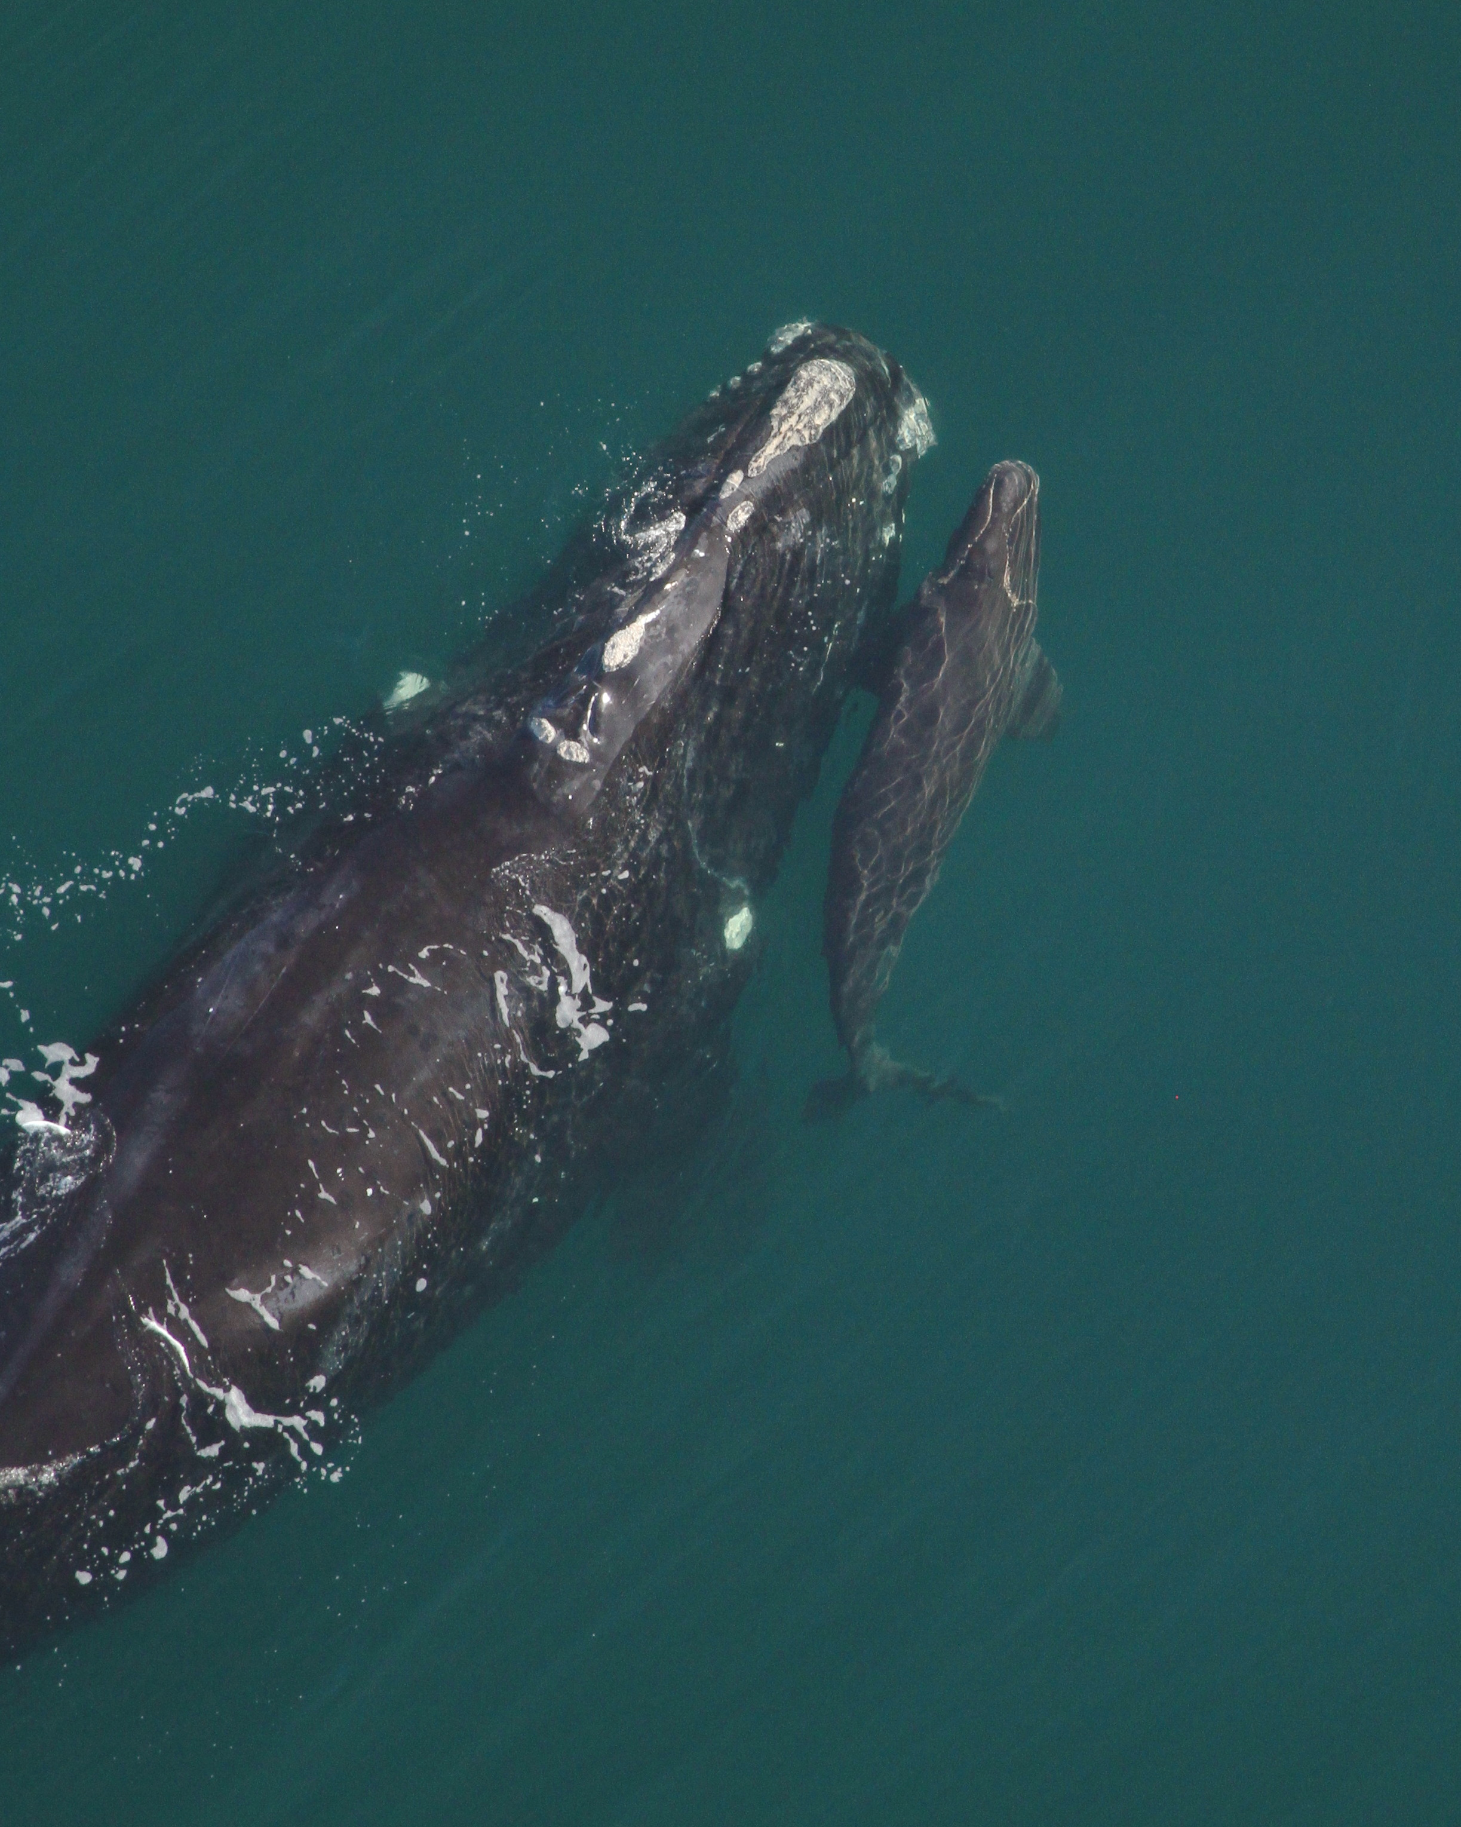
Essential Conservation Objective
“Facilitating successful calving by protecting the species’ calving area is a key conservation objective.” (50 FR 9314)
Photo by Florida FWC, taken under NOAA permit #15488
Notes:
Given that the area off the southeastern U.S. is the only known calving ground for North Atlantic right whales, and that the most biologically valuable portion of the species’ population is utilizing this habitat, we conclude that facilitating successful calving by protecting the species’ calving area is a key conservation objective.

Slide 10
Identifying specific areas that meet CH definition
What are the functions this area provides that promote successful calving and rearing?
What are the physical or biological features that are essential because they provide calving area functions in these areas?
Photo by Wildlife Trust, NOAA Permit #594-1759
Notes:
To identify specific areas that may meet the definition of critical habitat, we focused first on specifically defining what constitutes a ‘‘calving’’ area for North Atlantic right whales; that is, what are the functions this area provides that promote successful calving and rearing. We then examined these functions and next identified those physical or biological features that are essential to the conservation of the species because they provide calving area functions to the species in these areas.

Slide 11
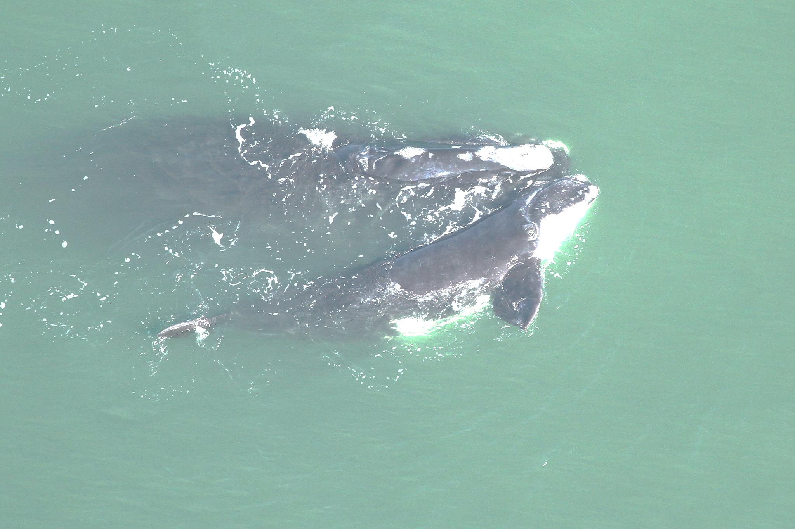
NARW Calving Habitat Essential Features
Calm seas surface conditions of Force 4 or less on the Beaufort Wind Scale;
Sea surface temperatures from a minimum of 7ºC and never more than 17ºC; and
Water depths of 6 to 28 meters, where…
these features simultaneously co-occur over contiguous areas of at least 231 km² of ocean waters during the months of November through April.
Notes:
The physical features of right whale calving habitat essential to the conservation of the NARW are: calm sea surface conditions, water temperatures of 7-17 degrees C, and water that is 6-28 meters deep –and where the features simultaneously co-occur over a contiguous area of > 231km2 from November through April.

Slide 12
Specific Areas on Which Are Found the Physical and Biological Features of Calving Habitat
Based on two predictive habitat models: Garrison (2007)/Keller et al. (2012), and Good et al. (2008)
75th percentile from Garrison (2007)/Keller et al. (2012) and Good’s (2008) habitat area selected by at least three of the monthly models account for 91% and 85% of all observed right whale mother-calf pair sightings, respectively.

Slide 13
Proposed Calving Area Critical Habitat (Unit 2)
All marine waters from Cape Fear, NC, southward to 29° N latitude (approximately 43 miles north of Cape Canaveral, FL) within the area bounded on the west by the shoreline and the 72 COLREGS lines, and on the east by rhumb lines connecting specific points described.
Notes:
22-25 nmi off SC/NC
~35 nmi off Hilton Head
35-40 nmi off GA
25 nmi of SJR

Slide 14
NARW Foraging Habitat Essential Features
Physical oceanographic conditions & structures of the Gulf of Maine and Georges Bank region that combine to distribute and aggregate C. finmarchicus (prevailing currents, circulation patterns, bathymetric features, oceanic fronts, etc.)
Low flow velocities in Jordan, Wilkinson, and Georges Basins that allow diapausing C. finmarchicus to aggregate passively below the convective layer …
Late stage C. finmarchicus in dense aggregations in the gulf of Maine and Georges Bank region; and
Diapausing C. finmarchicus in aggregations in the gulf of Maine and Georges Bank region

Slide 15
Comparison of Current and Proposed Critical Habitat
Unit 1: Foraging Habitat
Unit 2: Calving Habitat
Area = 21,334 nm²
Area = 8,611 nm²
Notes:
The proposed critical habitat, which you can see in these maps, greatly expands the previous designation. The key benefit of designating critical habitat is that other Federal agencies are put on notice that they must consult with NOAA Fisheries if they intend to authorize, fund, or carry out an action that may affect right whale critical habitat.

Slide 16
What “May Effect” Critical Habitat?
Based on Past Consultations
National Pollution Discharge Elimination System (NPDES) permitting
Oil spill response
Dredging and spoil disposal
Marine Construction Permitting
Construction and operation of energy facilities
Notes:
Based on historical consultations, we identified five categories of federal activities that may effect critical habitat. Of these, we identified two categories of activities that may require modifications to avoid adverse modification of essential features: water quality/NPDES and Oil Spill Response.

Slide 17
What “May Effect” Critical Habitat?
New Categories Anticipated:
Oil and gas exploration and development
Offshore alternative energy development
Directed copepod fisheries
Marine aquaculture
Notes:
We identified five categories that may effect critical habitat. Of these, we identified two categories of activities that may require modifications to avoid adverse modification of essential features: water quality/NPDES and Oil Spill Response.

Slide 18
Supplementary Information
Biological Source Document
Draft ESA Section 4(b)(2) Report
Notes:
A draft Biological Source Document provides the basis for our identification of the physical and biological features essential to the conservation of the species that may require special management considerations or protection.
A draft report was also prepared pursuant to the Endangered Species Act (ESA) in support of this proposal. ESA Section 4(b)(2) requires that when we designate or revise critical habitat we consider the economic impact, impact on national security, and any other relevant impact of specifying any particular area as critical habitat.

Slide 20
