Slide 1
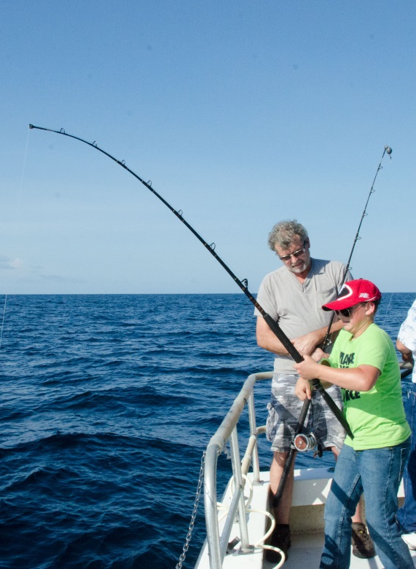
Red Snapper Mini-Season Voluntary Reporting
Prepared by Chip Collier
September 2017

Slide 2
Data Reporting Requirements
Commercial – Required to report through federal logbooks and state requirements.

Slide 3
Data Reporting Requirements
Commercial – Required to report through federal logbooks and state requirements.
Recreational
Headboat – Required to report through weekly federal logbooks.

Slide 4
Data Reporting Requirements
Commercial – Required to report through federal logbooks and state requirements.
Recreational
Headboat – Required to report through weekly federal logbooks.
Charter – Required reporting in SC and sampled through MRIP in other states.

Slide 5
Data Reporting Requirements
Commercial – Required to report through federal logbooks and state requirements.
Recreational
Headboat – Required to report through weekly federal logbooks.
Charter – Required reporting in SC and sampled through MRIP in other states.
Private – Sampled through MRIP in all states.

Slide 6
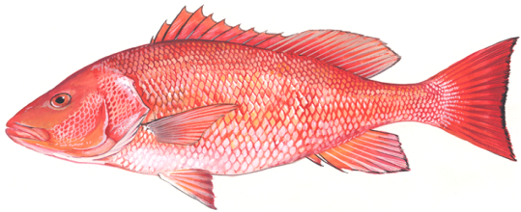
Past Red Snapper
Mini-Seasons Reporting
FLFWC – Dockside sampling, developed a method to estimate catch and effort, attempted contact of 100% offshore charter captains

Slide 7
Past Red Snapper
Mini-Seasons Reporting
FLFWC – Dockside sampling, developed a method to estimate catch and effort, attempted contact of 100% offshore charter captains
GADNR – Dockside sampling, carcass collection program, telephone survey of for-hire captains, voluntary angler electronic catch survey

Slide 8
Past Red Snapper
Mini-Seasons Reporting
FLFWC – Dockside sampling, developed a method to estimate catch and effort, attempted contact of 100% offshore charter captains
GADNR – Dockside sampling, carcass collection program, telephone survey of for-hire captains, voluntary angler electronic catch survey
SCDNR – Dockside sampling, carcass collection program, 100% reporting for for-hire trips, online recreational survey

Slide 9
Past Red Snapper
Mini-Seasons Reporting
FLFWC – Dockside sampling, developed a method to estimate catch and effort, attempted contact of 100% offshore charter captains
GADNR – Dockside sampling, carcass collection program, telephone survey of for-hire captains, voluntary angler electronic catch survey
SCDNR – Dockside sampling, carcass collection program, 100% reporting for for-hire trips, online recreational survey
NCDMF – Dockside sampling, carcass collection program, online recreational survey

Slide 10
New Red Snapper
Mini-Seasons Reporting
Voluntary Tournament Style Reporting App

Slide 11
New Red Snapper
Mini-Seasons Reporting
Voluntary Tournament Style Reporting App
Fishermen will need to sign up
Report red snapper caught and released or no catch
Can provide picture of red snapper, release treatment, and area fished

Slide 12
New Red Snapper
Mini-Seasons Reporting
Voluntary Tournament Style Reporting App
Fishermen will need to sign up
Report red snapper caught and released or no catch
Can provide picture of red snapper, release treatment, and area fished
Webpage can be developed to inform fishermen of the app, fishing season, and best fishing practices.

Slide 13
Best Fishing Practices
The practices below will allow for responsible and sustainable red snapper fishing including:
Avoid areas likely to have red snapper if you already have met your bag limit.

Slide 14
Best Fishing Practices
The practices below will allow for responsible and sustainable red snapper fishing including:
Avoid areas likely to have red snapper if you already met your bag limit.
Use single hook rigs since the bag limit for red snapper is one per person.

Slide 15
Best Fishing Practices
The practices below will allow for responsible and sustainable red snapper fishing including:
Avoid areas likely to have red snapper if you already have met your bag limit.
Use single hook rigs since the bag limit for red snapper is one per person.
Keep fish that will be released in the water as much as possible and to return fish back to water as quickly as possible. Use a dehooking device to remove the hook.

Slide 16
Best Fishing Practices
The practices below will allow for responsible and sustainable red snapper fishing including:
Avoid areas likely to have red snapper if you already met your bag limit.
Use single hook rigs since the bag limit for red snapper is one per person.
Keep fish that will be released in the water as much as possible and to return fish back to water as quickly as possible. Use a dehooking device to remove the hook.
Use descending devices if releasing fish with signs of barotrauma.

Slide 17
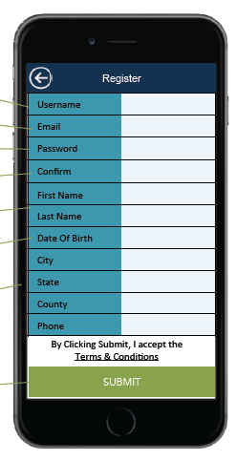
Reporting App Example
Based on iAngler
Access through cell phone or computer
Individual based information on email, name, city, state, etc.

Slide 18
Reporting App Example
Based on iAngler
Access through cell phone or computer
Individual based information on email, name, city, state, etc.
Data reported on departing port, number of angler, vessel number, target species

Slide 19
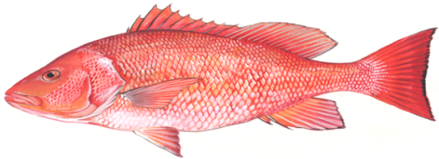
Reporting App Example
Based on iAngler
Access through cell phone or computer
Individual based information on email, name, city, state, etc.
Data reported on departing port, number of anglers, vessel number, target species
Fish level data – kept, released, size, location, and picture
RED SNAPPER

Slide 20
Data from Reporting App
SAFMC Staff will provide information on website between weekends. Based on reported information by fishermen using the app, we can:
Determine number fishermen reporting;
Calculate % of fishermen with catches and releases of red snapper;
Calculate % of red snapper released;
Estimate length of kept and released red snapper reported through app; and
Develop maps of relative fishing effort if sufficient data are provided.

Slide 21
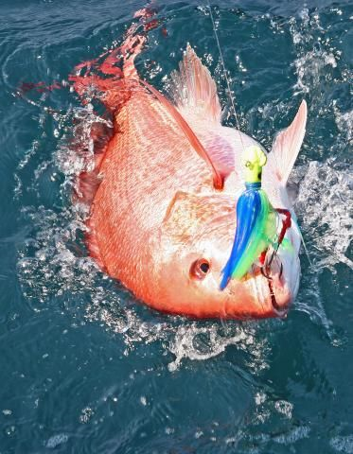
Questions?
David Rainer

