Slide 1
Review of MRIP Design Changes and Evaluation of Potential Impacts
John Foster
Dave Van Voorhees
SAFMC SSC Meeting
Charleston, South Carolina
30 April 2014
U.S. Department of Commerce | National Oceanic and Atmospheric Administration | NOAA Fisheries

Slide 2
MRIP Update
Overview of Access Point Angler Intercept Survey (APAIS) design changes in 2013
Evaluating potential effects of APAIS design changes
Overview of Future Changes

Slide 3
Overview of APAIS Design Changes
Design changes made to address:
Coverage gaps (nighttime, off-peak daytime)
Lack of formal probability sampling for all sites
Alternate site inclusion probabilities not easily known
Variable time intervals covered for each site visit
Difficult to expand data to represent a full day
New Design provides:
Full temporal coverage
Formal probability sampling of all sites and fixed time intervals for all site visits
Sample drawn from a list of “site clusters” comprised of 1 or 2 sites
Order of site visits within a cluster randomized and fixed
Interviewers not allowed to change time on site or move to other sites
Inclusion probabilities known for all site/time units in the sample
No opportunistic sampling of trips in alternate fishing modes
Inclusion probabilities for alternate mode trips difficult to determine

Slide 4
Overview of APAIS Design Changes
Six-hour assignments
Four time-block strata
Replaced variable length assignments under MRFSS
Eliminated difficulty of expanding data to represent a full day
No limit on number of interviews per site visit
Replaced MRFSS 30-interview cap
Direct design-based weighting of sample data
Eliminated need to model any weighting components

Slide 5
Evaluating Potential Effects of Changes
What design changes are relevant?
How can we evaluate potential effects?
What have we been able to do in the short term?
What longer term efforts could provide stronger conclusions?

Slide 6
What Changes are Relevant?
Only changes that could create systematic differences in the data are relevant
Example ➔ consistent difference in temporal coverage
Variable or random differences do not generally introduce bias
Example ➔temporal distributions in sample will vary
Complicating factors:
Limited data from new APAIS design (1 year)
Differences in sampler behavior over time within/among states

Slide 7
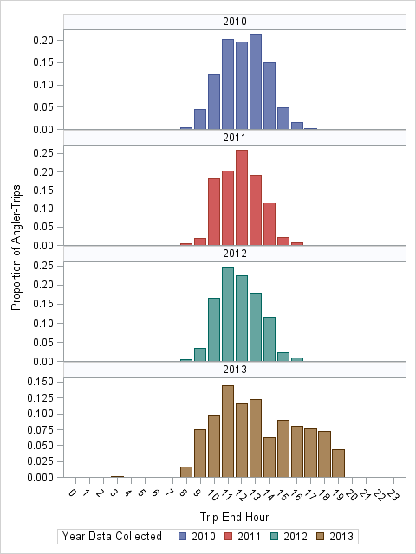
Alabama
All Waves
Private Boat
2010-2013
Significant change in
temporal coverage!

Slide 8
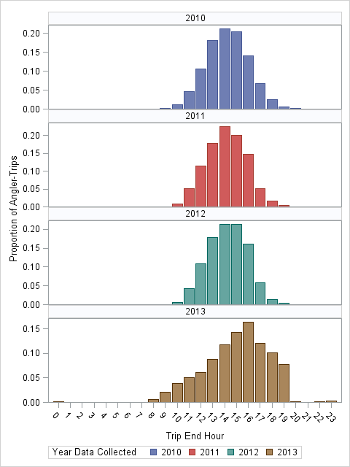
North Carolina
All Waves
Private Boat
2010-2013

Slide 9
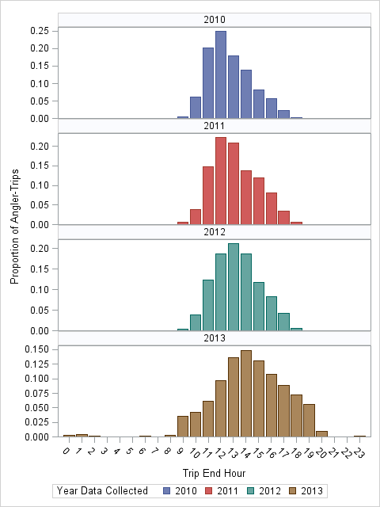
Florida-East
All Waves
Private Boat
2010-2013

Slide 10
How to Evaluate Potential Effects?
Empirical methods
Simulation methods

Slide 11
Empirical Methods
Descriptive Analysis of Estimation Components
Post-stratification
Make 2013 sample distributions resemble those in prior years (or vice versa) by adjusting sample weights
Examples: Time distributions, Site distributions
Relatively quick to perform
Difficult to determine if differences attributable to sample design changes
Data limitations may exclude important characteristics from analysis
Example: some sites may be present in data for some years but not all
Results confounded by real changes in fishery among years (changes in fish stocks, changes in regulations, changes in angler behavior, etc.)
Modeling
Regression, Time-series, etc.
Not feasible right now given only one year of data for APAIS design

Slide 12
Simulation Methods
Create a population of angler-trips
Sample repeatedly using:
2013 MRIP APAIS design
pre-2013 MRFSS APAIS design
Look for systematic differences in cpue’s and effort adjustments
Takes considerable time and effort to develop
Create multiple populations, varying distributions of important trip characteristics (e.g., return time, site, area fished, catch)
Identify numerous MRFSS sampling scenarios representing different patterns in sampler behavior
Results not confounded by year-to-year changes in angler behavior
Analysis does not require additional years of APAIS data

Slide 13
Progress to Date
Descriptive Analysis of Estimation Components
Four series of Estimation Components calculated from APAIS
Catch rates
Area fished proportions
Effort adjustment factors
Trip proportions by region
Four temporal domains: Morning, Peak, Evening, All
Comparing 2013 to 2010-2012
Expect preliminary results in May for GOM
Start on South Atlantic after GOM

Slide 14
Progress to Date
Post-stratification evaluation methods
Programs for adjusting sample weights and re-estimating catches developed
Optimal method for estimating bias in prior years not known at this time
Results confounded by real differences between years
Due to changes in regulations, weather, and other fishery conditions
Simulation approach
May 27th kick-off meeting with MRIP statistical consultants at CSU
MRIP Teams
Transition Team
Technical Team

Slide 15
Next Steps
Extend Descriptive Analysis to remaining sub regions
Develop simulation model
Mine intercept data from MRFSS and MRIP designs
Identify distributions for important trip characteristics needed to build angler-trip populations
Identify patterns in sampler behavior needed to create sampling scenarios under MRFSS design
Conduct simulation evaluations of MRFSS vs. MRIP
Determine best approach for Post-stratification evaluations
Provide recommendations for any needed adjustments to past estimates

Slide 16
Future Changes
APAIS
Effort Surveys

Slide 17
Future Changes - APAIS
2014
New “Peak” 6-hr time interval (11am-5pm)
First implemented in Wave 2 (March/April)
Site group stratification for PR and CH modes
Change allows for mixed mode sampling for PR and CH modes (PR and CH intercepts eligible on same assignment)
First implemented in Wave 3 (May/June)
2015
Offshore site group stratum (likely for GOM subregion)
Potential site group stratum for SH mode
Changes to APAIS stratification
No change in survey coverage
Should not expect systematic effects on estimates

Slide 18
Future Changes – Effort Surveys
2015
Fishing Effort Survey (FES)
PR and SH effort estimates
Dual-frame mail survey
U.S. Postal Service list of addresses
National Saltwater Angler Registry
Replacement for Coastal Household Telephone Survey (CHTS)

Slide 19
MRIP Transition Team Terms of Reference
Develop/recommend standardized process for transitioning from historical estimates to estimates derived from improved sampling and estimation designs. Process will describe/provide consistent approaches and methods for Councils, Commissions, and Regions to apply for:
Setting annual catch limits;
Monitoring catch against catch limits;
Assessing needs for and selection of accountability measures; and
Conducting analyses leading to adoption of recreational fishing regulations.
Develop/recommend methods to be used to compare legacy estimates to estimates produced with new or modified MRIP designs in a statistically robust manner.

Slide 20
MRIP Transition Team Terms of Reference
Determine when calibration or other means of linking legacy data sets with MRIP-derived data sets are feasible and necessary, and identify requirements and methods for making such linkages.
To minimize disruptions to stock assessments, catch monitoring, and management regulations, establish guidelines, in consultation with Regional Implementation Teams, to facilitate decisions on when and how implementation of changes to MRIP survey methods are introduced.
Report to MRIP Executive Steering Committee (ESC) on status of transition and any impediments to progress, along with suggestions for overcoming impediments, at least on an annual basis.
Submit all recommendations to MRIP ESC for approval/conveyance to NMFS Science and Regulatory Boards.

Slide 21
MRIP Transition Team Membership
Co-Chairs:
Galen Tromble (NMFS/SF)
Dave Van Voorhees (NMFS/ST)
Representatives:
NMFS Regional Offices
NMFS Science Centers
Councils
Interstate Commissions/States
Supported by Technical Work Group(s) as Needed

Slide 22
Review of MRIP Design Changes and Evaluation of Potential Impacts
John Foster
Dave Van Voorhees
SAFMC SSC Meeting
Charleston, South Carolina
30 April 2014
U.S. Department of Commerce | National Oceanic and Atmospheric Administration | NOAA Fisheries

