Slide 1
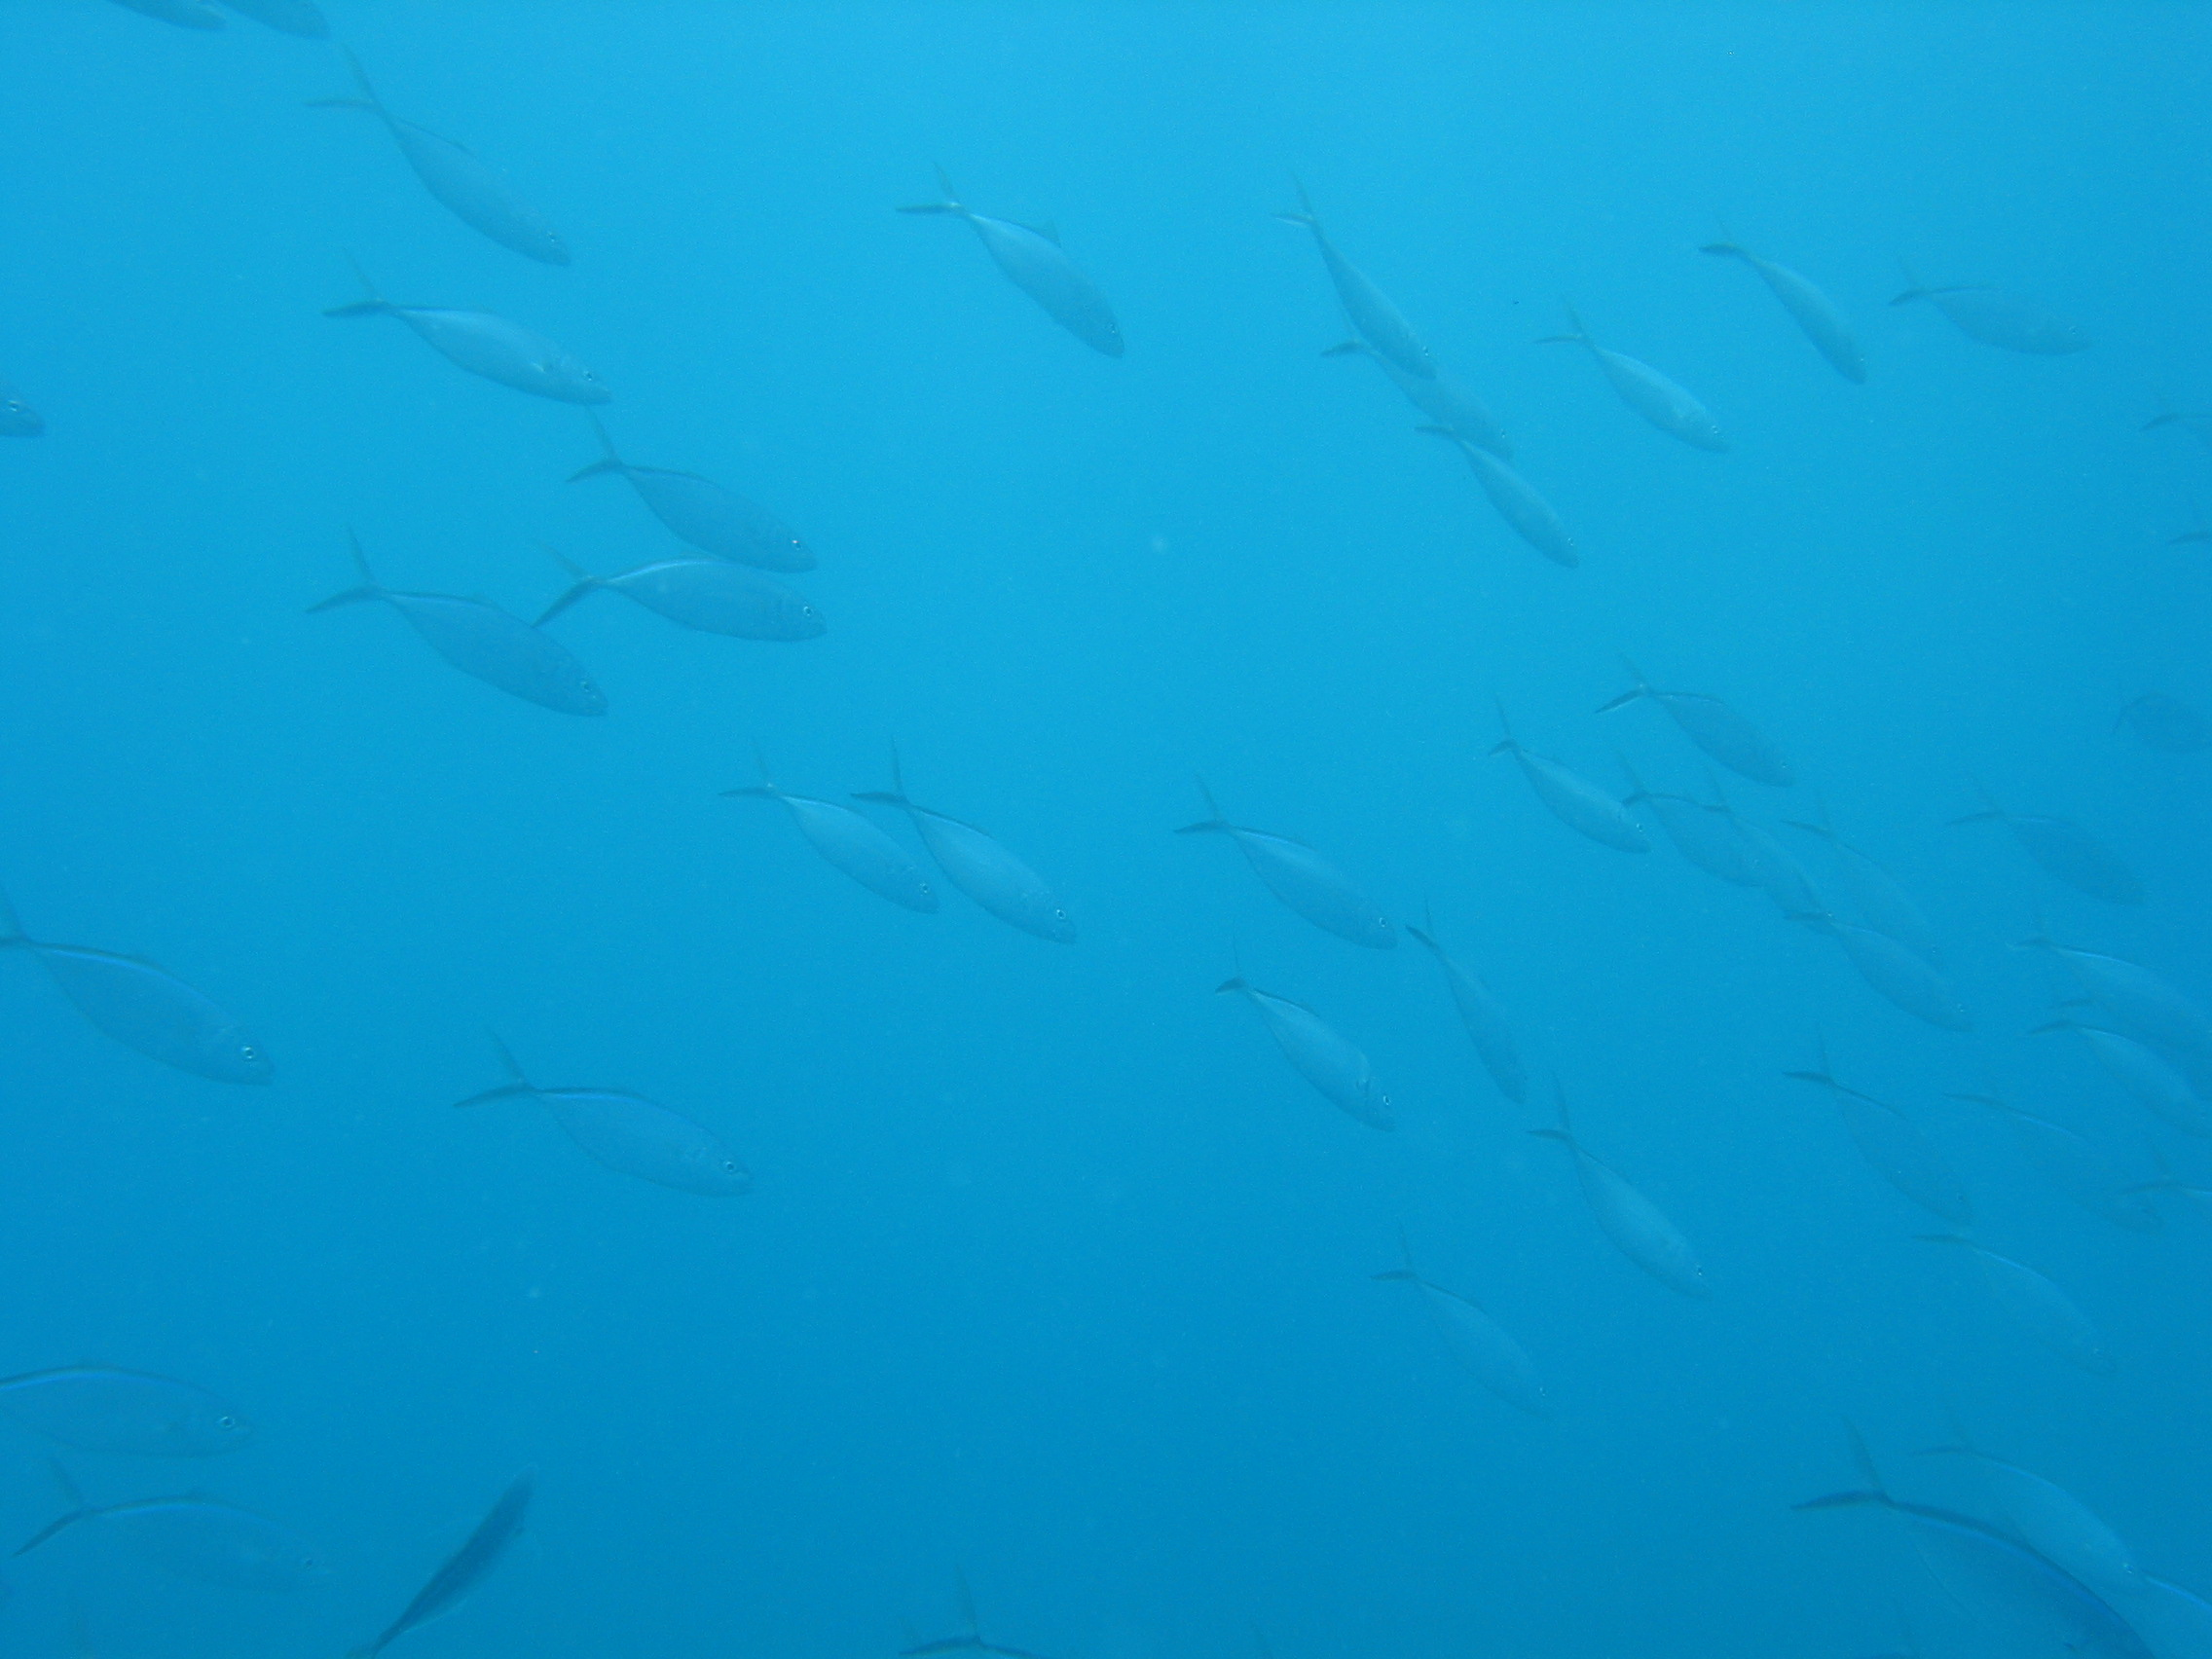
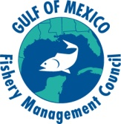
International Circle Hook Symposium
Miami, FL
May 4-6, 2011

Slide 2
In addition to the U.S.: 17 nations:
Australia, Brazil, Canada, China,
Colombia, Costa Rica, Ecuador,
Guatemala, Italy, Mexico, Morocco,
Nicaragua, Portugal, Spain,
Taiwan, Thailand and Uruguay

Slide 3
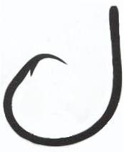
49 oral presentations and 30 posters
Most talks focused on the commercial long-line tuna
industry
Included pelagic long-lines and turtle interactions
Few talks on swordfish, reef fishes, tarpon, and sharks
Special Symposium Edition of the Bulletin of Marine Science

Slide 4
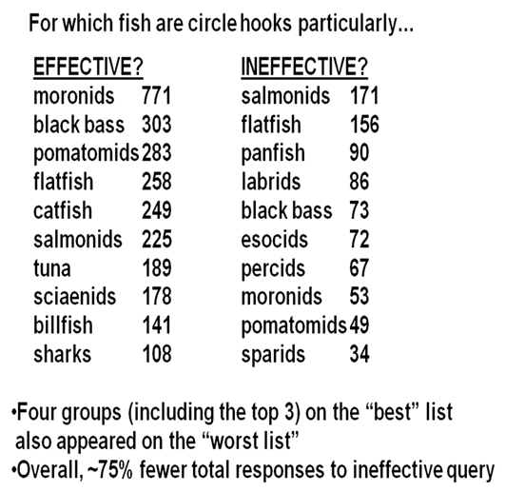

Slide 5
Conclusion:
It Depends
?

Slide 6

J and Circle Hooks
J Hook Zero Offset Circle Hook

Slide 7
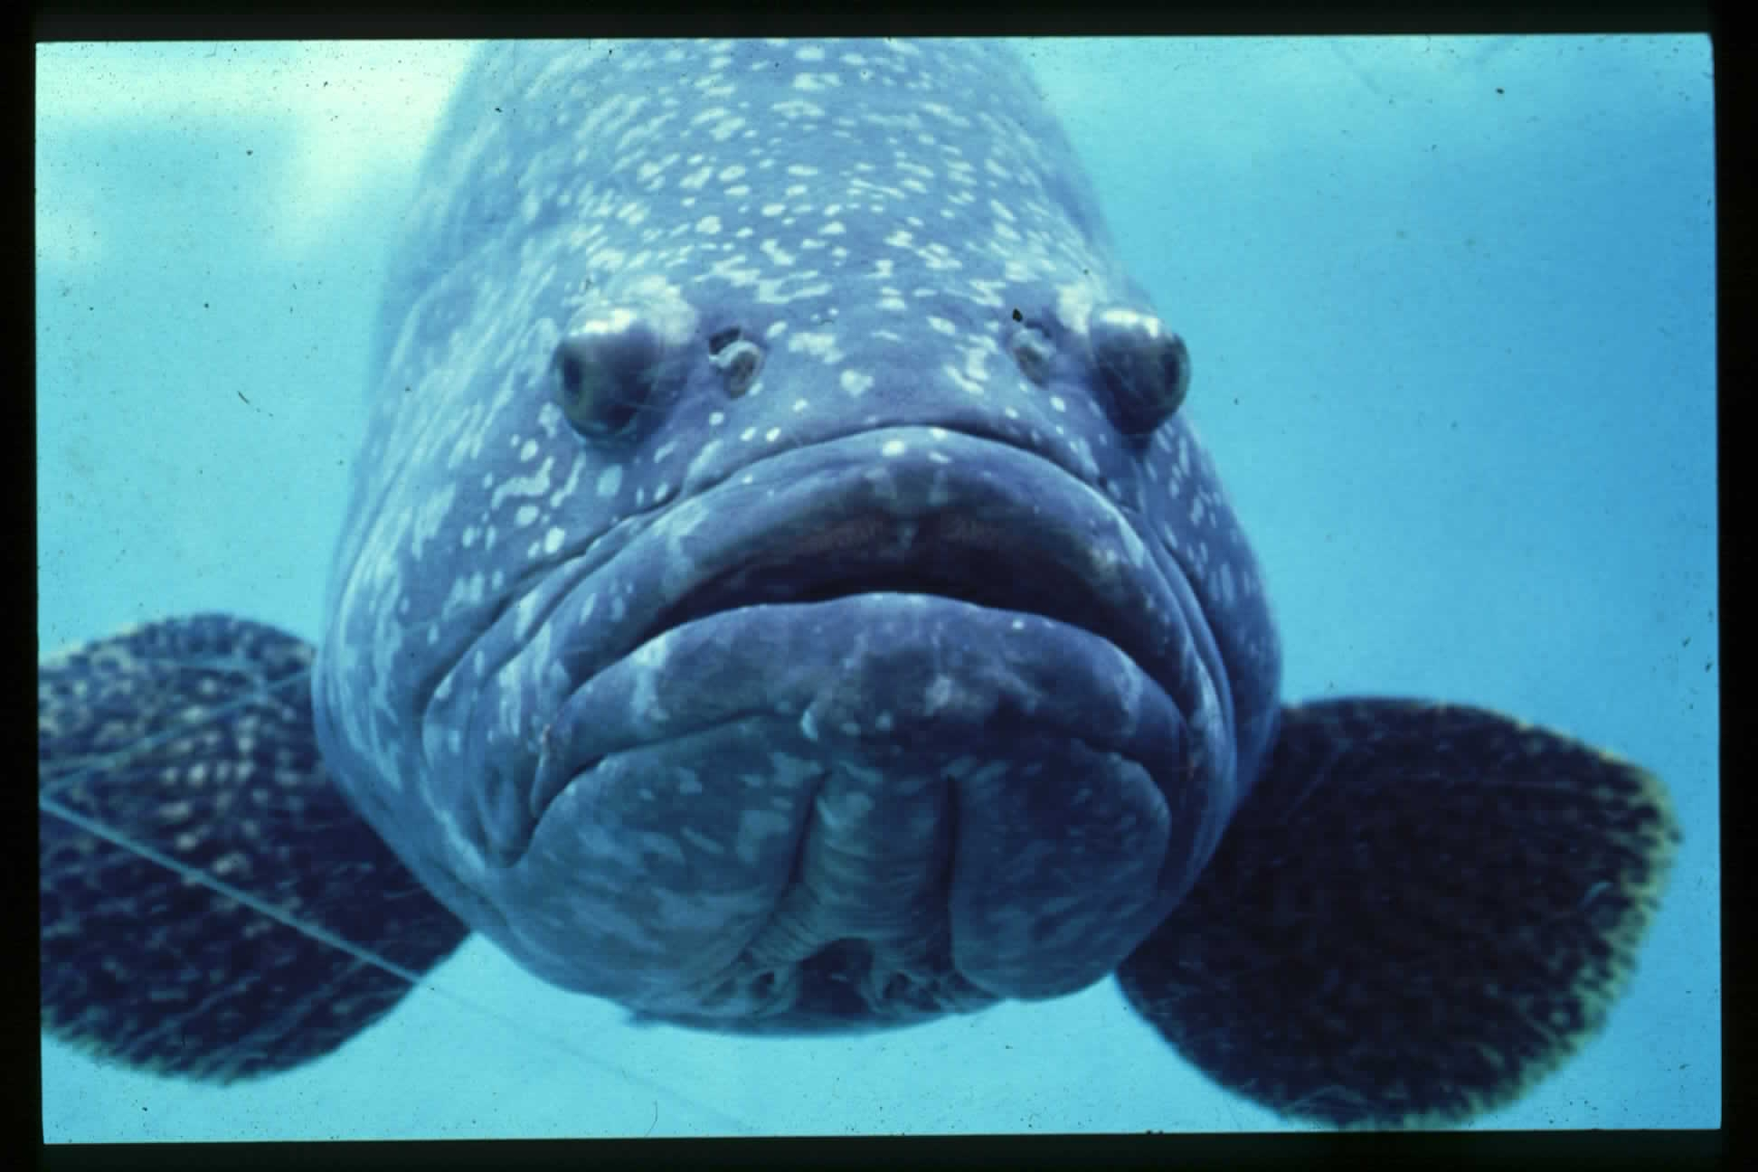
Think
Ecomorphology

Slide 8
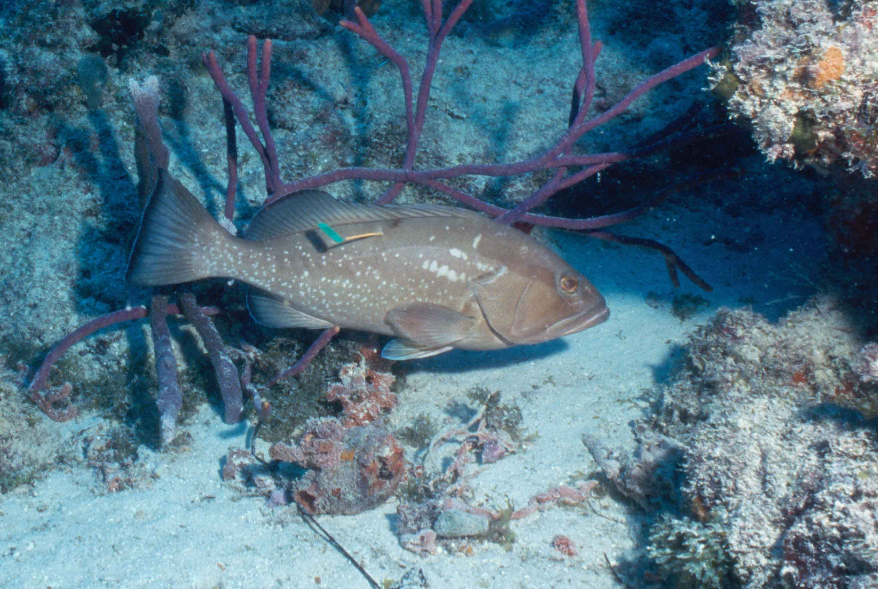
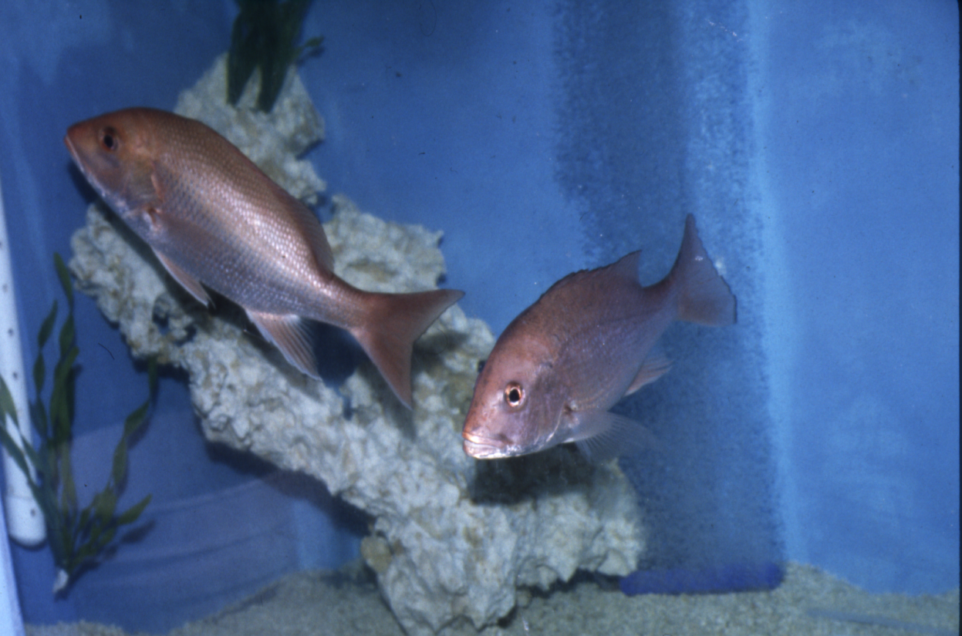
Red grouper
Epinephelus morio
Photo credit: Atlantis, FL Keys
Red snapper
Lutjanus campechanus

Slide 9
Methods: Hook Mortality
Necropsy: Acute Mortality & Latent Mortality Specimens
J & Circle Hooks
Dentition & Jaw Morphology
Fish Feeding Videos

Slide 10
Shipboard Acute Mortality

Slide 11
Red grouper have a low hook mortality
because most red grouper are jaw hooked

Slide 12
Mortality Effects Determined by Necropsy
Depth Hook Other

Slide 13
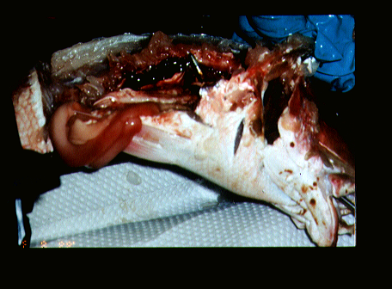
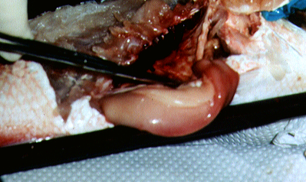
Acute and Latent Hook Mortality in Red Snapper
Acute
Latent

Slide 14
Reef Fish Study Area

Slide 15
Number of Tagged and Recaptured Fish
Number of Fish

Slide 16
Differences in J and Circle Hook Recaptures
Species | J hook tagged | J hook recap | Circle hook tagged | Circle hook recap | G-test p values
Red Grouper | 3,935 | 287 | 863 | 121 | 4.49 x 10⁻⁸
Red Snapper | 2,145 | 269 | 3,172 | 258 | 2.3x10⁻⁶

Slide 17
Red Snapper Recaptures by Depth
Water Depth ≤ 27.4 m
J | 1,660 | 220 | 13.3
Circle | 1,437 | 185 | 12.9
Water Depth > 27.4 m
J | 585 | 49 | 8.4
Circle | 1,765 | 71 | 4.0

Slide 18
Recaptures by Hook Type
Percent Recapture

Slide 19
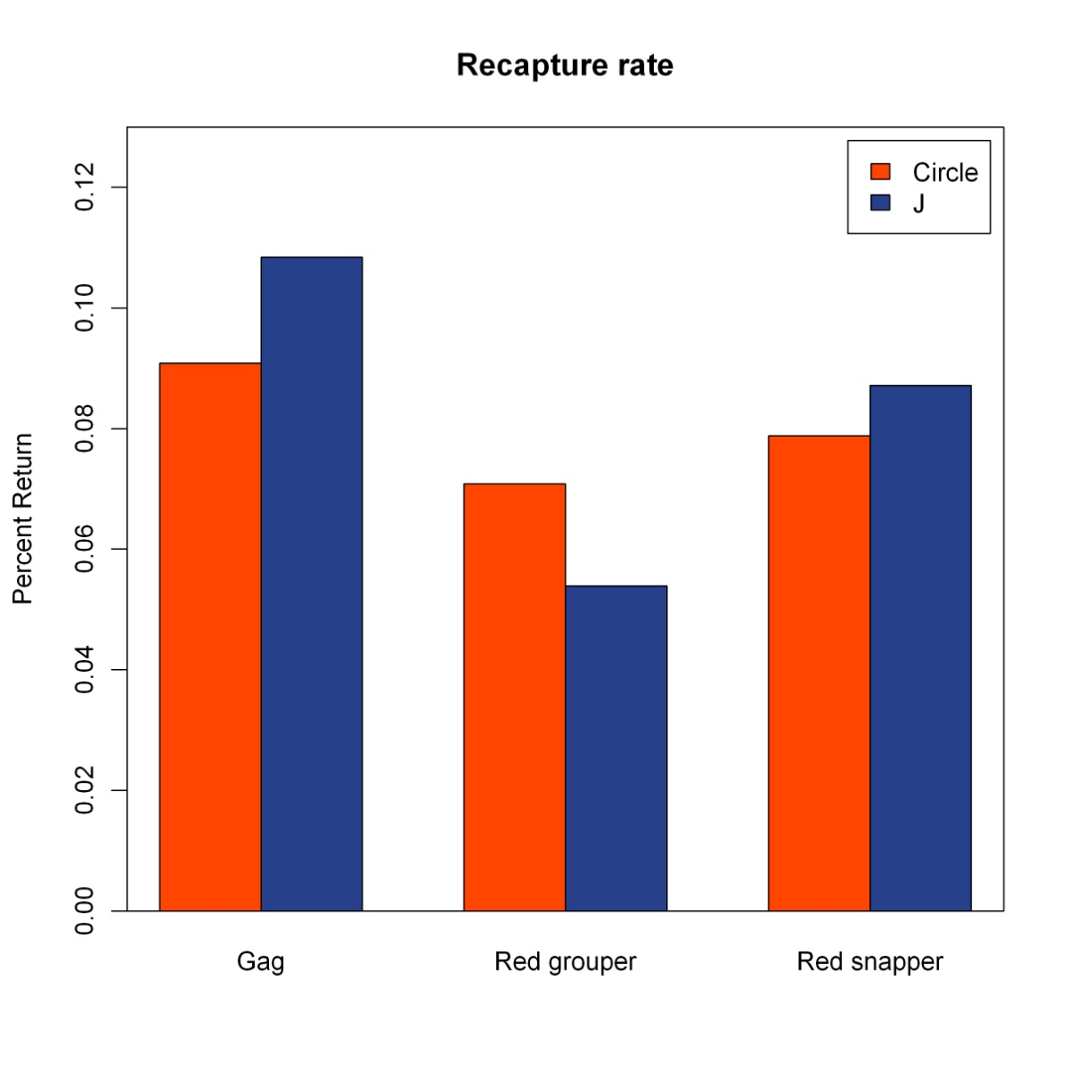
Recaptures from Circle vs J Hooks
Species | Hook Type | Tagged (n) | Recapture (n) | Recapture %
Gag | Circle | 1,024 | 93 | 9
 | J | 3,183 | 345 | 11
Red Grouper | Circle | 2,160 | 153 | 7
 | J | 8,381 | 452 | 5
Red Snapper | Circle | 3,630 | 286 | 8
 | J | 5,129 | 447 | 9

Slide 20
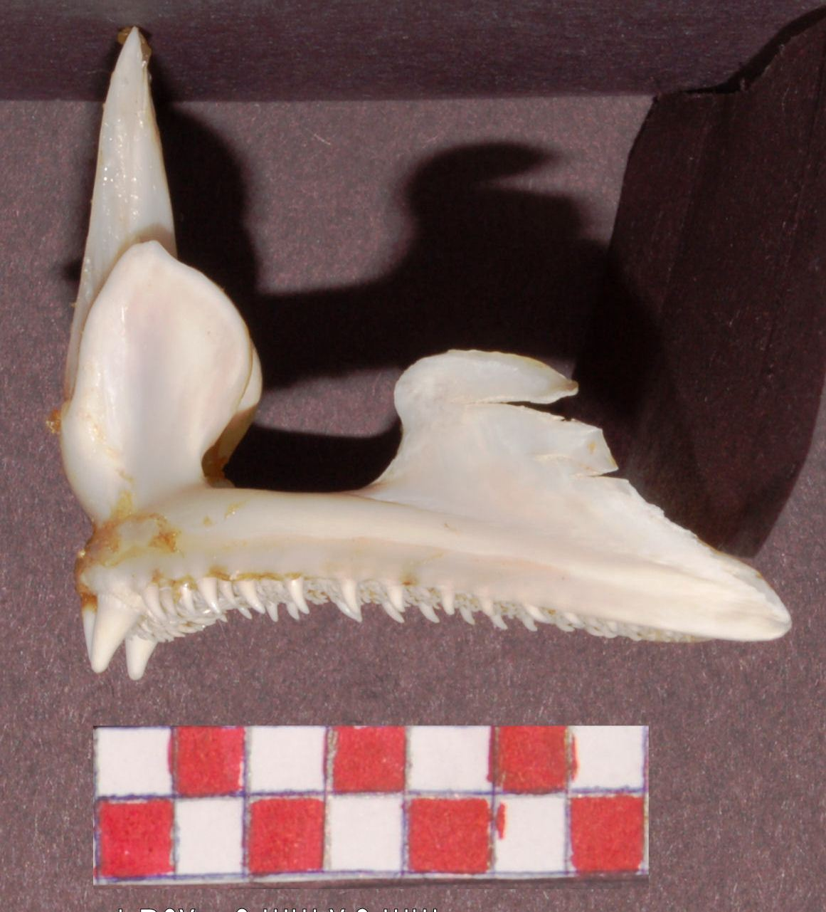
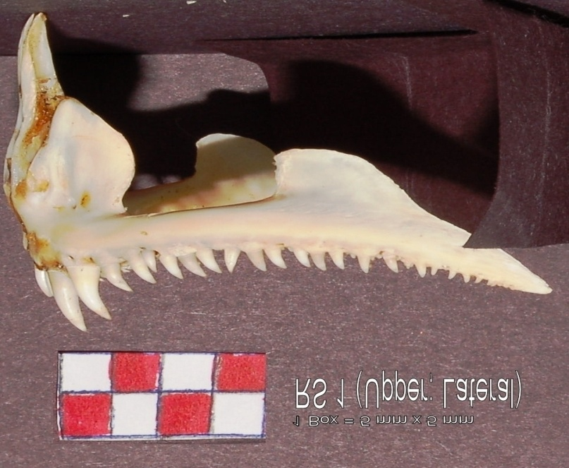
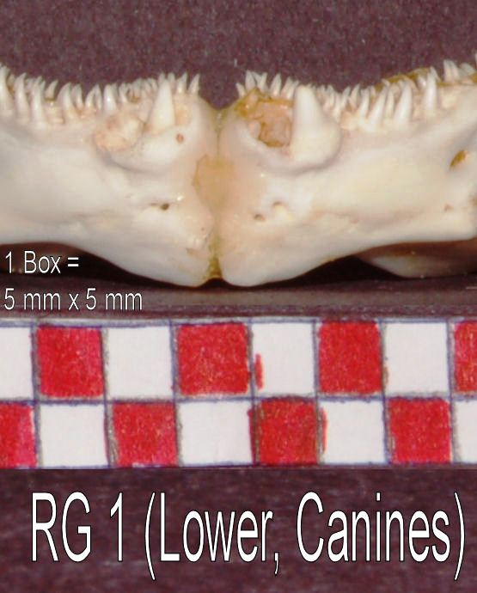
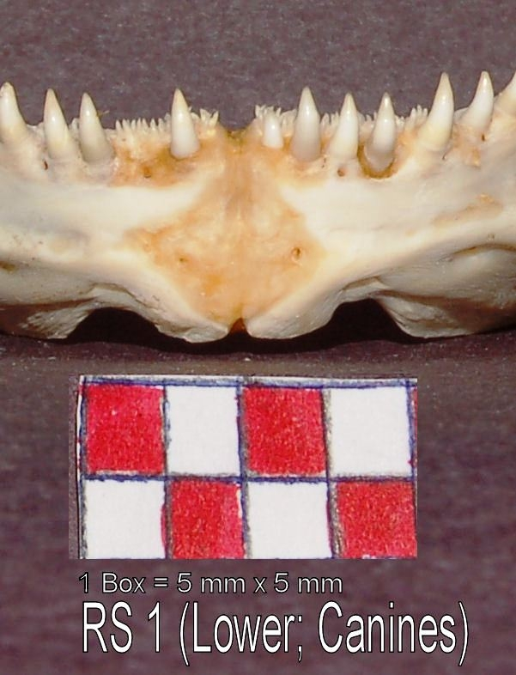
Dentition
Red
Grouper
Red
Snapper

Slide 21
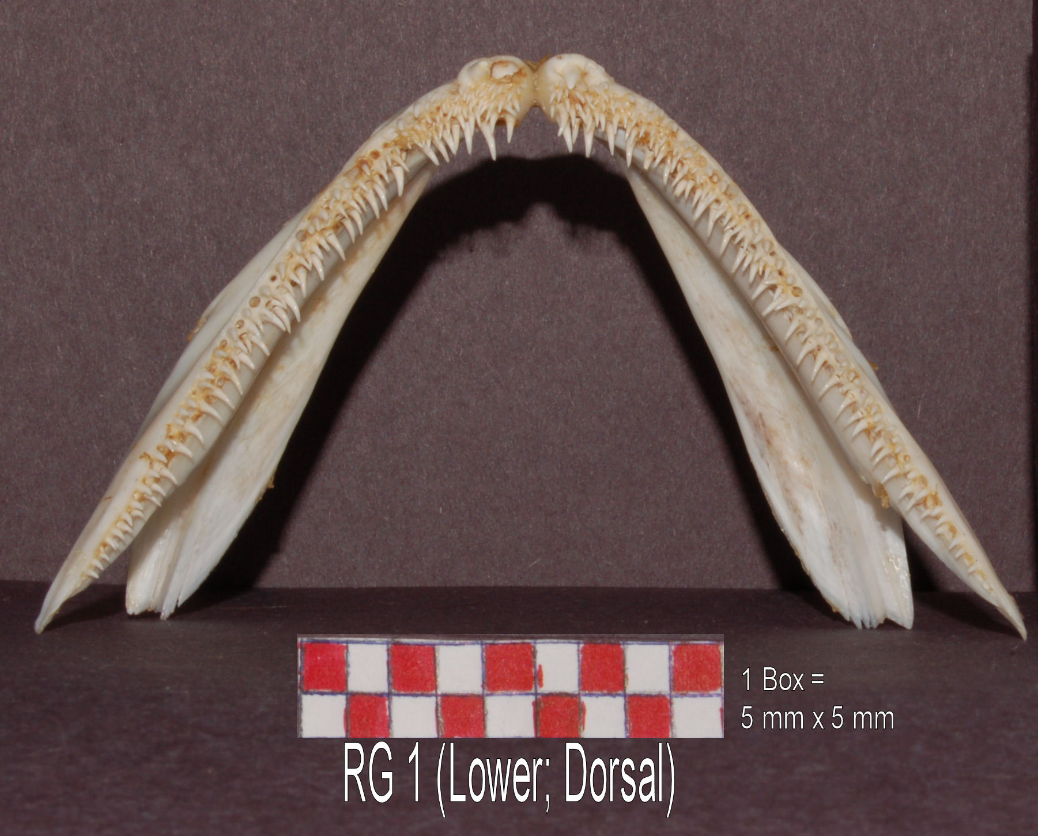
Red Grouper Lower Jaw Dorsal View

Slide 22
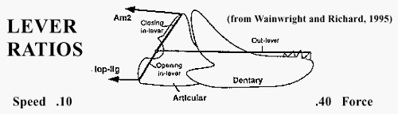
Closing & Opening Jaw Lever Ratios:
 | Red Grouper | Red Snapper
Closing in lever = distance from QM to AMM Out-lever distance | .17 | .32
Opening in lever = distance from QA to IL Out-lever distance | .24 | .22
QM = Quadrato-mandibular joint
AMM = Adductor mandibular muscle
IL = Interopercular ligament

Slide 23
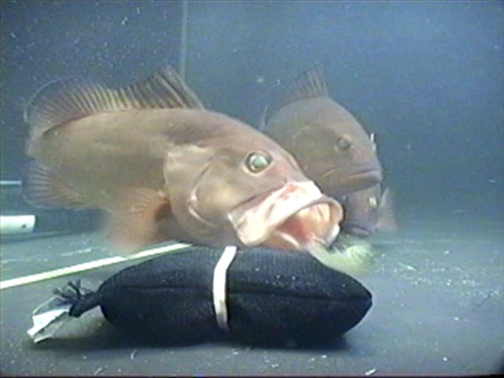
Red Grouper Exhibiting Suction Feeding

Slide 24
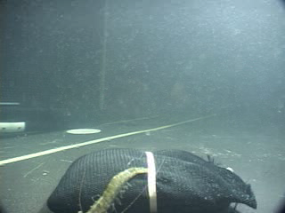

Slide 25
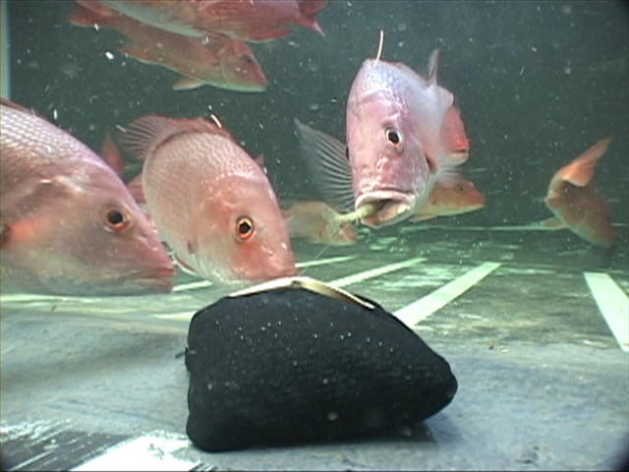
Red Snapper Exhibiting Biting Feeding

Slide 26
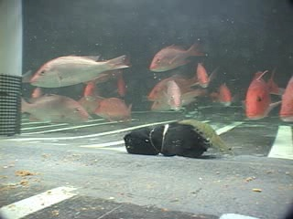

Slide 27
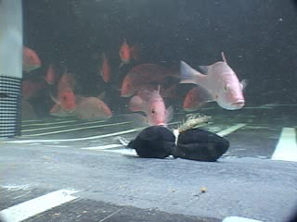

Slide 28

Prey residence time in fish’s mouth
Species |  | SE
Red Grouper | 6.62 | 0.419
Red Snapper | 3.74 | 0.289
t test mean value: p=<0.001

Slide 29
 | Red Grouper | Red Snapper
Dentition | Small, backward pointing | Larger, fewer, spacing
Lever Ratios | Faster | Stronger
Residence Time | Long | Short
Percent Recapture

Slide 30
Effect of circle hook size on reef fish catch rate,
catch composition, and size distribution
in the northern Gulf of Mexico recreational fishery
William F. Patterson, III, Andrew J. Strelcheck
and Clay E. Porch

Slide 31
5/0, 9/0, 12/0, or 15/0 Mustad circle hooks
Only 5/0 hooks produced deep hooking
in the gills or esophagus

Slide 32
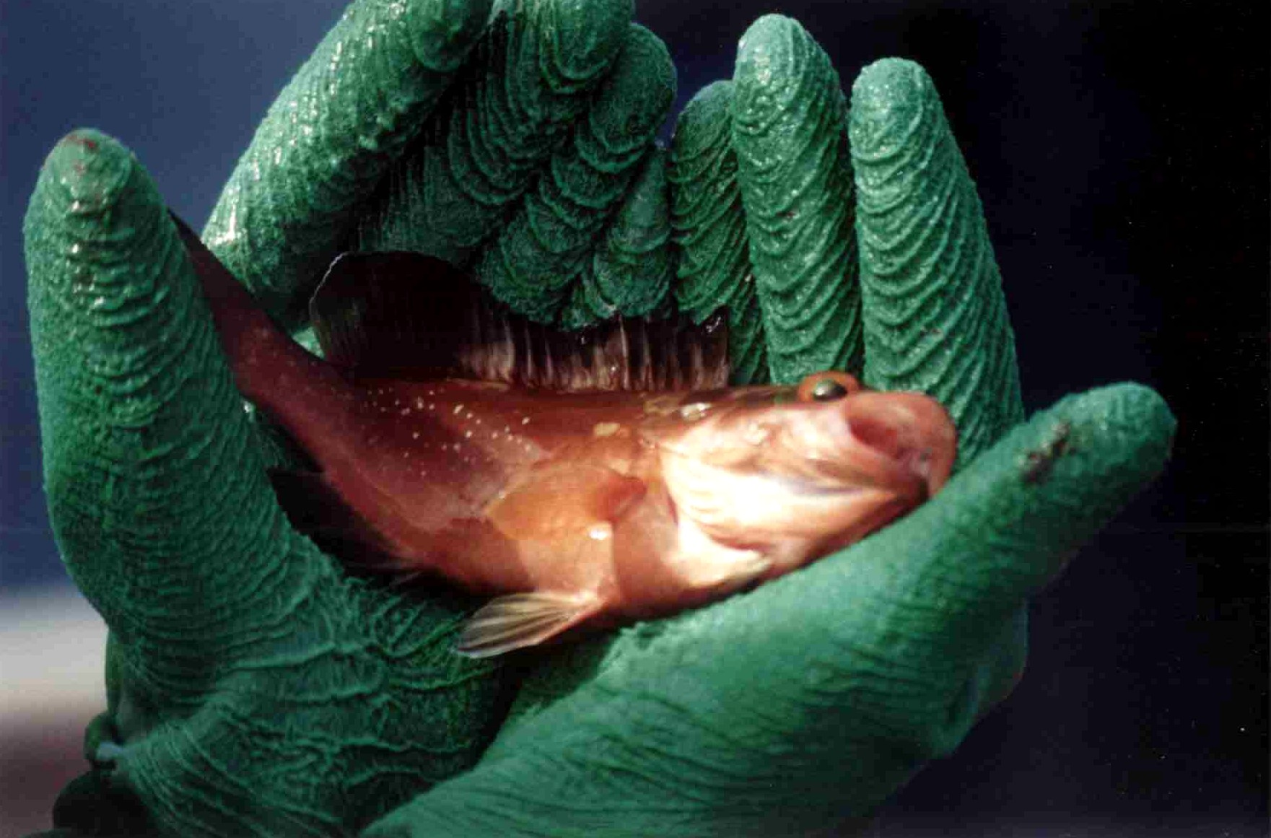
Red Grouper Caught Aboard a Headboat

Slide 33
“Overall, catch rate declined with increasing hook size for all reef fishes combined, but not for red snapper. …. Hook size could be regulated to affect selectivity, but tradeoffs may be diminished catch rates for some species, as well as a decline in numbers of species caught, with increasing hook size.”

Slide 34
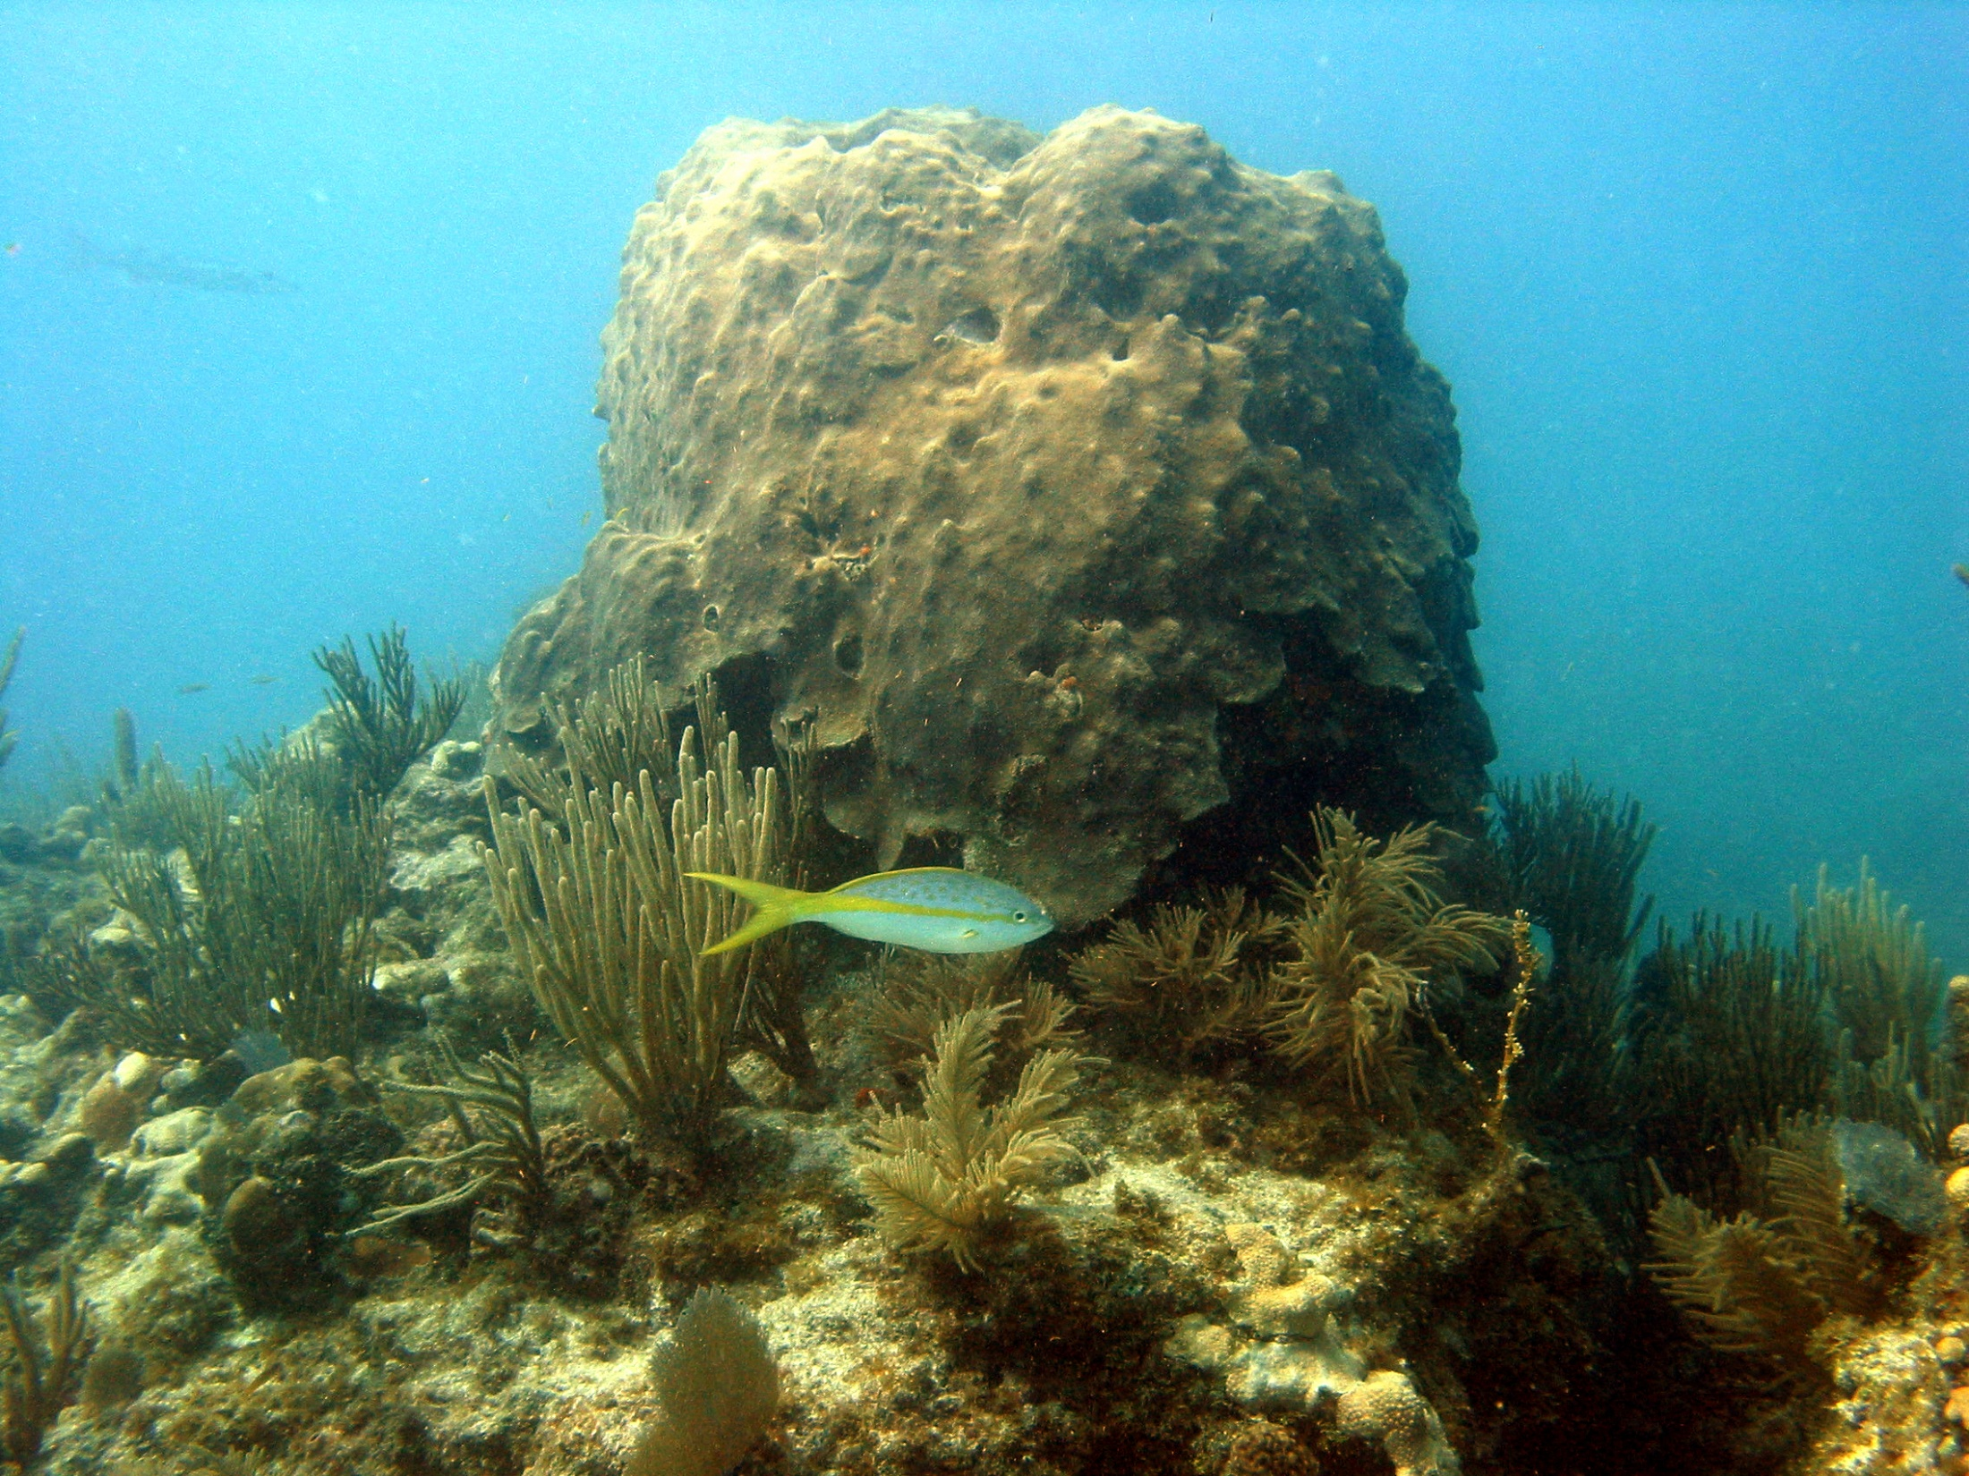

Slide 35
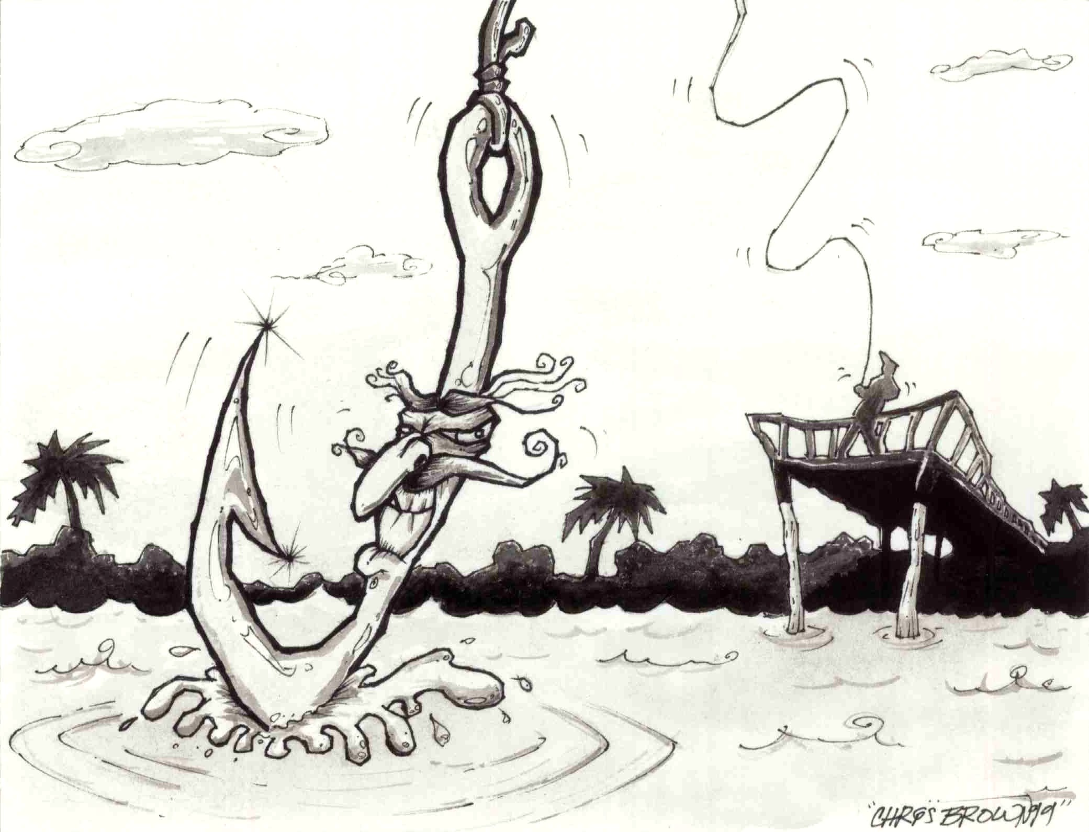
Hook mortality:
Varies by species
Influenced by eco-morphology and hook type and size

Slide 36
Regulations requiring the use
of circle hooks may be ineffective
in enhancing survival and may
even be detrimental if hook size is
not specified.
Hook size varies by manufacturer.

Slide 37
Acknowledgement of Help from A Cast of Thousands
NOAA/NMFS MARFIN & CRP Programs
Florida Sea Grant
Southern Offshore Fishing Association
Florida Offshore Anglers
Florida Sports Fishing Association
Fishermen’s Environmental Fund
All Participating Fishers, Researchers,
Student Interns
Eagle Claw

