Slide 1
Evaluating the Efficacy of Descender Devices in Increasing the Survival of Deepwater Groupers Using Telemetry
Brendan J. Runde* & Jeffrey A. Buckel
North Carolina State University, 303 College circle, morehead city, nc

Slide 2

Acknowledgements
P. Rudershausen,
J. Krause,
C. Luck,
R. Lyon,
UNCW R/V Cape Fear,
SeaQualizer,
N. Wegner,
J. Curtis,
C. Conroy.

Slide 3
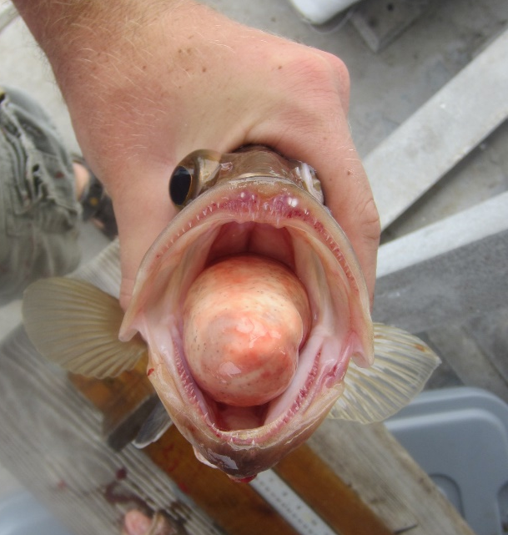
Discards and trauma – overall trends
Reasons for discards – regulations
Size limits
Bag limits
Seasonal closures
Total closures
Potential causes of injury → mortality
Exhaustion or fatigue
Water column predators
Barotrauma
Immediate mortality is easier to determine – severe injuries, floating
Delayed is difficult – better estimates needed in US southeast
Regulations
Discards
Time
Photo: Personal

Slide 4
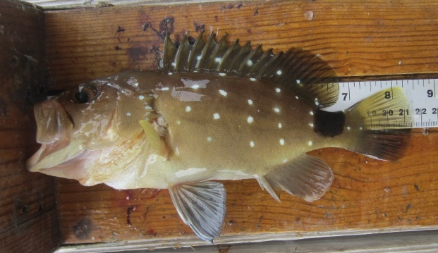
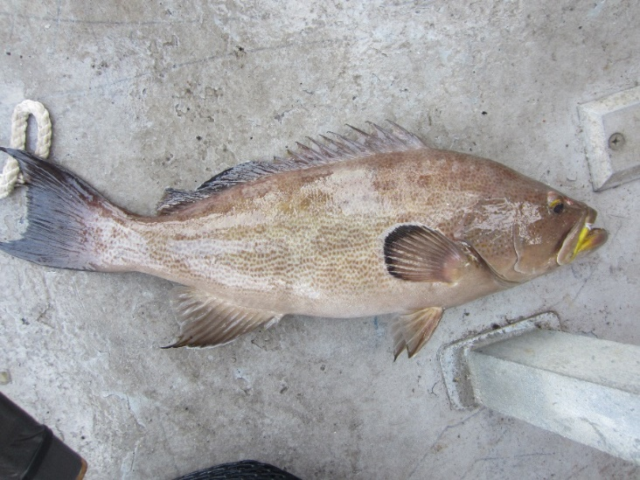
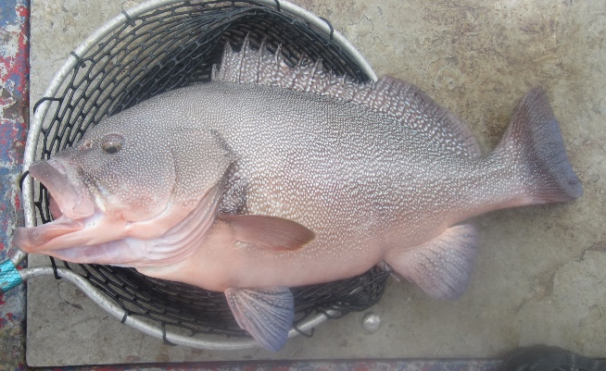
Deepwater groupers
Snowy grouper
Deeper water → severe barotrauma
  Higher discard mortality rates (near 100%)
  Some regulations reflect this rate
    e.g. no size limit for snowy grouper
Can we increase survival by forced recompression using a descender device?
Scamp
Speckled
hind
Photos: Personal, Pat Lyon

Slide 5
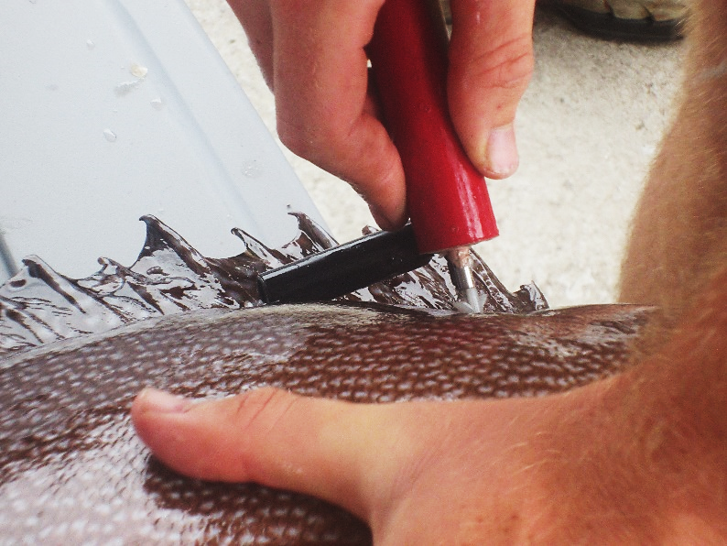
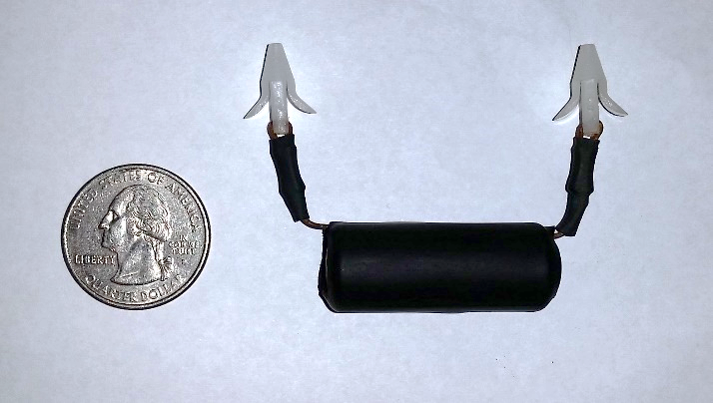
Acoustic telemetry methods
Conventional tagging would not be effective – low sample sizes
V13AP tags record acceleration and depth
  Behavior → proxy for fate (survival or death)
External attachment to avoid venting, long deck time, anesthesia
Photos: Personal, Pat Lyon

Slide 6
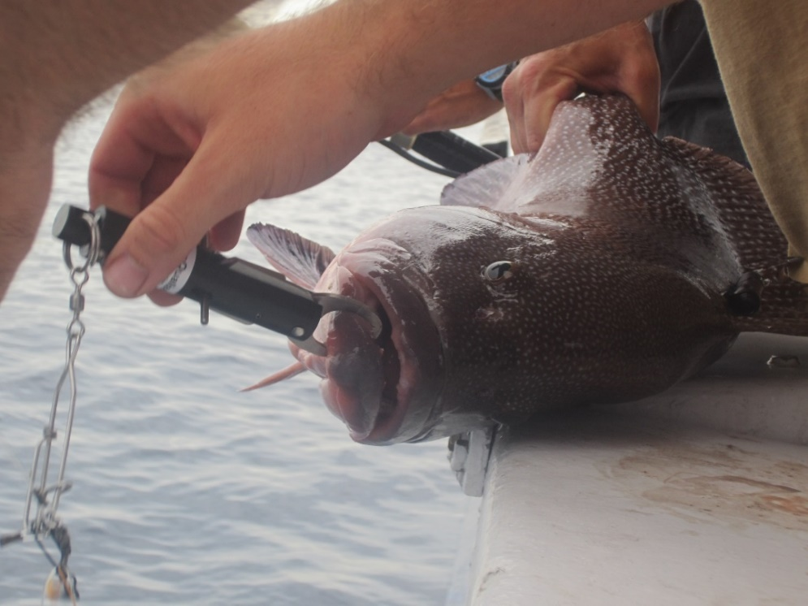
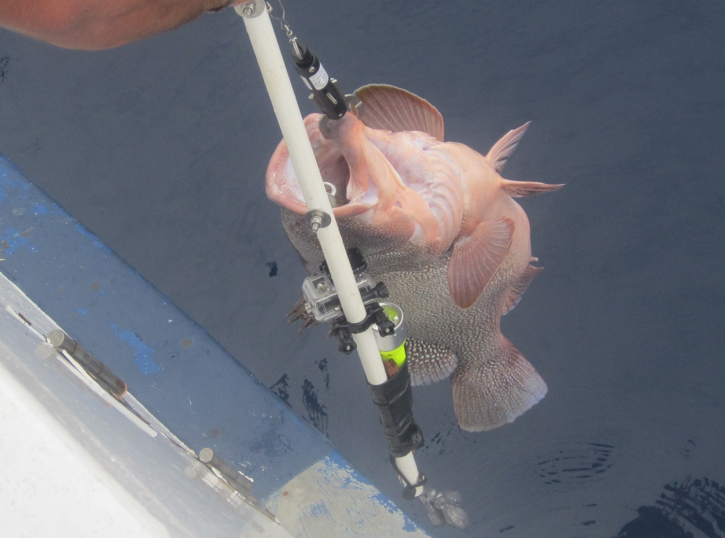
Recompression – SeaQualizer
Transmitter
SeaQualizer
Lead weights
Device attached to lower jaw
Weighted rig lowered into ocean
Photos: Personal, Pat Lyon

Slide 7


Slide 8
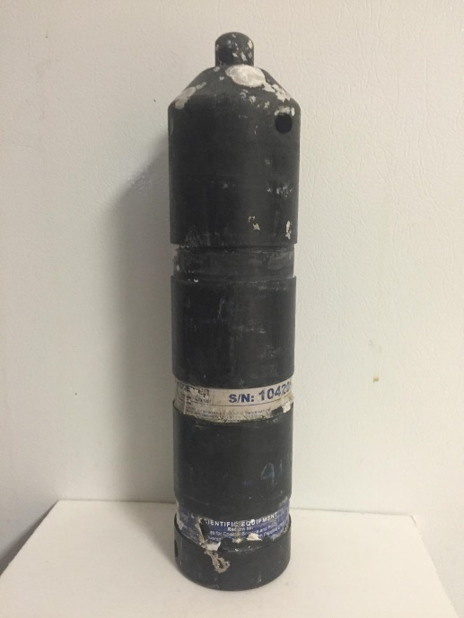
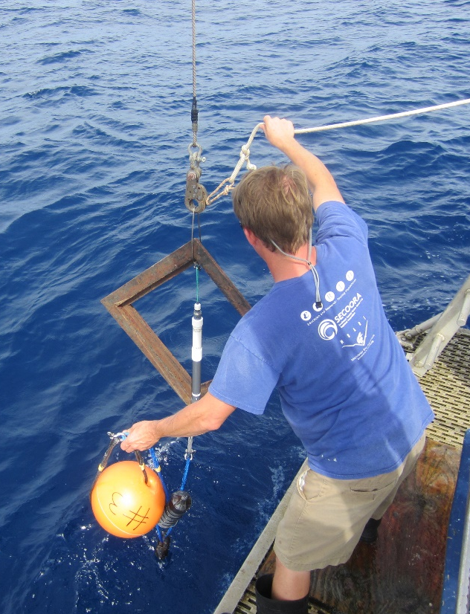
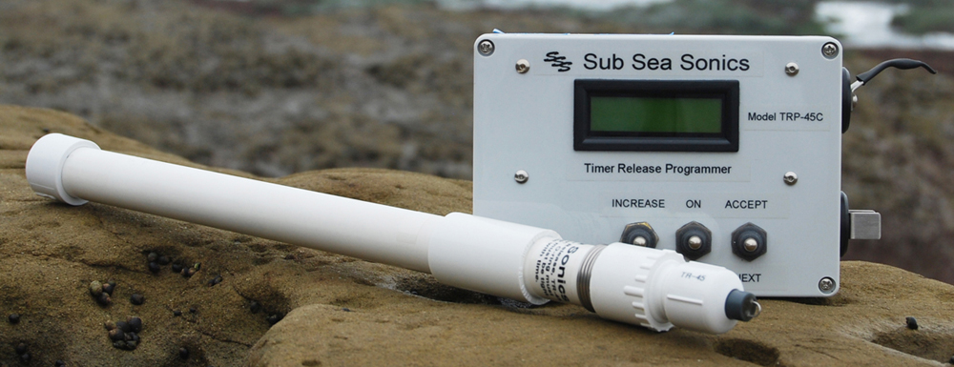
Acoustic receiver deployment
VR2W receivers moored to SubSeaSonics acoustic releases (AR-50-AA)
Moorings retrieved by signaling acoustic release
on September 30, 2015 (44 day study)
Photos: Personal, subseasonics.com

Slide 9
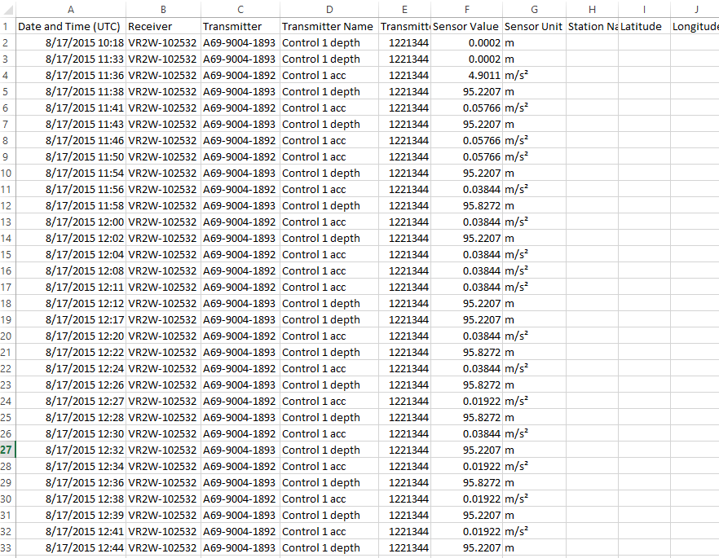
60,000 detections over 44 days

Slide 10
Kaplan-Meier Survivorship Procedure
All individuals are considered one of the following:
At risk (still alive)
Censorship (not enough data)
Mortality
Some individuals pose problems – unable to be certain about fate

Slide 11
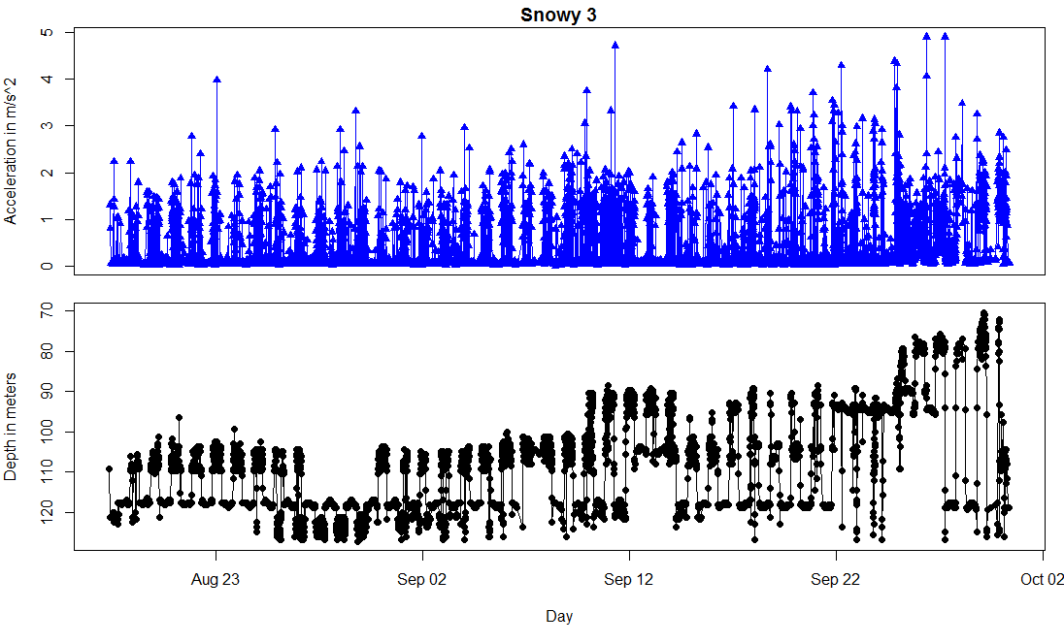
Dead or alive?

Slide 12
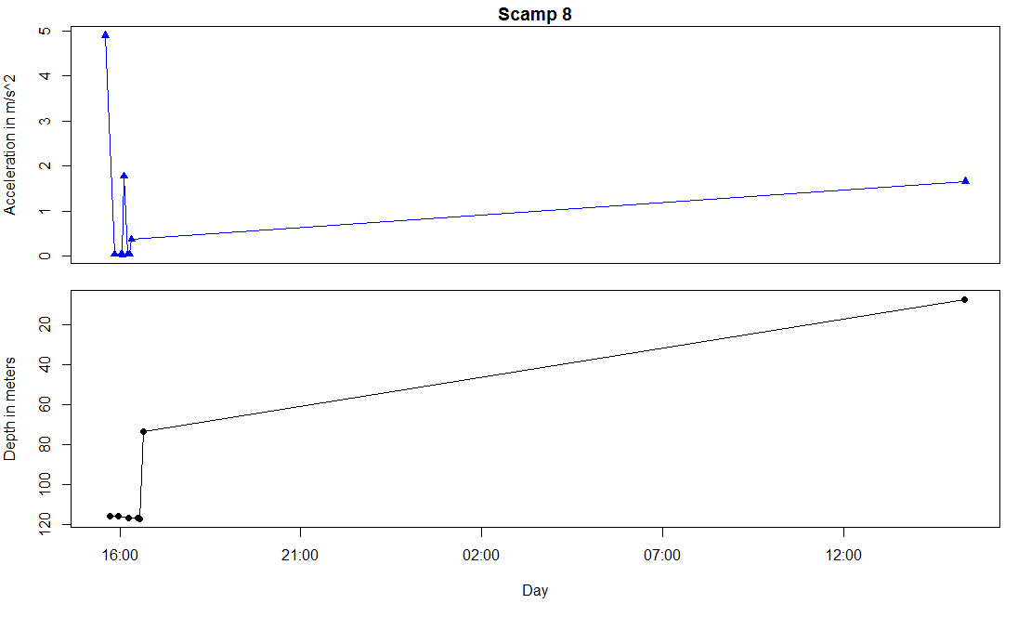
Dead or alive?

Slide 13
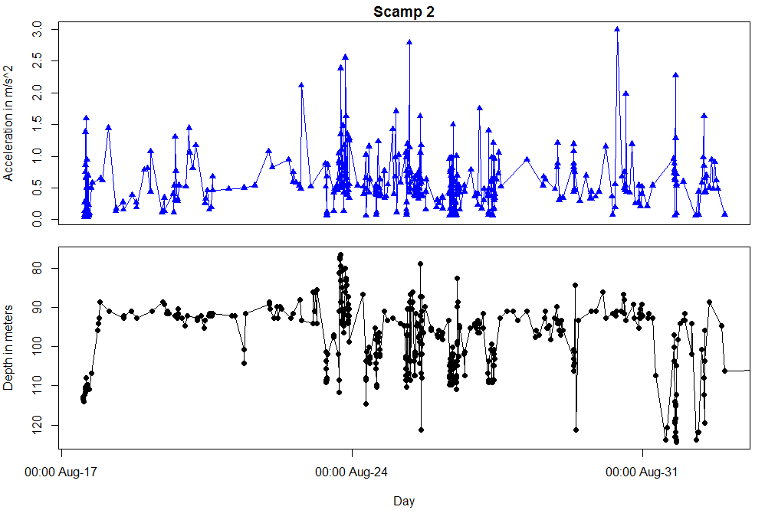
Dead or alive?

Slide 14
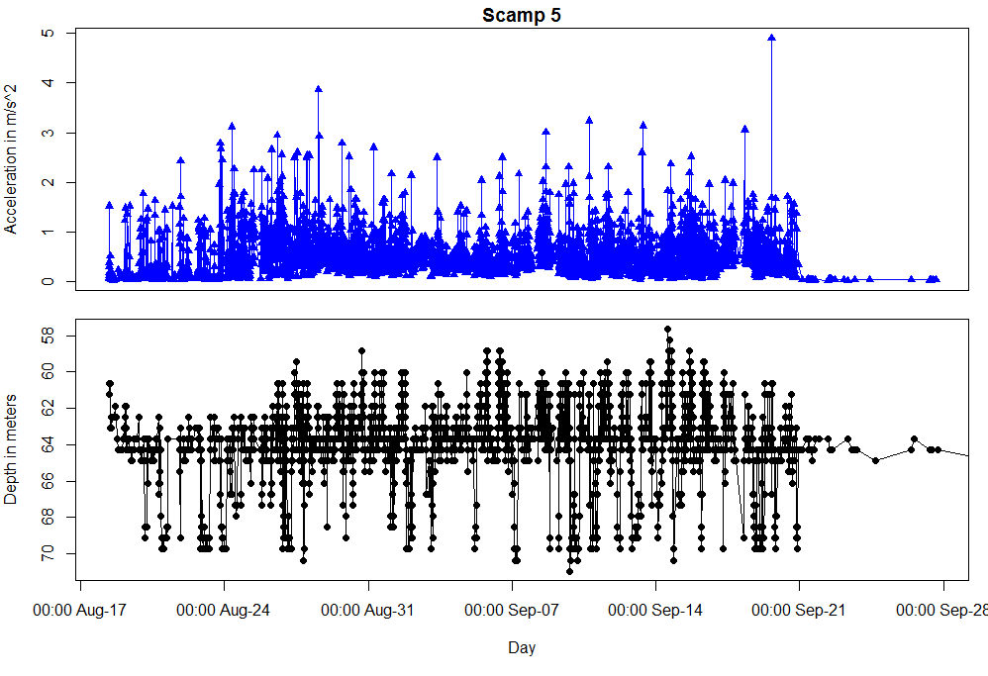
Dead or alive?
Tag stops moving

Slide 15
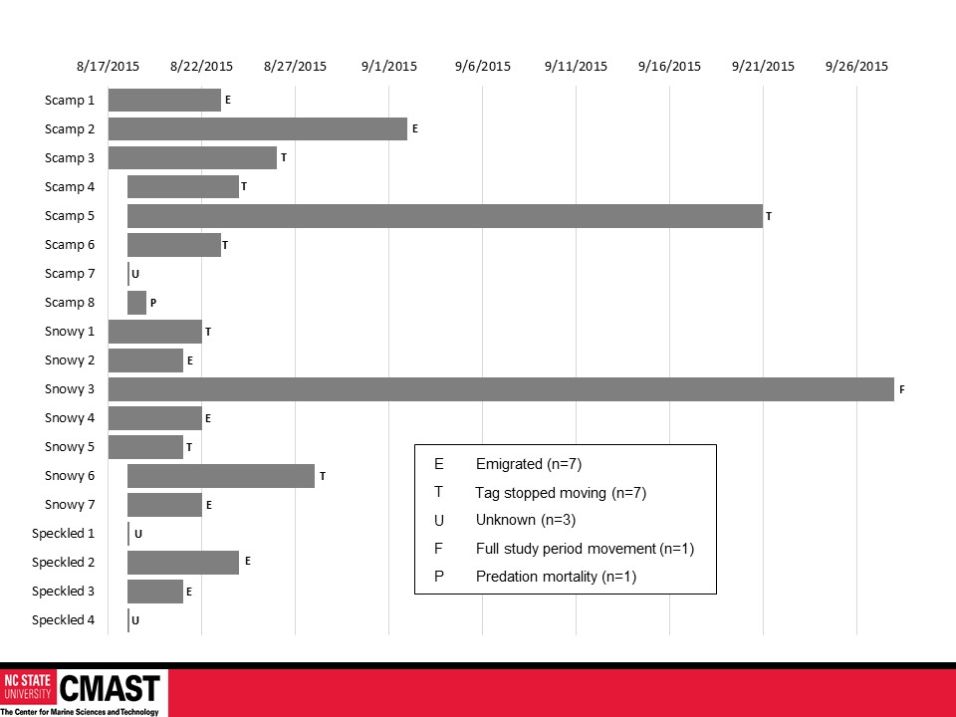
E
Emigrated (n=7)
T
Tag stopped moving (n=7)
U
Unknown (n=3)
F
Full study period movement (n=1)
P
Predation mortality (n=1)

Slide 16
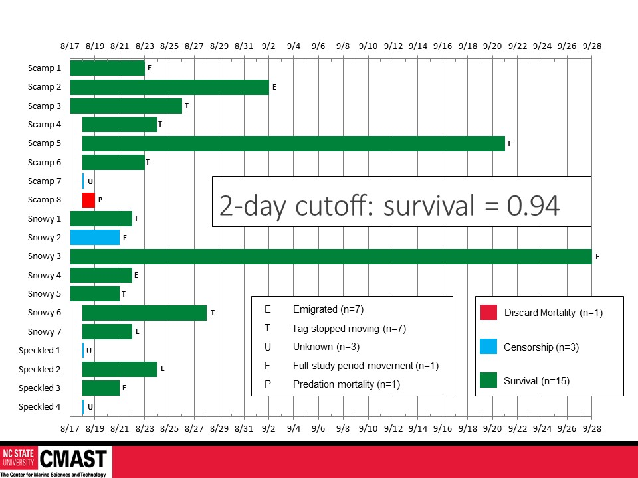

Slide 17


Slide 18
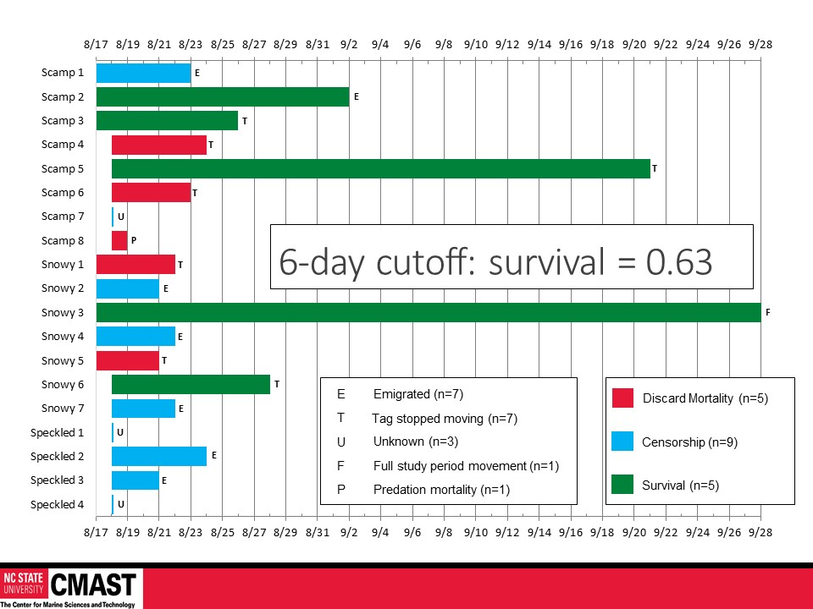

Slide 19
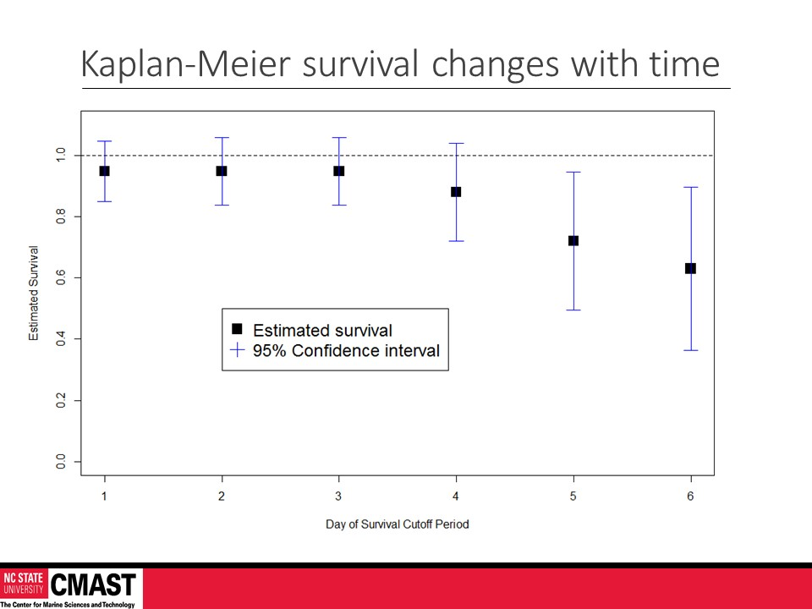

Slide 20
Conclusions
Recompression appears to promote survival
Management implications
  Gear requirements in regulations not unprecedented
    Circle hooks, dehooking tools, venting
Future work
  SK grant proposal to repeat study with control group
  More transmitters, more receivers – try to detect fish for longer periods (fewer emigrations)
  Address tag shedding vs discard mortality in 2 ways

