Slide 1
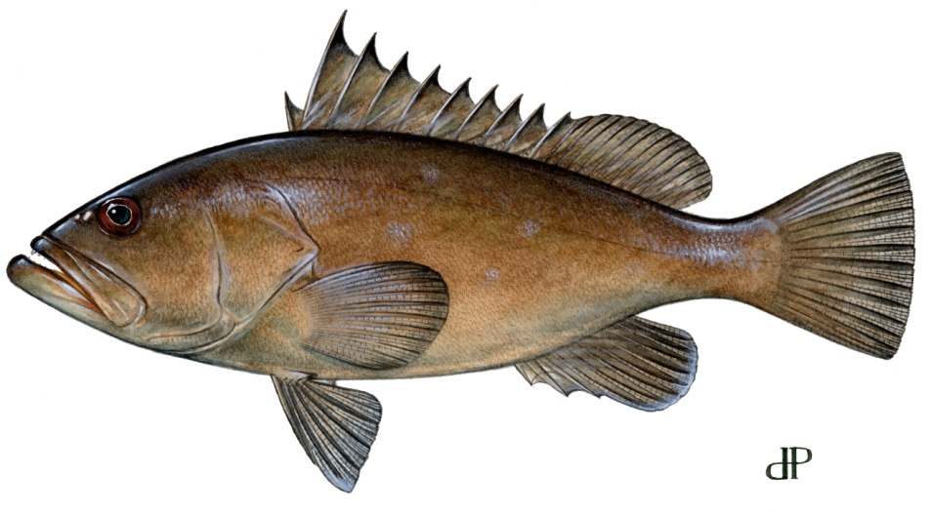
Regulatory Amendment 11
Speckled Hind and Warsaw Grouper Catch Data
Southeast Regional Office
St. Petersburg, Florida
Images: Diane Rome Peebles © 1992

Slide 2
Reg. Amendment 11
May adjust regulations implemented by Amendment 17B to alleviate social and economic impacts while maintaining reduced bycatch of speckled hind (SH) and warsaw grouper (WG).
Questions:
What data are available?
Where are they caught (areas & depths)?
What species are caught with them?

Slide 3
Analytical Challenges
Limited fishery-independent sampling
Few data available prior to 1992, no area or depth info.
Post-1992 data biased by:
Prohibition of sale
Limited discard information
Lack of depth-specific, spatially-resolved data
Disproportional effort (limited >240 ft)
Ontogenetic shifts in life history (habitat, depth)

Slide 4
Data Source | Years | Spatial Resolution | Discard Info | Depth Info
Commercial Logbooks | 2001-2009 | 1° X 1° area | 20% of records | 2005-present
Headboat Logbook | 1973-2009 | Variable; broad to 0.17° X 0.17° | 2004-present | None
Reef Fish Observer Program | 2006-2009 | Lat/Long (limited samples) | Yes | Yes
MARMAP | 1977-2009 | Lat/Long (limited samples) | Yes | Yes
ALS | 1962-2009 | State Sub-Regions | No | No
FL Trip Ticket | 1986-1992 | State Sub-Regions | No | No
GA & SC Trip Ticket | 1989-2009 | State Sub-Regions | No | No
NC Trip Ticket | 1994-2010 | State Sub-Regions | No | No

Slide 5
WHERE ARE THEY CAUGHT?
All Observations, Pooled Across Data Sources

Slide 6
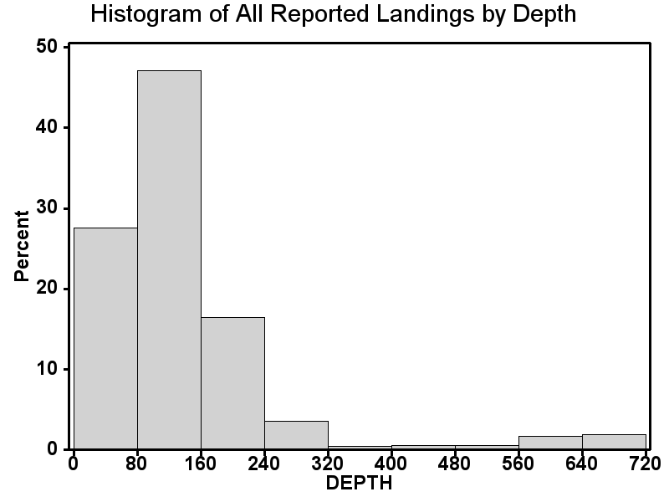
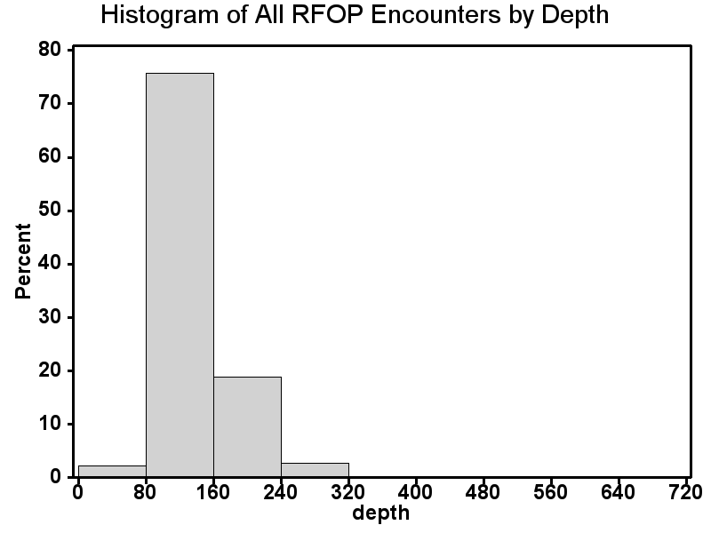
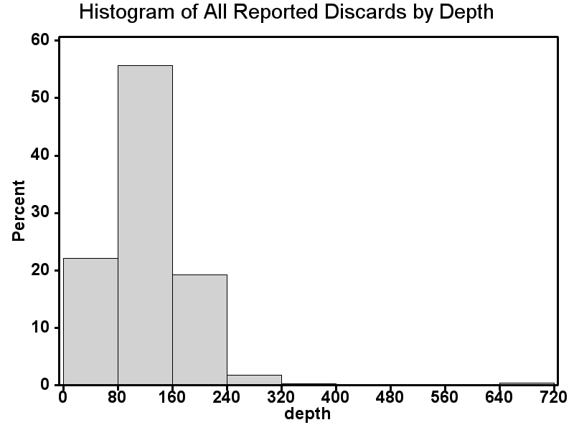
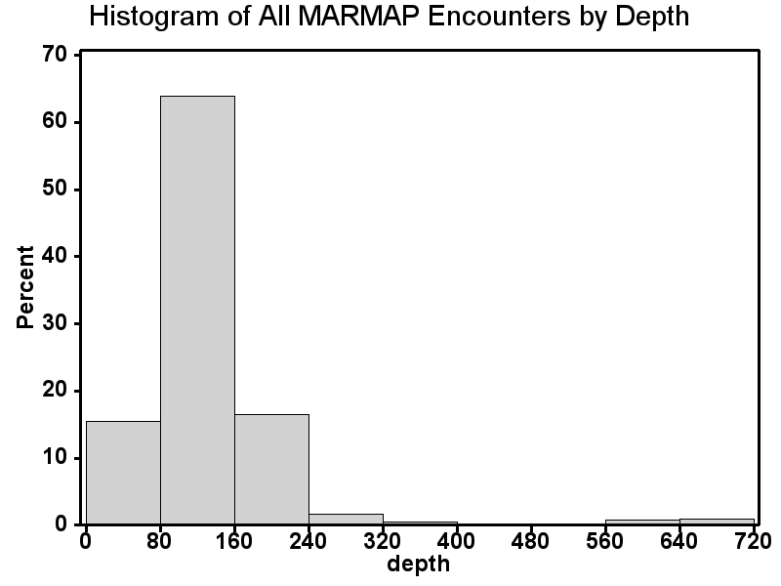
WHERE ARE THEY CAUGHT?
Available data sources are biased towards depths <240 ft:
Commercial Logbook
(N=844,748)
Reef Fish Observer
(N=18,299)
Discard Logbook
(N=17,085)
MARMAP
(N=25,346)
χ² / Fisher Exact Tests: Encounters of SH and WG are deeper than would be expected by sampling program’s depth distribution.

Slide 7
Where are they caught? (Depth)
Infrequent observations of speckled hind (0-640 ft) and warsaw grouper (80-480 ft).
Encounters more likely deeper than 160 ft.
Analysis confounded by:
Biased Sampling (area, depth, gear, self-reported)
1992 Harvest Prohibition
Ontogenetic Migration
Rarity

Slide 8
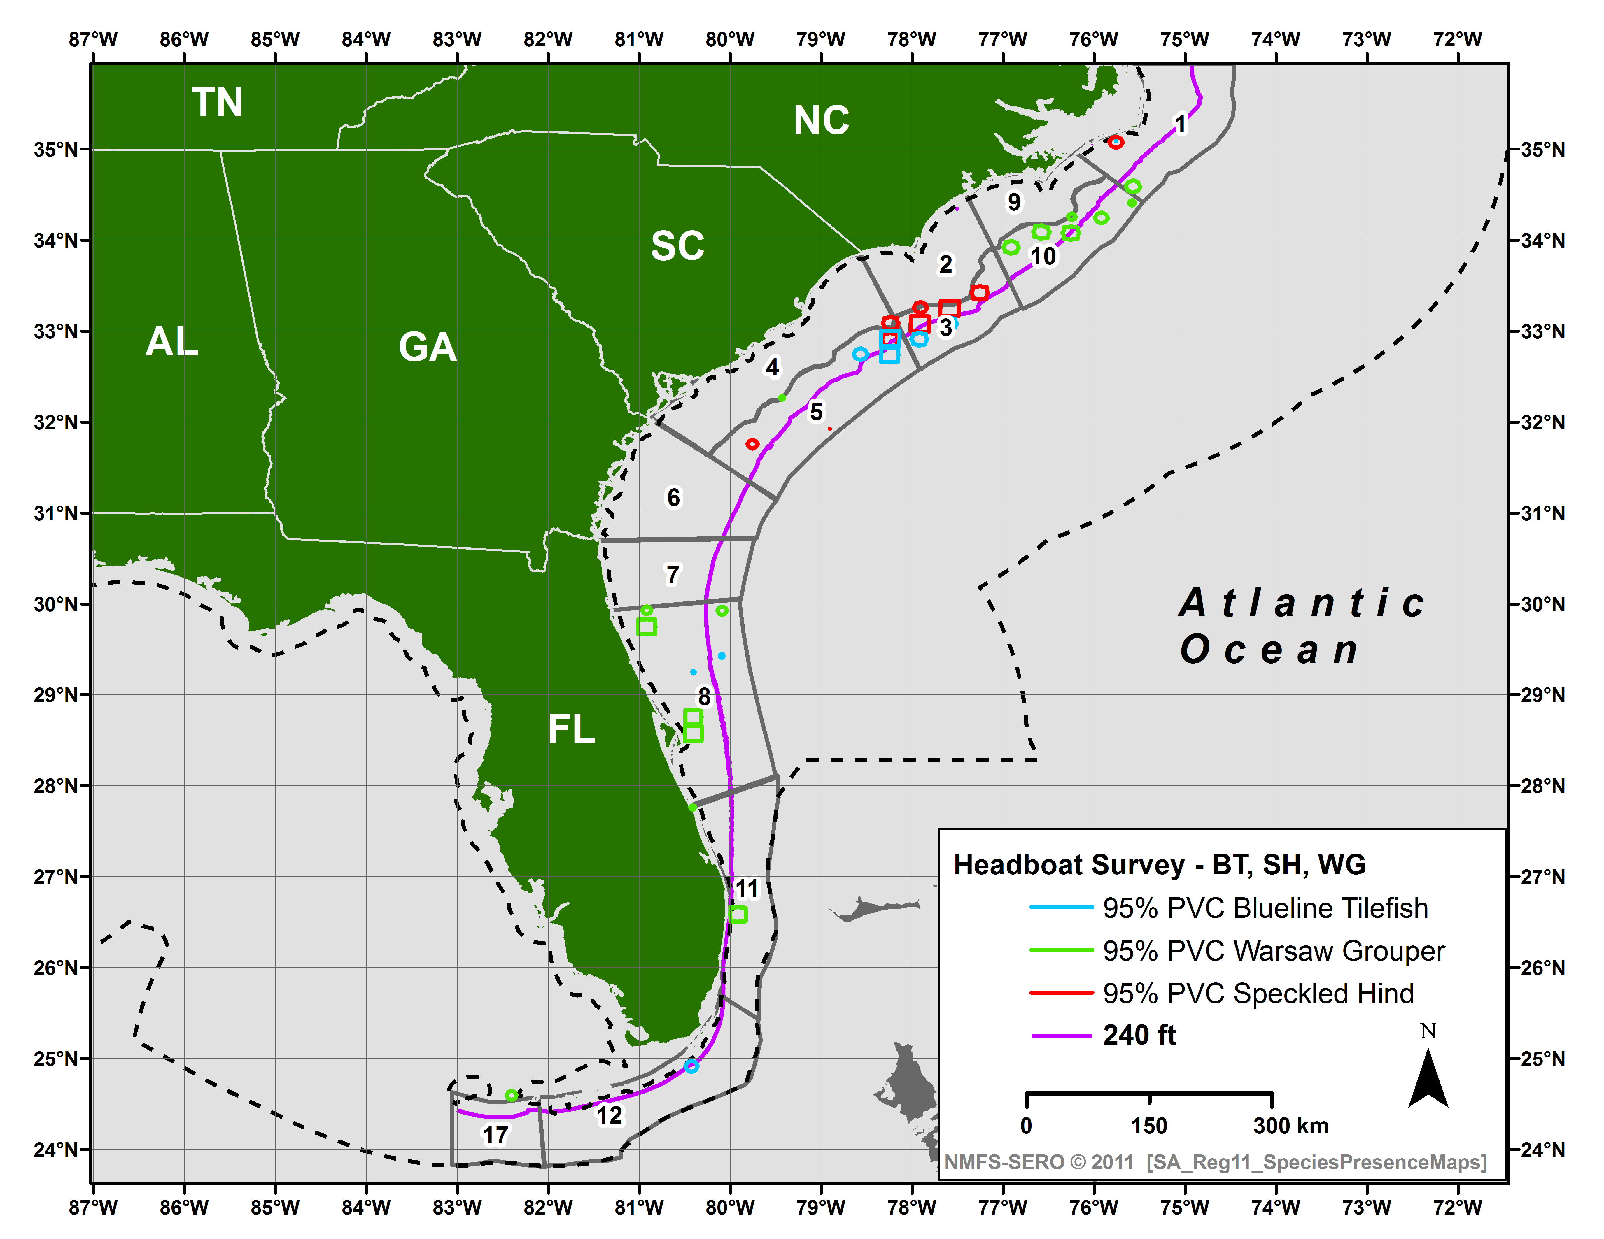
Where are they caught? (Spatial)
3079 Warsaw
24715 Speckled Hind
19886 Blueline Tilefish
Note: Low historical participation North of Hatteras

Slide 9
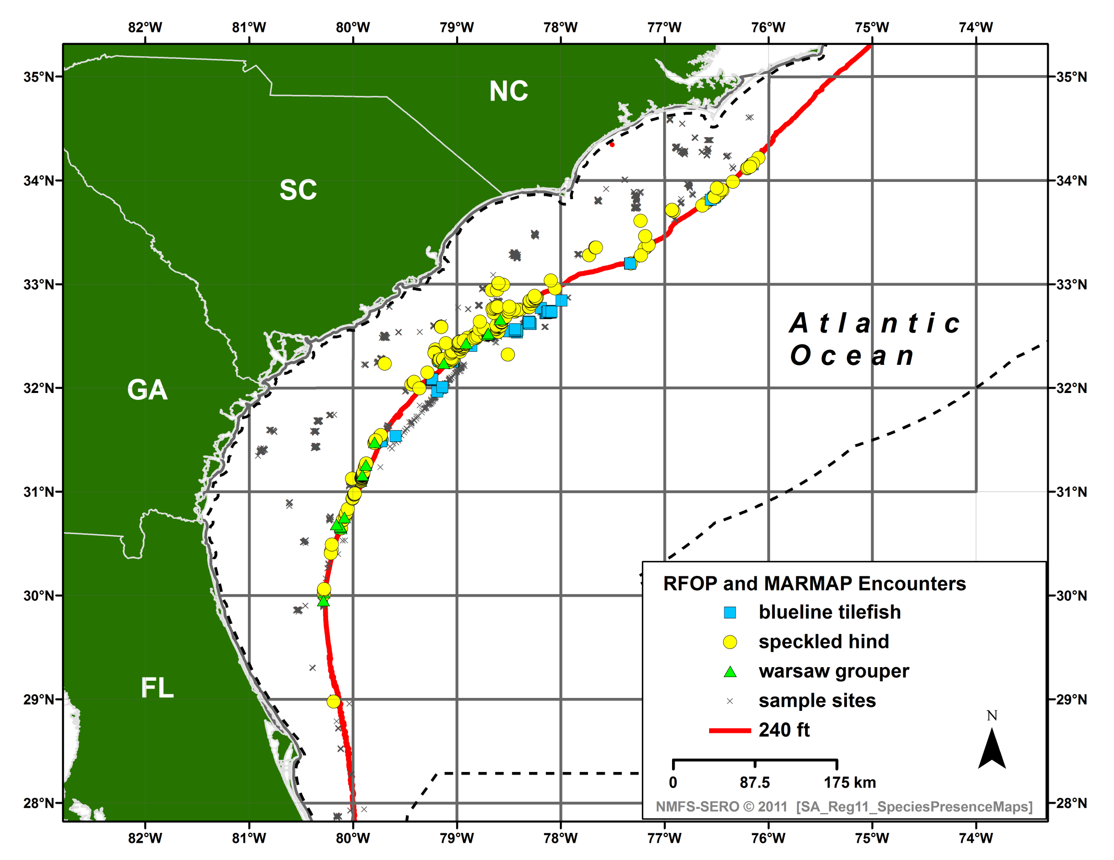
Where are they caught? (Spatial)
Note: Low sampling North of Hatteras, South of Canaveral

Slide 10
SPATIAL DISTRIBUTION: FLORIDA Trip Ticket (1986-1992) & ALS (1962-2010)
ALS n=2145; FL-TT n=205
SPECKLED HIND | Unknown | Jacksonville | Canaveral | West Palm | Miami | Keys
Trip Ticket | 79% | 18% |  | 1% | 2%
ALS |  | 4% | 12% | 5% | 8% | 72%
ALS n=2309; FL-TT n=1731
WARSAW GROUPER | Unknown | Jacksonville | Canaveral | West Palm | Miami | Keys
Trip Ticket | 20% | 29% | 32% | 9% | 3% | 7%
ALS |  | 3% | 8% | 2% | 24% | 64%
Notes:
Percentage of catch where specific Florida trip ticket (FTT) location data and accumulated landing system (ALS) data were available. Catch is in pounds gutted weight.

Slide 11
Trip Ticket Data
#Records | FL (1986-1992) | GA (2004-2009) | SC (1989-2009) | NC (1994-2010)
Speckled Hind | 205 | 0 | 350 | 38
Warsaw Grouper | 1,731 | 1 | 95 | 4
Notes:
Note 2010 NC Trip Ticket record for warsaw was coding error and has been removed in this table (A. Bianchi, NC-DENR).

Slide 12
Where are they caught? (Spatial)
 | North of Cape Hatteras, NC |  | South of Cape Canaveral, FL
Dataset | Warsaw Grouper | Speckled Hind | Warsaw Grouper | Speckled Hind
ALS | 0% | 0% | 4% | 12%
Trip Ticket | 0% | 1% | 24% | 1%
Headboat Survey | 0% | 1% | 5% | 3%
MARMAP | 0% | 0% | 0% | 0%
RFOP | 0% | 0% | 0% | 0%
CLB | 0% | 2% | 0% | 5%

Slide 13
What is Caught Together?
Sale of SH and WG prohibited since 1992.
SAFMC species groupings report approaches focused on highly resolved bins of data for encounters of all species.
Reg-11 analyses use longer, less-resolved time series of data and cluster only positive trips (e.g., trips with encounter of SH or WG)
Clustering using HCA and Dimension Reduction

Slide 14
Top Co-Occurring Species
 | With Speckled Hind |  | With Warsaw Grouper
Rank | Commercial | Headboat | Commercial | Headboat
1 | red porgy | vermilion snapper | red porgy | gray triggerfish
2 | scamp | gray triggerfish | scamp | black sea bass
3 | vermilion snapper | scamp | vermilion snapper | red snapper
4 | greater amberjack | red porgy | greater amberjack | gag
5 | red snapper | tomtate | speckled hind | gray snapper
6 | gag | white grunt | red snapper | lane snapper
7 | red grouper | knobbed porgy | gag | vermilion snapper
8 | gray triggerfish | greater amberjack | gray triggerfish | tomtate
9 | warsaw grouper | gag | red grouper | scamp
10 | rock sea bass | red snapper | red hind | whitebone porgy
11 | snowy grouper | black sea bass |  | greater amberjack
12 | yellowtail snapper | whitebone porgy |  | red porgy
13 | black grouper | almaco jack |  | red grouper
14 | blue runner | bank sea bass |  | white grunt
… | … | … | … | …
 | blueline tilefish (#22) | blueline tilefish (#32) | No blueline tilefish | blueline tilefish (#39)
Notes:
In general, speckled hind and warsaw grouper rarely co-occurred with snowy grouper, blueline tilefish, yellowedge grouper, misty grouper, queen snapper, or silk snapper.

Slide 15
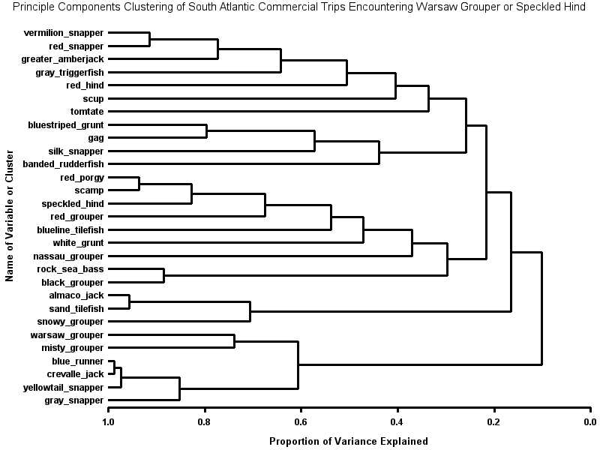
Dimension Reduction: Commercial
Logbooks
(2001-2009)
Notes:
Dimension reduction analyses of commercial logbook data showed warsaw grouper was closely associated with misty grouper and slightly with snowy grouper, but not other deep-water species. Speckled hind was closely associated with red grouper, scamp, and red porgy, slightly with blueline tilefish.

Slide 16
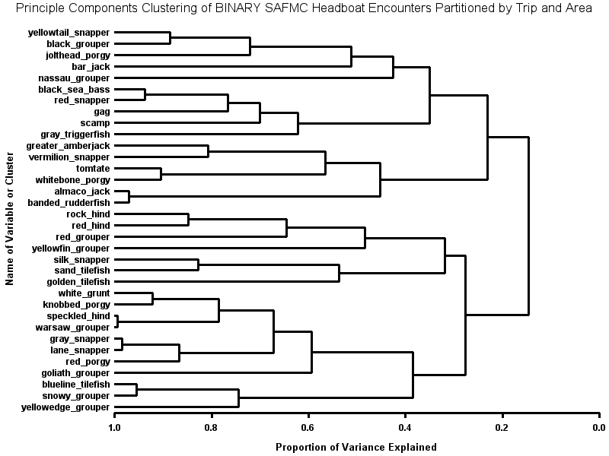
Dimension Reduction: Headboat
Logbooks
(1973-2009)
Notes:
Dimension reduction analyses of headboat data showed warsaw grouper and speckled hind were closely associated with each other. These species were also associated with grunts and porgies. Blueline tilefish was most closely associated with snowy grouper and yellowedge grouper.

Slide 17
What is Caught Together?
Speckled hind and warsaw grouper closely associated
Low association with blueline tilefish or snowy grouper
Warsaw grouper associated with misty grouper, shallow-water groupers.
Speckled hind associated with vermilion snapper, red grouper, scamp, porgies and grunts.

Slide 18
Conclusions
What data are available?
Extremely limited prior to 1992 prohibition of sale
Post-1992 data heavily biased (area, depth, under-reporting)
Where are they caught (area & depths)?
SH predominantly SC to south of Hatteras
WG mostly off FL and NC
Higher odds of encounter in >240 ft depth
What species are caught with them?
Low association with blueline tilefish, snowy grouper
CAVEATS:
Deep-water undersampled + under-reporting bias
Ontogenetic migration

Slide 19
Evaluation of Alternatives in Reg. Amendment 11
No action
+ Low reported catches of warsaw grouper, speckled hind
- Most reported catches inside 240 feet.
Allow harvest of blueline tilefish >240 ft depth contour
+ Low association with blueline tilefish
+ Few reported warsaw grouper, speckled hind >240 ft
- Increased odds of encountering WG and SH >240 ft

Slide 20
Evaluation of Alternatives in Reg. Amendment 11
Allow harvest of blueline tilefish >240 ft in North Carolina
+ Low association with blueline tilefish in available data
- Odds of encountering WG or SH increase >240 ft
- High WG (HBS) and SH (MARMAP) encounters off NC
Allow harvest of blueline tilefish >240 ft north of Cape Hatteras, NC
+ Few reported WG and SH >240 ft north of Hatteras
+ Substantial blueline tilefish landings north of Hatteras
+ Blueline tilefish may occupy different habitats vs. SH & WG

Slide 21
Evaluation of Alternatives in Reg. Amendment 11
Exclude blueline tilefish from >240 ft depth closure south of Cape Canaveral
+ Low association in available data with blueline tilefish
+ Blueline tilefish may occupy different habitats vs. SH & WG
- Some evidence of WG catches in SEFL and Keys
6. Open closed area >500 ft.
+ Extremely low reported catches WG (~3%) or SH (~1%)
+/- High snowy grouper (~60%), blueline tilefish (~40%) catch

Slide 22
Evaluation of Alternatives in Reg. Amendment 11
Allow harvest of snowy grouper >240 ft depth contour
+ Low association with snowy grouper in available data
- The majority snowy grouper landings (67%) >500 ft depth
- Increased odds of WG and SH encounters >240 ft
Allow harvest of snowy grouper >240 ft depth contour off North Carolina
+ Low association with snowy grouper in available data
- High WG (HBS) and SH (MARMAP) encounters off NC

Slide 23
Evaluation of Alternatives in Reg. Amendment 11
9. Allow harvest of snowy grouper >240 ft depth contour north of Cape Hatteras
+ Low association with snowy grouper in available data
+ Few reported WG and SH >240 ft north of Hatteras
Exclude snowy grouper from the deepwater closure south of Cape Canaveral
+ Low association in available data with snowy grouper
- Some evidence of WG catches in SEFL and Keys

Slide 24
Questions?
Images: Diane Rome Peebles © 1992

Slide 26
RESULTS: MARMAP (1977-2009)
NOTE: Fishery-independent; Limited gears and sets for DWG.
*Significantly different distribution (p<0.05)

Slide 27
RESULTS: Commercial Logbook
NOTE: 1992 Harvest Prohibition would impact these results.
*Significantly different distribution (p<0.05)

Slide 28
RESULTS: Discard Logbook
NOTE: Only 20% of commercial fishery (self-reported).
*Significantly different distribution (p<0.05)

Slide 29
RESULTS: Reef Fish Observer
NOTE: Voluntary program, limited sampling at >240 ft.
*Significantly different distribution (p<0.05)

Slide 30
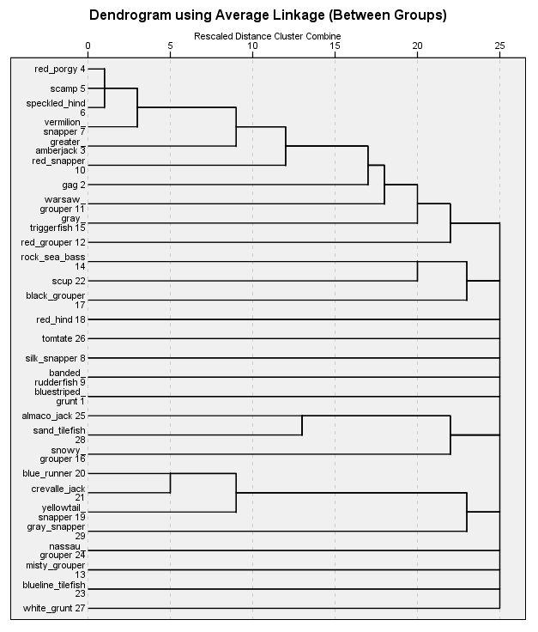
HCA: Commercial
Logbooks
(2001-2009)
HCA: Positive Trips
Aggregation:
Year, Month, Trip, Area
Linkage Method: Average
Similarity Measure: Sorenson
Transformation: Binary
Notes:
Hierarchal cluster analyses of commercial logbook data indicated relatively low levels of association between warsaw grouper, speckled hind and other deep-water species. Warsaw grouper was most closely associated with shallow-water groupers and speckled hind was most closely associated with vermilion snapper, red porgy, and scamp.

Slide 31
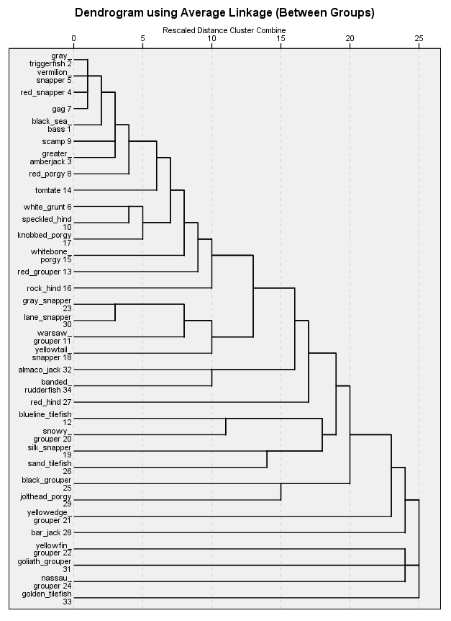
HCA: Headboat
Logbooks
(1973-2009)
Positive Trips Only
Aggregation:
Year, Month, Trip, Area
Linkage Method: Average
Similarity Measure: Sorenson
Transformation: Binary
Notes:
Hierarchal cluster analyses of headboat data indicated warsaw grouper most closely associated with shallow-water snappers and speckled hind were most closely associated with porgies and grunts.

Slide 32
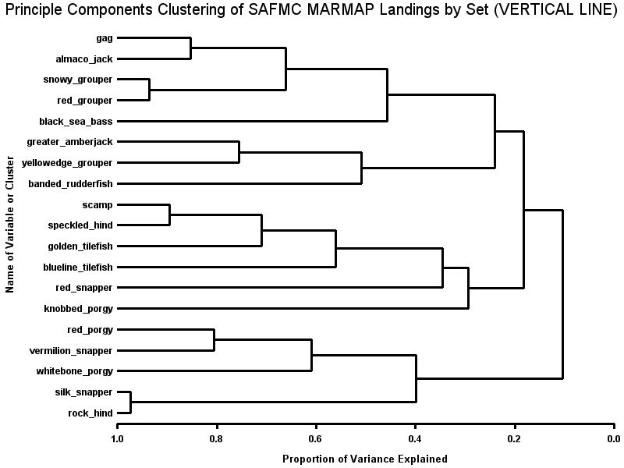
Dimension Reduction: MARMAP
(1977-2009)
<50 observations

Slide 33
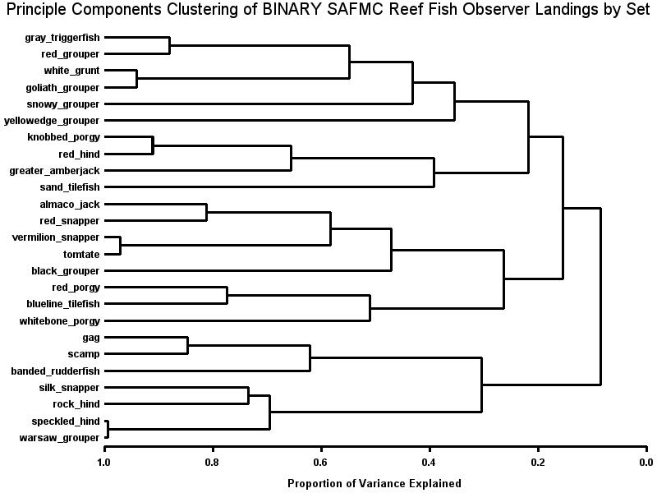
Dimension Reduction: RFOP
(2006-2009)
<200 observations

Slide 34
WHERE ARE THEY CAUGHT?
All Observations, Pooled Across Data Sources

