Slide 1
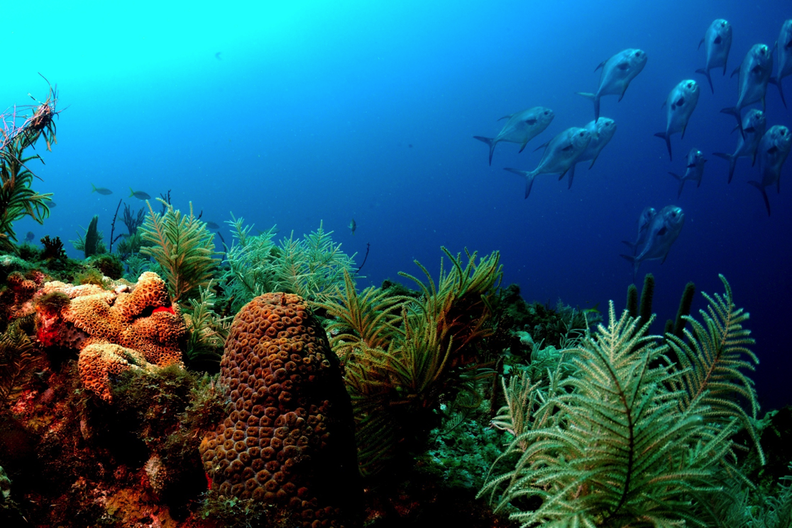
South Atlantic Ecosystem Model Workshop
Create the Future: Develop Refined and Focused South Atlantic Ecosystem Model/Model Suite & the Companion Physical Modeling Requirements
Habitat Protection and Ecosystem-Based Management Committee
Key West, Florida
June 8, 2015
Brett Boston – Workshop Facilitator

Slide 2
Our Team
Tom Okey, University of Victoria, Ocean Integrity Research
Jerry Ault, University of Miami
Rua Mordecai, South Atlantic Landscape Conservation Cooperative, (SALCC)
Vembu Subramanian, SECOORA
Ruoying He, North Carolina State University
Peter Sheng, University of Florida, Gainesville
Mitchell Roffer, ROFF's Ocean Fishing Forecasting Service, Inc.
Luiz Barbieri, FWRI
Marcel Reichert, SCDNR
Roger Pugliese, South Atlantic Fishery Management Council
Notes:
Pat Halpen, Duke is a member, in coordination with SALCC, we are looking to add a grad student to assist.

Slide 3
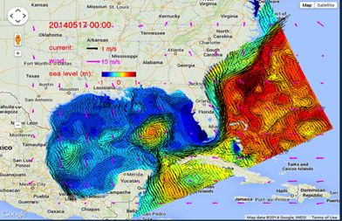
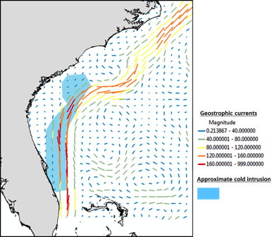
The Models should:
Link to hydrodynamic oceanographic models and satellite data
Provide more realistic predictions about spatial policy options
Predict impacts of episodic events that are limited in space (oil spills, red tides, upwelling)
Meet the immediate needs of the SSC and the needs of the South Atlantic Council

Slide 4
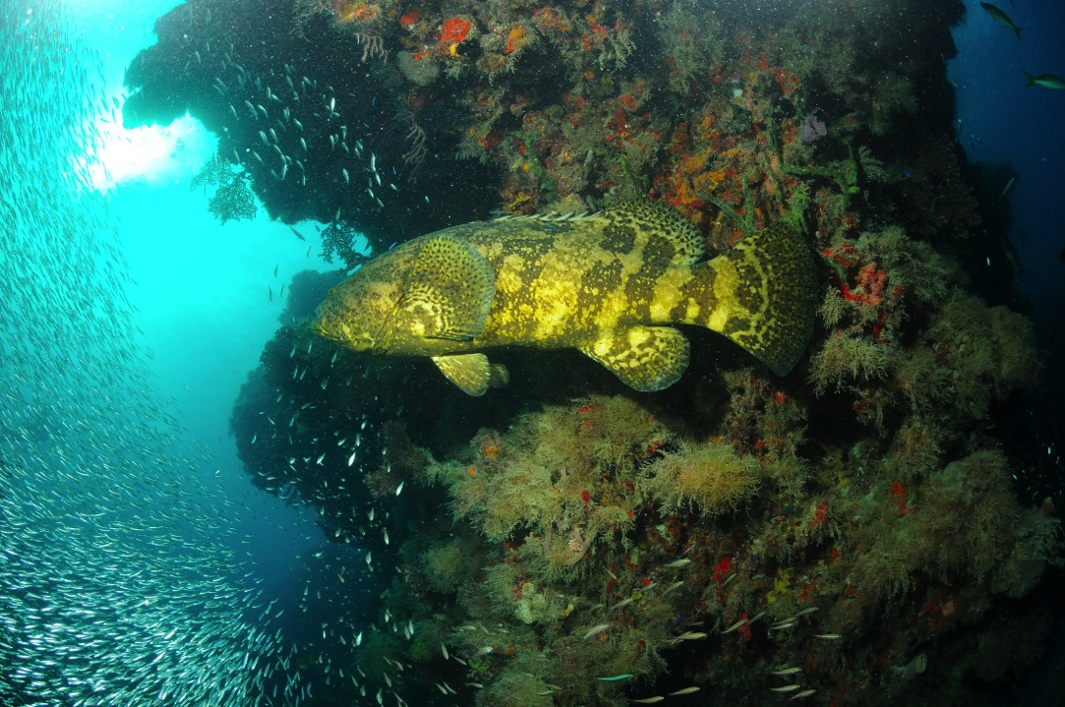
Develop Refined and Focused South Atlantic Ecopath/Ecosim/Ecospace Model & the Companion Physical Modeling Requirements
Decision Support
Engage SAFMC SSC in needs assessment
Develop useful tools for the Council initial focus to include red snapper and gray trigger fish
Define existing and desired data technology needs and coverage needs

Slide 5
Develop Refined and Focused South Atlantic Ecopath/Ecosim/Ecospace Model & the Companion Physical Modeling Requirements
Model Features
Provide enhanced spatial management capabilities
Link Ecopath to physical and chemical oceanographic models
Link to the South Atlantic Landscape Conservation Cooperative’s connectivity of systems
Refine Essential Fish Habitat and modeling

Slide 6
Goal: Create a blueprint for examining and refining fish ecosystem modeling tools that will be used to help sustain natural and cultural resources to be used for:
Decision Support
Creating tools to conduct ecosystem-based evaluations of fisheries policies and tradeoffs
Identifying tradeoffs among conflicting management objectives , e.g. conservation vs. profits
Integrating environmental data into the stock management process

Slide 7
Goal: Create a blueprint for examining and refining fish ecosystem modeling tools that will be used to help sustain natural and cultural resources to be used for:
Model Features
Helping elucidate the natural variability of the physical and biological components.
Characterizing environmental uncertainty in stock projections
Developing habitat, environmental and ecosystem dynamics views
Planning and evaluating spatial policy options

Slide 8
Model 1.0
Better utilize existing datasets and assessments:
Define the essential data needed for the first generation of the model
Leverage existing analytical tools & metrics for evaluation of fishery management alternatives (including the environmental portion)
Integrate available data and updated stock assessments to expand risk assessment capabilities
Enhance description of interactive influences - stock, productivity, uncertainty
Conduct a team review and analysis of existing data
Ensure connectivity data is included: estuaries and rivers (food web)
Outcome: New SA Ecopath/Ecosim/Ecospace Model completed

Slide 9
Model 2.0
Develop the next generation of ecosystem models
Decision Support
Enable the evaluation of Council Managed Areas (i.e., MPAs, Spawning SMZs, HAPCs) and Regional Conservation Priorities
Promote better stock assessments
Develop useful tools that enable evaluation of fishery projections

Slide 10
Model 2.0
Develop the next generation of ecosystem models
Model Features
Evolve spatial capabilities of the modeling
Expand utilization of existing data sets
Integrate habitat layers
Define ongoing and future data needs - define the collection process
Develop indicators to incorporate movement from estuaries to oceans, and also along the coast
Outcome: Full-scale South Atlantic Model/Model Suite completed

Slide 11
Create the best possible information for use by managers and decision-makers
Work with managers and decision-makers to ensure models meet their needs
Recruit top researchers to assist in an inclusive, long-term management effort
Build an ecosystem technical advisory group that ensures our approach includes both practical science and leading-edge thinking
Multi-year modeling that seeks the best available science from all disciplines
Establish linkages to coastal/ocean ecosystems, estuarine and riverine systems

Slide 12


Funding Sources
The South Atlantic LCC has committed to coastal integration funding as part of completing the connectivity of Blueprint 2.1 and enhancing linkages with developing SAFMC FEP II
The Southeast Coastal Ocean Observing Regional Association (SECOORA) is funding refined oceanographic models to support ecosystem modeling ,enhance ecosystem condition forecasting and ecosystem-based fishery management
A robust plan and expert model development team leaves us well positioned to leverage available ecosystem partner funding to create the next generation of South Atlantic Ecosystem Models which support and enhance regional Conservation and Management.

Slide 13
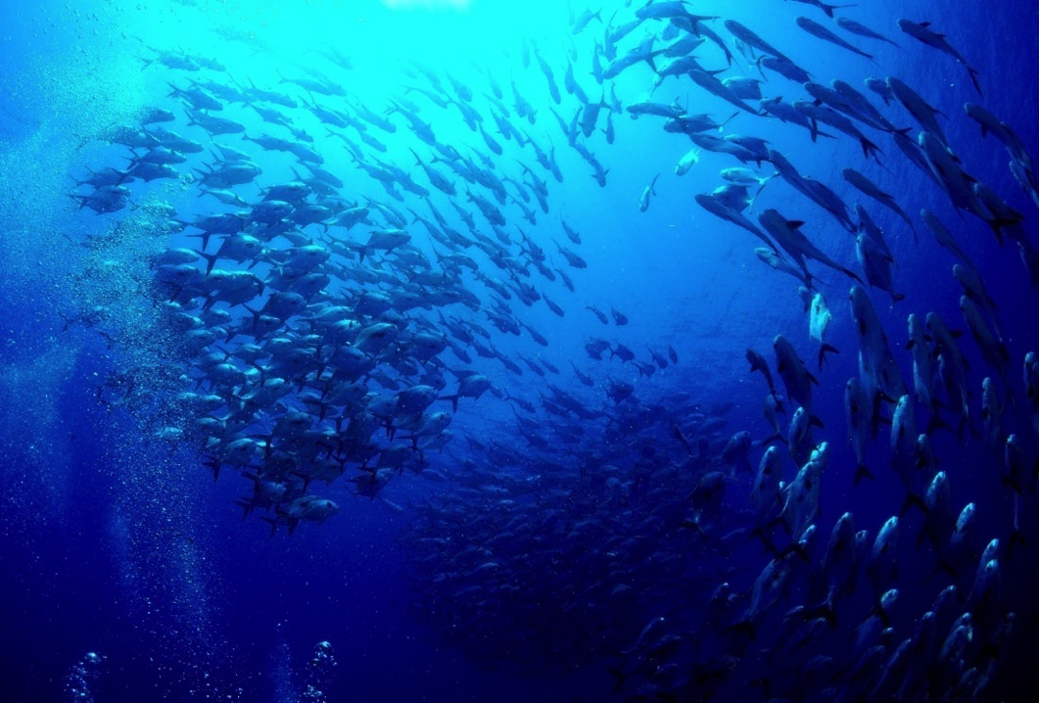
Questions?

