Slide 1
Species groupings for management of the SAFMC Snapper-Grouper FMU
DRAFT – Under SEFSC Review
Southeast Regional Office
St. Petersburg, Florida

Slide 2
Caveats
These results and conclusions are preliminary and subject to revision.
Report is currently under review at SERO.
Will be reviewed by SEFSC and SAFMC SSC.
Final report should be available for Dec 2010 meeting.

Slide 3
Why Group Species?
Under June 2010 Preferred Alternative, Council will need to establish ACLs for 24 unassessed species.
Assigning species to assemblages may:
  Mitigate uncertainty in species identification
  Reduce regulatory impacts of fluctuations in landings for incidentally-caught species
  Simplify management
  Address some ecosystem dynamics

Slide 4
What’s a Stock Complex?
“Stock complexes may be comprised of:
1) One or more indicator stocks, each of which has SDC and ACLs, and several other stocks;
2) Several stocks without an indicator stock, with SDC and an ACL for the complex as a whole; or
3) One of more indicator stocks, each of which has SDC and management objectives, with an ACL for the complex as a whole…”
ACL Final Rule

Slide 5
Goals & Objectives
GOALS: Provide guidance to SAFMC for setting ACLs within Snapper-Grouper FMU.
OBJECTIVES:
  Identify species assemblages
  Evaluate consistency across sectors
  To develop species complexes that are “sufficiently similar in geographic distribution, life history, and vulnerabilities to the fishery such that the impact of management actions on the stocks is similar.” (NS1)

Slide 6
Data Sources
SEFSC Coastal Logbook [vertical line] (2005-2009)
SEFSC Coastal Logbook [longline] (2005-2009)
Reef Fish Observer Program (2006-2009)
SEFSC Headboat Survey (2004-2009)
Marine Recreational Fisheries Statistics Survey (2000-2009)
Marine Resources Monitoring, Assessment and Prediction Survey (1978-2009)

Slide 7
Methods
Life history
Vulnerability
Percent encounters
Dimension reduction
Hierarchical clustering
WMCA Index
Biogeographic distribution

Slide 8
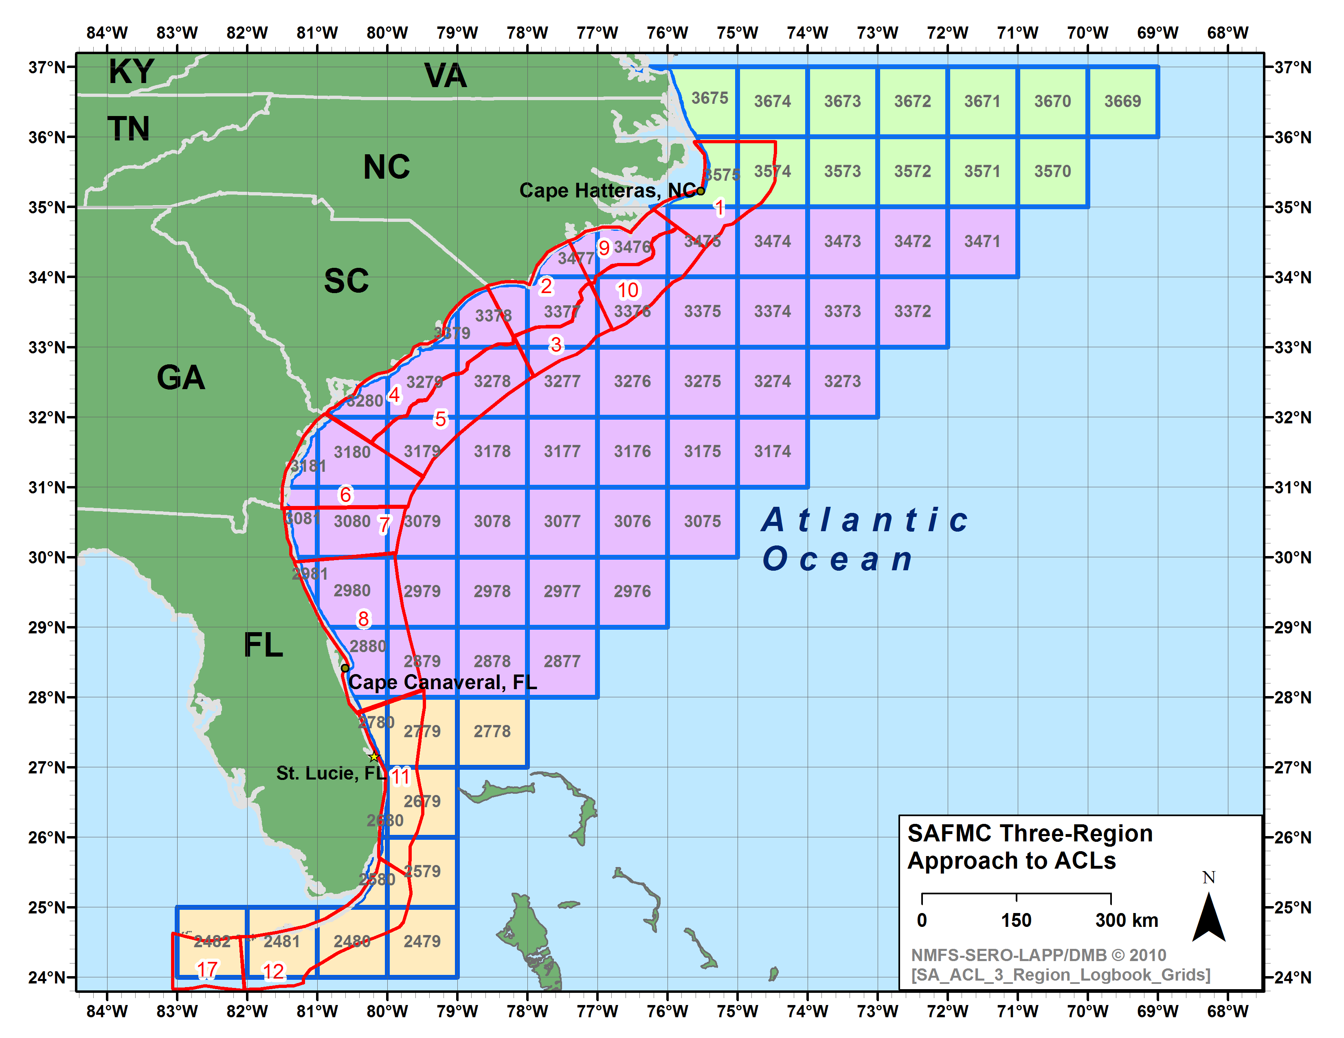
45 species
65 species
70 species
Biogeographic Zones

Slide 9
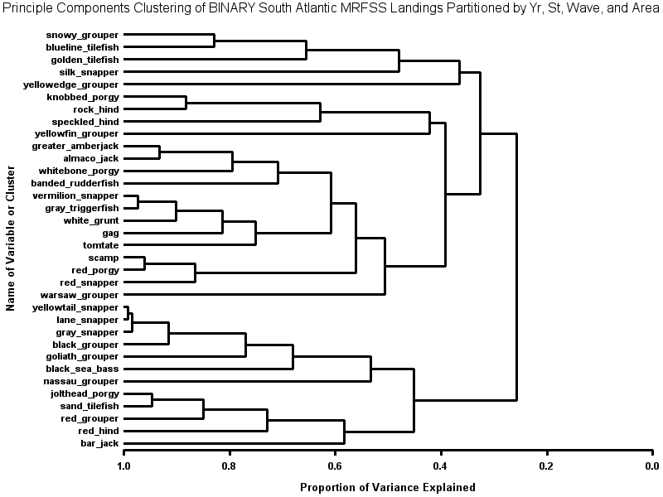
HCA of MRFSS by Year, Month, State, Mode, Wave
DEEP
NC/EFL
JACKS
EFL
NC/NEFL
SEFL
SEFL/NC

Slide 10
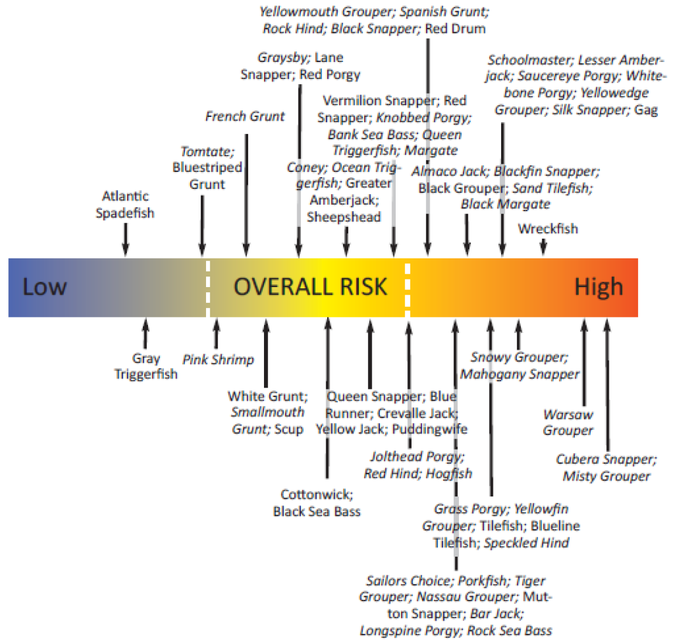

MRAG PSA
R,S
B
G
Source: PSA_SA-Results_MRAG.pdf
NOAA Fisheries

Slide 11
DRAFT: Table of SAFMC Snapper-Grouper FMU species, indicating species with completed or pending assessments and top five most associated species, by species, per weighted mean cluster association index. Productivity-Susceptibility Analysis (PSA) scores of overall risk from MRAG Americas South Atlantic Final Report provided when available (MRAG 2009a,b). Color-coding denotes associations; dashed lines denote distinct life histories between associated species.

Slide 12
PRELIMINARY RESULTS – PENDING SEFSC & SSC REVIEW
DEEP-WATER COMPLEX
DEEP-WATER COMPLEX
WARSAW GROUPER₂
YELLOWEDGE GROUPER
SNOWY GROUPER₁
BLUELINE TILEFISH
SAND TILEFISH
GOLDEN TILEFISH₁
SILK SNAPPER
WARSAW GROUPER₂
YELLOWEDGE GROUPER
SNOWY GROUPER₁
1A
BLUELINE TILEFISH
SAND TILEFISH
GOLDEN TILEFISH₁
1B
SILK SNAPPER (?)
1C
Assessed Species₁
Most Vulnerable Species₂
ADDITIONAL COMPLEX
WRECKFISH₁

Slide 13
PRELIMINARY RESULTS – PENDING SEFSC & SSC REVIEW
SHALLOW-WATER GROUPER COMPLEX
SWG COMPLEX
GAG_{1,2}
RED GROUPER₁
SCAMP
BLACK GROUPER₁
YELLOWFIN GROUPER
SPECKLED HIND
GAG_{1,2}
1A
RED GROUPER₁
SCAMP
1B
BLACK GROUPER₁
1C
YELLOWFIN GROUPER
SPECKLED HIND
1D
Assessed Species₁
Most Vulnerable Species₂
ADDITIONAL
COMPLEXES
GOLIATH GROUPER₁
NASSAU GROUPER
BLACK SEA BASS₁

Slide 14
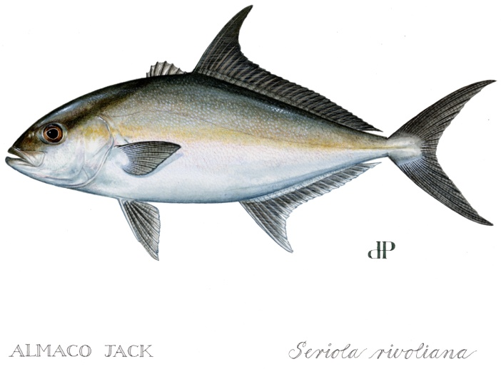
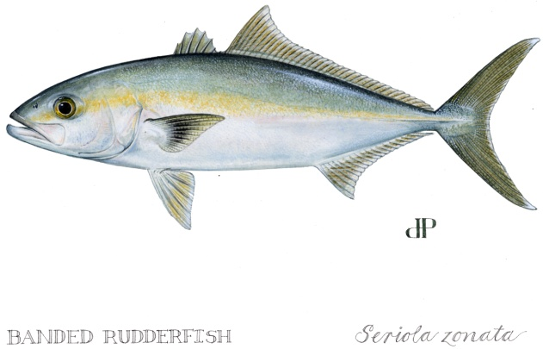
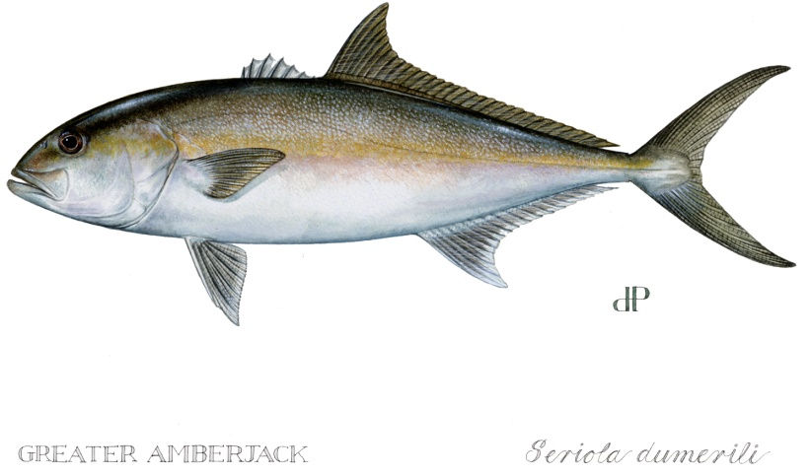
PRELIMINARY RESULTS – PENDING SEFSC & SSC REVIEW
JACKS COMPLEX
JACKS COMPLEX
GREATER AMBERJACK₁
ALMACO JACK₂
BANDED RUDDERFISH
GREATER AMBERJACK₁
1A
ALMACO JACK₂
BANDED RUDDERFISH
1B
Assessed Species₁
Most Vulnerable Species₂
ADDITIONAL COMPLEX
BAR JACK

Slide 15
PRELIMINARY RESULTS – PENDING SEFSC & SSC REVIEW
SHALLOW-WATER SNAPPER COMPLEX
SWS COMPLEX
YELLOWTAIL SNAPPER₁
GRAY SNAPPER₂
LANE SNAPPER
YELLOWTAIL SNAPPER₁
1A
GRAY SNAPPER₂
LANE SNAPPER
1B
Assessed Species₁
Most Vulnerable Species₂

Slide 16
PRELIMINARY RESULTS – PENDING SEFSC & SSC REVIEW
PORGIES, GRUNTS,
& HINDS COMPLEX
PGH COMPLEX
WHITEBONE PORGY₂
KNOBBED PORGY
JOLTHEAD PORGY
RED HIND
ROCK HIND
TOMTATE
WHITE GRUNT
WHITEBONE PORGY₂
KNOBBED PORGY
JOLTHEAD PORGY
1A
RED HIND
ROCK HIND
1B
TOMTATE
WHITE GRUNT
1C
Assessed Species₁
Most Vulnerable Species₂

Slide 17
PRELIMINARY RESULTS – PENDING SEFSC & SSC REVIEW
INDIVIDUAL ACLs
RED SNAPPER₁
GOLIATH GROUPER₁
VERMILION SNAPPER₁
NASSAU GROUPER
GRAY TRIGGERFISH
BLACK SEA BASS₁
RED PORGY₁
WRECKFISH₁
BAR JACK
Assessed Species₁

Slide 18
SAFMC vs. GULF
SAFMC jurisdiction covers broad range of latitudes with 2-3 biogeographic regions.
Extreme bathymetric slope on continental shelf results in:
  broad depth range available to fishers on a single trip
  less distinct depth separation by sector vs. Gulf

Slide 19
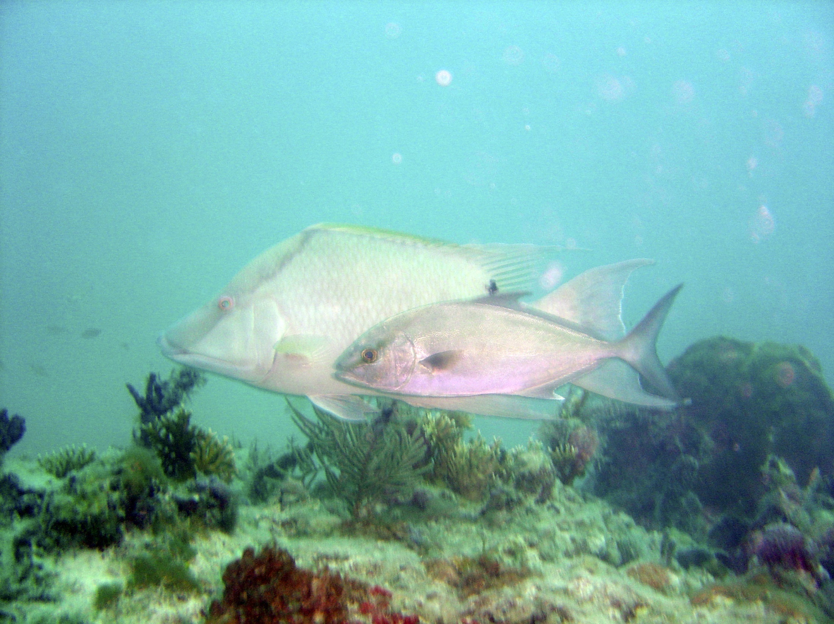
Any questions?

Slide 20
ADVANTAGES OF
STOCK COMPLEXES
Stock complexes achieve management goals:
  Avoids AMs associated with exceeding ACL for species whose landings fluctuate widely due to rarity / ID issues
  Allow primary data collection and enforcement focus on economically-important species
  Promotes regulations considering multispecies context; prelude to ecosystem-based management
Ideally, stock complexes would:
  Be adaptive management, modified by new data/assessment
  Use indicator species to trigger AMs
Notes:
Bycatch, species associations for regulations

Slide 21
DISADVANTAGES OF STOCK COMPLEXES
Main goal of a stock complex is to place rarely caught species with some indicator, but these species are the most difficult to cluster.
Use of assessed species as indicator species may be only practical way to set ACL, but assessed species may not be the most vulnerable species in the complex.
Most vulnerable species in complex may still be prone to overfishing, although no SDC exists to determine this.
Current assemblages may not be natural, as overexploitation may alter community structure.

