Slide 1
Ecosystem Based Management
Place based
Focused on sustaining valued ecosystem services by protecting ecosystem structure and function,
Recognizes internal and external linkages of the whole system, and
Specifically considers economic, social and institutional aspects of the system
Notes:
This is the distillation of the Consensus statement used in the evaluation. It is repeated here to provide context for the evaluation’s assessment of the input we received and the synthesis of that input to generate the construct of 5 basic tenets of EBM.

Slide 2
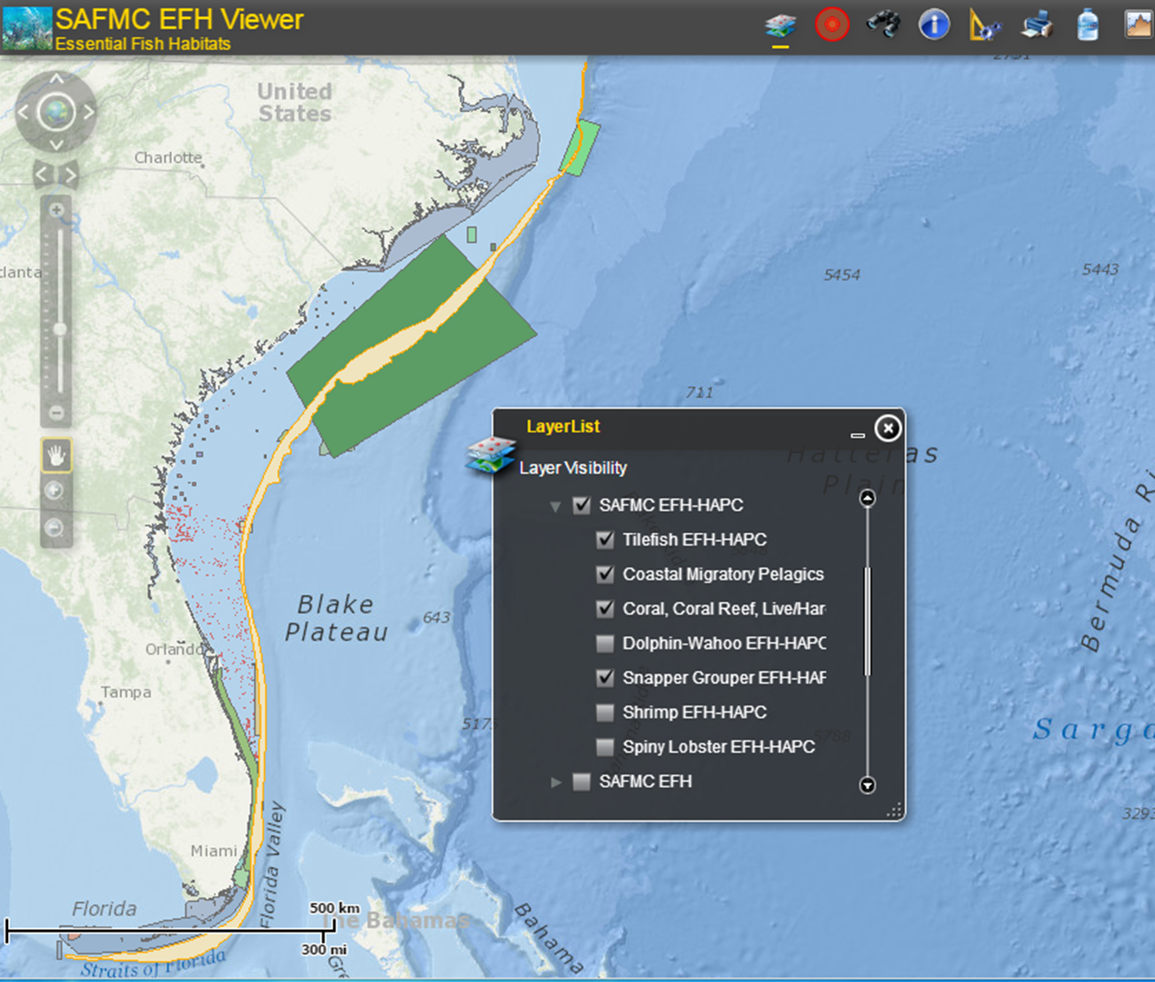
“ecosystem-based”
is
a program characteristic
NOT
a program structure

Slide 3
Essential conditions if an ecosystem-based initiative is to succeed
United Nations Environment Program. 2006. Ecosystem-based management: Markers for assessing progress. 58pp. unep/gpa, The Hague
Unambiguous goals
Well-informed stakeholders
Delegation of authority and financial resources to sustain implementation
Capacity within implementing institutions

Slide 4
EBM - Stakeholder Collaboration
Optimistic model
Trust transforms interests and leads to innovation
Agreement on science basis leads to feasible, well-founded plan
Involvement reduces challenges
Pessimistic model
Consensus seeking leads to lowest common denominator
Socio-economic interests dilute precaution
Special interests resurface impeding implementation
Adapted from: Judith Layzer. 2008. Natural Experiments: Ecosystem-based management and the environment. The MIT Press. Cambridge, MA.

Slide 5
EBM - Adaptive Management
Optimistic model
Emphasis on flexibility promotes ‘better-than-minimum’ performance
Monitoring informs practice ensuring use of best available understanding
Pessimistic model
Flexibility facilitates evasion by laggards
Managers resist adjustments and development interests prevail
Adapted from: Judith Layzer. 2008. Natural Experiments: Ecosystem-based management and the envrionment. The MIT Press. Cambridge, MA.

Slide 6
essential elements of EBM
holistic vision / plan
comprehensive description of system, articulation of multiple management objectives
community
effective engagement of policy makers, managers, stakeholders, scientists
process
effective adaptive management
foundation
legal framework, management institutions, financial resources, effective communications
Notes:
6

Slide 7
program framework
Articulate program goals
Develop system level model for goal attainment
Assess current management efforts – identify gaps
Develop management strategy
Develop monitoring program
Assess performance
Manage adaptively

Slide 8
program framework
Articulate program goals
Develop system level model for goal attainment
Assess current management efforts – identify gaps
Develop management strategy
Develop monitoring program
Assess performance
Manage adaptively

Slide 9
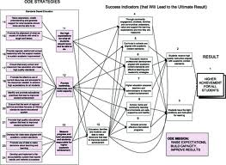
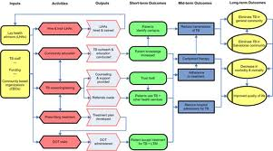
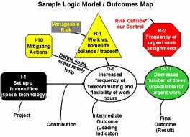
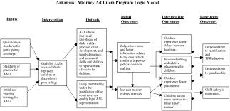
Logic models

Slide 10
program framework
Articulate program goals
Describe factors influencing goal attainment
Assess current management efforts – identify gaps
Develop management strategy
Develop monitoring program
Assess performance
Manage adaptively

Slide 11
Goal modeling identification of factors potentially affecting attainment
biological factors
fauna
flora
Microorganisms
physical factors
structure
hydrology
temperature
chemical factors
salinity
pH
nutrients
toxics
human factors
use objectives
modification of system
knowledge

Slide 12
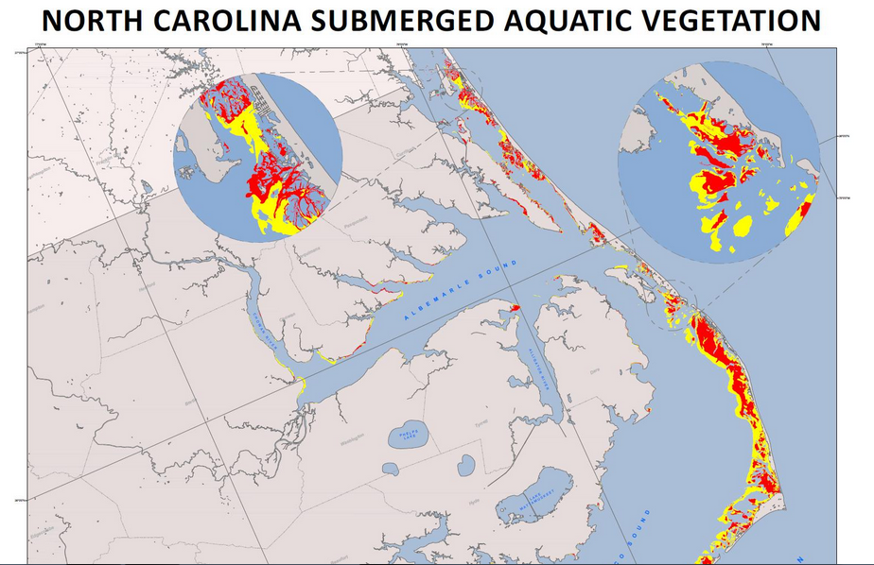

Slide 13
program framework
Articulate program goals
Develop system level model for goal attainment
Assess current management efforts – identify gaps
Develop management strategy
Develop monitoring program
Assess performance
Manage adaptively

Slide 14
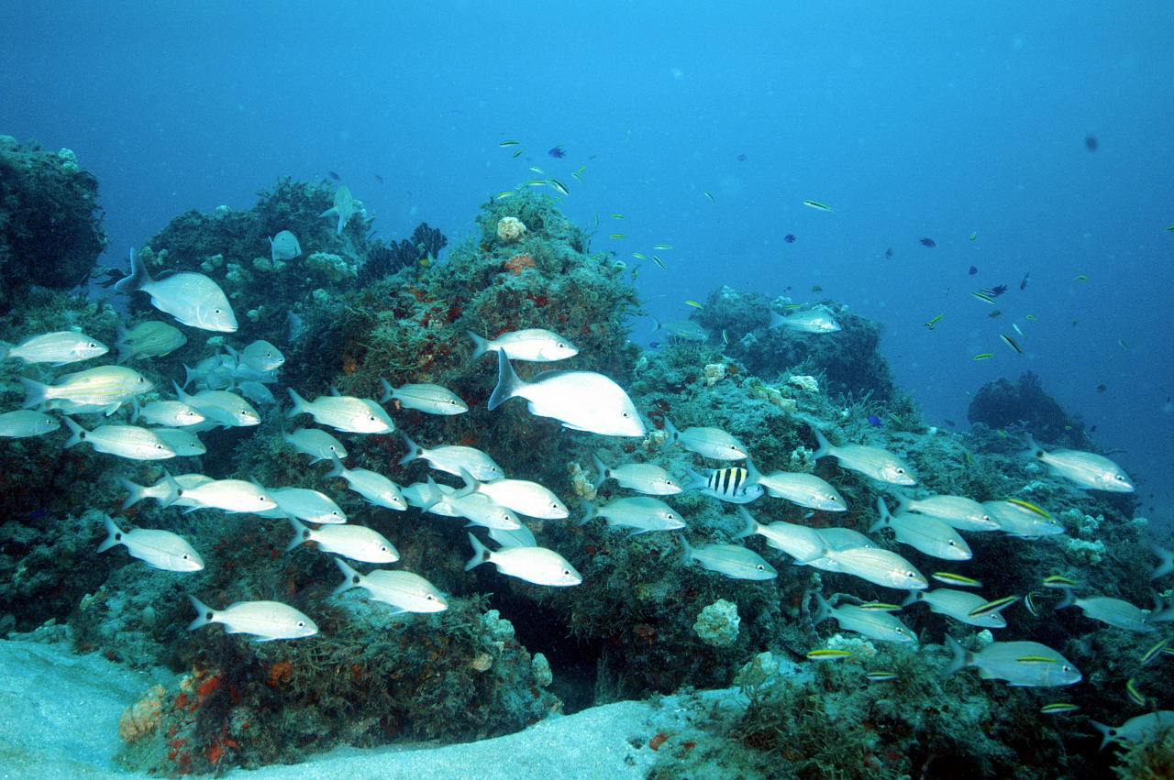
Comprehensive Ecosystem-Based Amendment 1
Coral Habitat Areas of Particular Concern (CHAPCs)
golden crab
royal red shrimp

Slide 15
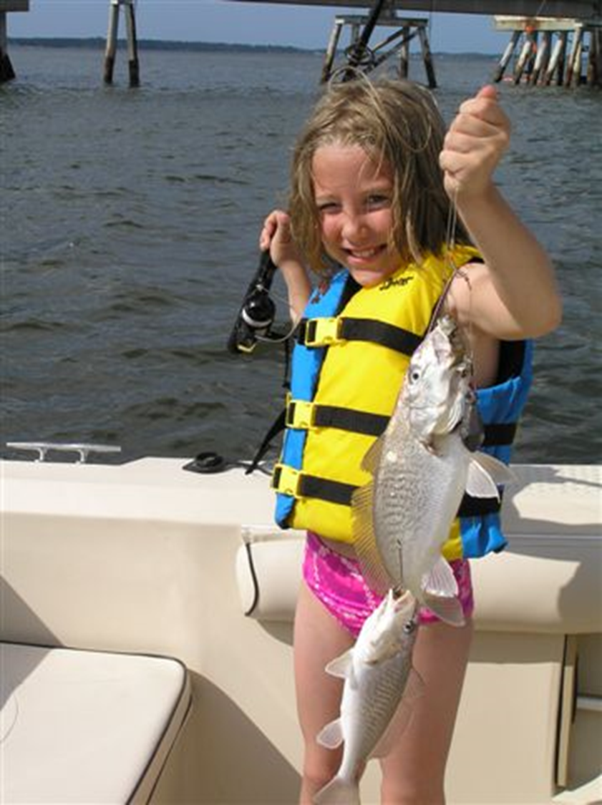
program framework
Articulate program goals
Develop system level model for goal attainment
Assess current management efforts – identify gaps
Develop management strategy
Develop monitoring program
Assess performance
Manage adaptively

Slide 16

Develop monitoring program
accountability
  actions undertaken
  outcomes realized
assumptions
  system drivers not managed
partnership performance
  adaptive management implemented (really?)
  external program coordination
http://sero.nmfs.noaa.gov/sustainable_fisheries/acl_monitoring/

Slide 17
program framework
Articulate program goals
Develop system level model for goal attainment
Assess current management efforts – identify gaps
Develop management strategy
Develop monitoring program
Assess performance
Manage adaptively

Slide 18
Establishing performance expectations
response
time
response
response
time
time

Slide 19
Establishing performance expectations
response
Identifying uncertainty
time
response
response
time
time

Slide 20

program framework
articulate program goals
refine system level model for goal attainment
re-assess current management efforts – identify gaps
revise management strategy
adjust monitoring program
assess performance
manage adaptively

Slide 21
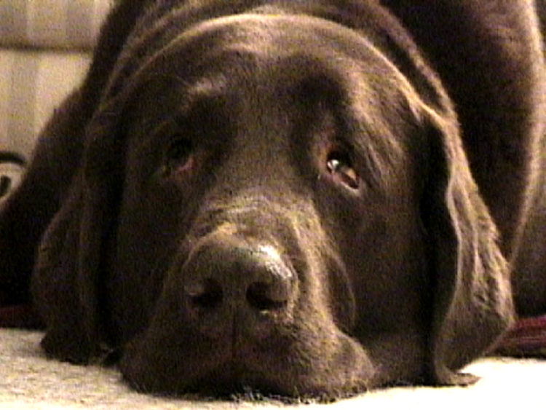
Carl Hershner
Center for Coastal Resources Management
Virginia Institute of Marine Science
carl@vims.edu
804-684-73

