Slide 1
Renewable Energy Mapping and Planning Activities in the South Atlantic
March 2, 2015
South Atlantic Fisheries Management Council
St. Simons Island, Georgia
Brian Krevor, Environmental Protection Specialist
Office of Renewable Energy Programs
Bureau of Ocean Energy Management

Slide 2
Outline
South Atlantic Overview
North Carolina
  Planning Process
  NEPA Process
South Carolina Planning Efforts
BOEM Studies Efforts

Slide 3
South Atlantic Overview
State | Milestones
North Carolina | WEAs Announced – August 11, 2014 EA Published – January 22, 2015 Next Steps: Finalize Environmental Review, Lease Sale
South Carolina | Third Task Force Meeting – September 23, 2014 Next Steps: Publish Call for Information and Nominations
Georgia | EA for Interim Policy Lease – April 1, 2014 Next Steps: Finalize Environmental Review, Issue Interim Policy Lease
Florida | Interim Policy Lease Issued to FAU – June 1, 2014 First Task Force Meeting – December 11, 2014

Slide 4
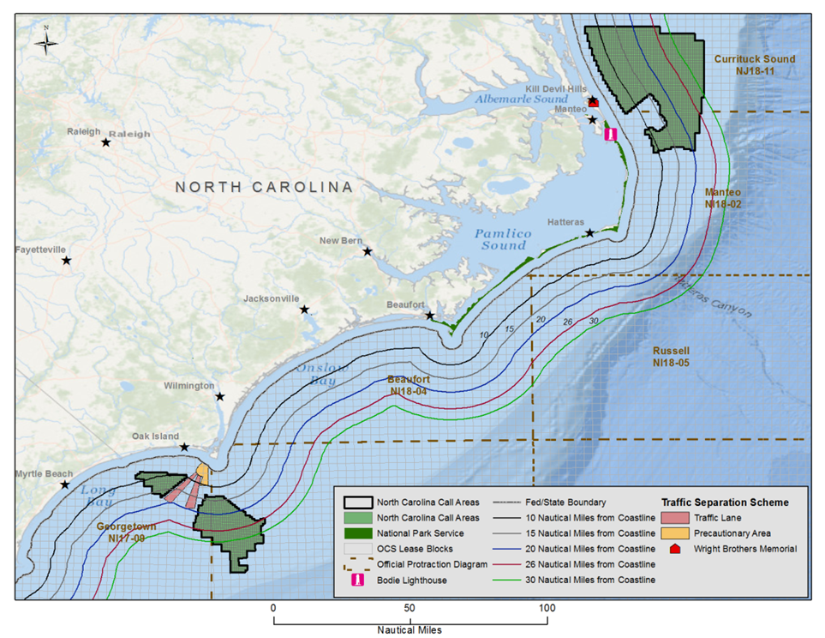
North Carolina Planning Efforts
Call published in December 2013
Key issues to resolve:
  Visual impacts from NPS lands
  Vessel traffic/navigational safety

Slide 5
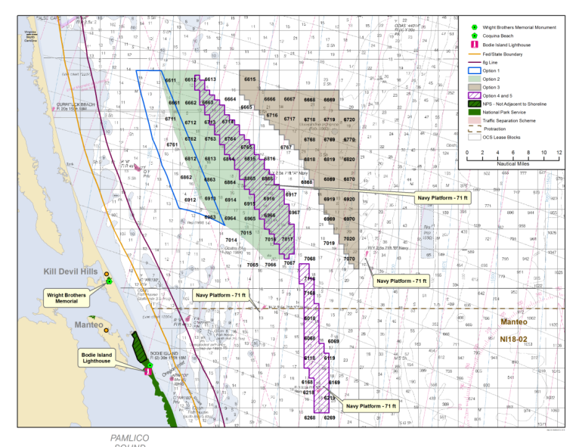
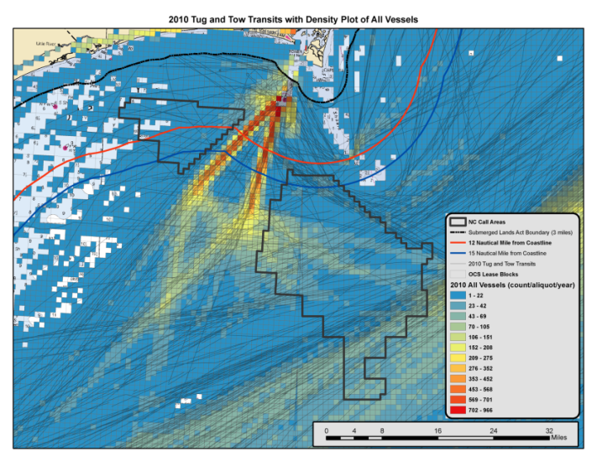
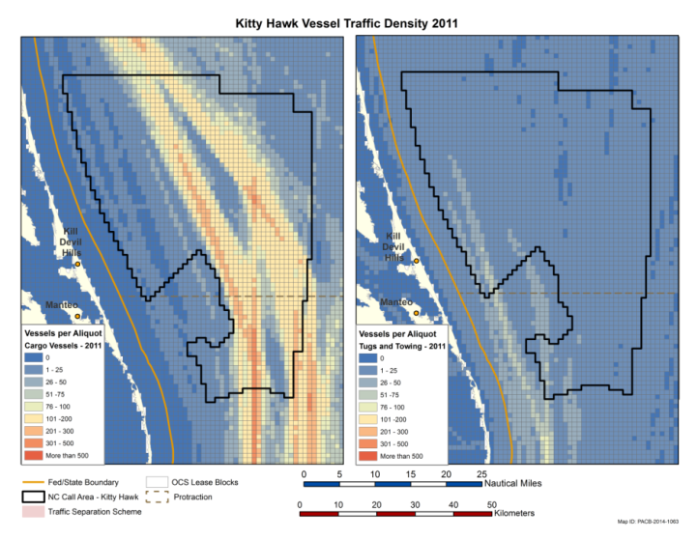
North Carolina Planning Efforts: Maritime Concerns
Maritime stakeholder meetings held:
  December 2012 Norfolk, VA
  June 2013 Norfolk and Arlington, VA
September 2013 questionnaire/survey effort lead by the USCG
  100 members

Slide 6
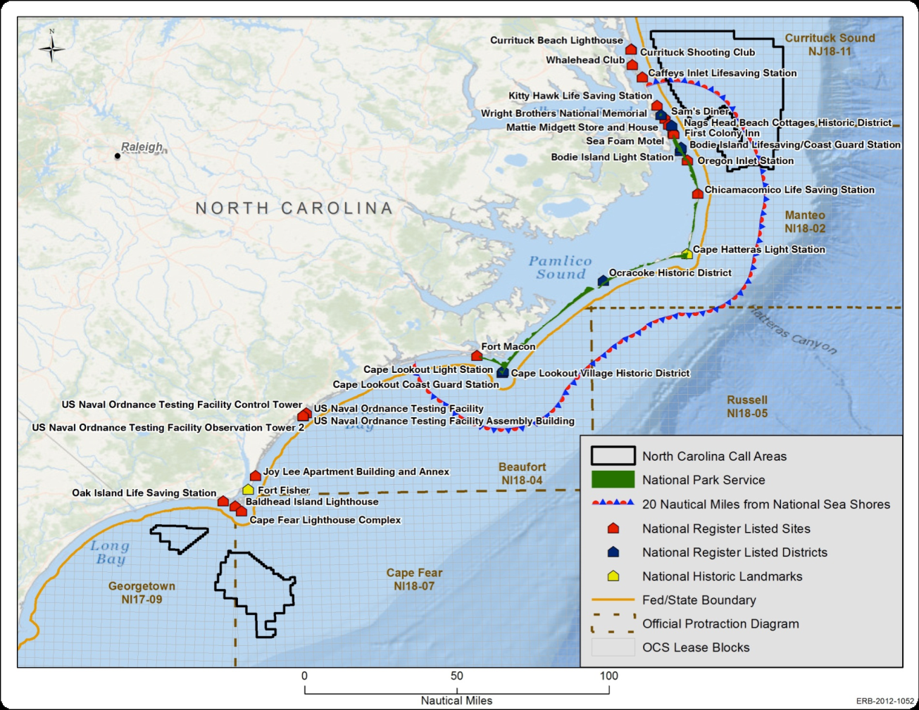
North Carolina Planning Efforts
North Carolina Visual Simulation Study
Public open houses
Meetings with NPS

Slide 7
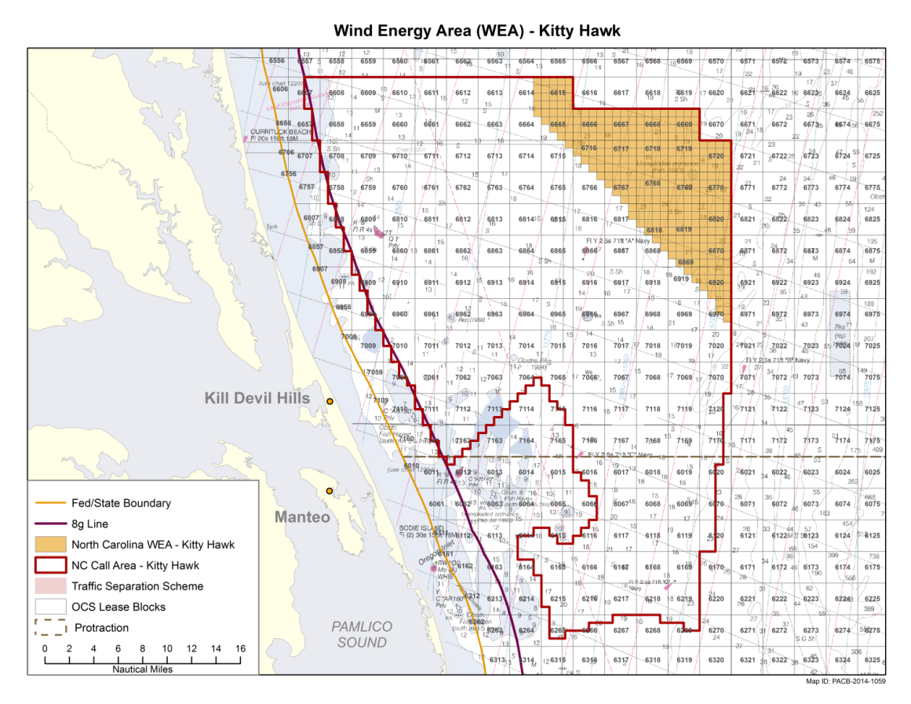
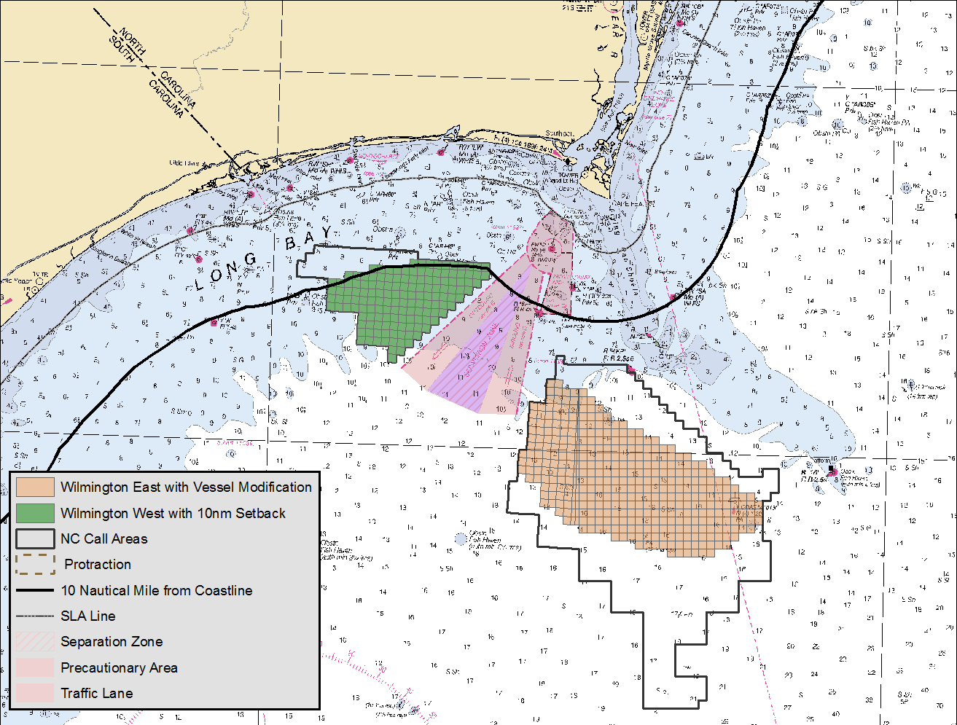
North Carolina Planning Efforts: Wind Energy Areas

Slide 8
North Carolina Environmental Assessment (EA)
The National Environmental Policy Act (NEPA) was established by Congress in 1969.
Two primary purposes of NEPA:
  Informed decisions
  Public involvement
North Carolina EA published January 22, 2015
  Public meetings held in Kitty Hawk, Wilmington, and Carolina Shores, NC
  30-day public comment period ended on February 23, 2015

Slide 9
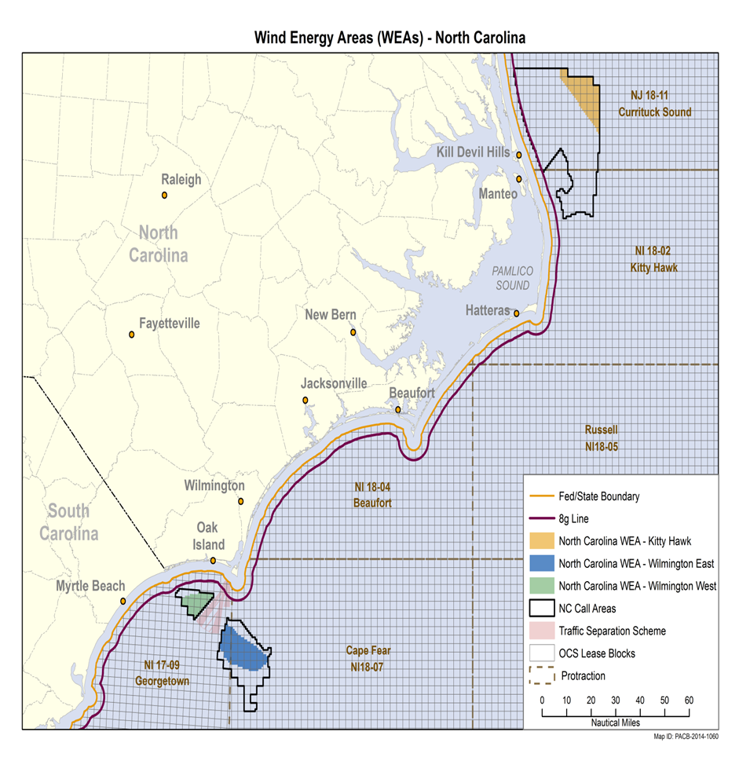
North Carolina EA:
Proposed Action (Alternative A)
Lease issuance of all three Wind Energy Areas (WEAs)
Associated site characterization surveys (e.g., shallow hazards, geological, geotechnical, archaeological, and biological surveys)
Subsequent site assessment activities (e.g., construction and operation of meteorological towers and/or buoys)

Slide 10
North Carolina EA:
Alternatives Considered
Alternative B | Removal of Wilmington West WEA due to migrating North Atlantic right whales
Alternative C | Prohibits high resolution geological and geophysical survey activities from November 1 - April 30 due to migration patterns of North Atlantic right whales
Alternative D | No action

Slide 11
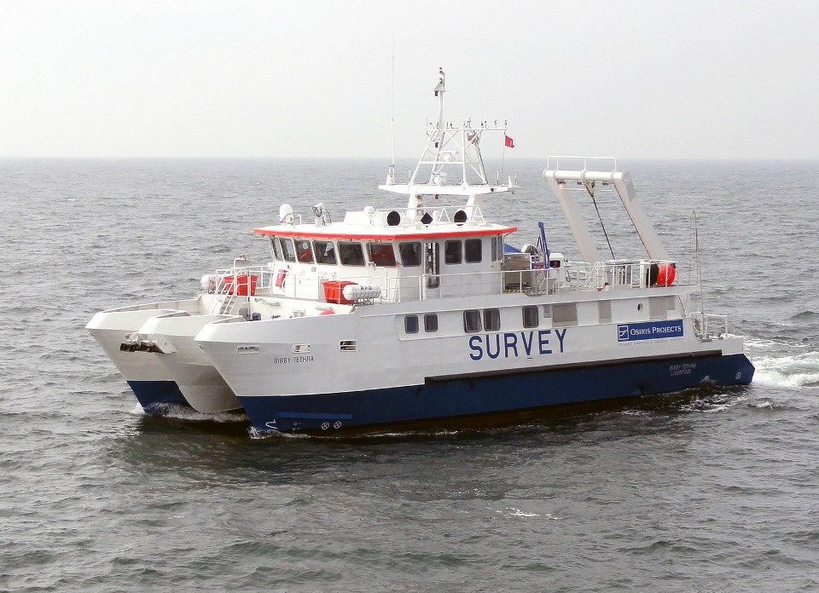
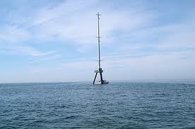
Impact Producing Factors
Vessel Traffic
Noise (Pile Driving, Surveys)
Vessel Collisions/Allisions
Bottom Disturbance
Emissions and Discharges
Lighting
Severe Storms
Visual and Aesthetic Interference

Slide 12
Environmental and Socioeconomic Resources Considered
Physical
  Air Quality
  Water Quality
Biological
  Marine Mammals
  Sea Turtles
  Fish and Essential Fish Habitat (EFH)
  Coastal Habitats
  Benthic Resources
  Avian and Bat Species
Socioeconomic
  Aesthetics and Visual Resources
  Commercial and Recreational Fishing
  Cultural Resources
  Military Uses
  Environmental Justice
  Land Use and Coastal Infrastructure
  Tourism and Recreation
  Demographics and Employment

Slide 13
North Carolina EA:
Standard Operating Conditions
Appendix B of the EA
Based on previous and ongoing consultations with NOAA NMFS and FWS
Part of the proposed action or “in place”
Developed to reduce or eliminate the potential for environmental risks
Enforced through lease stipulations or terms and conditions of plan approval
Include vessel strike avoidance measures, protected species observers (PSO), exclusion zones, and ramp up requirements

Slide 14

North Carolina EA:
Next Steps
Based on the nature and extent of comments received, we may:
Publish a Finding No Significant Impacts (FONSI);
Revise the EA; or
Determine that an Environmental Impact Statement (EIS) is required.

Slide 15
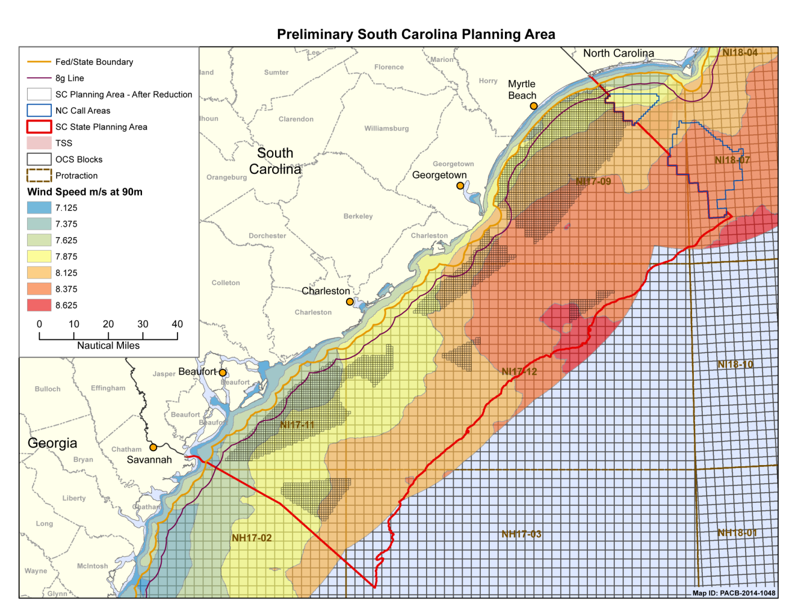
South Carolina Planning Efforts
Three task force meetings held
Areas removed for conflicts with military uses and navigational safety

Slide 16
Proposed North Atlantic Right Whale Critical Habitat
On February 20, 2015, NOAA NMFS proposed the expansion of critical habitat for North Atlantic right whales
60-day public comment period
Proposed Southeastern U.S. Calving Critical Habitat

Slide 17




Recent Study Highlights
Collaboration in Wilmington-East Call Area
  UNC Institute of Marine Sciences
  Geodynamics
  NOAA’s Center for Coastal Habitat & Fisheries Research
  BOEM
Main Objectives:
  To obtain spatially explicit information on where wind energy development can avoid known stakeholder conflicts (fishing, diving, and ecotourism)
  To obtain spatially explicit information about the seafloor in Wilmington-East
  To better understand the ecology of these benthic habitats and value to fishes for marine spatial planning

Slide 18
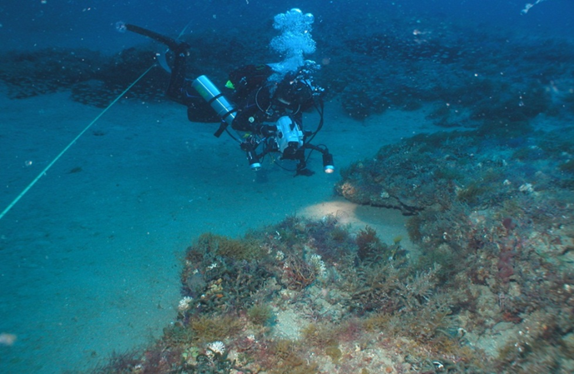
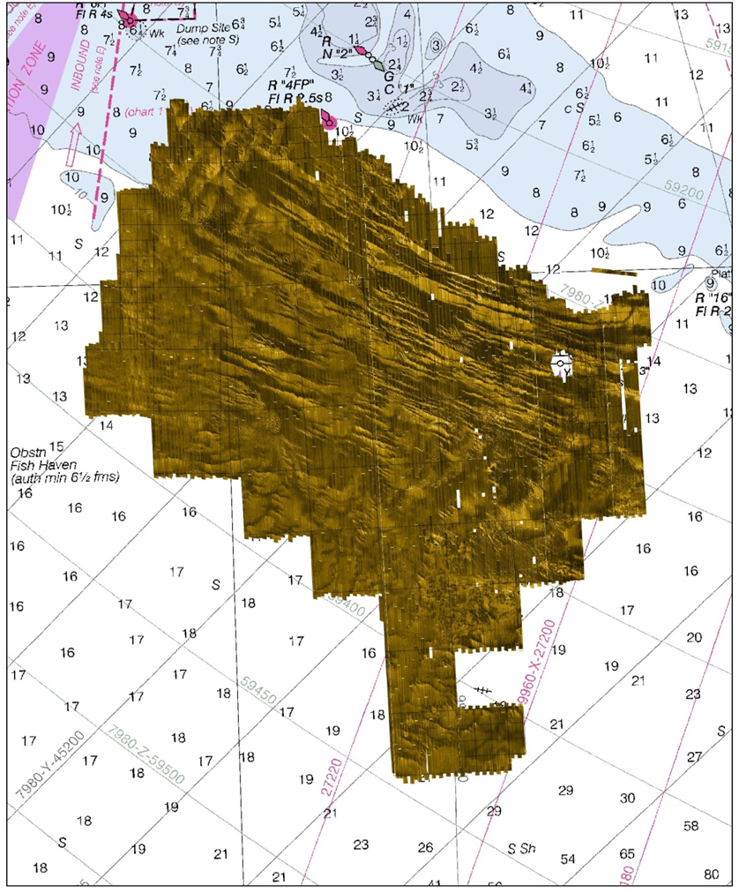
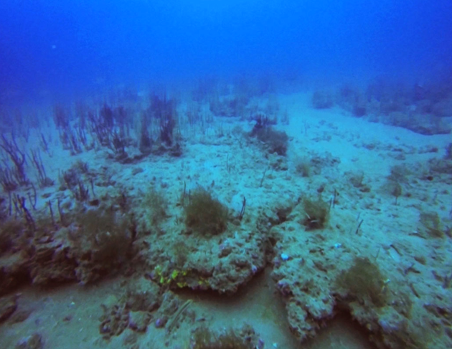

Slide 19
Recent Study Highlights
Socio-Economic Impact of OCS Wind Development on Fishing
  An inter-agency agreement with NEFSC Woods Hole.
  Uses combination of dealer and VTR reports to obtain a spatially-explicit revenue model.
  Provides detailed “exposure” of revenue obtained from wind energy areas.
  Covers Massachusetts to North Carolina.

Slide 20
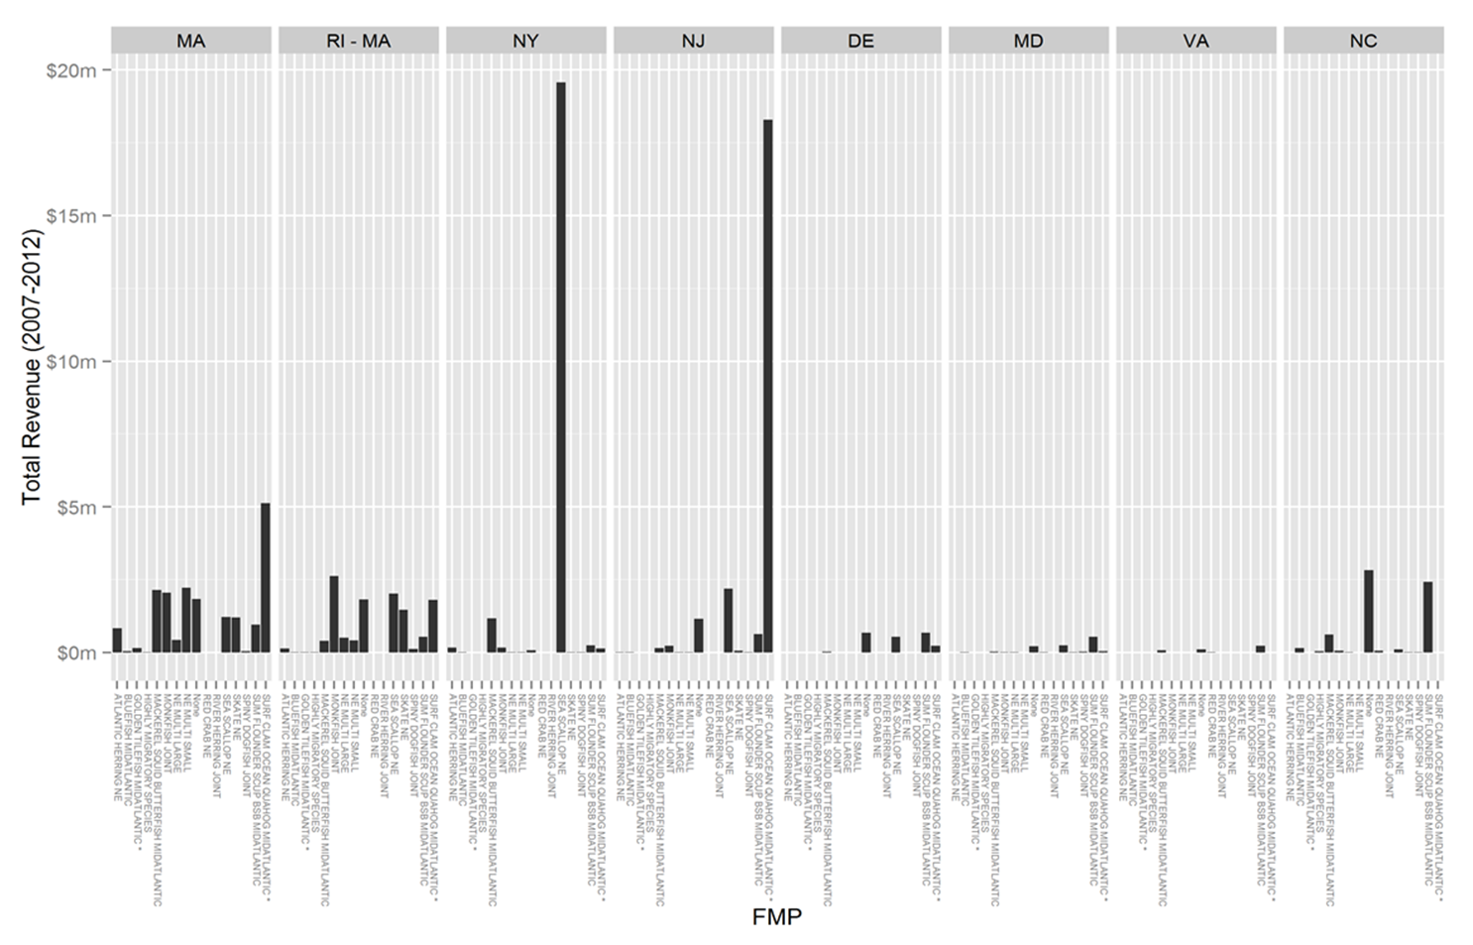

Slide 21
Other Studies: Biological
Use of Northeast Coastal Ocean Forecast System in Offshore Wind Energy Resource Planning (Southern New England/Mid-Atlantic) - UMass
EMF impact studies are continuing:
  EMF model-based assessment and literature review is completed.
  Atlantic EMF study (Long Island Sound) on elasmobranch (sharks, rays and skates) and American lobster movement and migration. – URI/Cranfield University
Effects of Pile Driving Sounds on Auditory and Non-Auditory Tissues of Fish.
Assessing Potential Impacts of Offshore Wind Farm Development on Fisheries Resources(Southern New England)- Commercial Fisheries Research Foundation
Benthic Habitat Assessment (Southern New England/Mid-Atlantic) – NEFSC Sandy Hook
Lobster Cooperative Ventless Trap Study (Southern New England) - URI

Slide 22
Other Studies: Socioeconomic
Development of Mitigation Measures to Address Potential Use Conflicts Between the Wind and Commercial Fishing Industries (nine workshops from Maine to NC)
Collaborative Fisheries Planning for Virginia’s Offshore Wind Energy Area - Virginia Department of Environmental Quality
Digitization of 1976 Anglers Guide to the United States Coast

Slide 23
Questions?
Brian Krevor, Environmental Protection Specialist
Brian.Krevor@boem.gov
703-787-1346

