Slide 1

Final Rule Designating North Atlantic Right Whale Critical Habitat
South Atlantic Fisheries Management Council Protected Resources Committee Meeting
Jennifer Lee
Fishery Management Liaison
Southeast Regional Office,
Sea Turtles and Fisheries Coordination Branch
Protected Resources Division
March 7, 2016

Slide 2
Preface
Presentation excludes:
Background and Proposed Rule (See NARW Critical Habitat Presentation from March 2015 SAFMC Meeting)
Presentation focuses on:
Critical habitat in SER (Unit 2) –particularly changes from Proposed Rule

Slide 3
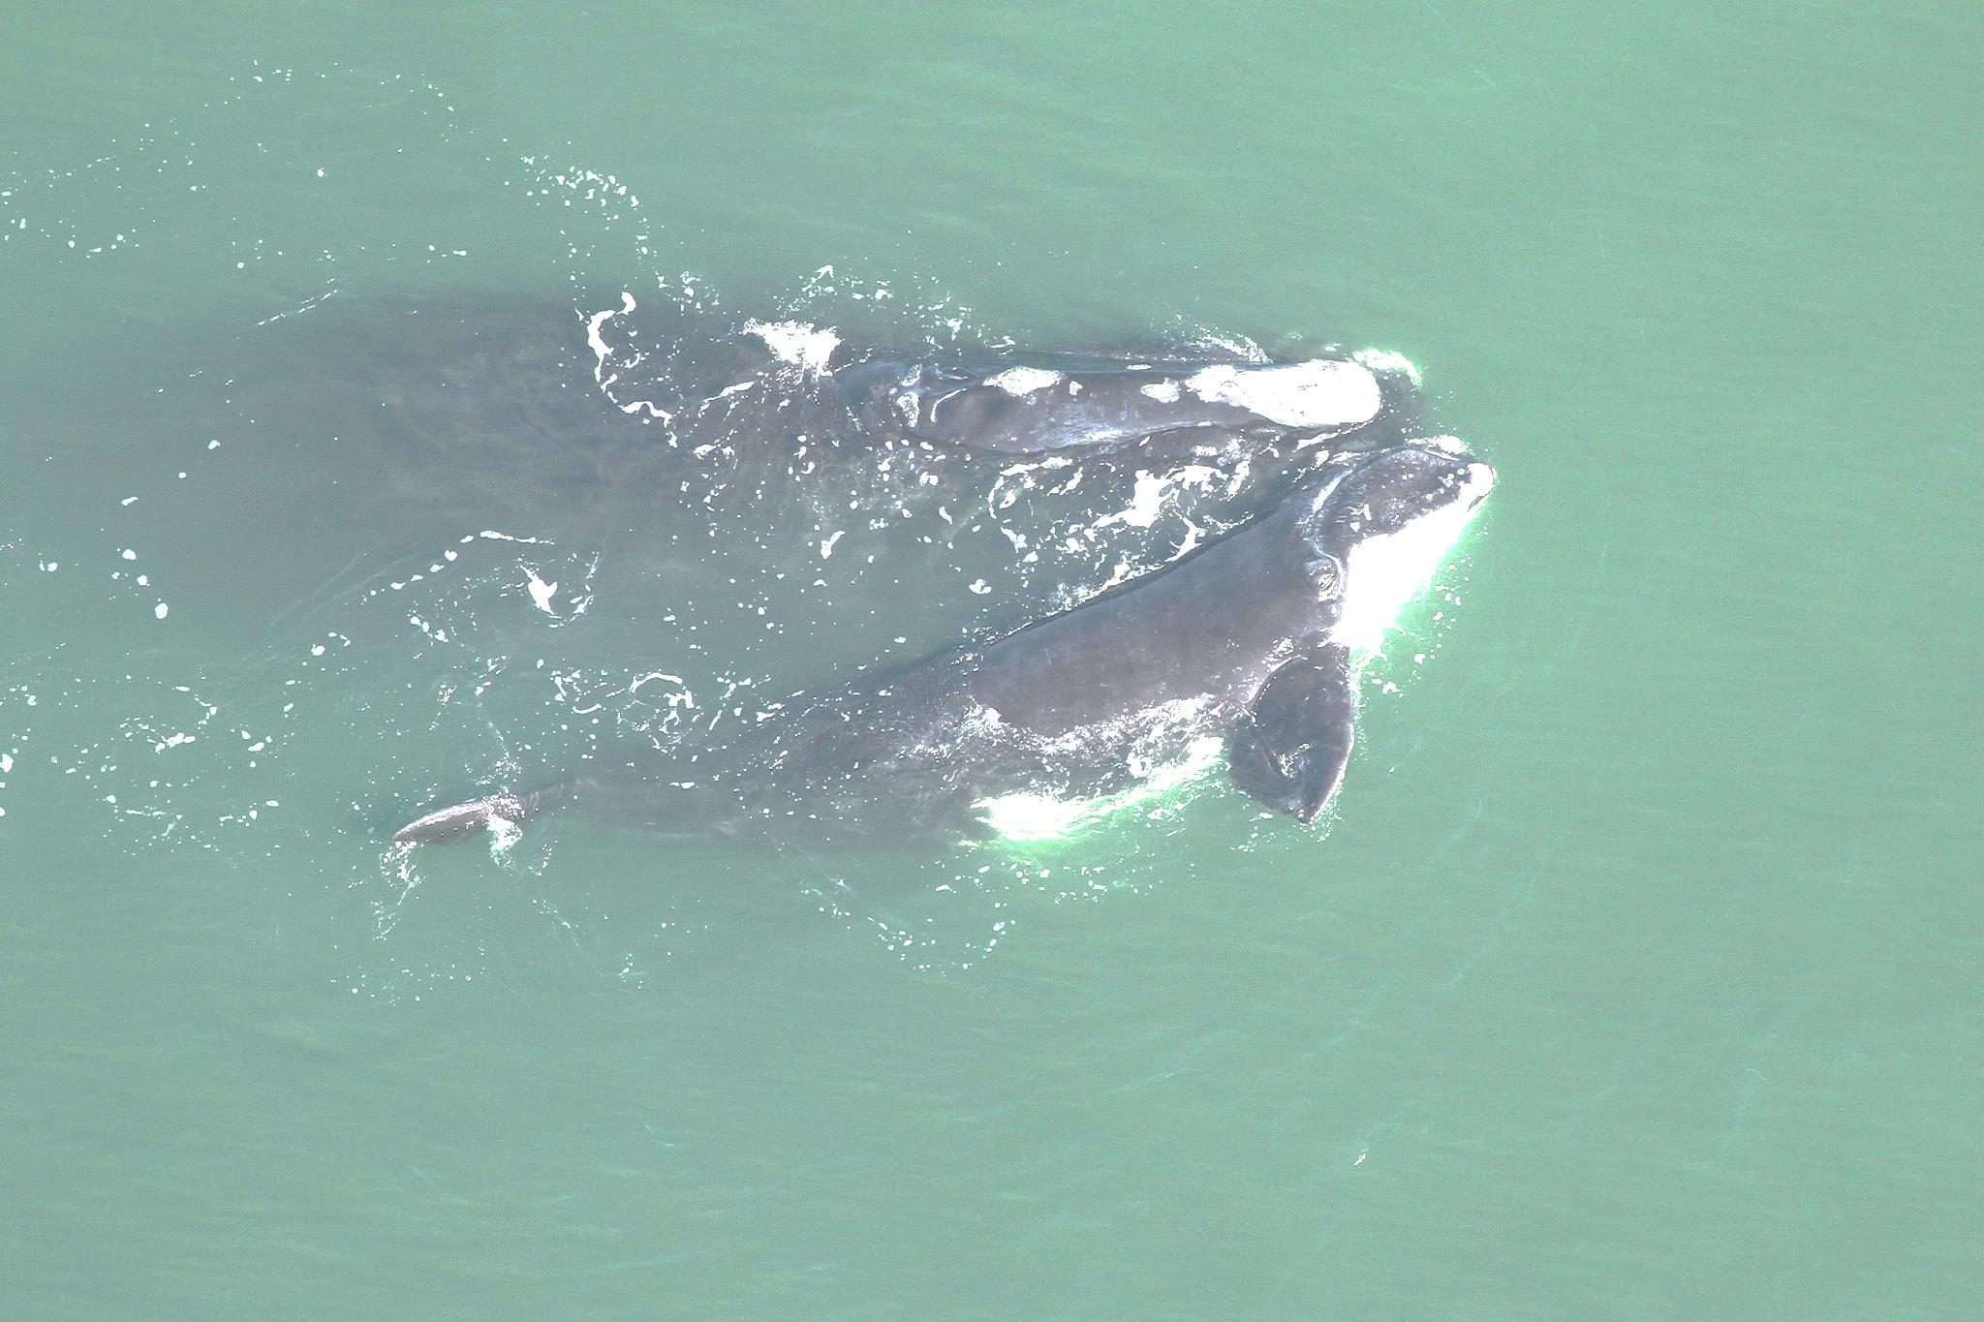
NARW Calving Habitat Essential Features
Calm seas surface conditions of Force 4 or less on the Beaufort Wind Scale;
Sea surface temperatures from a minimum of 7ºC and never more than 17ºC; and
Water depths of 6 to 28 meters, where…
these features simultaneously co-occur over contiguous areas of at least 231 km² of ocean waters during the months of November through April.

Slide 4
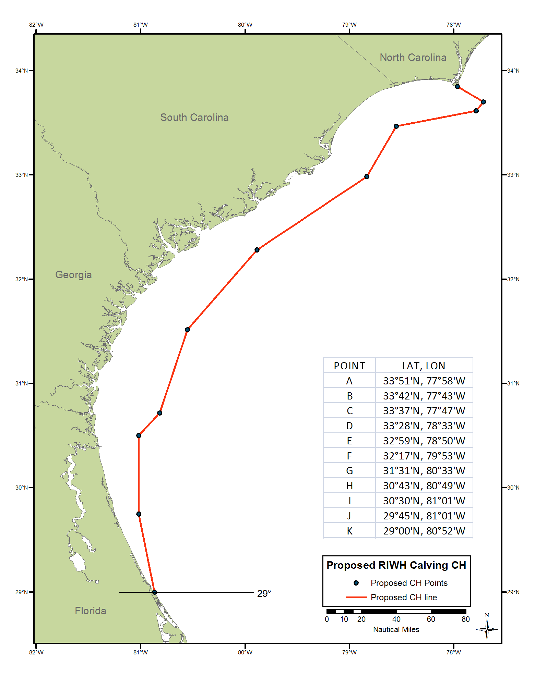
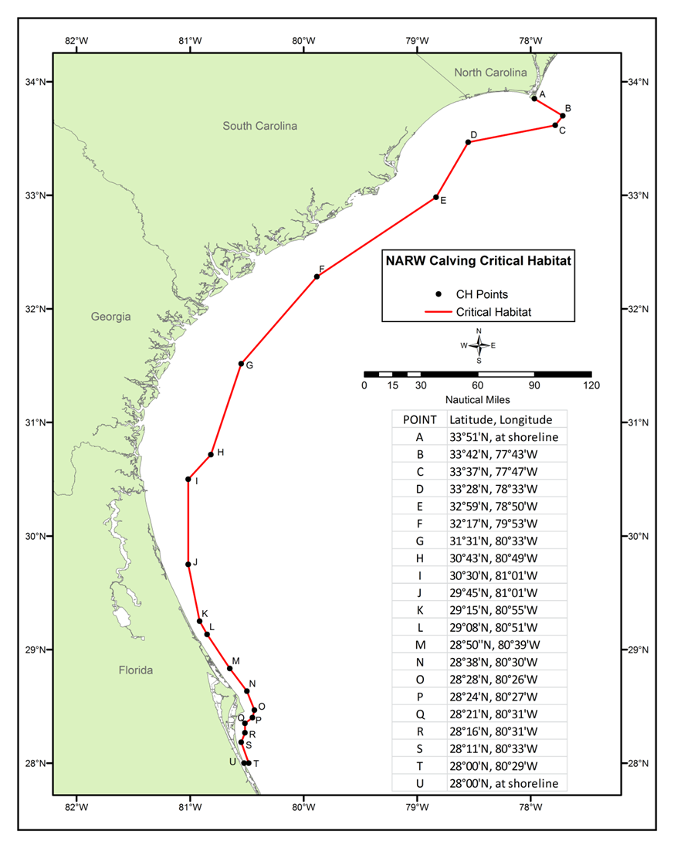
Proposed vs. Final Critical Habitat (Unit 2)
8,088 nm²
8,429 nm²
Proposed
Final

Slide 5
Reason for Adding “Southern Tail”
A number of comments received about including the southern portion in critical habitat
NMFS considered and agreed because:
  m/c pairs within the area are predictable and consistent,
  Presence of all essential features are predicted to occur at least part of the calving season when m/c pairs are present in the area, and
  Features in the area may require special management similar to elsewhere in calving area critical habitat

Slide 6
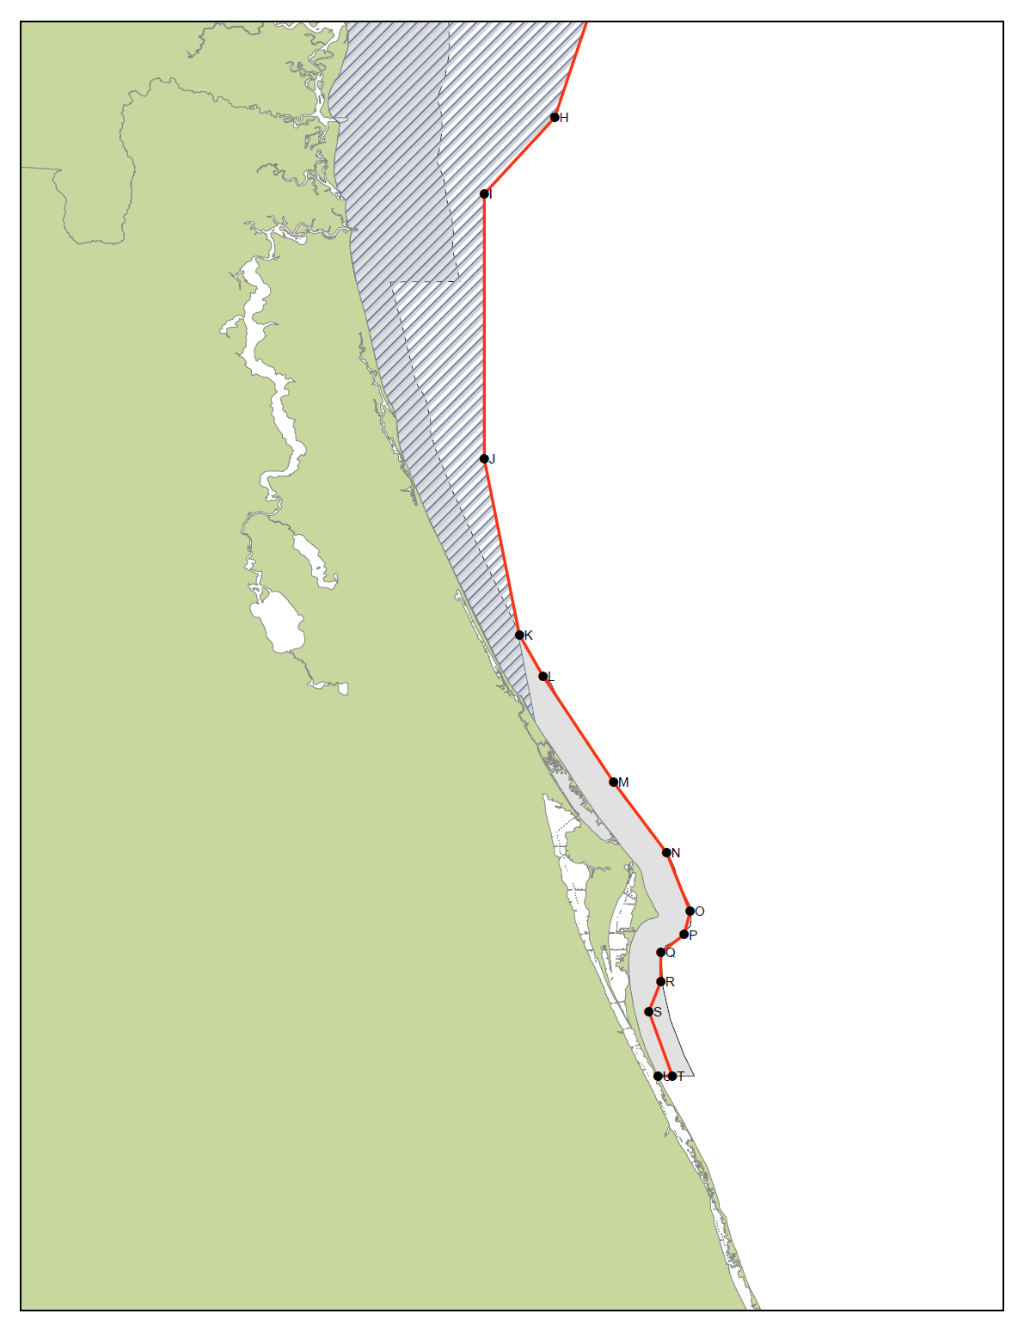
Old, Proposed, and Final Critical Habitat
Old
Proposed
Final

Slide 7
What “May Effect” Critical Habitat?
Based on Past Consultations
National Pollution Discharge Elimination System (NPDES) permitting
Oil spill response
Dredging and spoil disposal
Marine Construction Permitting
Construction and operation of energy facilities

Slide 8
What “May Effect” Critical Habitat?
New Categories Anticipated:
Oil and gas exploration and development
Offshore alternative energy development
Directed copepod fisheries
Marine aquaculture

Slide 9
