Slide 1
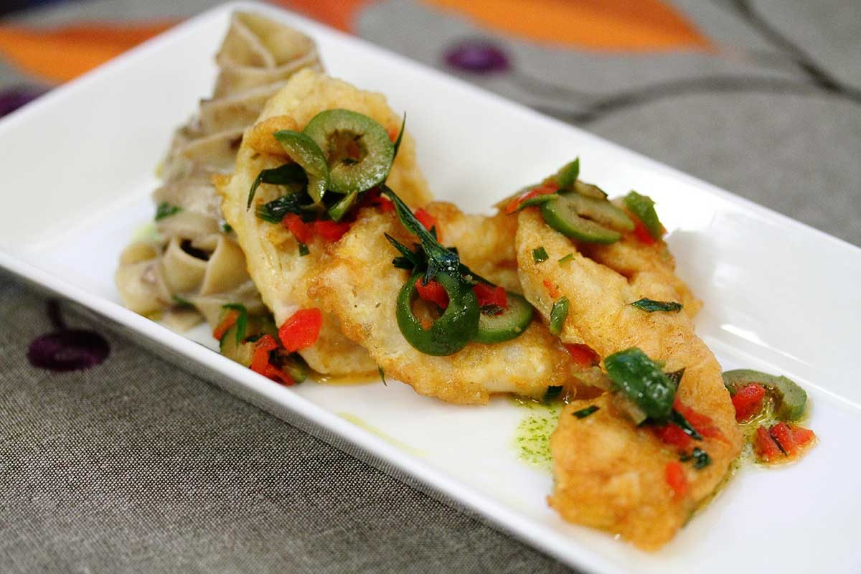
Saltonstall-Kennedy Research Program
Background, Process, and Transparency
Presented by Dan Namur
NMFS Financial Assistance Division Chief

Slide 2
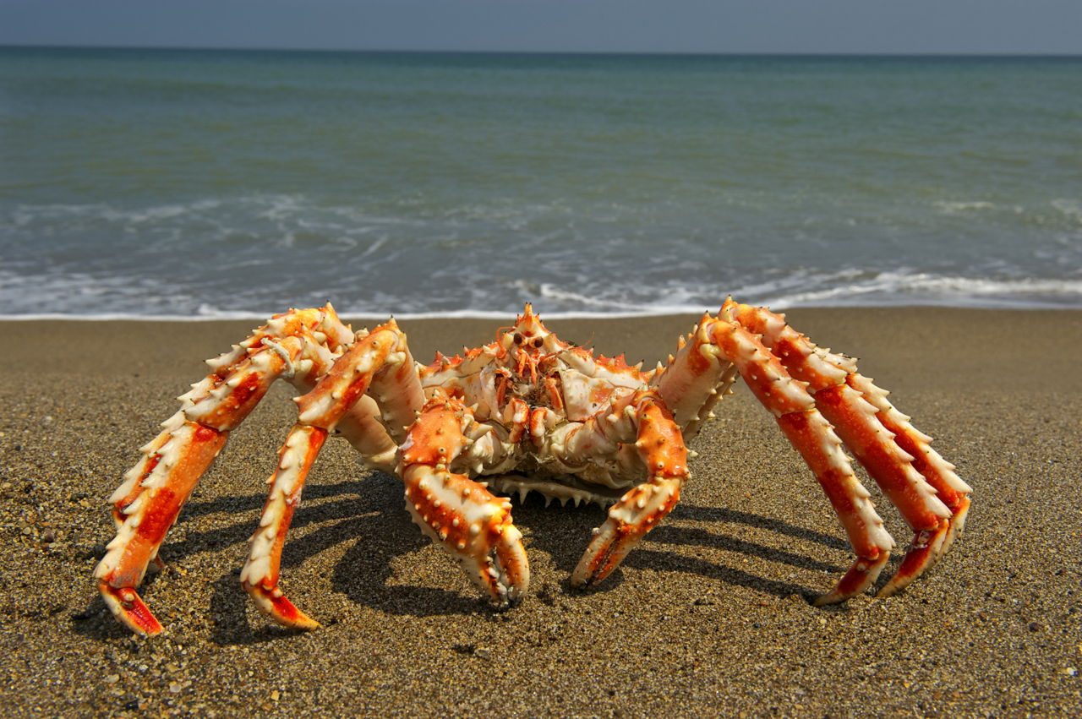
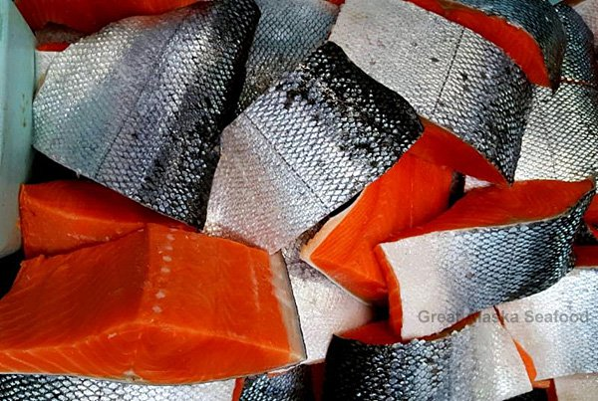
Financial Assistance
NMFS Grants Enterprise
691 Grants
$393M
____________
S-K Competitive Program
40 Grants
$10M

Slide 3
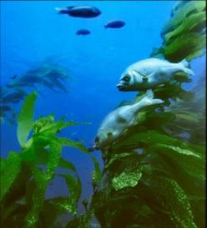
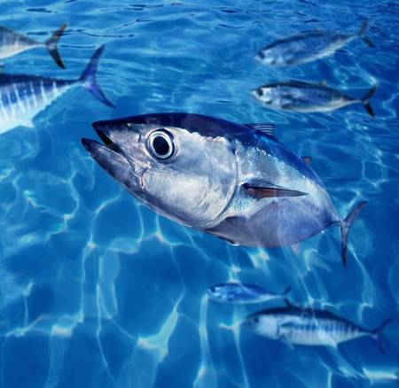
Major Program Areas
Sustainable Fisheries
  IJ Grants
  Councils and Commissions
  Saltonstall Kennedy Program
Protected Resources
  Mitchell Act
  PCSRF
  ESA Grants
  Marine Mammal Grants
Habitat Conservation
  Coral Program
  Resiliency Grants
  DARPP
Science and Technology
  Fisheries Information Networks
Aquaculture
Enforcement
International Affairs
Notes:
during the S-K pre-proposal and technical review phases

Slide 4
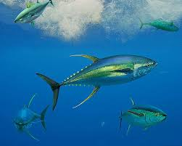
The Saltonstall-Kennedy Act
Promote and Develop (P&D)
Signed into law in 1954
Established a fund used by the Secretary of Commerce to provide grants or cooperative agreements for fisheries research and development projects addressing aspects of U.S. fisheries, including:
    harvesting
    processing
    marketing

Slide 5
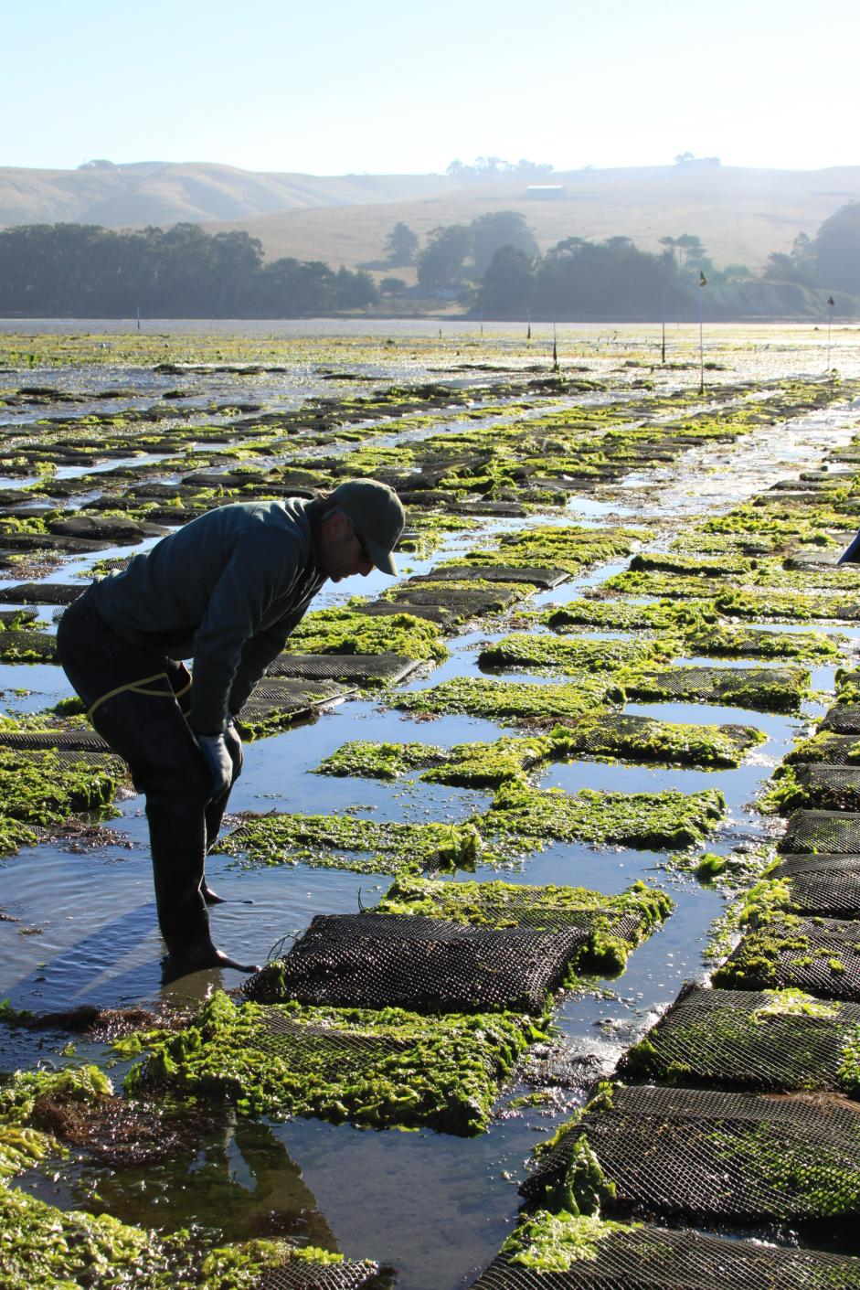
Program Objective
Address the needs of fishing communities in optimizing economic benefits within the context of rebuilding and maintaining sustainable fisheries and practices, and in dealing with the impacts of conservation and management measures

Slide 6

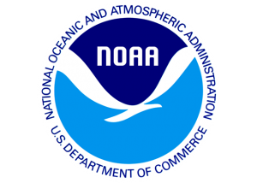
Duties Collected & Transferred
Duties collected from Imports $
$513M
Duties collected from imports are transferred to U.S. Dept. of Agriculture.
USDA then transfers 30% of the duties from seafood and seafood products to NOAA’s Promote and Develop Fisheries Products Account.
This transfer of funding is the only source of funding for NOAA’s Promote and Develop Fisheries Products Account.
$154M 30%

Slide 7
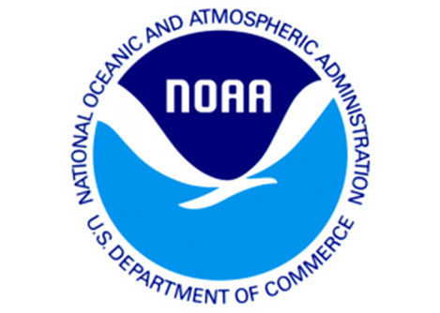
NOAA Accounts (P&D, ORF Offset, and S-K)
Transfer $154.6M from Ag
Promote and Develop Fisheries Products Account (P&D)
(Mandatory)
$144M Offset to ORF
Operations, Research, and
Facilities Account (ORF) (Discretionary)
Fisheries Data Collections, Surveys, and Assessments
  Expand Annual Stock Assessments
  Fish Information Networks
  Survey and Monitoring Projects
  Cooperative Research
Interjurisdictional Fisheries Grants
Remaining $10.6M in P&D after ORF Offset
Available for Saltonstall-Kennedy Grant Program (Mandatory)
Competitive Grant Program
National Program

Slide 8
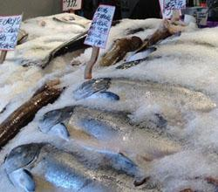
S-K Competitive Grant Program
NMFS seeks applications that demonstrate direct benefits to the U.S. fishing industries and encourages proposals that involve fishing community participation
Priorities are set yearly by NOAA/NMFS
Proposals are peer reviewed

Slide 9
Saltonstall-Kennedy Program
Regional Councils
NMFS Leadership
NMFS Regional Offices
NMFS Science Centers
3 Interstate Fishery Commissions
Saltonstall-Kennedy Grant Program Priorities
The S-K program funds projects that address the needs of fishing communities, optimize economic benefits by building and maintaining sustainable fisheries, and increase other opportunities to keep working waterfronts viable.
Priority areas are developed in coordination with regional councils, commissions and NMFS regional offices.

Slide 10
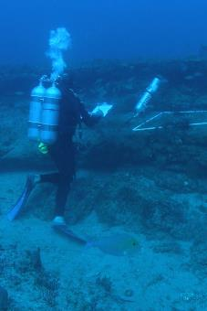
Review and Selection Process
Regional Councils
Pre-Proposal Review
NMFS Leadership
Saltonstall-Kennedy Technical Reviews and Ranking
NMFS Regional Offices
Saltonstall-Kennedy Panel Review and Ranking
NMFS Science Centers
3 Interstate Fishery Commissions
Grant
Selection

Slide 11
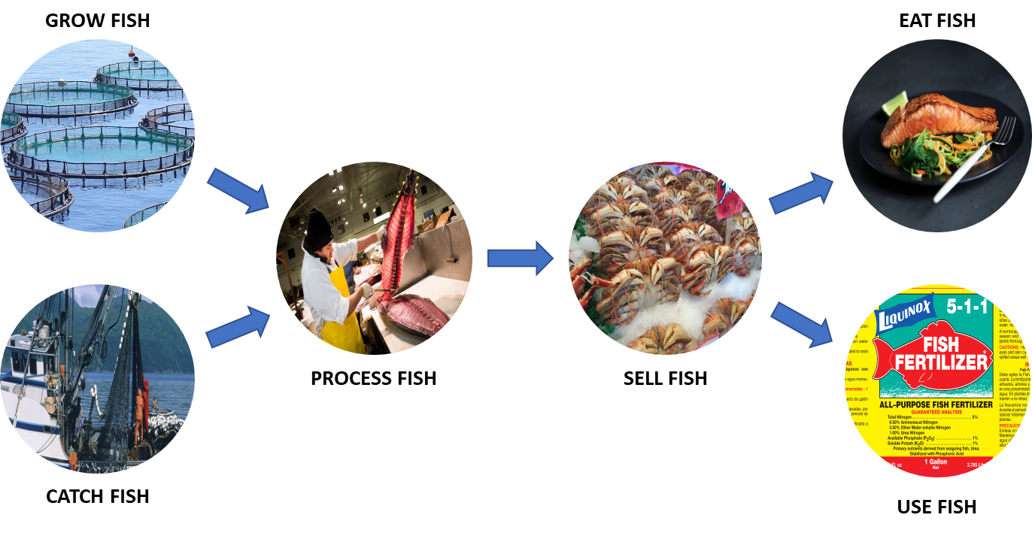
Fisheries Supply Chain

Slide 12
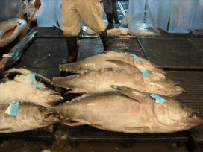
S-K Program Changes in 2019
3 Priorities for the S-K 2019 competition
Priority #1 Promote, Development and Marketing
Priority #2 Marine Aquaculture
      Priority #3 Support of Science that Maximizes Fishing Opportunities,
      Revenue and Jobs in U.S. Fisheries While Ensuring the Long-
      Term Sustainability of Marine Resources

Slide 13
S-K Program Changes in 2020
2 Priorities for the S-K 2020 competition
Priority #1 Promote, Development and Marketing
Priority #2 Science or Technology that Promotes
U.S. Seafood Production and Harvesting
S-K FY20 FFO Posted May 30
Pre-Proposals Due July 30, 2019
Full Proposals Due Nov 12, 2109

Slide 14
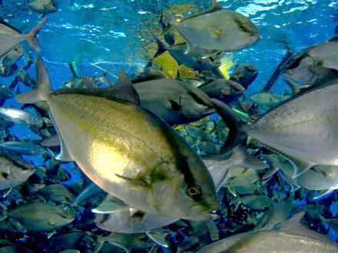
Independent Review
Assess and report on the results of awarded projects to determine if the objectives of the Saltonstall-Kennedy (S-K) Grant Program are being achieved
Assess current S-K program management processes and recommend opportunities for improvement

Slide 15
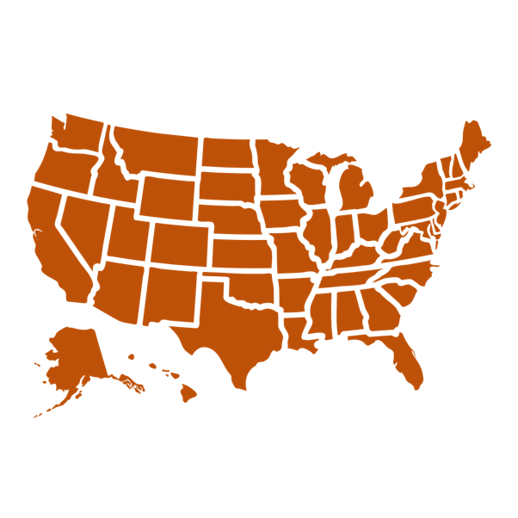
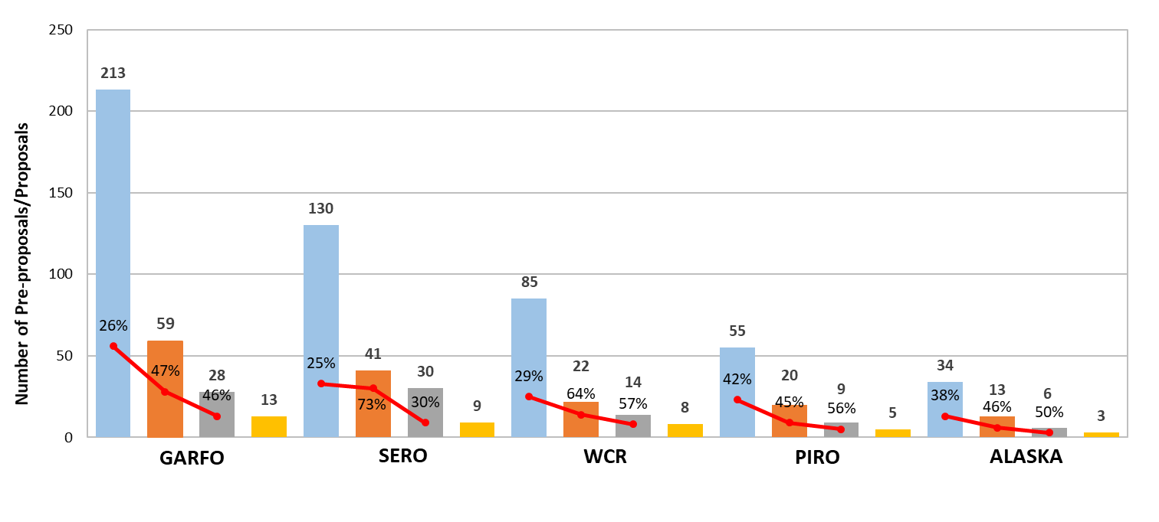
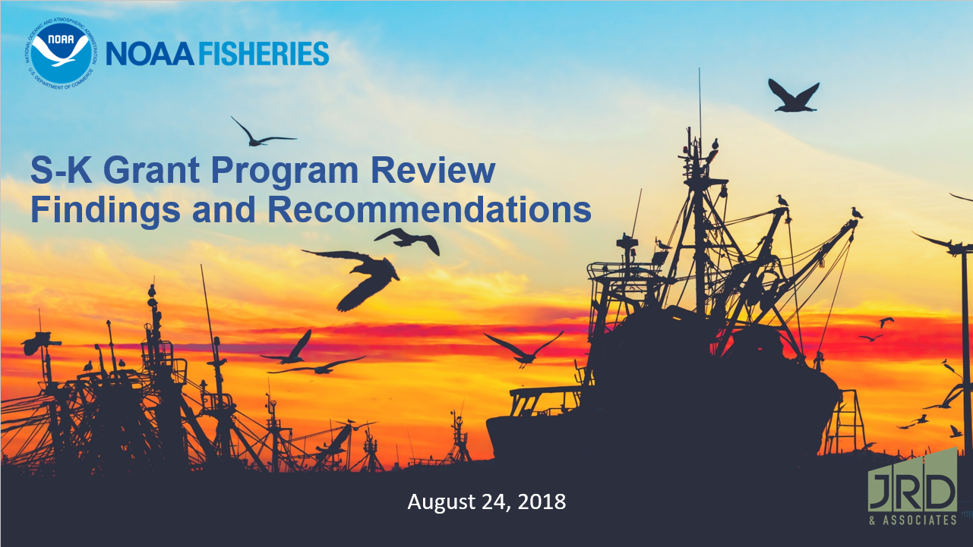
Project Methodology
  _{Visited all regions}
  _{Conducted 108 interviews}
  _{Interviewed 152 people}
S-K Performance Dashboards
Findings and Recommendation Report

Slide 16
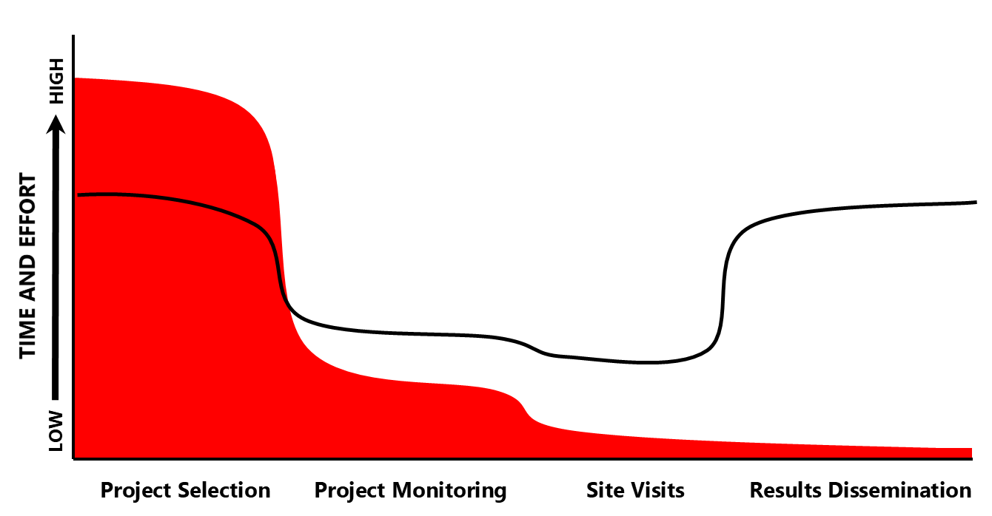
NMFS Time and Effort Spent on the S-K Competitive Grant Program
= Time and Effort Spent

Slide 17
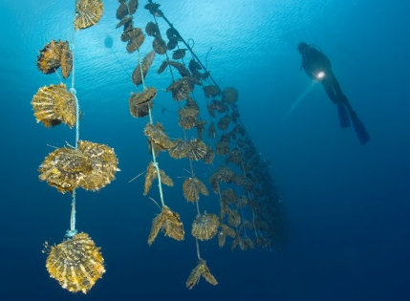

S-K Feedback Sessions
  Today from 5 – 6 PM
  Immediately After the Council Meeting
To Discuss:
Constituent Interest in the Dissemination of Results from Funded S-K Projects

Slide 18
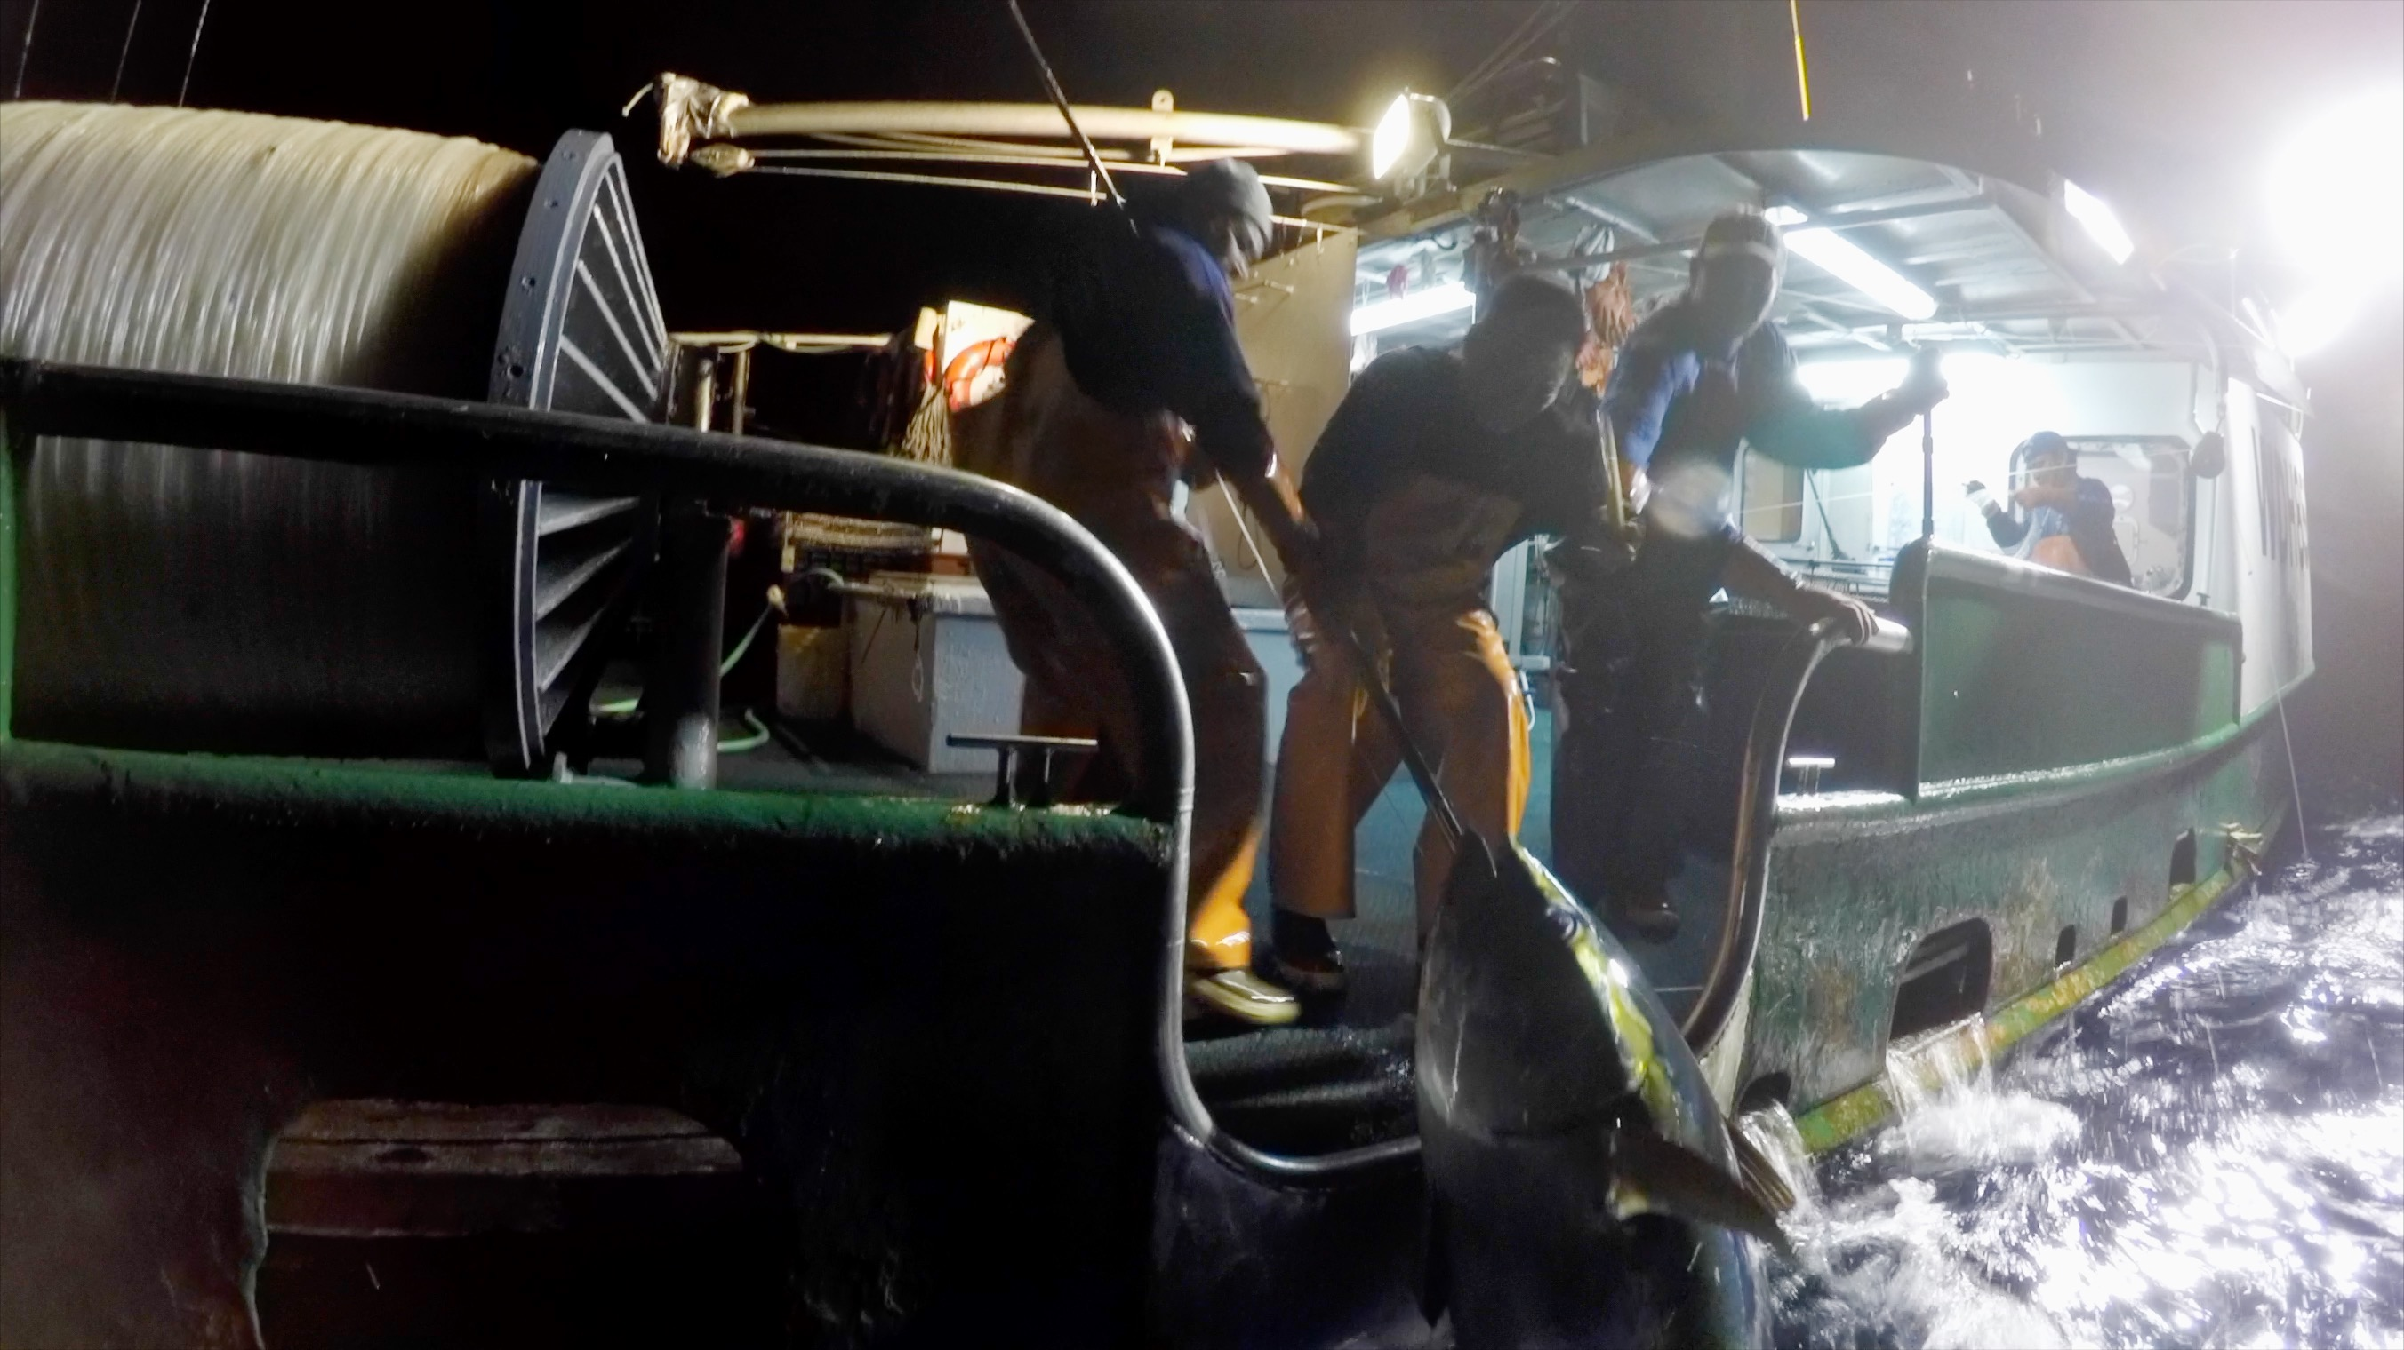
Questions?
U.S. Department of Commerce | National Oceanic and Atmospheric Administration | NOAA Fisheries | Page 18

