Slide 1
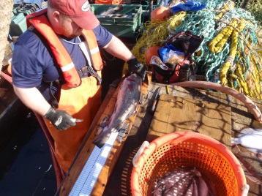
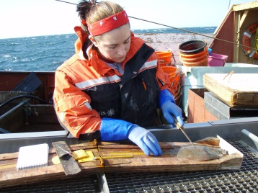
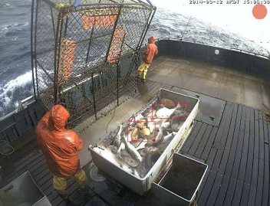
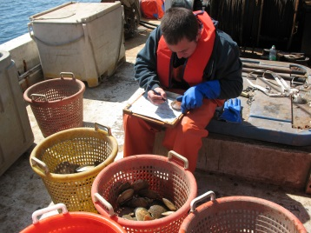
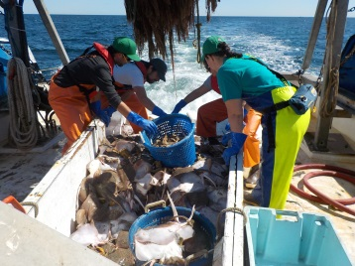
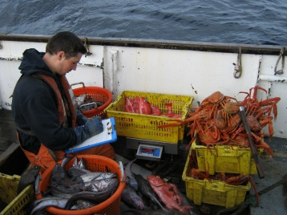
U.S. National Observer Program and Regional Electronic Technology Implementation Plans for 2016 -2018
Jane DiCosimo
National Observer Program
Office of Science and Technology
Silver Spring, MD
September 17, 2015

Slide 2
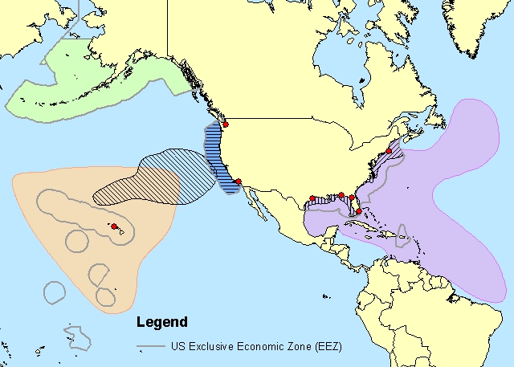

Presentation Overview
National and regional observer programs
  South Atlantic Observer Programs
Budgets
Regional Electronic Technologies Implementation Plans
  Electronic monitoring
Future challenges
U.S. Department of Commerce | National Oceanic and Atmospheric Administration | NOAA Fisheries | Page 2

Slide 3
National Observer Program (1999)
Mission
Provide a formalized mechanism for NOAA Fisheries to address observer issues of national importance and to develop policies and procedures to ensure that NOAA Fisheries observers and observer programs are fully supported. The policies must reflect the diverse needs of regional observer programs while enhancing data quality and achieving consistency in key areas of national importance.
Objectives
Coordinate the National Observer Program Advisory Team.
Communicate and advocate the mission of the National Observer Program and each regional observer program.
Develop and support national standards and policies to create high quality, cost effective, efficient, and productive observer programs.
Characterize and qualify the activities and resources of NOAA Fisheries observer programs and advocate for full support
  Deploys 900 observers / 79,000 sea days / 48 fisheries
U.S. Department of Commerce | National Oceanic and Atmospheric Administration | NOAA Fisheries | Page 3

Slide 4
National Observer Program Budget
U.S. Department of Commerce | National Oceanic and Atmospheric Administration | NOAA Fisheries | Page 4

Slide 5
FY 2015 Observer Budget
($ in Thousands) | FY 2015 Available
PPA: Observers and Training:
Atlantic Coast Observers | $3,334
East Coast Observers | $333
Hawaii Longline Observer Program | $3,775
North Pacific Observer Program | $5,566
NE Fisheries Observers | $8,226
National Observer Program | $12,305
S. Atlantic/Gulf Shrimp Observers | $1,751
West Coast Observers | $4,807
Subtotal, Observers/Training PPA | $40,097
PPA: Reducing Bycatch - Observers Portion Only | $651
Total Observers Funding | $40,748
FY 2015 Enacted amount for Observers and Training is $43.0 million. FY 2015 Available funding shown above include reductions for Hollings Rescission, Prior year De-obligations, and HQ administrative costs.

Slide 6
FY 2015 Observer Budget by Region
($ in Thousands) | FY 2015 Available | North East | South East | West Coast | North West | Alaska | Pacific Islands | Sci. & Tech.
PPA: Observers and Training:
Atlantic Coast Observers | $3,334 | $1,473 | $1,812 | $0 | $0 | $0 | $0 | $49
East Coast Observers | $333 | $0 | $333 | $0 | $0 | $0 | $0 | $0
Hawaii Longline Observer Program | $3,775 | $0 | $0 | $0 | $0 | $0 | $3,775 | $0
North Pacific Observer Program | $5,566 | $0 | $0 | $0 | $0 | $5,566 | $0 | $0
NE Fisheries Observers | $8,226 | $8,226 | $0 | $0 | $0 | $0 | $0 | $0
National Observer Program | $12,305 | $5,039 | $1,036 | $1,039 | $958 | $1,556 | $2,085 | $592
Electronic Monitoring/Reporting | [$900] | [$0] | [$56] | [$174] | [$200] | [$375] | [$95] | [$0]
S. Atlantic/Gulf Shrimp Observers | $1,751 | $0 | $1,751 | $0 | $0 | $0 | $0 | $0
West Coast Observers | $4,807 | $0 | $0 | $0 | $4,807 | $0 | $0 | $0
Subtotal, Observers/Training PPA | $40,097 | $14,738 | $4,932 | $1,039 | $5,765 | $7,122 | $5,860 | $641
PPA: Reducing Bycatch - Observers Portion | $651 | $94 | $94 | $94 | $94 | $94 | $94 | $87
TOTAL | $40,748 | $14,832 | $5,026 | $1,133 | $5,859 | $7,216 | $5,954 | $728
FY 2015 Enacted amount for Observers and Training is $43.0 million. FY 2015 Available funding shown above include reductions for Hollings Rescission, PY De-obligations, and HQ administrative costs.

Slide 7
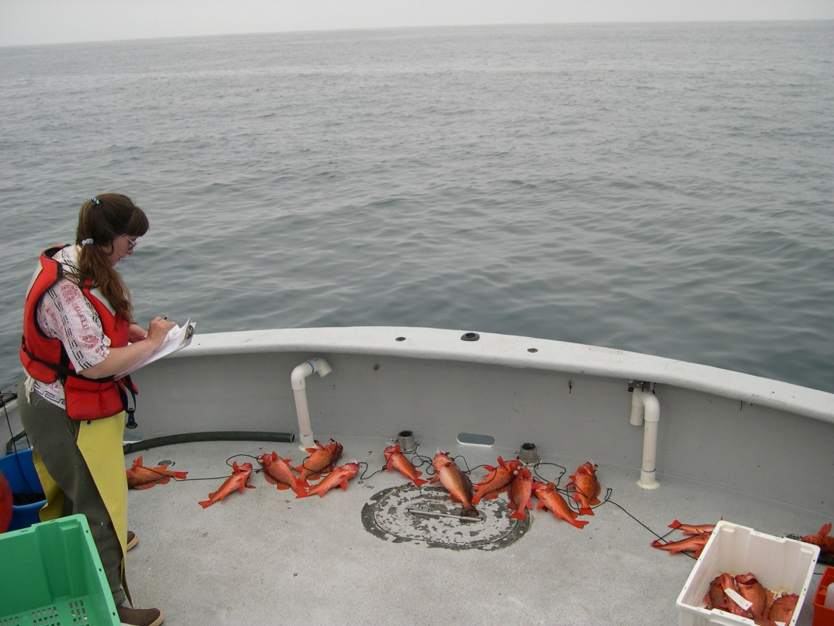
Responsibilities of Regional Observer Programs
Sampling protocols and coverage levels
Safety training
Observer deployment
Observer debriefing
Data management
Data analysis
U.S. Department of Commerce | National Oceanic and Atmospheric Administration | NOAA Fisheries | Page 7

Slide 8
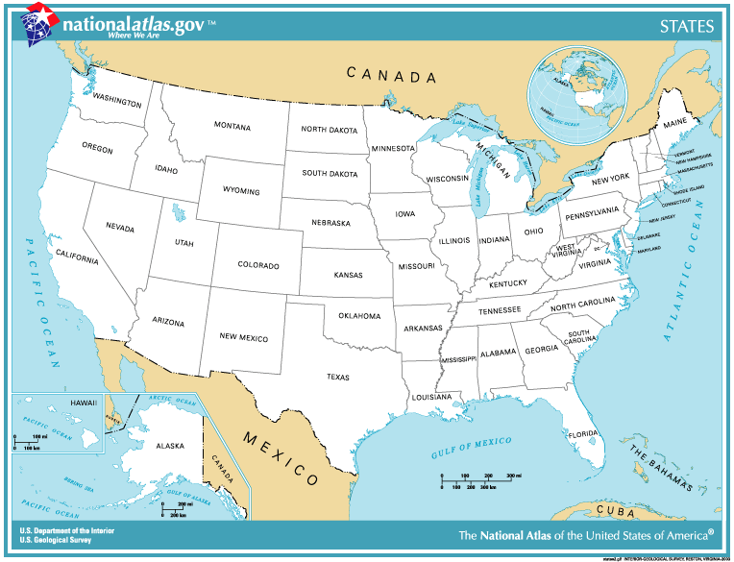
Location of Regional Programs
Seattle, WA
North Pacific Groundfish
West Coast Groundfish / At-Sea Hake
Falmouth, MA
Northeast Groundfish / Scallop Dredge
Mid-Atlantic Gillnet, Beach Seine, Pot
Silver Spring, MD
National Coordination
Long Beach, CA
Pelagic Driftnet and Longline
Honolulu, HI
Pelagic Longline / Bottomfish
American Samoa
Pelagic Longline
Panama City, FL
Shark Driftnet
Shark Bottom Longlline
Galveston, TX
Atlantic and GMX Shrimp Trawl
Miami, FL
Pelagic Longline
Juneau, AK
Salmon Gillnet and Purse Seine
U.S. Department of Commerce | National Oceanic and Atmospheric Administration | NOAA Fisheries | Page 8

Slide 9
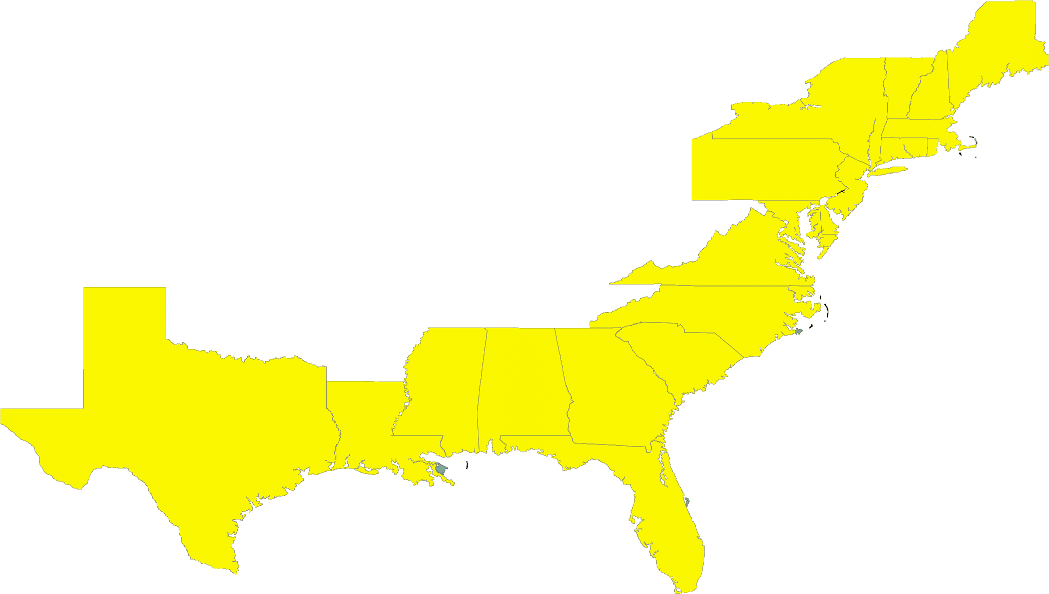
Atlantic Ocean and Gulf of Mexico 2013 coverage
NE Groundfish
Gillnet/Trawl
Coverage: approx. 8%
NE Scallop Dredge
Coverage: 5-20% based on permit type & area fished
Mid-Atlantic Large and Small Mesh Trawl
Coverage: approx. <8%
Herring Trawl (incl. Pair Trawl)
Coverage: 20%
Mid-Atlantic Coastal Gillnet/Pot/Seine
Coverage: <8%
Shrimp Otter Trawl
Coverage: 2%
Atlantic Pelagic Longline
Coverage: 10%
Atlantic Shark Bottom Longline
Coverage: approx. 5%
S Atlantic Shark Driftnet
Coverage: 38%
U.S. Department of Commerce | National Oceanic and Atmospheric Administration | NOAA Fisheries | Page 9

Slide 10
3 South Atlantic Fishery Observer Programs
Southeast Gillnet
Shark Bottom Longline
Mid-shelf and deepwater reef fish

Slide 11
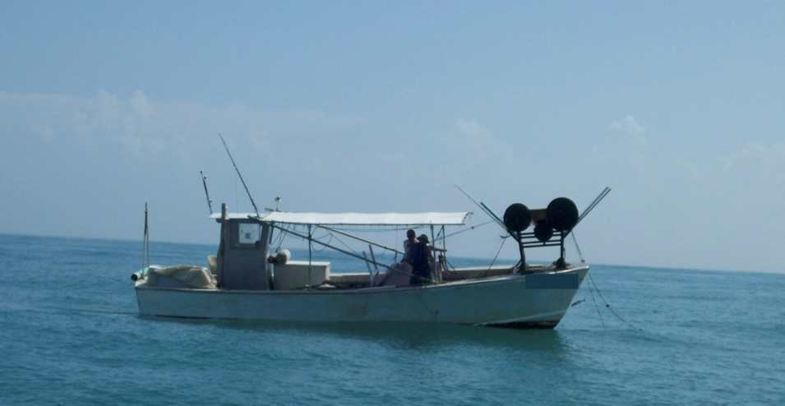
Southeast Gillnet Fishery Observer Program
Administered by SEFSC-Panama City Laboratory
Relatively small boats: 25 – 40 ft. length
Vessels fish North Carolina to Texas
Trips are usually overnight
Most vessels change species targeted and gear type frequently: sharks, mackerel, bluefish, croaker, dogfish
Gear:
  Drift, Strike and Sink

Slide 12
  Southeast Gillnet Fishery Observer Program
  (cont.)
Goals
  Vessels are selected for coverage by randomly choosing vessels from a pool of vessels each quarter based on
    Reported using gillnets in the same season of the previous year
    Target coverage 8-10%
  Provide estimates of sea turtle or marine mammal interactions occurring within all gillnet fisheries in the southeast US
  Collect data on catch and bycatch of all species of fish, shark, and protected resources
    Bioprofile samples taken on select species

Slide 13
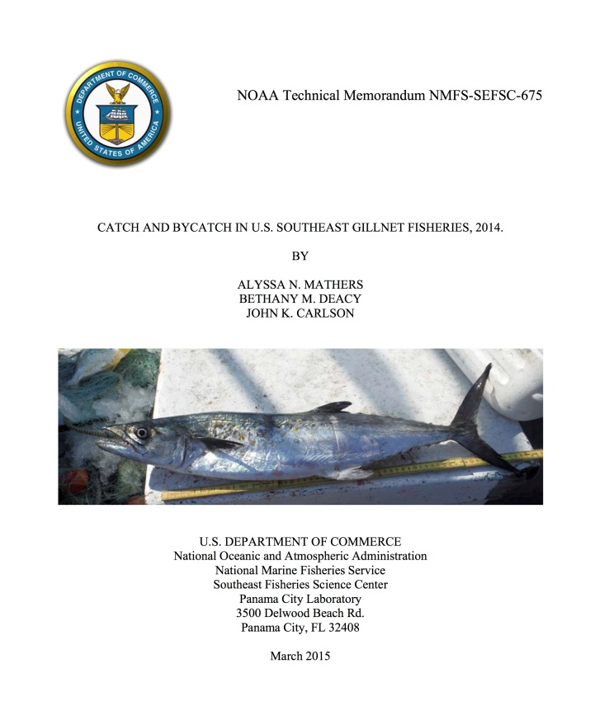
Southeast Gillnet Fishery Observer Program
(cont.)
Annual reports describing effort distribution, catch and bycatch available at:
http://www.sefsc.noaa.gov/labs/panama/ob/gillnet.htm

Slide 14
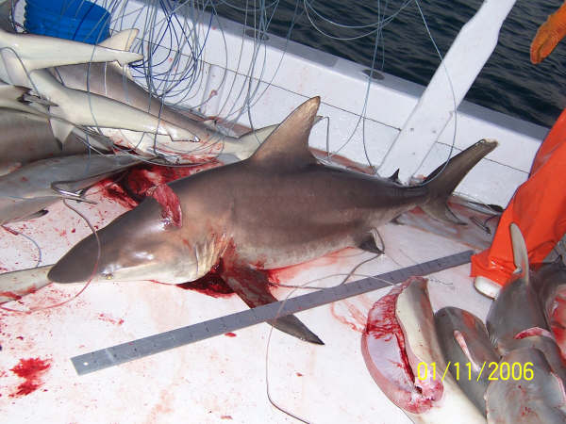
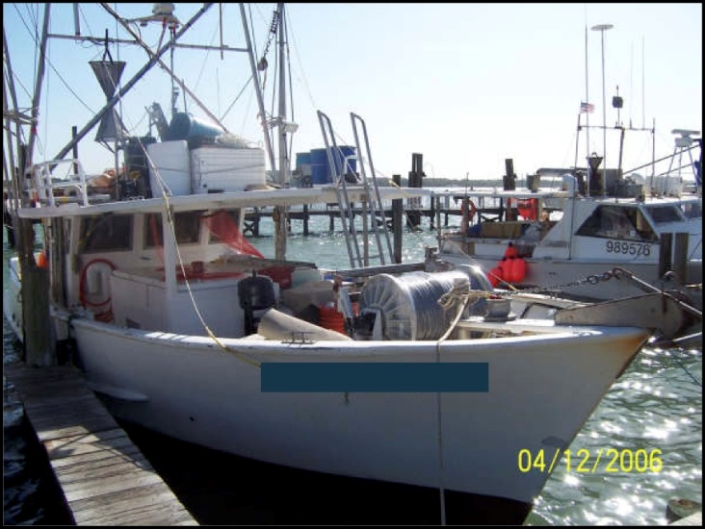
Shark Bottom Longline Fishery Observer Program
  Administered by SEFSC-Panama City Laboratory
Vessels fish North Carolina to Louisiana
Trips are 1-3 days in length
Target large coastal sharks (e.g. blacktip, bull, sandbar sharks)
Longline characteristics vary but gear normally consists of about 8-24 km of longline and 500-1500 hooks

Slide 15
Shark Bottom Longline Fishery Observer Program
(cont.)
Current Goals of Observer Program
  Vessels are selected for coverage by randomly choosing vessels from a pool of vessels each quarter based on
    Reported using longline and target shark in the same season of the previous year
    Target coverage 5-10%
    Shark Research Fishery– 5-10 vessels, 100% coverage, allowed to harvest sandbar shark
      Research Fishery also functions to conduct gear modification experiments to reduce bycatch with aid of industry
  Provide estimates of sea turtle or marine mammal interactions
  Collect data on catch and bycatch of all species of shark, fish and protected resources
    Bioprofile samples taken on select species

Slide 16
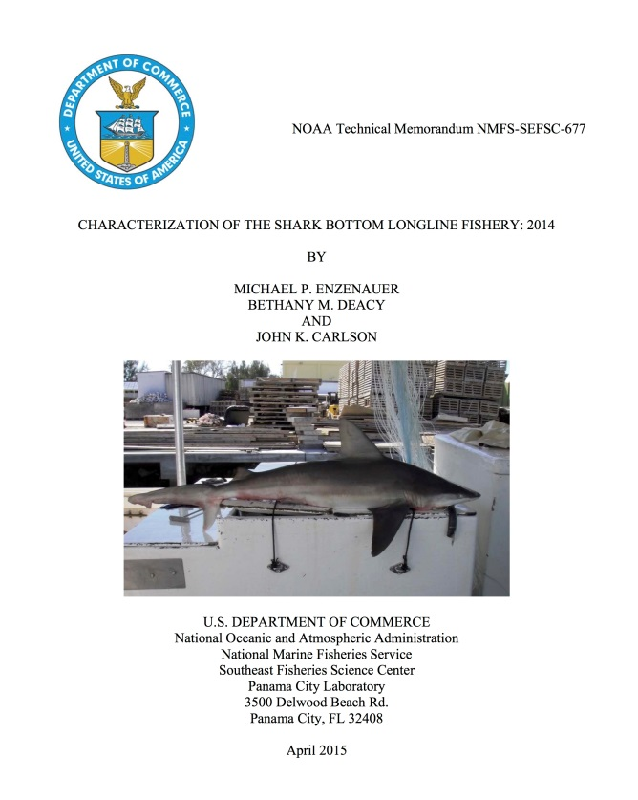
Shark Bottom Longline Fishery Observer Program
(cont.)
Annual reports describing effort distribution, catch and bycatch available at:
http://www.sefsc.noaa.gov/labs/panama/ob/bottomlineobserver.htm

Slide 17
Characterization of the southeastern U.S. Atlantic mid-shelf and deepwater reef fish fisheries
Gulf and South Atlantic Fisheries Foundation administers a voluntary reef fish observer program to characterize catch and discards within the snapper-grouper vertical hook-and-line fishery
    vessels not randomly sampled
    no biological samples collected
Need for 1) more information about mid and deepwater species and 2) better on-board documentation of composition and disposition of commercial catch and biological sampling as needed for assessments

Slide 18
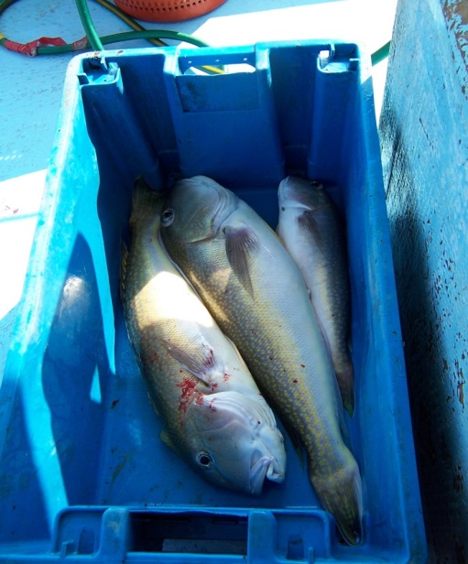
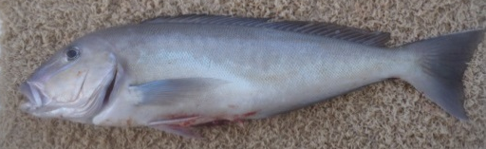
Characterization of the southeastern U.S. Atlantic mid-shelf and deepwater reef fish fisheries
(cont.)
From Feb 2014-Jan 2015, a MARFIN award allowed for the initial placement of SEFSC observers with an overall target of 62 sea days randomly spread throughout the fishery
Program was not funded past one year.

Slide 19
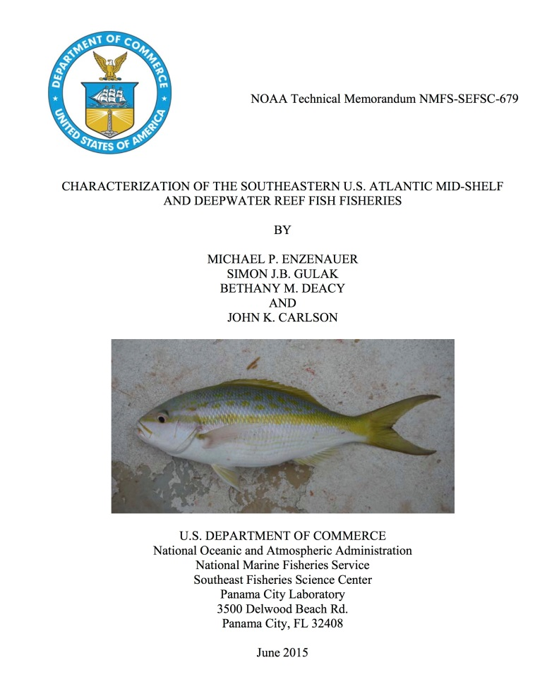
Characterization of the southeastern U.S. Atlantic mid-shelf and deepwater reef fish fisheries
(cont.)
A total of 27 trips on 15 vessels with a total of 408 vertical line and trolling hauls were observed
  Mean sampling rate for biological samples (otoliths and gonads) averaged ~4.0 samples per sea day for vermillion snapper, red porgy, red snapper, gag grouper, and gray and yellowtail snapper.
Funding sought for 2016 from the Atlantic Coastal Cooperative Statistics Program

Slide 20
Regional Electronic Technologies Implementation Plans
Electronic Reporting (ER) & Electronic Monitoring (EM)
U.S. Department of Commerce | National Oceanic and Atmospheric Administration | NOAA Fisheries | Page 20

Slide 21
Electronic Technologies Budget (all sources)
U.S. Department of Commerce | National Oceanic and Atmospheric Administration | NOAA Fisheries | Page 21

Slide 22
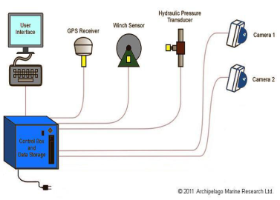
Overview of Electronic Monitoring
EM (video monitoring) purposes include:
  Compliance monitoring – are regulations being followed (fishery and protected species)
  Management – data to support real-time management (individual vessel quotas, catch limits)
  Scientific data collection – assessments, socioeconomic, ecological and ecosystem research, bycatch reporting
NOAA Fisheries has funded > 30 EM pilot projects.
5 EM programs ~ implemented:
Atlantic HMS and 4 Alaska groundfish fisheries
3 EM programs ~ pre-implementation:
Northeast, West Coast, and Alaska
U.S. Department of Commerce | National Oceanic and Atmospheric Administration | NOAA Fisheries | Page 22
Notes:
The demands for more frequent, more precise, and more types of fishery dependent data for the agency’s science, compliance and management use continue to rise every year. Program sustainability is at-risk.
Electronic monitoring (EM) has the potential as a tool to be utilized in a comprehensive monitoring program that would likely also include observers, logbooks, and dockside monitoring

Slide 23
EM Lessons Learned (So Far . . .)
Potential Benefits
  Suitability across a wide range of vessel sizes
  Compliance tool for monitoring requirements or prohibitions
  Fully integrated data collection tools that can create a profile of fishing activity at sea
  Potentially lower costs (yet to be determined)
  24/7 operation on many vessels
Challenges
  Species identification
  Estimating weights of discarded species
  Archiving and storing huge amounts of data
  Costs and time delays associated with analysis of EM data
  Regulatory and operational constraints, including enforcement
U.S. Department of Commerce | National Oceanic and Atmospheric Administration | NOAA Fisheries | Page 23
Notes:
Suitability across a wide range of vessel sizes, particularly smaller vessels that may not meet all requirements for carrying observers
Potentially lower costs (depending on a number of factors such as amount of data reviewed, data storage, and time requirements for the delivery of the data)
24/7 operation on many vessels (with some exceptions), thereby capturing all events for later analysis or sampling
Enforcement issues including covering cameras and turning them off.

Slide 24
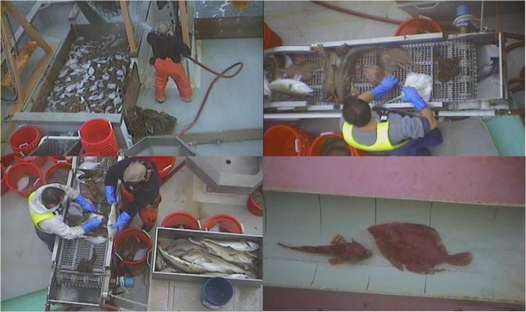
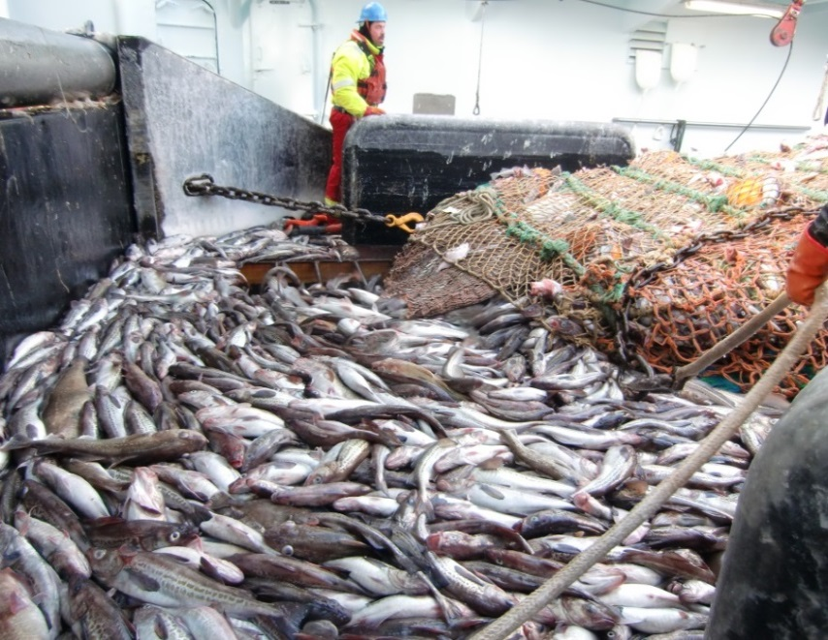
Future Challenges
Flat federal budget does not allow for increased observer coverage.
Pressure to implement electronic monitoring programs.
Lack of consistency in industry funding of observer programs (and possibly electronic monitoring) around the United States.
U.S. Department of Commerce | National Oceanic and Atmospheric Administration | NOAA Fisheries | Page 24

Slide 25
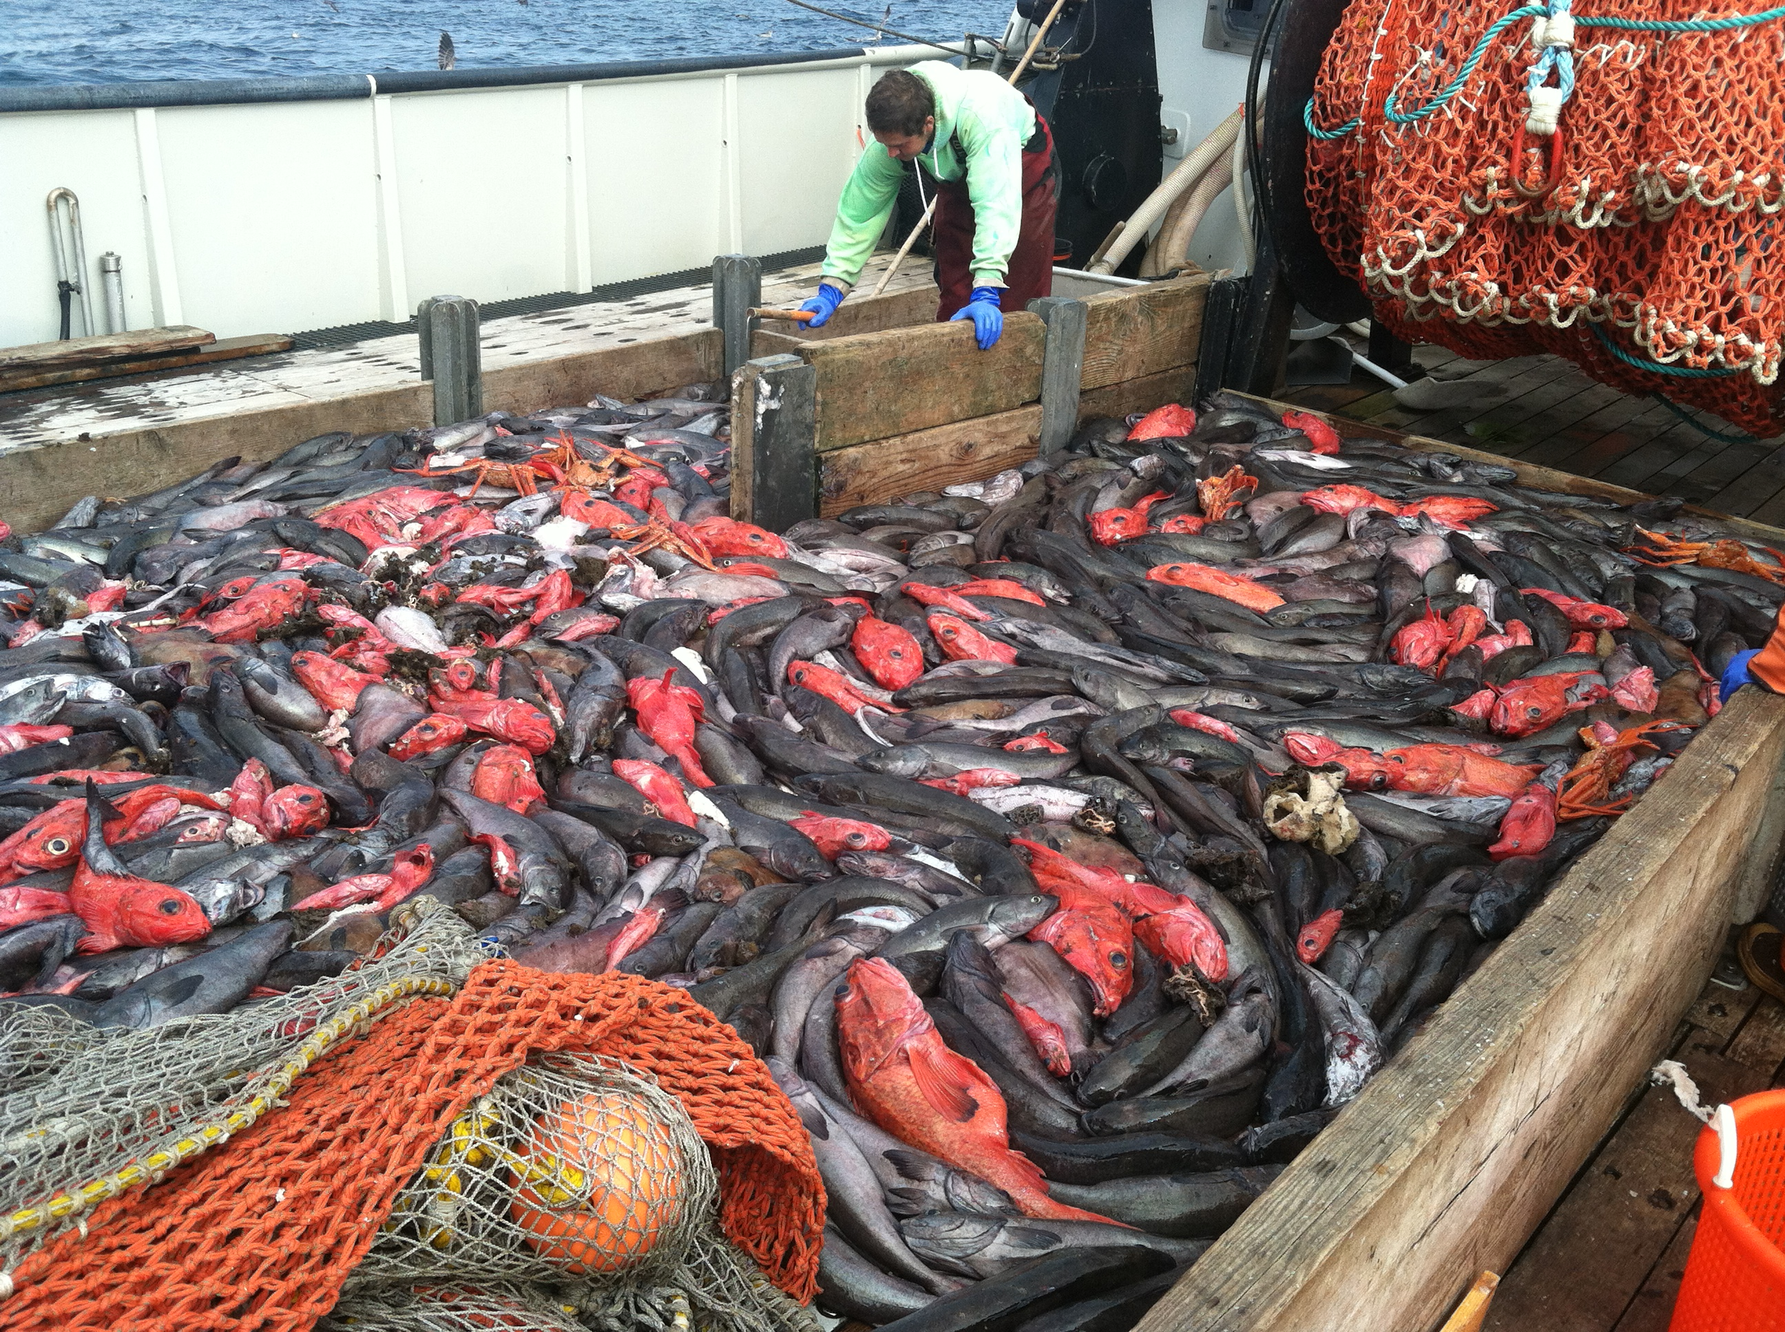
Thank You!
Contact:
Jane.DiCosimo@noaa.gov
U.S. Department of Commerce | National Oceanic and Atmospheric Administration | NOAA Fisheries | Page 25

