Slide 1
Southeast Reef Fish Survey MPA Monitoring
Overview of Fishery Independent
Chevron Trap and Longline Sampling in Current and Proposed MPAs
Presentation to the SAFMC Council
November, 2013
Wilmington, SC
Tracey Smart and Marcel Reichert

Slide 2
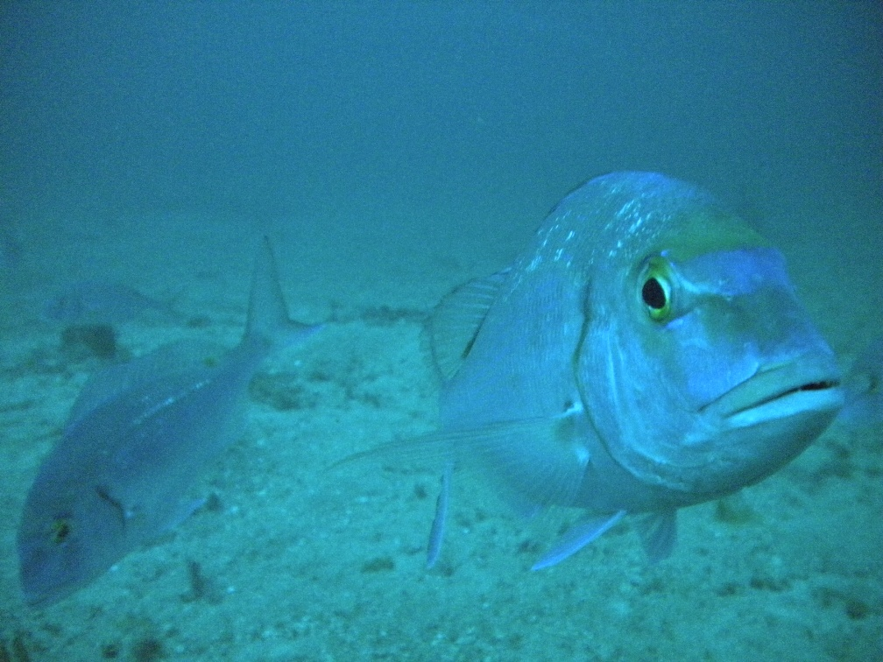
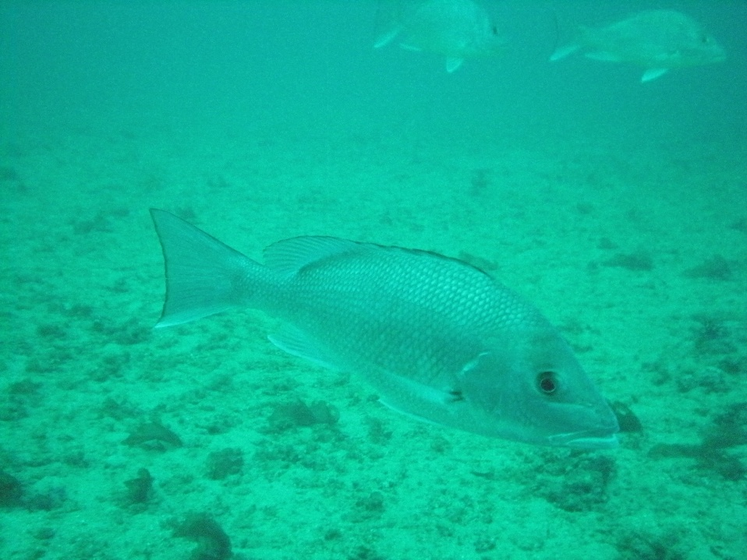
SouthEast Reef Fish Survey (SERFS)
Collaborative regional reef fish monitoring effort:
MARMAP - SC-DNR/NOAA 1972 / 1989 (Chevron traps)
Historical data
SEAMAP-SA - SC-DNR/NOAA (1986) 2009 (RF)
SEFIS - SEFSC 2010 (RF)

Slide 3
Fishery Independent Surveys
SERFS Chevron Trap Universe
≈3,100 live-bottom stations
Mostly low to moderate relief
≈1,300 randomly selected each year
MARMAP/SEAMAP-SA
Short-Bottom Longline (SBLL) Universe
334 live-bottom stations
Moderate to high relief
~220 randomly selected each year
Monitoring survey halted in 2012
Long Bottom Longline (LBLL)
Sampled in Loran blocks
Tilefish grounds
Monitoring survey halted in 2012
Notes:
MARMAP/SEAMAP-SA Reef Fish
2006 – 2009:
690 collections annually
MARMAP/SEAMAP-SA/SEFIS
2010 – 2013:
1,000 - 1,500 collections annually
Highlight that seamap stepped in to help with declining marmap funding on longline survey

Slide 4
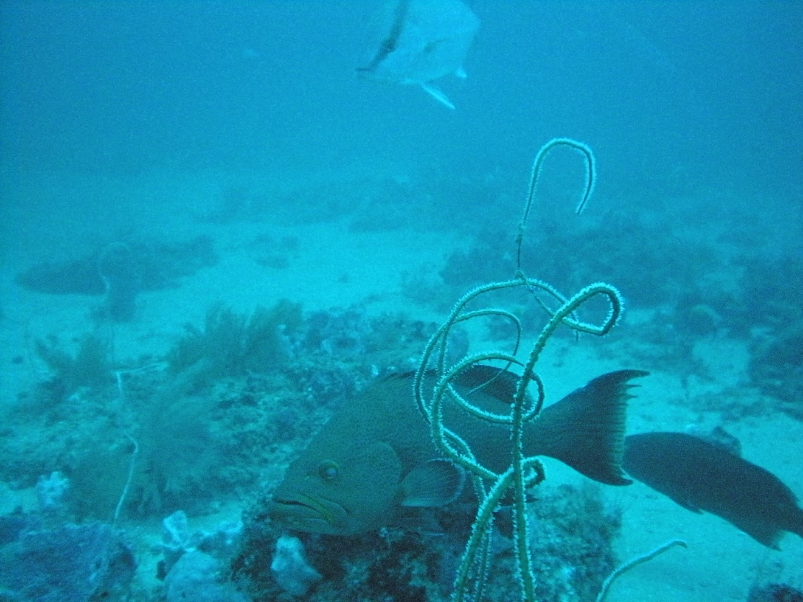
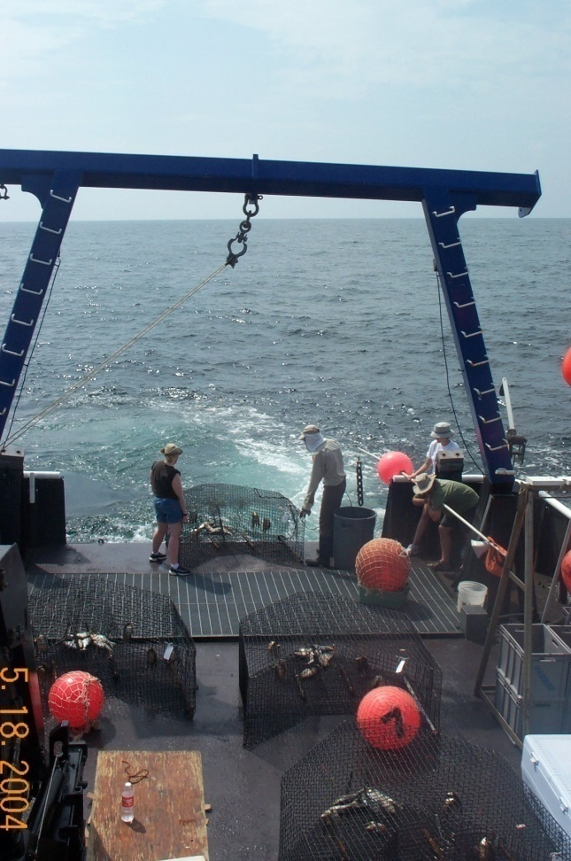
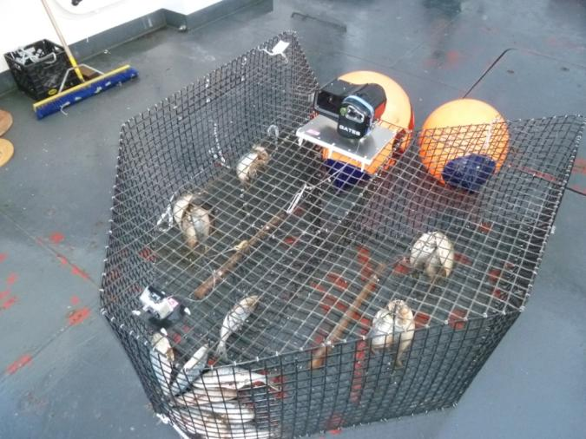
Chevron trap
Used since 1988 (1990)
Deployed in depths to ≈90 m
Soak time ≈ 90 minutes
Baited (menhaden)
Cameras since 2009 (video: 2010)

Slide 5
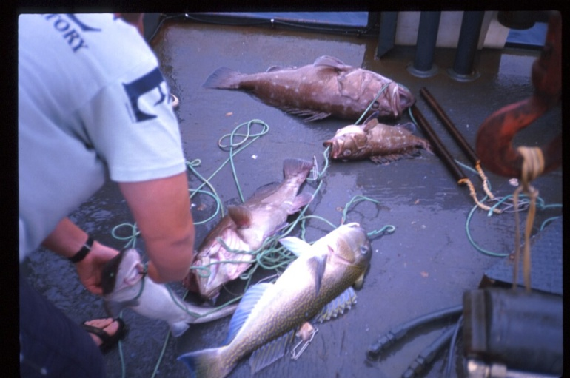
Short Bottom Longline
Used since 1978 (halted in 2012!)
Areas of high relief in depths ( >90 m)
20 baited (squid) hooks
Soak time ±90 minutes
Species:
snowy grouper, jacks, tilefish, speckled hind, etc.
Notes:
Deployed off the side hauled over the side.

Slide 6
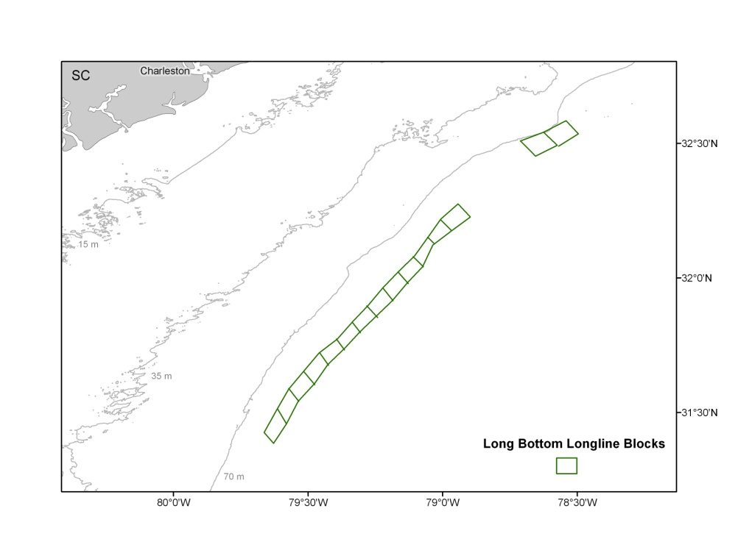
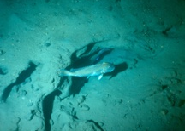
Long Bottom Longline
Used since 1982 (1996), halted in 2012!
100 baited (squid) hooks
Muddy bottom / tilefish grounds
≈ 200 m (600 ft.)
Sampled based on LORAN “blocks”
15 blocks off SC and GA (and n. FL)
Goal: sample 2-4 lines per block
Species: tilefish, blackbelly rosefish, etc.

Slide 7
SERFS sampling in MPAs
General caveats of sampling in MPAs
Ongoing sampling mortality (even with “catch and release”)
Increasing efforts (better data) result in increases in mortality
Video index possible alternative.
How to treat MPA data within the index development?
Trade-off between investigating / sampling new areas versus ongoing monitoring given current funding and effort confounds.
Monitoring efforts in possible newly designated MPAs
SERFS has survey monitoring stations in a majority of proposed MPAs as location of proposed MPAs was in large part based on MARMAP stations:
Loss of non-MPA monitoring stations for abundance indices (historical monitoring stations becoming MPA monitoring stations)
Possible effect on index development
Loss of adjacent (non-MPA) areas for comparison with current MPAs (Edisto, North Florida)

Slide 8
Part 1: Current MPAs
SERFS MPA Monitoring

Slide 9
Fish. Indep. Survey Coverage
3 of 8 MPAs: no sampling expected
Georgia MPA: soft bottom TF grounds - long bottom longline
4 remaining MPAs with chevron and short bottom longline sampling or sampling within 15 NM
Current sampling
Historic (pre-MPA establishment, prior to 2009)
Snowy Grouper Wreck
Northern South Carolina
Edisto
North Florida
Data in overview:
Through 2012
Selected species
Simple nominal CPUE

Slide 10
Survey Coverage: Current MPAs
Area | State | Chevron |  | # 2013 Stations | SBLL |  | # 2013 Stations
 |  | Historic | Current |  | Historic | Current
Snowy Wreck | NC |  | √ | 7 | √ | √ | 14
Northern SC | SC | √ | √ | 86 | √ | √ | 8
Charleston Deep Artificial | SC |  |  | 0 |  |  | 0
Edisto | SC | √ | √ | 89 | √ | √ | 6
Georgia | GA |  |  | 0 |  |  | 0
North Florida | FL | √ | √ | 36 | √ | √ | 1
St. Lucie Hump | FL |  |  | 0 |  |  | 0
East Hump | FL |  |  | 0 |  |  | 0

Slide 11
North Carolina Current MPA

Slide 12
North Carolina Current MPAs Snowy Grouper Wreck
Chevron Trap
No historical data inside MPA
Added: 6 stations in 2012, 1 in 2013
Recent catches generally low
(1 or 2 red porgy per trap)
Short Bottom Longline
One historical station
14 current stations
Halted in 2012
Data will be available in future years
Closest outside MPA cluster
for comparison:
Chevron ~15 NM
SBLL ~11 NM
Notes:
Chevron Trap
No historical data inside MPA for comparison
6 stations added for 2012 sampling season; 1 for 2013
Recent catches by chevron trap at these sites are generally low (1 or 2 red porgy per trap)
Short-Bottom Longline
One historical station; 14 current stations
SBLL survey halted in 2012 due to funding limitations

Slide 13
South Carolina Current MPA Note: Deepwater MPA - no known live-bottom habitat

Slide 14
South Carolina Current MPAs Northern SC
Historical and current stations available for comparison
(CHV and SBLL)
Northern SC has adjacent stations for comparison
Edisto has adjacent sampling areas for comparison
Typical catches for deep continental shelf and shelf-edge
Chevron stations along same depth contours used for comparison
Closest outside MPA cluster
for comparison:
Chevron ~13 NM
SBLL ~5 NM
Notes:
Historical and current stations available for comparison (CHV and SBLL)
Northern SC has adjacent stations (13 nm) for comparison
Edisto has adjacent sampling areas for comparison
Typical catches for deep continental shelf and shelf-edge

Slide 15
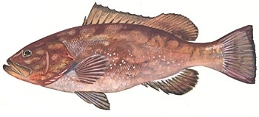
South Carolina Current MPAs Northern SC
n=11
n=6
n=18
n=13
n=6
n=12
n=18
n=12
n=18
n=14
n=23
n=17
n= # traps deployed each year
MPA Established

Slide 16
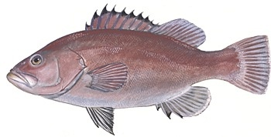
South Carolina Current MPAs
Northern SC
n=11
n=6
n=18
n=13
n=6
n=12
n=18
n=12
n=18
n=14
n=23
n=17
n= # traps deployed each year
MPA Established

Slide 17
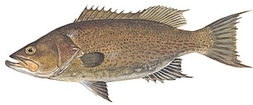
South Carolina Current MPAs Northern SC
n=11
n=6
n=18
n=13
n=6
n=12
n=18
n=12
n=18
n=14
n=23
n=17
n= # traps deployed each year
MPA Established

Slide 18
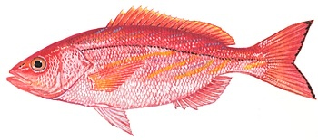
South Carolina Current MPAs Northern SC
n=11
n=6
n=18
n=13
n=6
n=12
n=18
n=12
n=18
n=14
n=23
n=17
n= # traps deployed each year
MPA Established

Slide 19
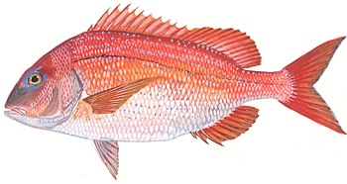
South Carolina Current MPAs Northern SC
n=11
n=6
n=18
n=13
n=6
n=12
n=18
n=12
n=18
n=14
n=23
n=17
n= # traps deployed each year
MPA Established

Slide 20
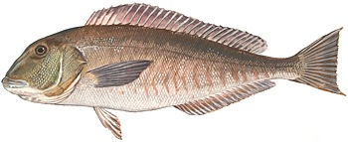
South Carolina Current MPAs Northern SC
MPA Established
n= # longlines deployed each year

Slide 21
South Carolina Current MPAs Edisto
Chevron stations along same depth contours used for comparison
Historical and current stations available for comparison (CHV and SBLL)
Adjacent sampling areas available for comparison
SBLL samples in 2008 (n=6)
No catches of snapper-grouper in 2008
Low catches of snapper-grouper in earlier years
No sampling from 2009-2012
Closest outside MPA cluster
for comparison:
Chevron < 1 NM
SBLL ~1 NM
Notes:
Short-bottom Longline samples in 2008 (n=6)
No catches of snapper-grouper in 2008
Low catches of snapper-grouper in earlier years
No sampling from 2009-2012

Slide 22
South Carolina Current MPAs Edisto
n=6
n=10
n=6
n=7
n=10
n=7
n=6
n=8
n=10
n=7
n=12
n=12
n= # traps deployed each year
MPA Established
Notes:
On all, add in data for species abundance from adjacent area. Or add to same plot and animated after.

Slide 23
South Carolina Current MPAs Edisto
n=6
n=10
n=6
n=7
n=10
n=7
n=6
n=8
n=10
n=7
n=12
n=12
n= # traps deployed each year
MPA Established
Notes:
On all, add in data for species abundance from adjacent area. Or add to same plot and animated after.

Slide 24
South Carolina Current MPAs Edisto
n=6
n=10
n=6
n=7
n=10
n=7
n=6
n=8
n=10
n=7
n=12
n=12
n= # traps deployed each year
MPA Established
Notes:
On all, add in data for species abundance from adjacent area. Or add to same plot and animated after.

Slide 25
Georgia Current MPA b “Golden Tilefish MPA”; no chevron or SBLL sampling. Some Long Bottom Longline: soft-bottom sampling

Slide 26
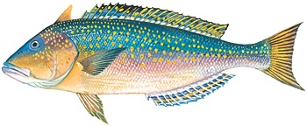
Georgia Current MPA Long Bottom Longline
n=8
n=14
n=4
n=11
n=6
n=9
n= # LB longlines per year
MPA Established

Slide 27
Florida Current MPAs Information for North Florida MPA Remaining MPAs south of SERFS sampling coverage

Slide 28
Florida Current MPAs North Florida
Chevron stations along similar depth contours used for comparison
Closest outside MPA cluster
for comparison:
Chevron ~8 NM
SBLL > 80 NM

Slide 29
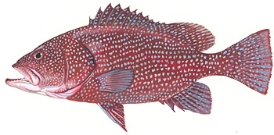
Florida Current MPAs North Florida
n=5
n=6
n=0
n=18
n=5
n=11
n=7
n=17
n=16
n=17
n=18
n=22
n= # traps deployed each year
MPA Established

Slide 30
Florida Current MPAs North Florida
n=5
n=6
n=0
n=18
n=5
n=11
n=7
n=17
n=16
n=17
n=18
n=22
n= # traps deployed each year
MPA Established

Slide 31
Florida Current MPAs North Florida
n=5
n=6
n=0
n=18
n=5
n=11
n=7
n=17
n=16
n=17
n=18
n=22
n= # traps deployed each year
MPA Established

Slide 32
Florida Current MPAs North Florida
n=5
n=6
n=0
n=18
n=5
n=11
n=7
n=17
n=16
n=17
n=18
n=22
n= # traps deployed each year
MPA Established

Slide 33
Florida Current MPAs North Florida
MPA Established
n= # longlines deployed each year

Slide 34
Part 2: Proposed MPAs
SERFS MPA Monitoring

Slide 35
SERFS Survey Coverage Proposed MPAs NC

Slide 36
SERFS Survey Coverage: Proposed NC MPAs
Area | State | Chevron |  | # 2013 Stations | SBLL |  | # 2013 Stations
 |  | Historic | Current |  | Historic | Current
Manuela Wreck | NC |  |  | 0 |  |  | 0
Malchace Wreck | NC |  | √ | 3 |  |  | 0
780 Bottom | NC |  | √ | 18 | √ | √ | 1
N. Cape Lookout 3 | NC |  |  | 0 | √ | √ | 1
N. Cape Lookout | NC |  |  | 0 | √ | √ | 13
N. Cape Lookout 2 | NC |  |  | 0 | √ | √ | 3
S. Cape Lookout | NC |  |  | 0 | √ | √ | 19
Snowy Wreck Reconfig | NC |  |  | 0 |  |  | 0
Southern NC | NC |  | √ | 7 | √ | √ | 11

Slide 37
North Carolina SERFS Chevron Trap Survey

Slide 38
North Carolina MARMAP Short Bottom Longline Survey

Slide 39
SERFS Survey Coverage Proposed MPAs SC

Slide 40
SERFS Survey Coverage: Proposed SC MPAs
Area | State | Chevron |  | # 2013 Stations | SBLL |  | # 2013 Stations
 |  | Historic | Current |  | Historic | Current
Northern SC Ext* | SC | √ | √ | 1 |  |  | 0
Mid SC* | SC | √ | √ | 29 |  |  | 0
Devil’s Hole 2 | SC | √ | √ | 11 |  | √ | 3
Devil’s Hole 3 | SC | √ | √ | 5 |  | √ | 3
Charleston Shelf* | SC | √ | √ | 71 | √ | √ | 3
Edisto Reconfig 3* | SC | √ | √ | 177 | √ | √ | 14
Edisto S Ext* | SC | √ | √ | 92 | √ | √ | 5
*Indicates an area that can be used to compare effectiveness of current MPAs

Slide 41
South Carolina SERFS Chevron Trap Survey

Slide 42
South Carolina MARMAP Short Bottom Longline Survey

Slide 43
SERFS Survey Coverage Proposed MPAs GA

Slide 44
SERFS Survey Coverage: Proposed GA MPAs
Area | State | Chevron |  | # 2013 Stations | SBLL |  | # 2013 Stations
 |  | Historic | Current |  | Historic | Current
Georgia Reconfig N2 | GA |  |  | 0 |  |  | 0
Georgia Ext | GA | √ | √ | 23 |  |  | 0
Georgia Reconfig | GA | √ | √ | 47 |  |  | 0

Slide 45
Georgia SERFS Chevron Trap Survey
*No SBLL stations in GA proposed MPAs

Slide 46
SERFS Survey Coverage Proposed MPAs FL

Slide 47
SERFS Survey Coverage: Proposed FL MPAs
Area | State | Chevron |  | # 2013 Stations | SBLL |  | # 2013 Stations
 |  | Historic | Current |  | Historic | Current
St. Simons 2 | FL | √ | √ | 24 |  |  | 0
St. Simons Ext 2 | FL | √ | √ | 36 |  |  | 0
Fernandina * | FL | √ | √ | 3 |  |  | 0
St. Augustine 2 | FL | √ | √ | 53 |  |  | 0
St. Augustine Ext 2 | FL | √ | √ | 21 |  |  | 0
Daytona Ledge | FL |  |  | 0 |  |  | 0
Daytona Steeples | FL |  |  | 0 |  |  | 0
Push Button Hill | FL |  |  | 0 |  |  | 0
Juno Beach | FL |  |  | 0 |  |  | 0
Warsaw Hole 4 | FL |  |  | 0 |  |  | 0
*: Indicates an area that can be used to compare effectiveness of current MPA

Slide 48
Florida SERFS Chevron Trap Survey

Slide 49
Florida MARMAP Short Bottom Longline Survey

Slide 50
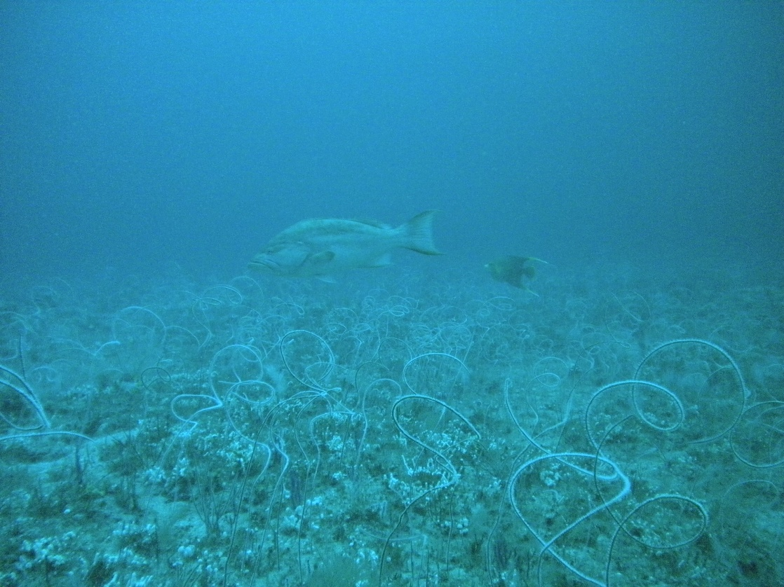
THANK YOU

Slide 51
South Carolina Current MPAs: Edisto
n=6
n=10
n=6
n=7
n=10
n=7
n=6
n=8
n=10
n=7
n=12
n=12
n= # traps deployed each year
MPA Established
Notes:
On all, add in data for species abundance from adjacent area. Or add to same plot and animated after.

