Slide 1
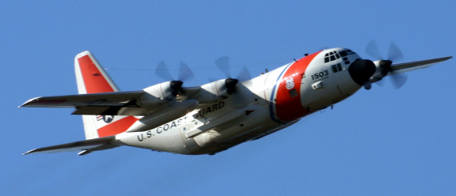
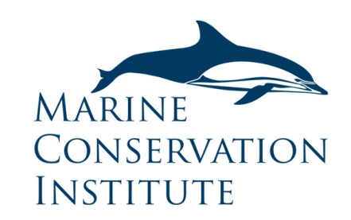
Surveillance and enforcement of Federal Fisheries in the southeastern US
Sandra Brooke PhD, Marine Conservation Institute

Slide 2
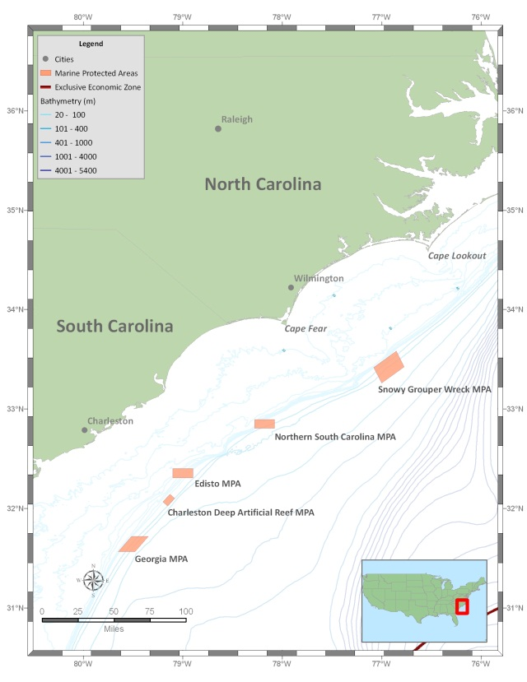
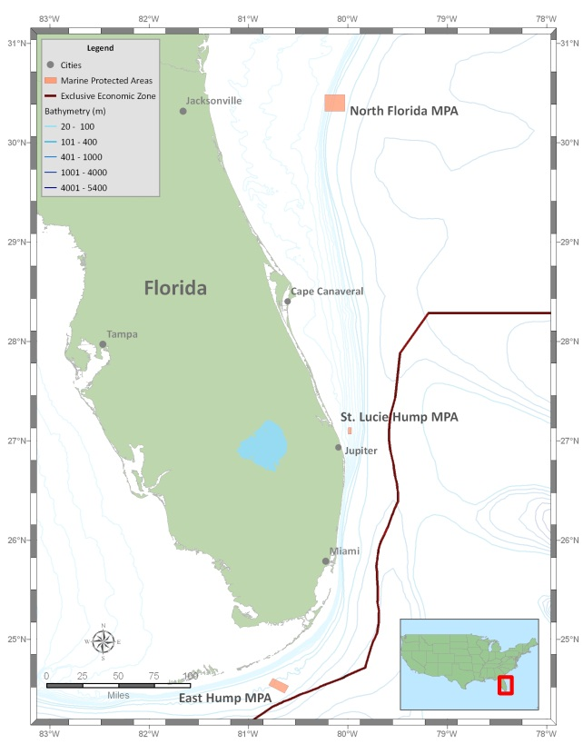
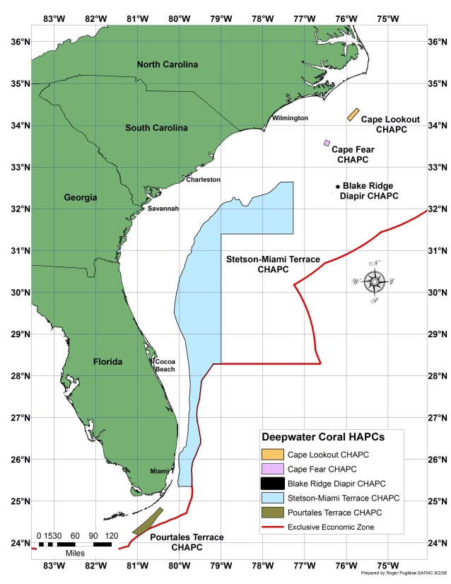
Project Background
2009: Surveillance and enforcement of remote maritime areas (SERMA) workshop for high seas and domestic remote MPAs
2010: MCBI Technical document on surveillance technologies
2010: SAFMC implemented 5 CHAPCs and 8 MPAs
Other protected areas in the region include OHAPC, GRNMS, FKNMS
Notes:
MCBI started getting interested in s and e in 2009, held workshop of experts in LE and management, both domestic and international.

Slide 3
Project Objectives
Review surveillance technologies for application to SAFMC protected areas
Review surveillance and enforcement capacity for the SAFMC region
Hold workshop of regional managers, state and federal LE and outreach
Produce final report with options for improving S and E capacity and efficiency in the region
Produce training documents for LE officers in the region
Notes:
Purpose of the project – new CHAPC and MPAs

Slide 4
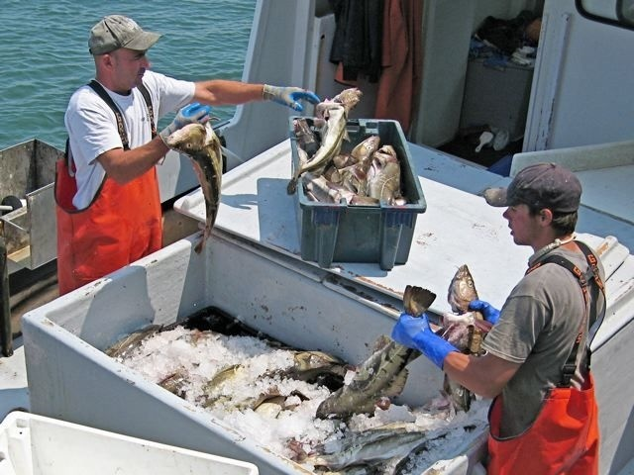
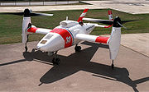
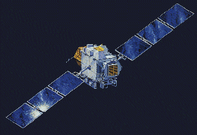
Surveillance technologies for application to SAFMC protected areas
Cooperative vs. non cooperative
Classified vs. civilian
Ground, sea, air or space-based
Continuous vs. periodic
Manned vs. unmanned

Slide 5
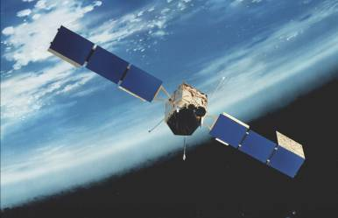
Vessel monitoring systems (VMS)
Device on vessel sends signal to satellite showing vessel location and speed
Ground stations can alert enforcement about “interesting” tracks
Enforcement can investigate
Real-time data
VMS in use for rock shrimp in SAFMC region

Slide 6
Automatic identification systems (AIS)
Shipboard VHF broadcasting system
Designed for vessel tracking and identification, but additional channels for other data streams
Limited range – 20nm (line of sight) only unless on towers or buoys
Intended for vessel safety but increasingly used for Maritime Domain Awareness
Not used for fisheries monitoring
Why?
AIS only required on vessels >19 m to enter US port
Fishing vessels are exempt
Notes:
The primary current use of AIS is navigational safety and collision avoidance, as originally intended under SOLAS. However, the obvious power of AIS in monitoring maritime traffic has attracted the attention of many navies and coast guards worldwide. AIS data from various sources (coastal stations, buoys, aircraft, etc.; see below) is increasingly being used to achieve ‘maritime domain awareness’ (MDA). Research is also underway by NATO and other groups on integrating AIS data with direct observation system
all EU fishing vessels over 15 m length to be class A AIS-equipped by mid-2014, and the US is also moving to expand the range of vessels required to carry AIS; the US coastguard issued a Federal Register proposal in early 2009, to reduce the AIS carriage requirements down to 65’ (19 m) for vessels entering a US port.
Class A units ~$5k, Class B $600

Slide 7
AIS potential expansion
In 2008 USCG proposed a rule to include fishing and passenger vessels in AIS and are implementing NAIS system accessible to all LE
AIS channels could be used to transmit information (eg MPA boundaries) to vessels
Deployment from moored buoys and other platforms increase range
Space based AIS expands to global coverage, but not real time
Notes:
Add images of buoys and satellites. Canada uses AIS on oil platforms

Slide 8
Non Cooperative surveillance
Platforms
Space-based – satellites
Aircraft – manned and unmanned
Vessels - manned and unmanned
Land or buoy-based
Sensors
Visual imaging systems
Radar systems
Acoustics
Surveillance systems use a combination of platforms and sensors to fulfill specific requirements

Slide 9
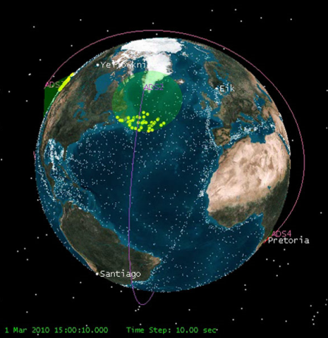
Satellite-based surveillance
Satellite technologies capture information from a target on earth and relay data back to a control center
Advantages: large scale, high resolution images
Disadvantages: Surveillance not continuous, images expensive and some systems sensitive to weather and light
Visual imaging
Optical and IR cameras
Radar
Synthetic aperture radar
Space-based AIS
Notes:
Because of the nature of the RMA, space based intelligence of some variety is the most effective first look at the larger area
Advantages – can see a large area very quickly
Disdvantages – expensive and refresh rates can be slow, depending on system.

Slide 10
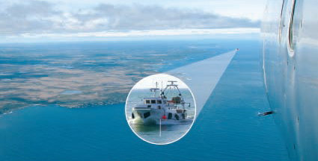
Manned aircraft
Aircraft can be equipped with a great variety of sensors including radar, SAR, visual and/or IR cameras, and more specialized sensors for pollutants
Surveillance of RMAs often requires long range aircraft
Expensive to purchase and operate (agency cost-sharing)
Canada and UK use commercial contractor on per mission basis.
Notes:
These are expensive assets to purchase and maintain, but are very valuable for medium range surveillance
Too expensive for many natural resource agencies, even US coastguard, which is responsible for policing 4.5 millions sq miles of EEZ only have 22 long range aircraft.
UK and Canada have an alternative approach in that they use commercial charter companies and pay on a per mission basis, thus obviating the need to own and operate their own assets.

Slide 11
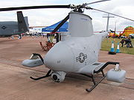
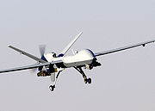
Unmanned aerial vehicles (UAVs)
US Navy MQ-8B
fire scout rotorcraft
US Coast Guard
Bell Eagle
MQ-9 used by US and British armed forces
Payloads can include visual and/or IR cameras, biological or chemical sensors, and radar/SAR
UAVs can fly extended missions (8 to >48 hours)
Most are currently operated by military
Flights limited by FAA regulations
Notes:
Expensive, though possibly more cost effective than manned aircraft b/c of extended duration.
Most currently owned and operated by military, although they are commercially available
Problem is FAA airspace issues.

Slide 12
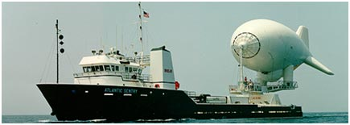
Other platforms
Airships, aerostats and helikites
Can be deployed from land, ships or vehicles
Can be tethered or untethered, very small or very large
Used for visual sensors and transceivers
Moorings (sub-surface)
Platforms for acoustic packages
Only useful when systems relay data in near real-time
Cannot indentify individual vessels
May be able to identify activity
Buoys (surface)
Platforms can be used to extend AIS and radar capabilities

Slide 13
Surveillance and Enforcement Workshop
28 participants from SAFMC, GRNMS, FKNMS, FL, GA, SC, NC state LE, NOAA OLE, USCG
Presentations:
SAFMC Protected areas, management challenges and outreach (A Martin, M Brouwer, K Iverson)
Surveillance and enforcement challenges in National Marine Sanctuaries the southeast region (B Causey)
Surveillance, enforcement and compliance challenges in Grays Reef National Marine Sanctuary (G Sedberry)
Southeast vessel monitoring system (VMS) overview (P O’Shaunessy)
Surveillance and enforcement of remote maritime areas (S Brooke)
Notes:
Workshop included 28 pa

Slide 14
Breakout sessions
Surveillance and enforcement operations: Challenges, technologies, assets, response capabilities, critical needs, improvements
Interagency collaboration (includes management): current status, JEA, challenges, improvements
Education and outreach: Current status, public perception, officer-public interaction, improvements

Slide 15
Outcomes
Surveillance and enforcement operations:
Insufficient assets, officers and funding. More officers = more patrol time, interceptions and public interactions. NOAA OLE critically undercapacity
Need for increased remote surveillance technologies to target limited enforcement assets.
More funding needed for JEA program - critical to supplement limited federal LE
Lack of criminal provisions in MSA places total burden of prosecution on civil GC attorneys and judges
GC attorneys understaffed and overwhelmed with caseload.
VMS best surveillance option for commercial fisheries monitoring
Recreational sector biggest challenge to enforce
Notes:
Surveillance and enforcement assets
NOAAs office of Law Enforcement is the primary federal fisheries enforcement authority, with a geographical jurisdiction of over 3 million square miles of ocean and 85,000 miles of US coastline, plus the National Marine Sanctuaries and Marine National Monuments. The agency is also responsible for enforcing US treaties and international law governing the high seas and international trade. NOAA OLE has only 146 special agents and 17 enforcement officers to fulfil this responsibility therefore relies heavily on cooperative partnerships with other federal (especially USGS) and state law enforcement agencies.
District 7 of the US Coastguard provides enforcement support for federal waters of the SAFMC management region, and the FKNMS and GRNMS. District 7 is divided into 6 sectors (Charleston, Jacksonville, Miami, Key West, St Petersburg and San Juan). The SE region has a minimum of 146 officers but the USCG has multiple demands and responsibilities; fisheries enforcement is only one of them. District 7 has 2 high endurance cutters (>400ft), with each region allocated a specific number of days per year, and 12 medium endurance cutters (210-270 ft) that can spend up to a week patrolling out to the US EEZ. Each station also has several smaller boats that have a more limited range (25-50 miles).
Below is a table of State assets that are potentially used to assist in the enforcement of federal regulations in the southeastern US through these agreements.
Asset
Florida
Georgia
South Carolina
North Carolina
Officers
220 ¹
24
51
48
Patrol boat (<29 ft)
201
28
Several vessels, unspecified size
Unspecified ³
Patrol boat (30-49 ft)
4
2
Patrol boat (>50 ft)
1
0
Fixed wing a/c
381 hrs marine fisheries ²
0
Several patrols/month
>1 patrol/week
Helicopter
207 hrs marine fisheries ²
> 1 patrol/week
VMS
Federal - State has data access
Federal - State has data access
Federal - State has data access
Federal - State has data access
Radar
Yes
Yes
Yes
Yes
FLIR
Yes
Hand-held
Vessel and aircraft
Night vision
Yes
Yes
Yes, hand-held
Yes
VHF radio
Yes
Yes
Yes
Yes

Slide 16
Interagency collaboration
Management agencies should consult LE during development of regulations.
JEA is critical to enforcing federal fisheries, however ongoing training of state LE is often inadequate as federal regulations are complex and change frequently
Too few NOAA OLE field officers - leads to lack of State LE commitment to JEA
Need more interagency training, sharing of patrol time and information
Too little feedback on federal cases made by state LE
Need more multi-agency ‘details’
USCG has high turnover and multiple responsibilities, fisheries not high priority
Interpersonal relationships most important to interagency collaboration

Slide 17
Education and outreach
No reliable or consistent metrics of compliance
No readily accessible location where all protected areas and regulations can be found
More public outreach on new and existing regulations – explain purpose of protective measures
GMFMC uses cell phone application to disseminate information
Protected area boundaries should be easy to chart with square borders - coordinates should be readily available
Publicize successful case outcomes - shames offender, increases compliance, raises LE morale.
Notes:
No link between SAFMC and NMS

Slide 18
Selected recommendations
Surveillance and Enforcement
Investigate potential effect and capability of changing civil provisions in MSA to criminal
Increase the number of GC to prosecute resource laws
Implement VMS in snapper-grouper fishery for SAFMC region (would require additional VMS tech staff)
Introduce use of AIS for monitoring fishing vessel activity
Use towers, buoys, aerostats to increase range of radar and cameras
Address boundary placement - how much of an enforcement challenge are the irregular boundaries

Slide 19
Interagency collaboration
Increase training of state LE by NOAA OLE by scheduling regular classroom and at sea sessions
Facilitate interpersonal relationships between agency LE through informal meetings or joint training programs (eg USCG has open training sessions annually)
Increase the frequency of multi-agency details
Create a joint LE forum for sharing information and coordinating enforcement actions

Slide 20
Education and outreach
Create centralized database for regulation information (SAFMC)
- user friendly (google earth) mapping of protected areas
- all regulations in one place (SAFMC, NMS, FMPs)
Use social media to disseminate information
Enforcement representatives attend and make presentations at fishing clubs and meetings
Use NMS and SAFMC public meetings to increase outreach efforts
Make sure new regulations are distributed quickly and are clear and enforceable

Slide 21
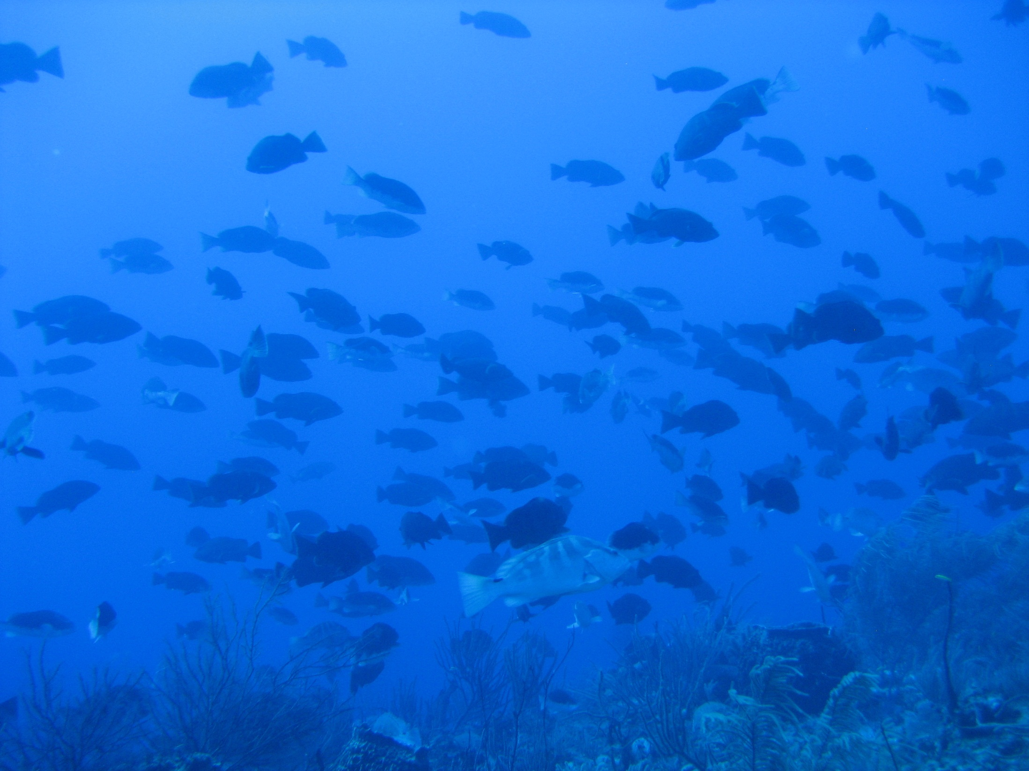
Questions?

