Slide 1
Visioning and Strategic Planning
Mid-Atlantic Fishery Management Council
December 3, 2012

Slide 2
Overview
Topic I: Context and Objectives
Topic II: Data Gathering Methods and Results
Topic III: Strategic Planning Process and Progress
Topic IV: Hindsight and Lessons Learned

Slide 3
Topic I: Context and Objectives of the Visioning and Strategic planning Project

Slide 4
Background
Timing
2009-2010: Several fisheries declared rebuilt
March 2010: Catch shares workshop
Context
Difficult rebuilding history
Stakeholder frustration and disengagement
Uncertainty, limited long-range planning
Transitional point in Council history
Desire to shift from reactive to proactive management

Slide 5
Rationale for Visioning and Strategic Planning Process
Opportunities
Rebuilt stocks
Defining success for the future
Risks
Stakeholder disengagement
Pervasive gaps in confidence
Environmental and economic uncertainty
Long-term goals
e.g. Ecosystem-based management, stakeholder engagement
Organizational structure
e.g. Changing membership, limited meeting time

Slide 6
Purpose
Goal: “Develop a comprehensive, stakeholder-informed vision for Mid-Atlantic fisheries that will be used to inform the Council’s strategic plan.”
Engage Stakeholders
&
Understand Stakeholder Concerns
Build Trust
&
Improve Relationships
Solicit Stakeholder Input on all Issues Related to Fisheries Management
Develop a 10-Year Plan Based on Stakeholder Input

Slide 7
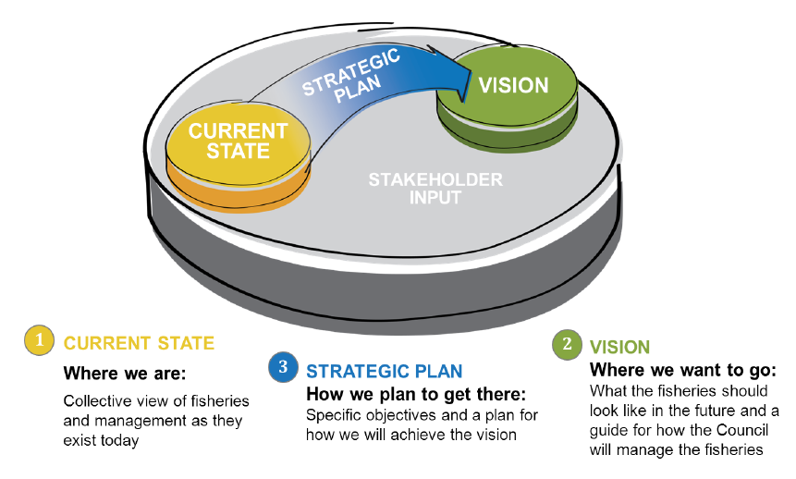
Visioning and Strategic Planning Approach

Slide 8
Topic II: Data Gathering Methods and Results

Slide 9
Data Collection Methods
Surveys
Roundtable Sessions
Late Addition
Position Letters
General
1,253 responses
12 Letters
14 commercial 5 recreational 1 ENGO
Fishery-specific
1,048 responses

Slide 10
Why did we choose these methods?
We wanted to achieve both depth of input and breadth of stakeholder participation
Survey
Roundtable Discussions
Position Letters
Inclusive
Relatively inexpensive
Wide distribution
In-depth data
More conducive to discussions of complex issues
Builds trust
Successfully partnered with local co-hosts
Added at the request of several organizations
Free-form
Lets organizations provide input on behalf of members

Slide 11
Communication Strategies
Council formed a Visioning working group (Rec/Comm/ENGO/Academic/ASMFC/etc.) to inform the data collection and outreach methods
Success required persistent communication efforts
Emails, mailings, permit holder letters, social media, phone calls, outreach events, media coverage
Most important: Engaging the Council’s existing “key contacts” for help with spreading the word
Call Mary Clark on Council staff for more information - mclark@mafmc.org, (302) 526-5261

Slide 12
Analysis: Theme Categories
Science and Data
Management Strategies
Economic Challenges
Communication and Participation
Governance
Ecosystems
55 themes across
3 stakeholder groups
123 stakeholder recommendations

Slide 13
Common Stakeholder Themes
Lack of confidence in the data used to inform management decisions
Insufficient stakeholder involvement in management
Confusion about jurisdictions, regulations, and authority of fishery management organizations
Need better communication and greater transparency in the decision-making process
Ecosystem and trophic interactions should be given more consideration
The Council is not uniformly perceived to represent stakeholder interests
Pollution is degrading health of fisheries

Slide 14
Stakeholder Visions
Vision
Sustainable fisheries
Accurate scientific data
Stakeholder participation in management
Thriving coastal communities
Healthy ecosystems
Clear and honest communication
Fair treatment of stakeholders
Efficient use of fishery resources
Coordination among management organizations
Social and economic considerations
Consistent regulations

Slide 15
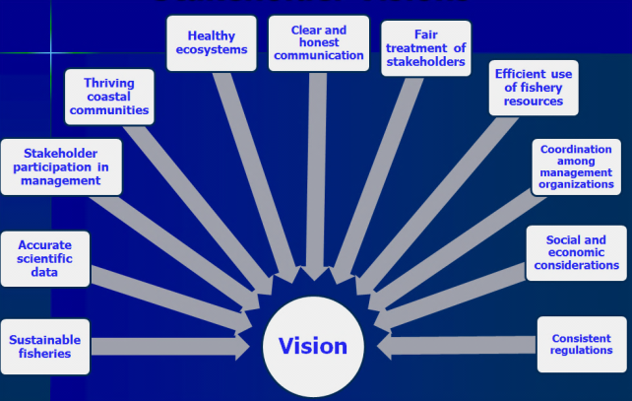
Stakeholder Visions
Accurate scientific data
Commercial
Industry participation in trawl survey design and operation
Recreational
Accurate system for recreational catch estimation
ENGO
Data collection transparency and timeliness
Timeliness
Utilization of volunteer angler input
Cooperative research
Stock assessments in the context of ecosystems
Effective monitoring of catch and bycatch
Substantial use of cooperative research results
Effective use of fishery-dependent data
Integration of existing unutilized data streams

Slide 16
Topic III: Strategic Planning Process and Progress

Slide 17
Strategic Planning Approach
Environmental (situational) Assessment
Stakeholder Input Report
Define Mission
&
Ideal State (Vision)
Articulate Goals
&
Objectives
Develop a Path (Strategy)
Establish Metrics
&
Timelines

Slide 18
Strategic Planning Participants
Visioning and Strategic Planning Working Group
Council members (Visioning Committee)
Stakeholders
Key leaders (ASMFC, NERO, NEFSC)
Strategic Plan Review
Public comment period
Full-Council review
Staff Involvement and Guidance

Slide 19
Strategic Planning Process
Organic—stakeholder driven
Builds upon the foundation established in the data-collection phase of the Visioning Project
Defines Vision and Mission
Strategic Planning Working Group develops strategic goals, objectives, and strategies for each category (e.g. Science and Data.)

Slide 20
Topic IV: Hindsight and Lessons Learned

Slide 21
Before Beginning…
Clearly identify objectives and parameters. Be realistic.
Decide who should be involved (or who shouldn’t).
Develop a full, beginning-to-end project plan.
Develop a strategic communications plan.
Establish clear (and reasonable) expectations.
Consultants can bring specialized expertise to the process but Council staff involvement in the project is essential to a successful outcome.

Slide 22
Final Thoughts
The traditional strategic planning process is designed for businesses in which most stakeholders have the same goals…
Consider how the Council’s needs may differ before initiating a planning process. Participants in the planning process may have…
Different definitions of success
Different ideas about trade-offs
Different orders of priorities
Make sure you develop a process that is tailored to your needs

