Slide 1
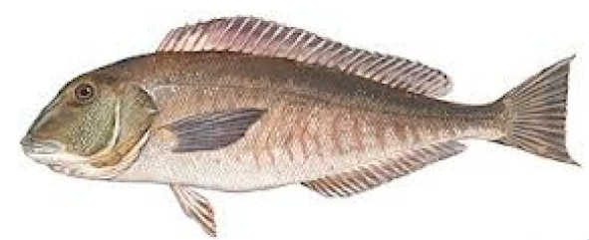
Derivation of P* for
Blueline Tilefish from SEDAR32 Assessment
Steve Cadrin
SEDAR32 Review Workshop Chair

Slide 2
SEDAR 32 Review Workshop
Morehead City NC, August 27-30 2013
Review Panel: Steve Cadrin (chair), Churchill Grimes (SA SSC), Will Patterson (GSMFC representative), Gary Melvin (CIE), Stephen Smith (CIE), Kevin Stokes (CIE)
Analytical Team: Kevin Craig (SEFSC – tilefish lead), Erik Williams (SEFSC), Katie Andrews (SEFSC), Kyle Shertzer (SEFSC), Rob Cheshire (SEFSC), Lou Coggins (SEFSC), Brian Langseth(SEFSC), Eric Fitzpatrick (SEFSC), …
Council & Agency Staff: Julia Byrd (SEDAR coordinator), Mike Erriggo (SAFMC), Julie O’Dell (SAFMC), Jessica Stephen (SERO),
Observers: Michelle Duval (SAFMC), Dewey Hemilright (NC Commercial Fishing Industry), Robert Johnson (FL Recreational Fishing Industry), Doug Vaughan (AFS), Bob O’Boyle (PEW), Mike Prager (Omega Protein), …

Slide 3
Approach
Brief Summary of blueline tilefish stock assessment relevant to P*
  Data (data included in the final assessment)
  Assessment (accepted models)
  Results:
    Stock status
    Catch Projections
Suggested P* scoring for SSC discussion

Slide 4
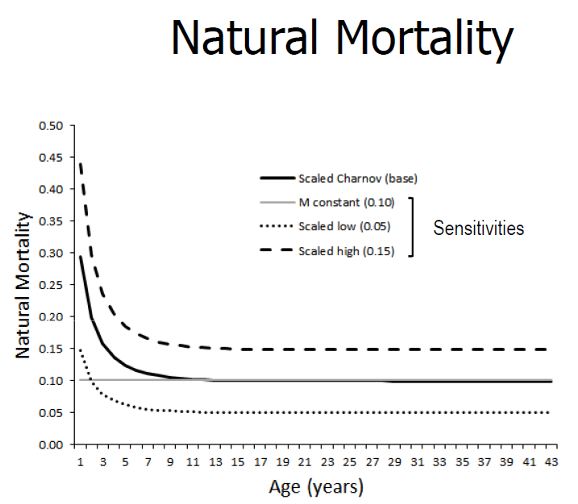

Slide 5
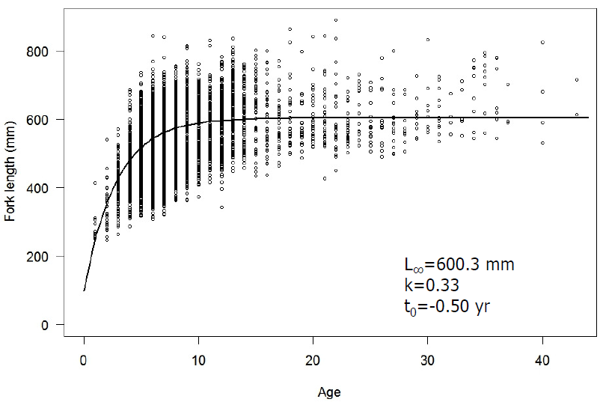
Growth

Slide 6
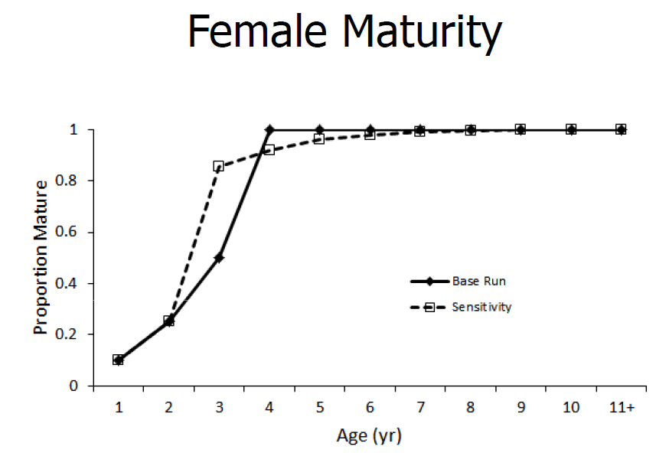

Slide 7
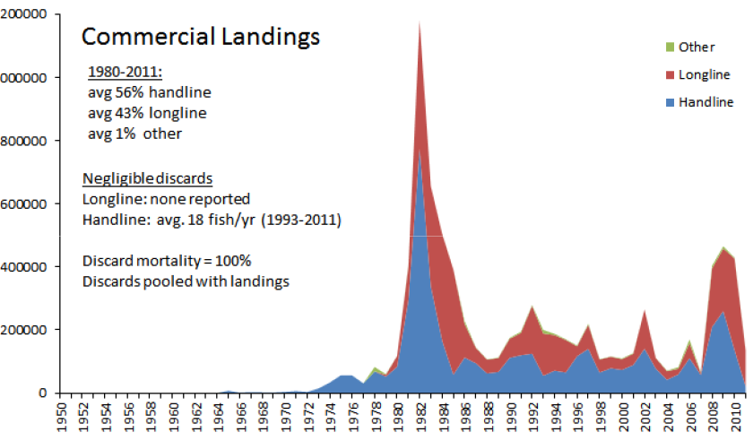
Commercial Catch
Catch (lbs)

Slide 8
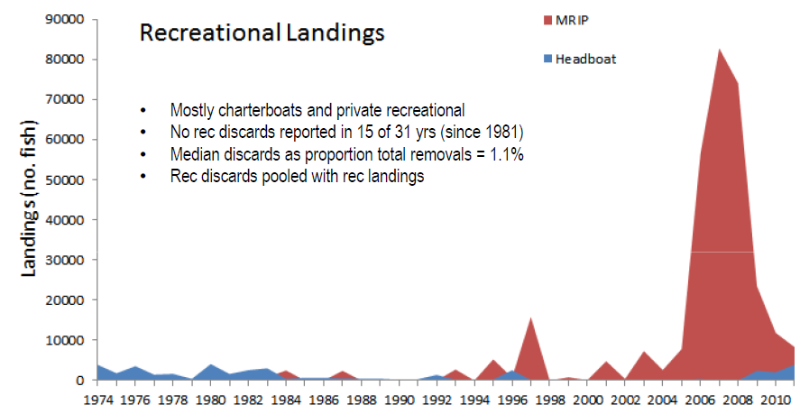
Recreational Catch
Catch (fish)

Slide 9
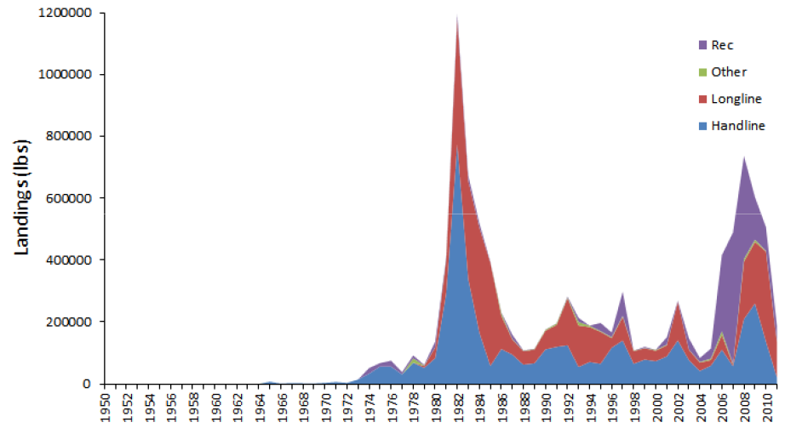
Total Catch
Catch (lbs)

Slide 10
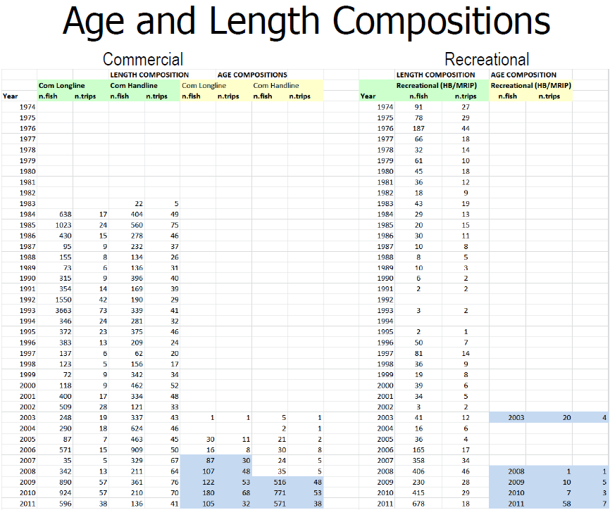

Slide 11
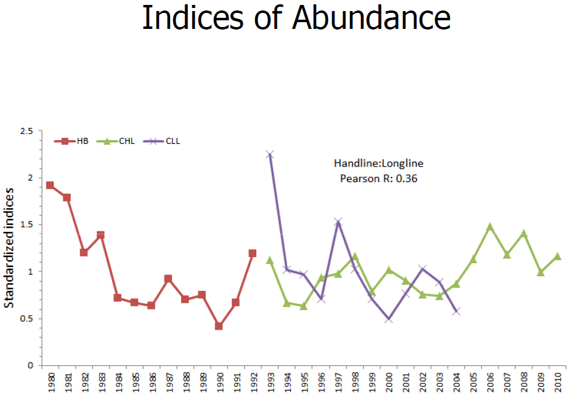

Slide 12
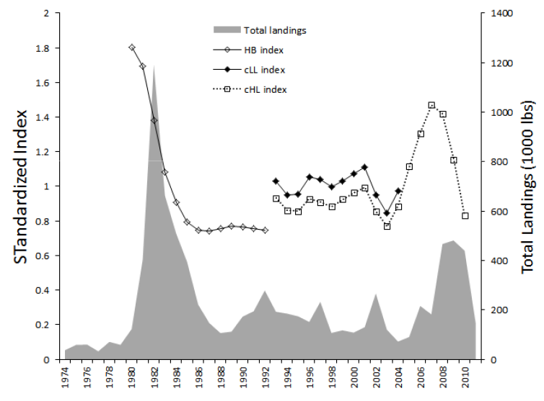
Abundance Indices and Catch

Slide 13
Beaufort Assessment Model
1974–2011 (Earliest year consistent data was available; 99.5% landings occurred after 1974)
ages: 1–15+ (plus group based on inspection of age compositions and where growth and M reach asymptotes)
Von Bertalannfy growth and age-based natural mortality
Initial numbers at age assumed equilibrium age structure and an estimated historical fishing mortality rate
Beverton-Holt spawner-recruit relationship with lognormal recruitment deviations
Spawning potential: mature female biomass (N x wgt x fraction female) at time of peak spawning (May)
Three Fleets: recreational, commercial handline, commercial longline; discards pooled with landings
Abundance Indices: all fishery-dependent; recreational headboat (HB), commercial handline (cHL), commercial longline (cLL)
Separate catchability for each fleet, assumed constant in time
Logistic electivity functions for landings and indices. Constant in time.
Annual estimates of fishing mortality for each fleet; age-specific F computed as product full F and selectivity at age

Slide 14
BAM Input Data
Recreational removals (landings + discards): 1974-2011
Commercial handline removals (landings + discards): 1974-2011
Commercial longline removals (landings): 1979-2011
Commercial age compositions
  handline: annual 2005-2011
  longline: annual 2006-2011
Recreational age compositions: pooled (2003, 2008-2011)
Headboat index (1980-1992)
Handline index (1993-2010)
Longline index (1993-2004)
Excluded length compositions because of conflicts with other data sources (recreational age comps and indices), changes in sampling (e.g., headboats early part of time series, general rec fleet later part of time series), and poor fits to length data
Iterative re-weighting for data components

Slide 15
BAM parameters
160 Estimated
  S-R parameters (2): R0, sigma-R; steepness fixed
  Annual R devs (36): 1974-2009
  Selectivity (6): 3 fleets (A50, slope)
  Catchability (3): q for each abundance index
  Annual Fishing mortality (112)
  Initial F (1): Initial fishing mortality rate
Fixed steepness (h) at 0.84
  h=0.84 meta analysis of marine demersal fishes including many Southeast US stocks (Shertzer and Conn 2012)
  h=0.836 mode of “Domain 3 nonanadromous” species (Myers et al. 2002)
  h=0.84 value assumed for golden tilefish (Sedar 25)

Slide 16
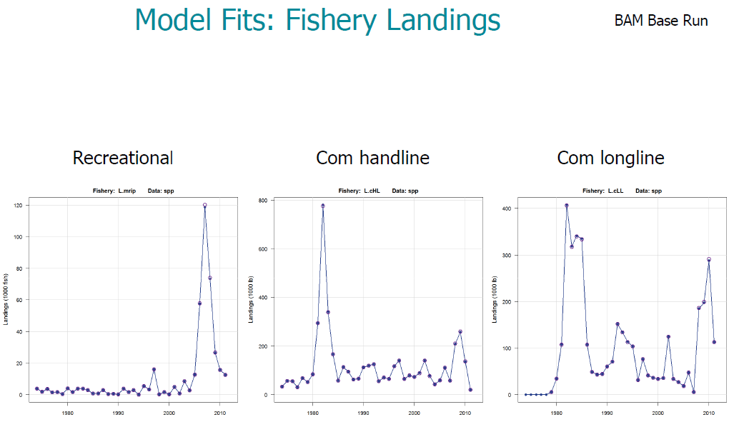

Slide 17
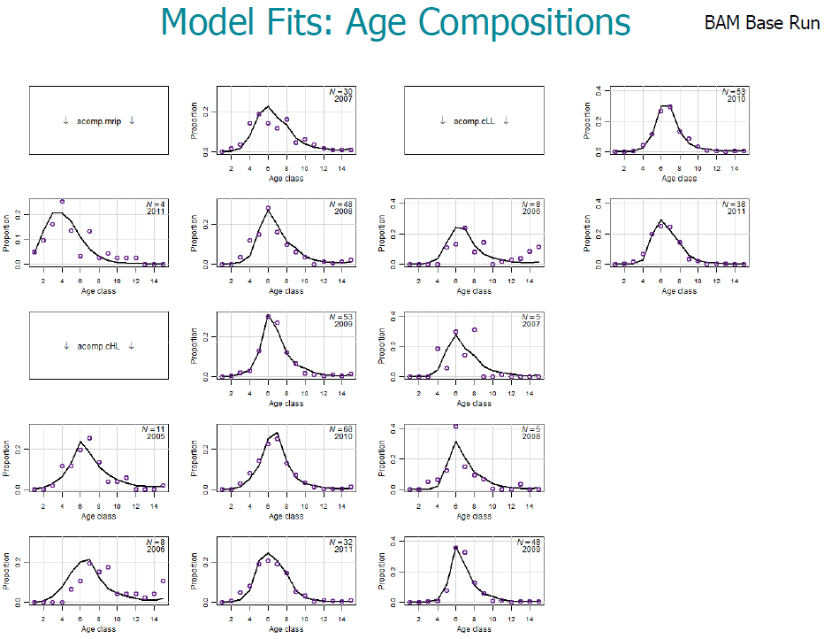

Slide 18
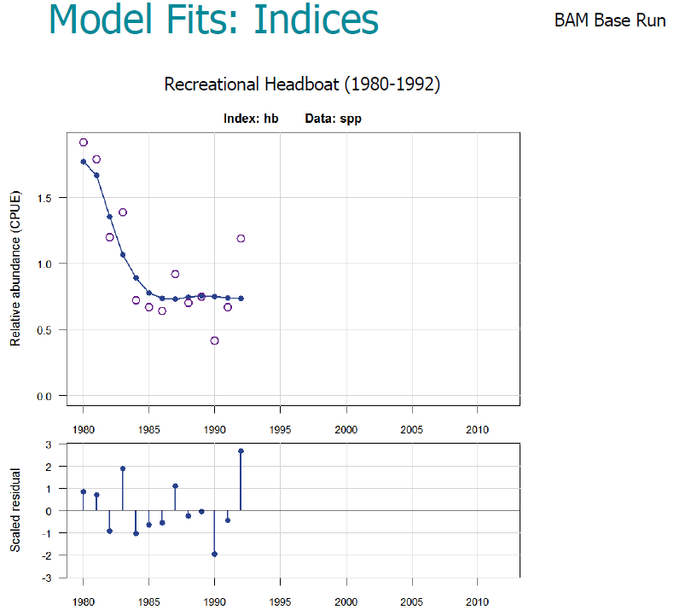

Slide 19
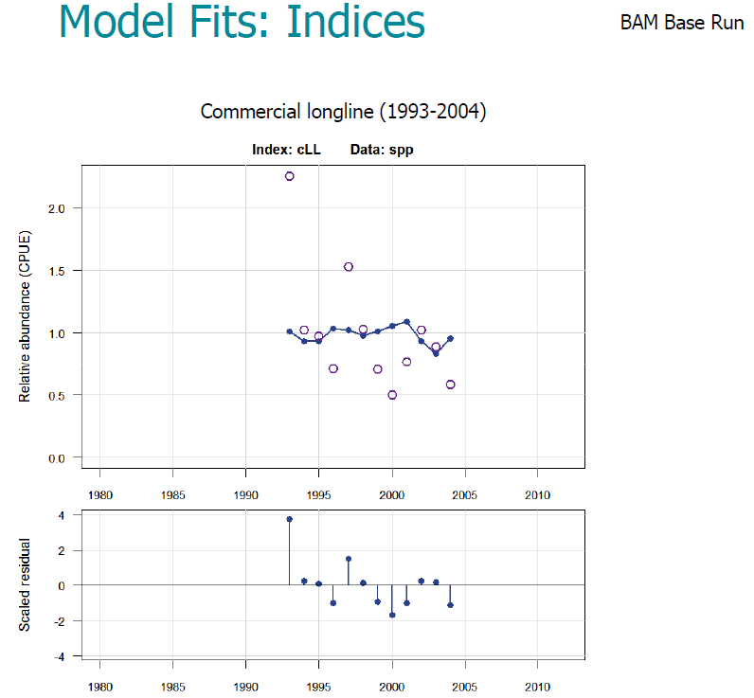

Slide 20
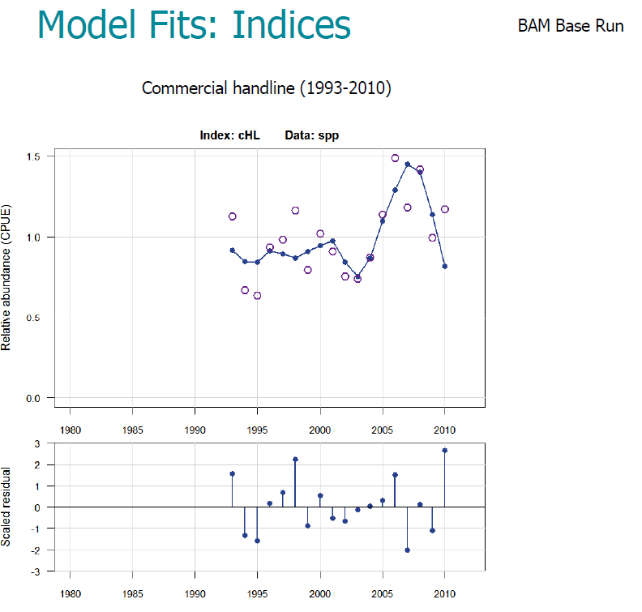

Slide 21
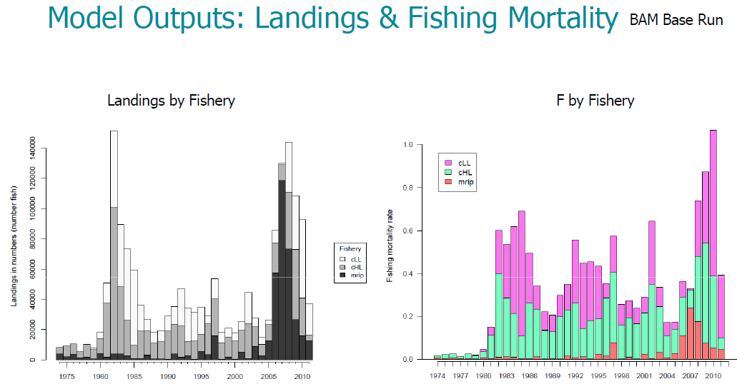

Slide 22
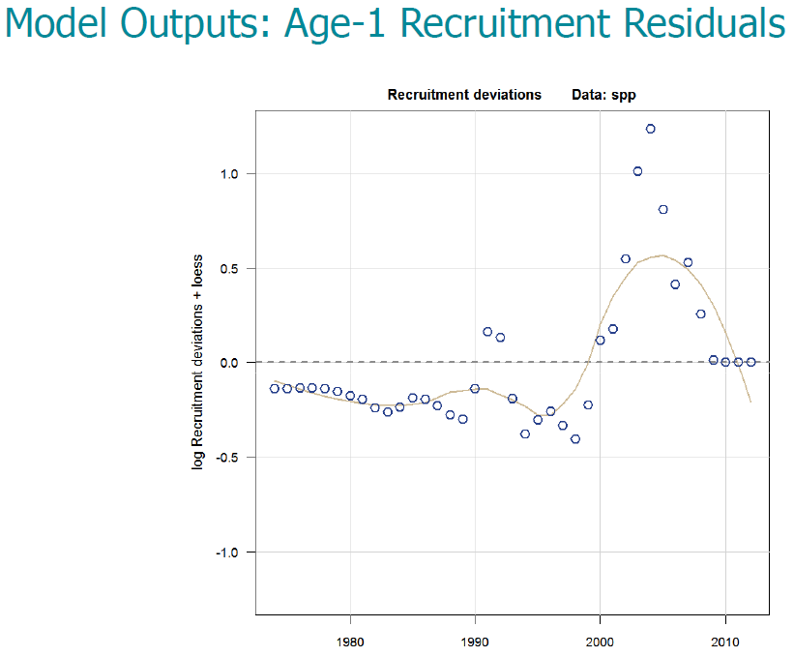

Slide 23
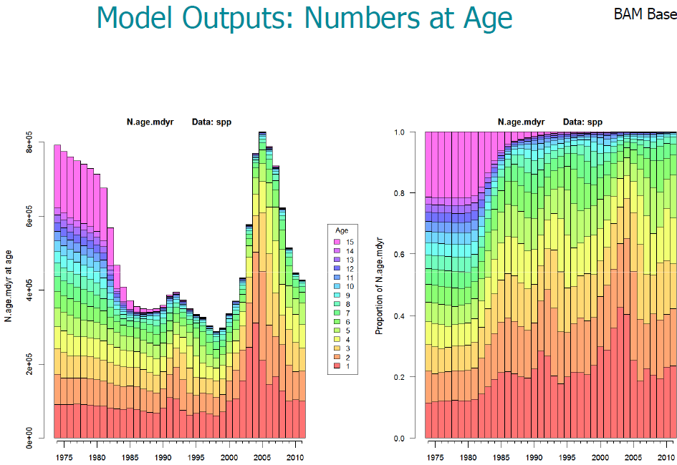

Slide 24
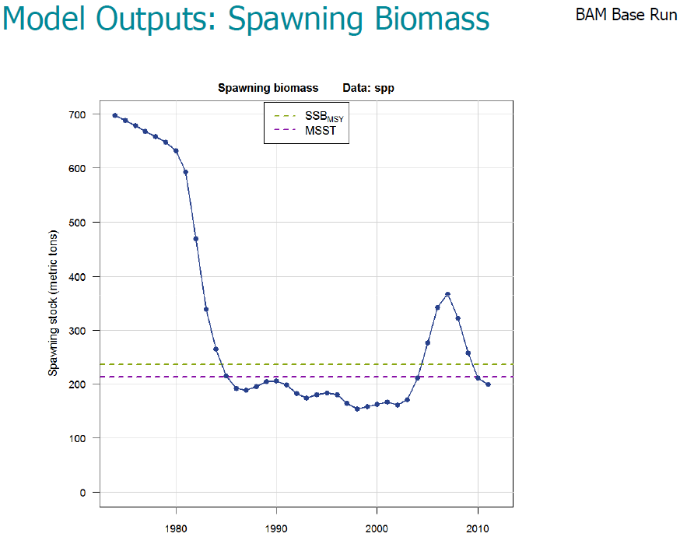

Slide 25
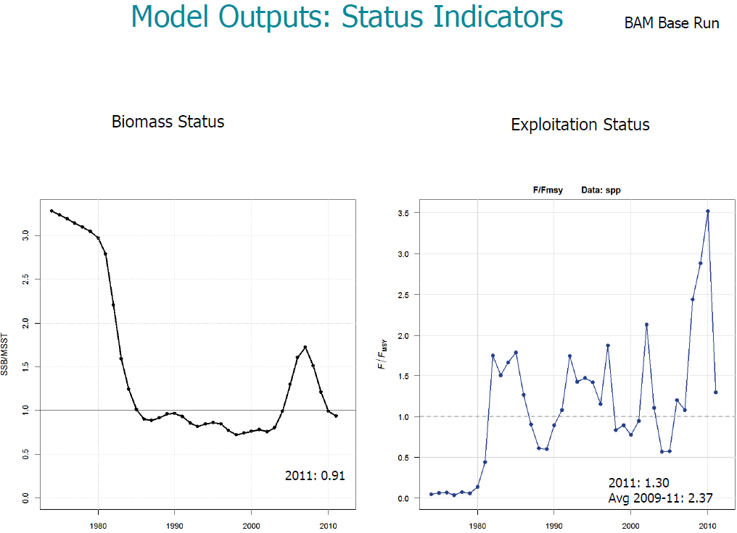

Slide 26
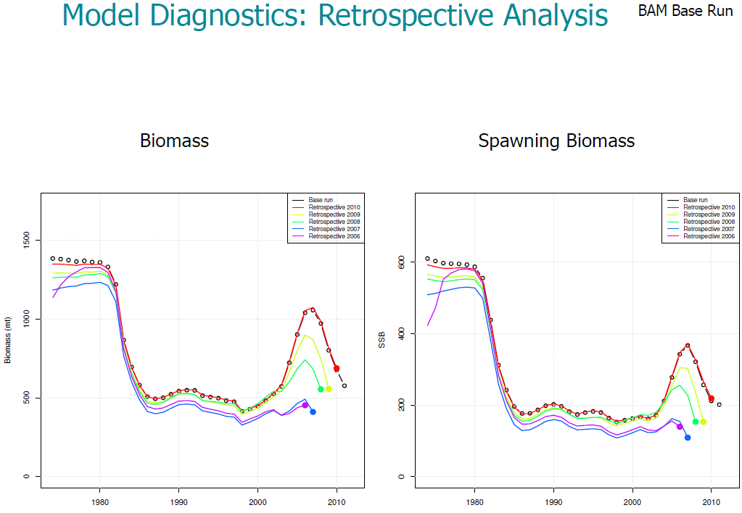
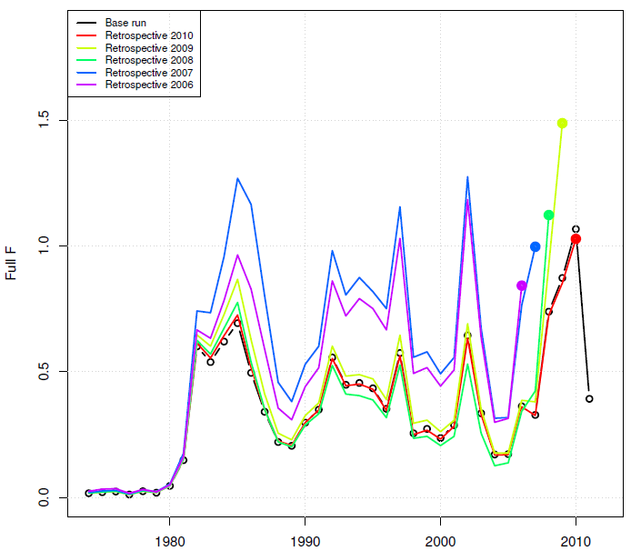
Fishing Mortality

Slide 27
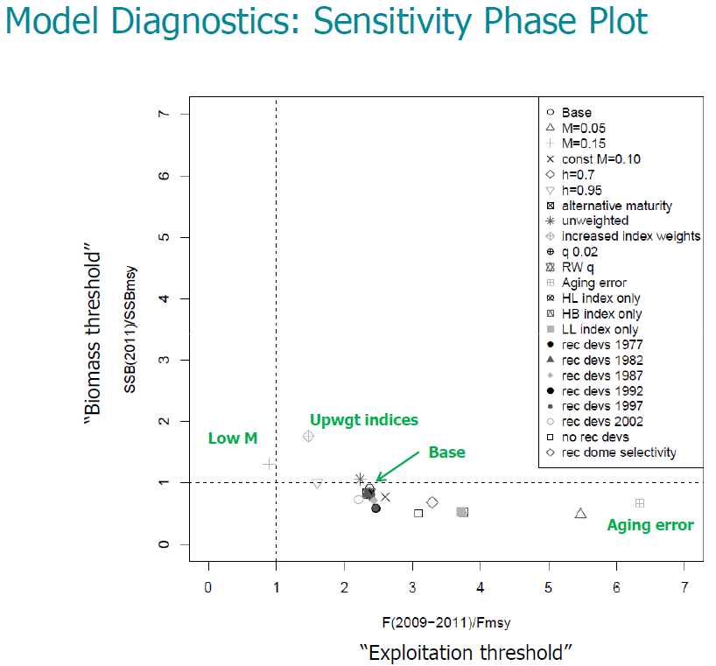

Slide 28
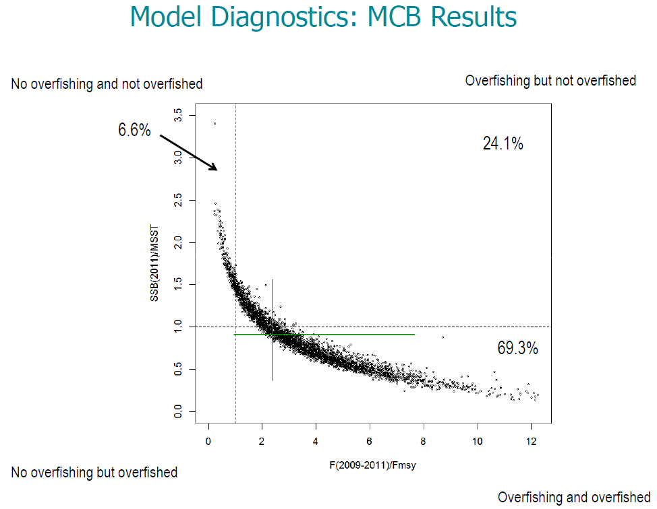

Slide 29
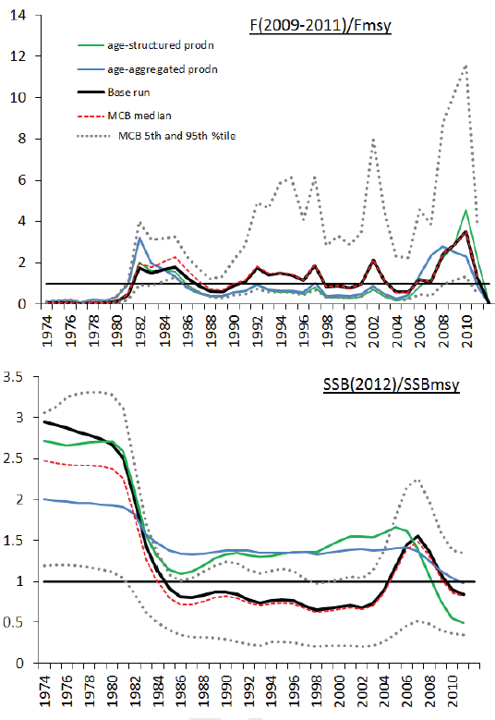
Alternative
Models
BAM Base Run (best for status determination)
MCB BAM (best for stochastic projection)
Age-Structured Production Model (BAM with no Rdev)
Age-Aggregated Production Model (ASPIC)

Slide 30
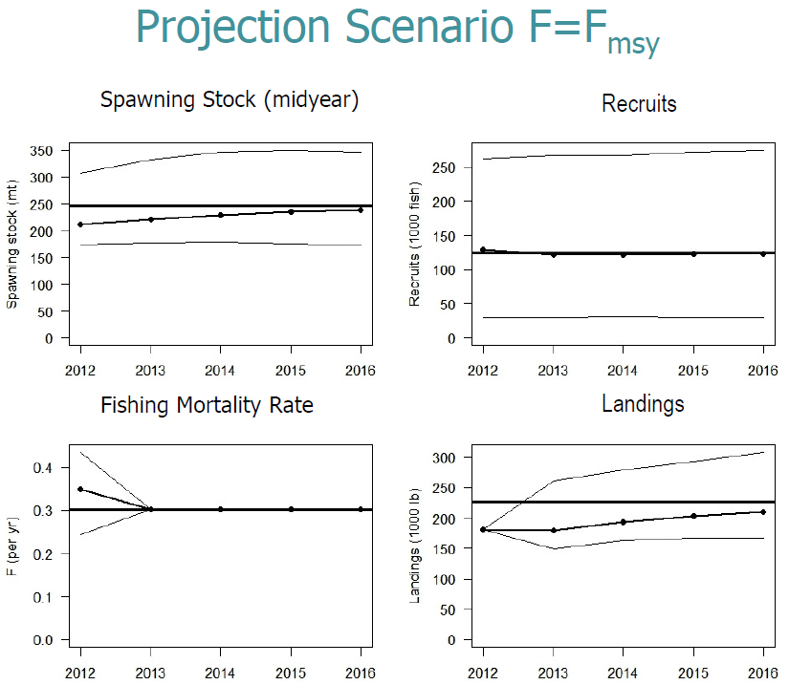

Slide 31
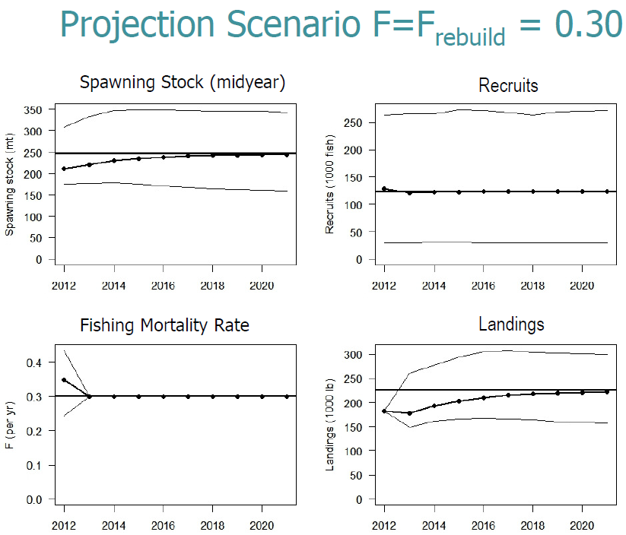

Slide 32
Approach
Brief Summary of blueline tilefish stock assessment relevant to P*
  Data (data included in the final assessment)
  Assessment (accepted models)
  Results:
    Stock status
    Catch Projections
Suggested P* scoring for SSC discussion

Slide 33
Derivation of P*
P*=0.1 to 0.5=(50+penalty)/100
Penalties for scientific uncertainty:
  Assessment Information Tiers Scoring (0 to -10)
  Uncertainty Tiers, Examples, and Scoring (0 to -10)
  Stock Status Tiers and Scoring (0 to -10)
  Productivity-Susceptibility Assessment Tiers and Scoring (0 to -10)

Slide 34
1. Assessment Information (penalty)
Quantitative assessment provides estimates of exploitation and biomass; includes MSY-derived benchmarks. (0)
Quantitative assessment provides estimates of either exploitation or biomass, but not MSY benchmarks; requires proxy reference points. (-2.5)
Quantitative assessment that provides relative measures of exploitation or biomass; absolute measures of status are unavailable; references may be based on proxy. (-5)
Reliable catch history available (-7.5)
Scarce or unreliable catch records (-10)

Slide 35
2. Uncertainty (penalty)
Complete. This tier is for assessments providing a complete statistical (e.g. Bayesian re-sampling approach) treatment of major uncertainties, incorporating both observed data and environmental variability, which are carried forward into reference point calculations and stock projections. A key determinant of this level is that uncertainty in both assessment inputs and environmental conditions are included. No currently assessed stocks meet this level. (0)
High. This tier represents those assessments that include re-sampling (e.g. Bootstrap or Monte Carlo techniques) of important or critical inputs such as natural mortality, landings, discard rates, age and growth parameters. Such re-sampling is also carried forward and combined with recruitment uncertainty for projections and reference point calculations, including reference point distributions. . The key determinant for this level is that reference point estimates distributions reflect more than just uncertainty in future recruitment. (-2.5)
Medium: This tier represents assessments in which key uncertainties are addressed via statistical techniques and sensitivities, but the full uncertainties are not carried forward into the projections and reference point calculations. Projections may, however, reflect uncertainty in recruitment and population abundance. Although outputs include distributions of F, FMSY as in the ‘High’ category above, in this category fewer uncertainties are addressed in developing such distributions. One example for this level is a distribution of FMSY which only reflects uncertainty in recruitment. (-5)
Low. This tier represents those assessments lacking any statistical treatment of uncertainty. Sensitivity runs or explorations of multiple assessment models may be available. The key determinant for this level is that distributions for reference points are lacking. (-7.5)
None. This tier represents assessments that only provide single point estimates, with no sensitivities or other evaluation of uncertainties. (-10)

Slide 36
3. Stock Status (penalty)
Neither overfished nor overfishing, and stock is at high biomass and low exploitation relative to benchmark values. (0)
Neither overfished nor overfishing, but stock may be in close proximity to benchmark values (-2.5)
Stock is either overfished or overfishing (-5)
Stock is both overfished and overfishing (-7.5)
Either status criterion is unknown. (-10)

Slide 37
4. Productivity-Susceptibility Analysis (penalty)
Low Risk. High productivity, low vulnerability and susceptibility, score <2.641 (0)
Moderate Risk. Moderate productivity, vulnerability, susceptibility, score 2.64-3.181 (-5) (Spanish Mackerel 2.74)
High Risk. Low productivity, high vulnerability and susceptibility, score >3.181 (-10) (Cobia 3.29)

Slide 38
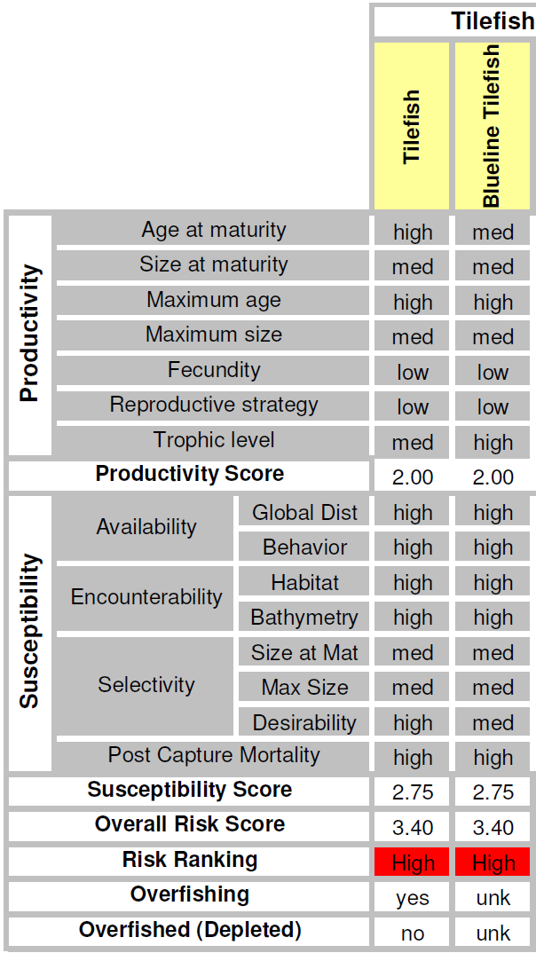
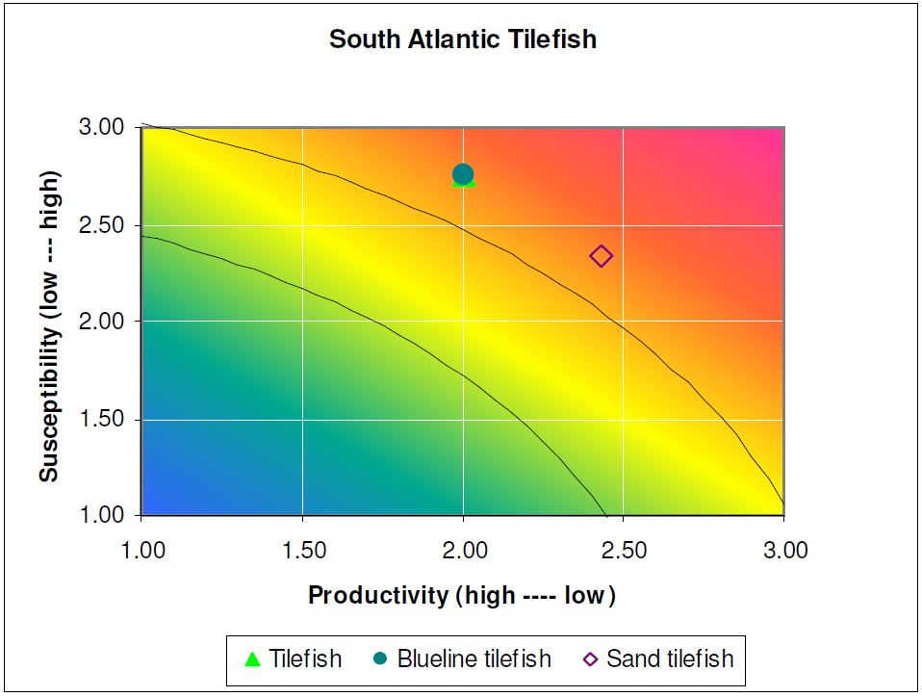
PSA Analysis
MRAG (2009)

Slide 39
Derivation of P*
P*=(50+penalty)/100
Penalties for scientific uncertainty:
  Assessment Information Tiers Scoring (quantitative, estimate of MSY, 0?)
  Uncertainty Tiers, Examples, and Scoring (‘high’, -2.5?)
  Stock Status Tiers and Scoring (overfishing and overfished, -7.5?)
  Productivity-Susceptibility Assessment Tiers and Scoring (‘high risk’, -10?)
P*= (50 -0 -2.5 -7.5 -10)/100 = 0.30?

