Slide 1
Southeast Fisheries Science Center
SAFMC Update – June 2011

Slide 2
HEADBOAT SURVEY & MRIP PILOT STUDY UPDATE
The 2010 estimated headboat landings and angler days for the South Atlantic and Gulf of Mexico completed in March 15, 2011.
Headboat Survey staff participated in SEDAR 25 Data Workshop. Headboat data will be used to create index of abundance for black sea bass but not for tilefish (due to limited HB data).
Analysis of MRIP Electronic Logbook Reporting Pilot study completed. Final report in review; will be available by June, 2011.
Results of MRIP Pilot study to be used to plan and develop strategy for full implementation of HB electronic logbook reporting.

Slide 3
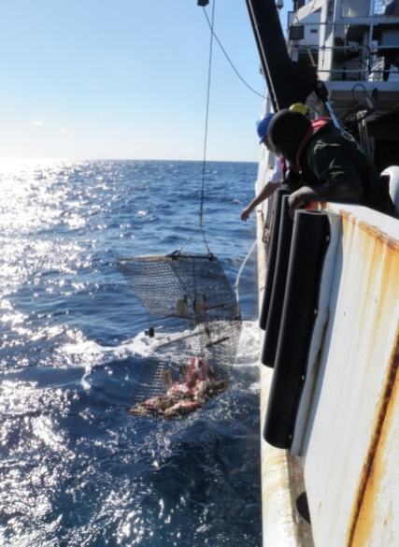
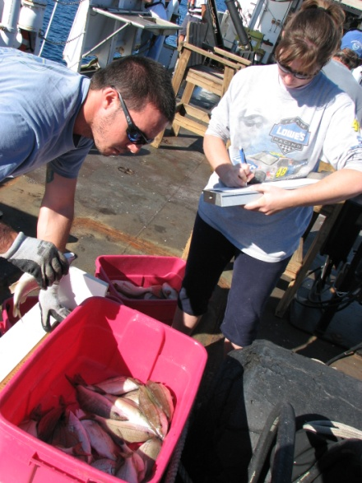
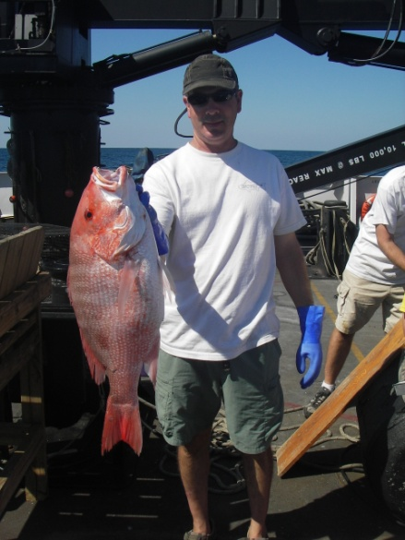
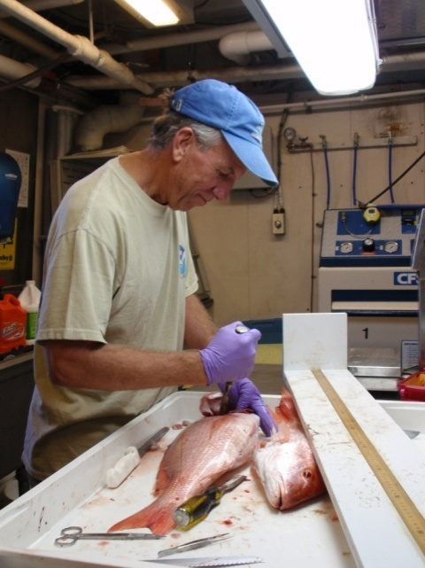
Southeast Fishery-Independent Survey (SEFIS)
Created in 2010 in response to:
Need to strengthen inputs to stock assessments
Reductions in fishery-dependent data
Incomplete spatial coverage of MARMAP
Trap selectivity issues

Slide 4
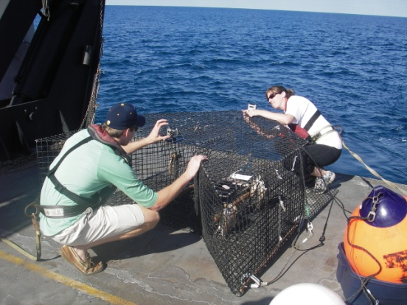
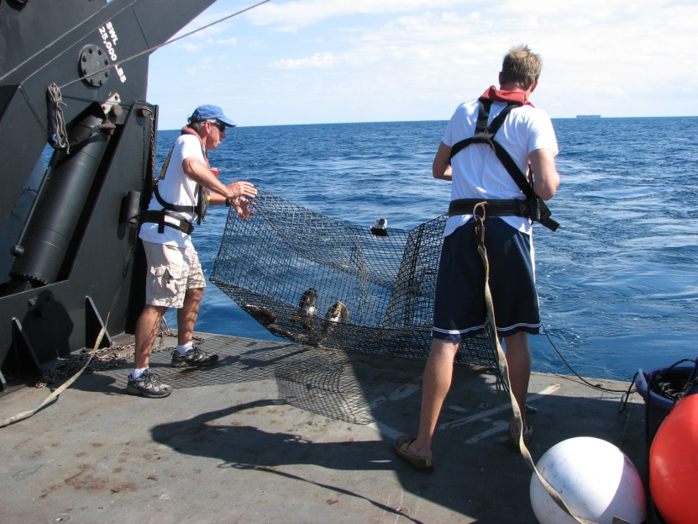
Objectives of SEFIS
Increase spatial footprint and sample sizes of fishery-independent surveys in US South Atlantic
Implement video cameras as a survey gear to address trap selectivity and develop indices of abundance
Map hardbottom habitats to improve survey design
Applied research to inform survey methods and address management issues

Slide 5
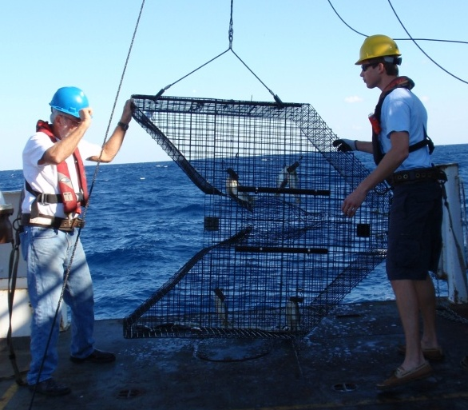
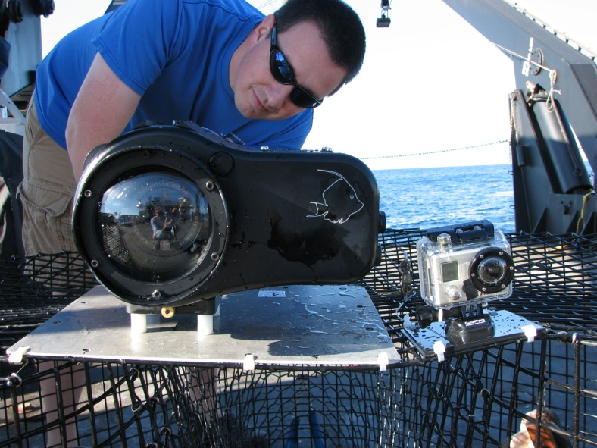
SEFIS sampling approach
Chevron traps
Video cameras affixed to traps
Multibeam mapping (expands sampling universe)
Directed ROV, longline and fisheries sonar efforts

Slide 6
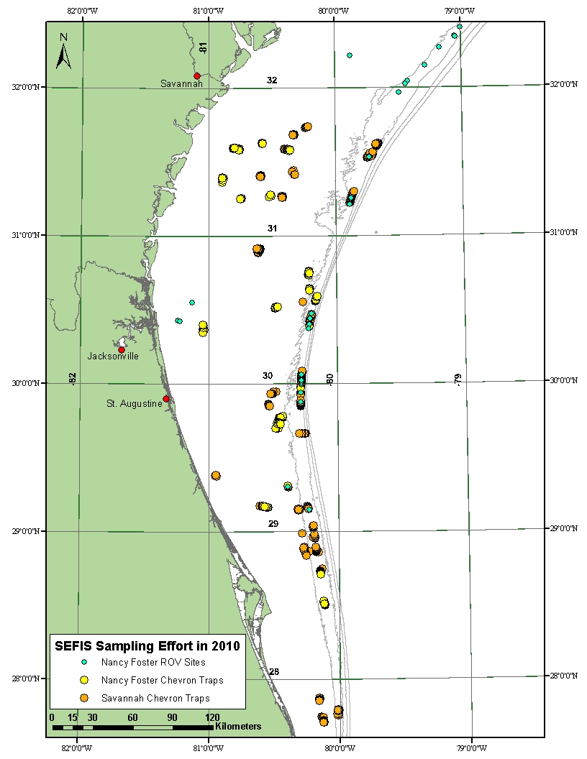
2010 Results
63 days at-sea
480 traps deployed (>97% affixed with cameras)
37 areas mapped (377 km²) with multibeam sonar
200 hours of split-beam sonar surveys
32 ROV dives

Slide 7
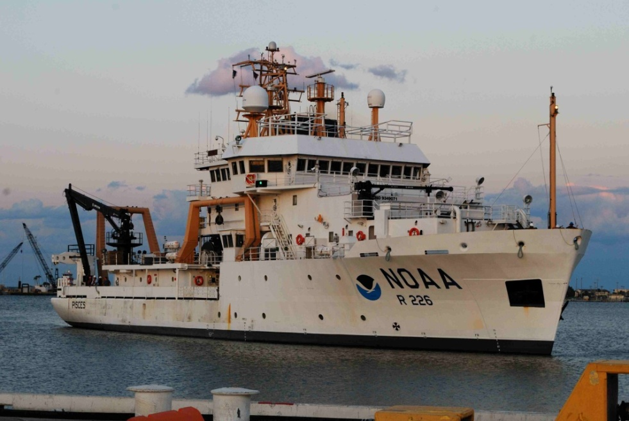
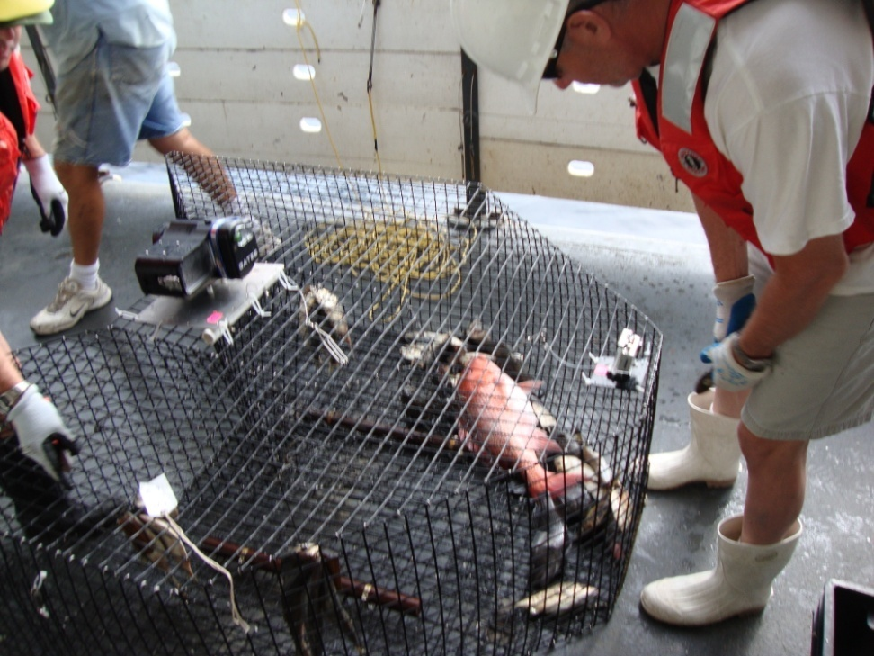
2011 Plans and Progress
12 days at sea on NOAA ship Pisces completed in Florida during May
130 trap/video samples
21 areas mapped with multibeam
> 42 days at sea planned on R/V Savannah in June – September
Video surveys now system-wide
> 800 trap/video samples likely (from SEFIS and MARMAP sampling combined) each year between NC and FL

Slide 8
Realized and anticipated results
100% increase in annual survey sample sizes over historical (solely MARMAP) levels
Improved trap-based abundance indices due to increased survey sample size and spatial footprint
Improved size-at-age and sex ratio information due to increase trap-based biological collections (otoliths and gonads)
Establishment of video-based abundance indices (more precise than trap-based) for use in future assessments
Improved knowledge of hardbottom distribution (via mapping) = improved survey design

