Slide 1
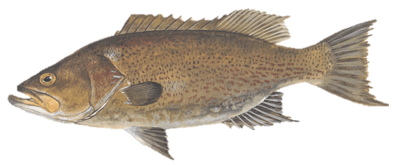
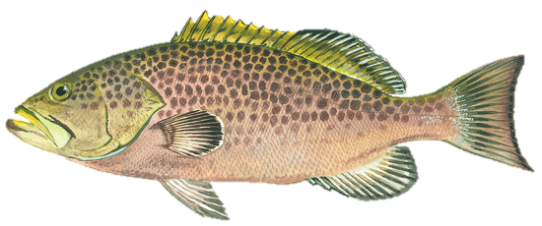
AMENDMENT 55 SCAMP AND YELLOWMOUTH GROUPER
DZFGD
Management Response
SNAPPER GROUPER ADVISORY PANEL
October 2022
Allie Iberle
allie.Iberle@safmc.net
843-225-8135

Slide 2
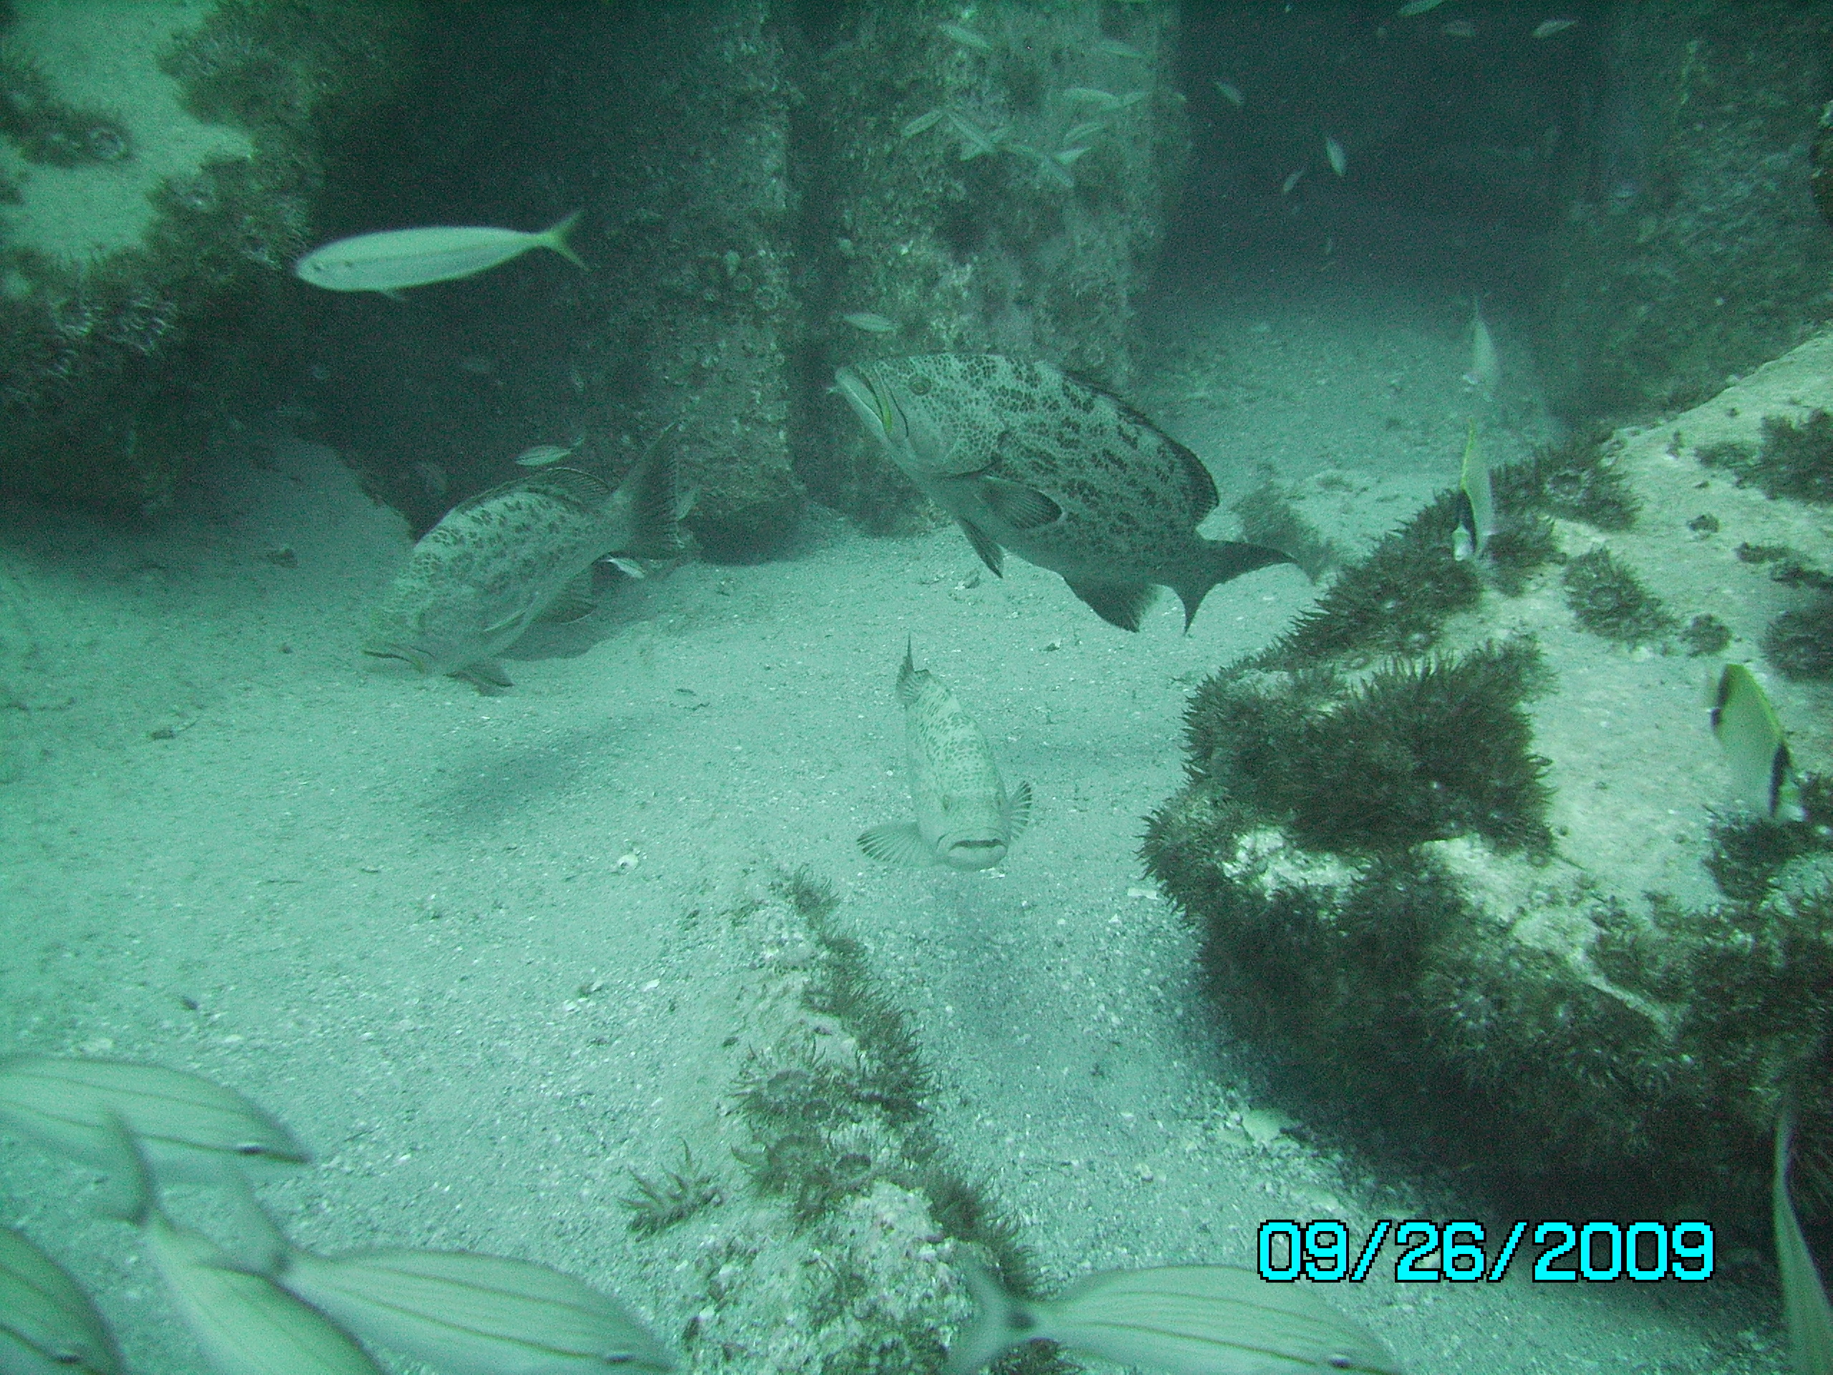
Current Regulations: Scamp and Shallow Water Groupers (SWG)
 |  | Current Shallow Water Grouper Complex
 | scamp | coney | graysby | red hind | rock hind | yellowfin | yellowmouth
aggregate bag limit | 3 | 3 | 3 | 3 | 3 | 3 | 3
trip limit | none | none | none | none | none | none | none
size limit | 20 in TL | none | none | none | none | 20 in TL | 20 in TL
season | May 1 - Dec 31

Slide 3
Shallow Water Grouper Complex
Total ACL (equal to ABC): 104,190 lbs ww
Notes:
These are catch levels NOT landings
TOTAL COMPLEX IS IN CHTS UNITS NOT FES
Yellowmouth poundage: 4,039 lbs ww

Slide 4
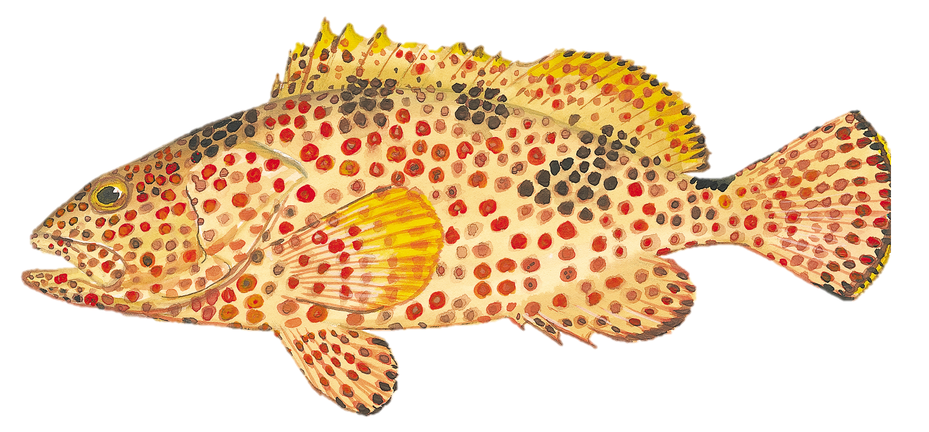
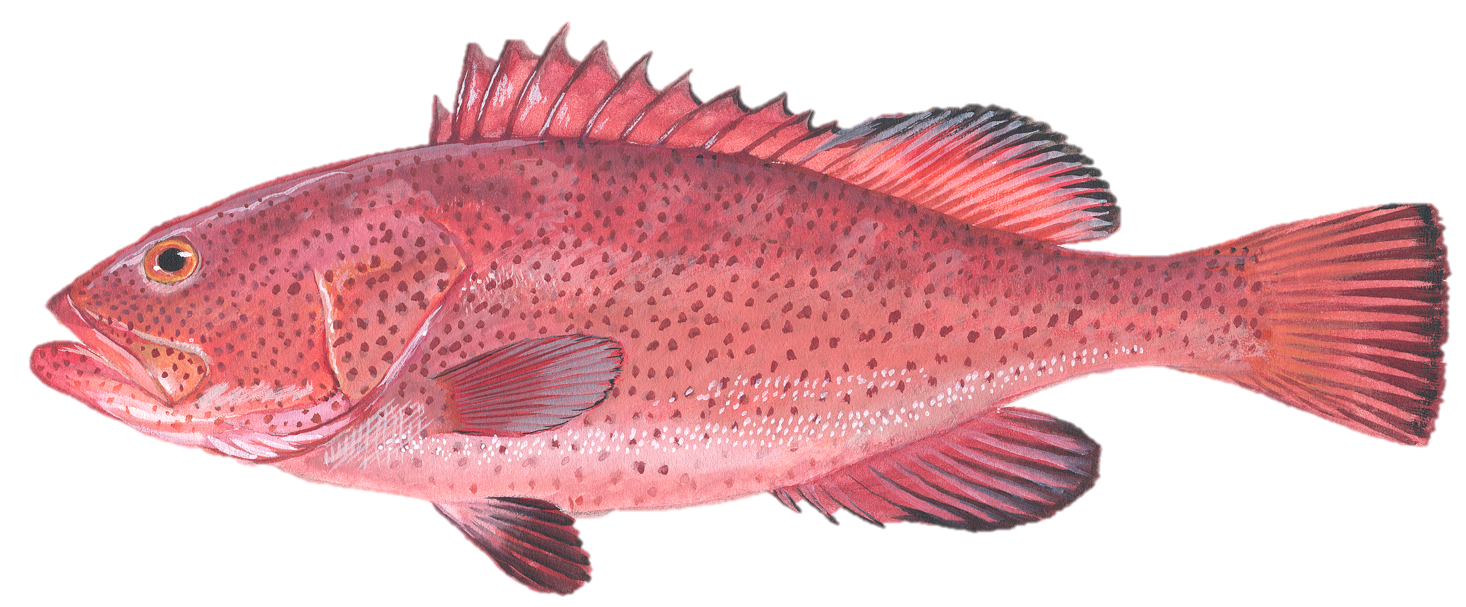
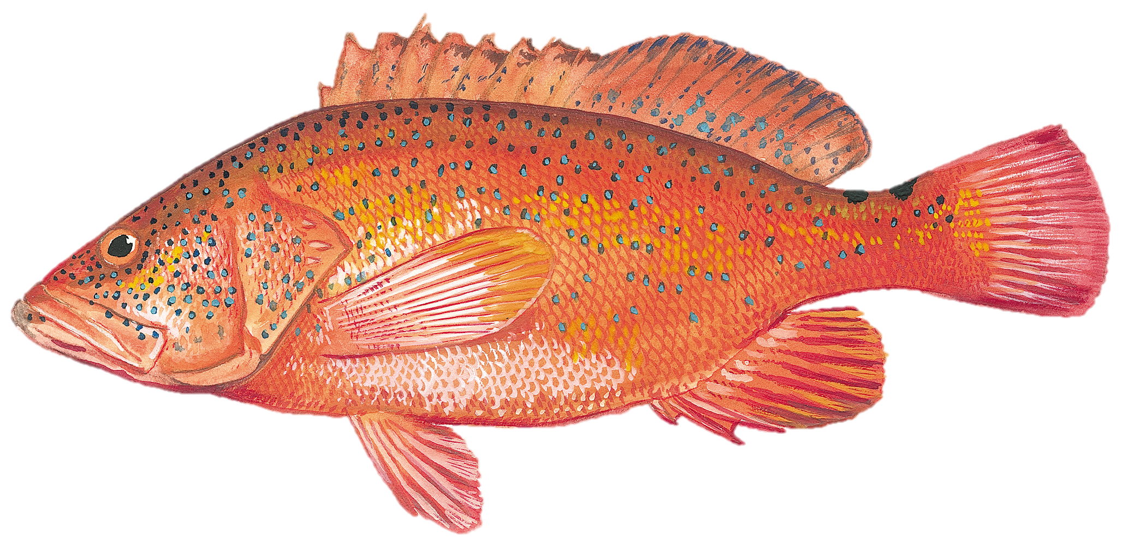
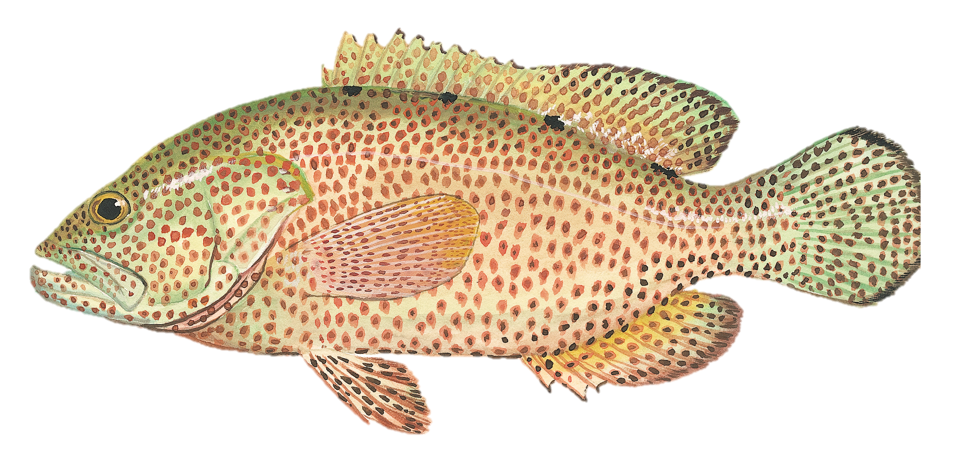
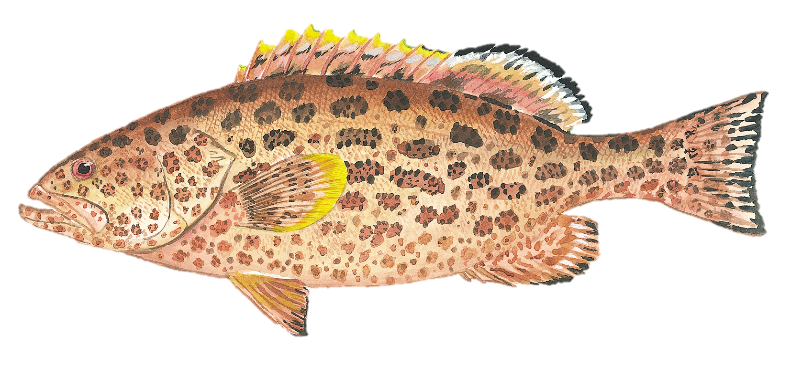
Recent Landings: Scamp and SWG
COMMERCIAL
RECREATIONAL CHTS
Notes:
LANDINGS ARE FORM ACL MONITORING – LANDINGS ESTIMATES AND ACLS ARE IN CHTS UNITS.

Slide 5
Recent Landings: Scamp and Yellowmouth Grouper

Slide 6
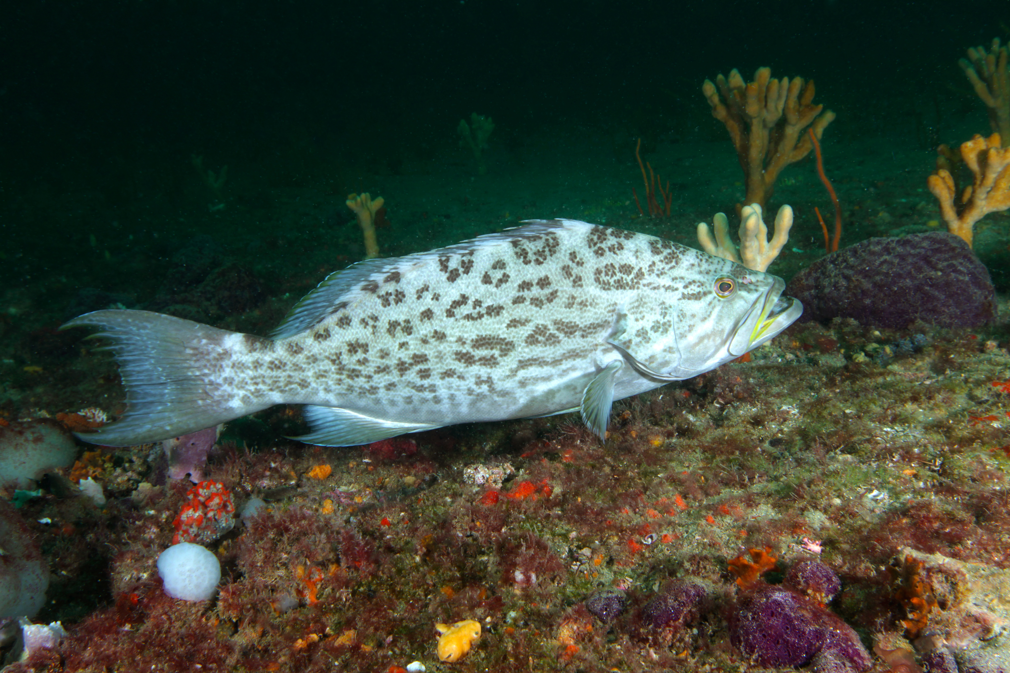
Amendment 55 Actions
SWG Complex ACL
(CHTS estimates)
Scamp ACL
(CHTS estimates)
Based on rebuilding projections
STEP 1.
Reorganize the SWG Complex and establish the new complex of scamp and yellowmouth
STEP 2.
STEP 3.
Establish stock status criteria for scamp/yellowmouth complex
Establish a rebuilding plan for the scamp/yellowmouth complex
By-product of STEP 1:
a. Will need to modify the SWG ACL
(CHTS estimates)
b. Update SWG ACL
CHTS FES estimates
UPCOMING UNASSESSED STOCK AMENDMENT

Slide 7
Amendment 55 Actions
STEP 1.
STEP 2.
STEP 3.
Reorganize the SWG Complex and establish the new complex of scamp and yellowmouth
Establish MSY, MSST, MFMT for scamp/yellowmouth complex
Establish a rebuilding plan for the scamp/yellowmouth complex
STEP 4.
STEP 6.
Establish ACLs and OYs
STEP 5.
Establish commercial and recreational AMs
Establish allocations and sector ACLs for scamp/yellowmouth complex
SWG complex
(subtraction of yellowmouth portion, CHTS rec estimates)
Scamp/yellow-mouth complex
Scamp/yellowmouth complex
SWG complex
Management Measures?

Slide 8
Tentative Timing and Next Steps
June 2023 | Review decision document and approve for scoping
Summer 2023 | Conduct scoping
September 2023 | Review scoping comments and select preferred total ACL alternative for the scamp/yellowmouth complex
October 2023 | SG AP review
December 2023 | Review preliminary analysis and approve for public hearings
Winter 2024 | Hold public hearings
March 2024 | Review public hearing comments and modify document as needed
April 2024 | SG AP review
June 2024 | Review and approve all actions
September 2024 | Review draft rationale, approve for formal review
Notes:
CHECK THIS IS ON THE RIGHT TRACK

Slide 9
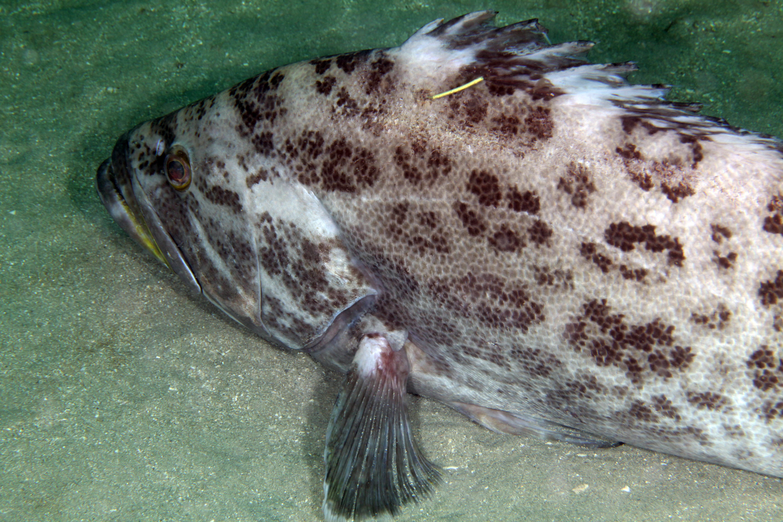

Questions?

