Slide 1
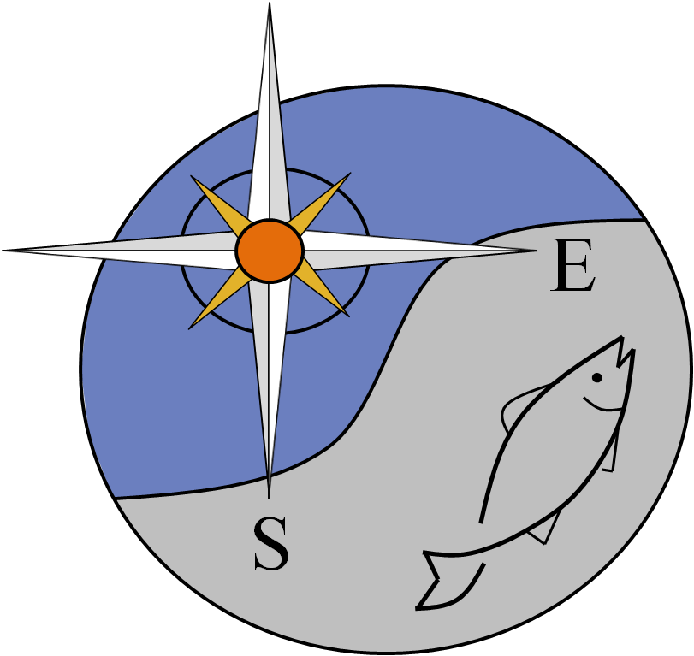
SEDAR Procedural Workshop 6: South Atlantic Shrimp Data Evaluation
Joint Shrimp and Deepwater Shrimp
Advisory Panel Meeting
April 16, 2015
Prepared by Julia Byrd

Slide 2
Why hold workshop on shrimp?
October 2012 presentation to SAFMC SSC on Gulf of Mexico pink shrimp assessment
SSC recommendation to proceed with exploratory phase to assess applicability of assessment to South Atlantic
First step – Hold a workshop to identify available shrimp data in the South Atlantic

Slide 3
Workshop Objectives
Evaluate available South Atlantic shrimp data for:
Potential use in shrimp stock assessment
Bycatch estimation for use in finfish stock assessments
Develop list of available datasets
Evaluate strengths/weaknesses of datasets
Identify data gaps and research needs
Provide best practice recommendations
Notes:
Remember to highlight ID data gaps and research needs – this what want feedback on from AP
Workshop held July 2014 in North Charleston
Participants = state agencies, federal agencies, ASMFC, SAFMC SSC, GSAFF, SAFMC and SEDAR Staff – open to public

Slide 4
Workshop Overview
Presentations
Monitoring and Management
Shrimp stock assessment
Bycatch estimation methods
Working Groups
Life History / Environment
Fishery Statistics
Indices
Best Practices Discussion
Workshop Report & Background Documents
http://sedarweb.org/pw-06
Notes:
FOCUS ON PENAEID!!!

Slide 5
Life History
Life history parameters and their application to shrimp
Important parameters for modeling: stock recruitment, natural mortality, age/length, growth
Stock recruitment relationship challenges
Natural mortality influenced by disease, environmental conditions, predation, density dependence
Natural mortality may have greater impact on population than fishing mortality
Length as proxy for age?

Slide 6
Life History
Take Home Messages
Shrimp are not fish
Environment and economics are important
Recruitment, natural mortality, and growth are influenced by environment
Habitat protection important
Fishery independent data critical to develop Life History parameters

Slide 7
Fishery Statistics
Fishery dependent data sources were reviewed for adequacy in effort, catch, bycatch, length/age
Data Needs
Long time series of catch and effort data
Species specific catch data ideal
Unit of time for effort data (hours fishing, # tows, etc.)
Gear description (headrope length, # nets, BRD/TED type, etc.)
Location information (stat grid, depth, distance from shore)

Slide 8
Fishery Statistics
Catch data generally sufficient; method to determine species specific catch varies by dataset
Unit of time not consistent between datasets
Gear description information limited and not consistent among states
BRD/TED compliance information limited
Size information dependent on dataset

Slide 9
Fishery Statistics
Overall Recommendations
Develop gear type overview and historical timelines
Increase observer coverage
Develop video techniques to characterize catch
Account for effects of fishing behavior on catch and bycatch
Support state cooperative projects

Slide 10
Indices
Develop recommendations for bycatch per unit effort (BCPUE) for non-shrimp species
Evaluate fishery independent and fishery dependent indices of abundance for potential use in shrimp assessments

Slide 11
Indices - BCPUE
Grouping Recommendations
Primary: year, season, area (estuarine, inshore, offshore)
Secondary: gear, region, target species, depth
Data Available
SEFSC Observer Program (1990s – present)
NCDMF Bycatch Characterization (2007-08, 2009, 2012-present)
GADNR Bycatch Characterization (1995-2005)
Fishery Independent Surveys?

Slide 12
Indices - BCPUE
Overall Recommendations
SEFSC Observer Program best available data for most gears and areas
NCDMF & GADNR should be used to supplement
Potential use of Fishery Independent Surveys
Could be useful if combined with observer data
Usually show higher BCPUE - gear configuration, timing, area
May correlate with commercial BCPUE
Explore use to scale or tune BCPUE from observer data
Quantify effects of BRD/TED on BCPUE

Slide 13
Indices - Shrimp
Fishery Independent Data
Recommend using SEAMAP – SA Coastal Survey
Recommend using state surveys as inshore supplement to SEAMAP
Recommend using NCDMF juvenile sampling to tune historical data/recruitment
Fishery Dependent Data
Recommend not using to develop indices
Difficult to develop standardized unit of effort
Changes in gear configuration and efficiency over time

Slide 14
Best Practice Recommendations
Recruitment overfishing unlikely with current state management regulations in place
Growth overfishing could occur if significant harvest of small shrimp allowed
Possible to overfish if unlimited fishing allowed on spawning stock
Methods could be developed to determine optimal yield for area specific management
Shrimp productivity tied to environmental factors, disease, predation, and fishing mortality
Timing of assessment and management critical

Slide 15
Best Practice Recommendations
Bycatch per unit effort (BCPUE) preferred method for estimating bycatch
Fishery Independent data could be used to supplement observer bycatch work

Slide 16
Overall Data Gaps
Non- penaeid shrimp species
Bait shrimp fishery
More detailed commercial effort
Gear description/configurations
Gears other than otter trawls
TED/BRD compliance rates
Recreational catch and effort

