Slide 1

Who we are
Private regional non-profit research organization
Represent commercial seafood and fishing industry
Virginia to Texas
Administered over 600 research grants since 1976

Slide 2
Foundation Observer Programs
2 in the Gulf of Mexico
  Bycatch Reduction Device (BRD) Development and Assessment in the Shrimp Trawl Fishery
  Electronic Logbook Data Collection
1 in the South Atlantic
  Snapper-Grouper Bandit Fishery
    Focus of this presentation

Slide 3
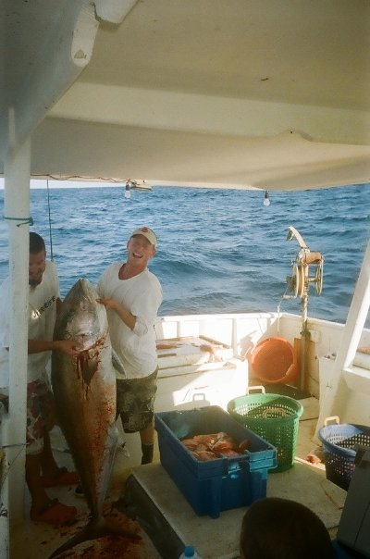
Catch Characterization and Discards within the Snapper-Grouper Vertical Hook-and-Line
Fishery of the South Atlantic
United States
Awards #NA06NMF4540059 / #NA08NMF4540399 / #NA10NMF4540102
Frank C. Helies
Program Director
Gulf and South Atlantic Fisheries Foundation
and
Scott W. Raborn, Ph.D.
Fisheries Scientist
LGL Ecological Research Associates, Inc.

Slide 4
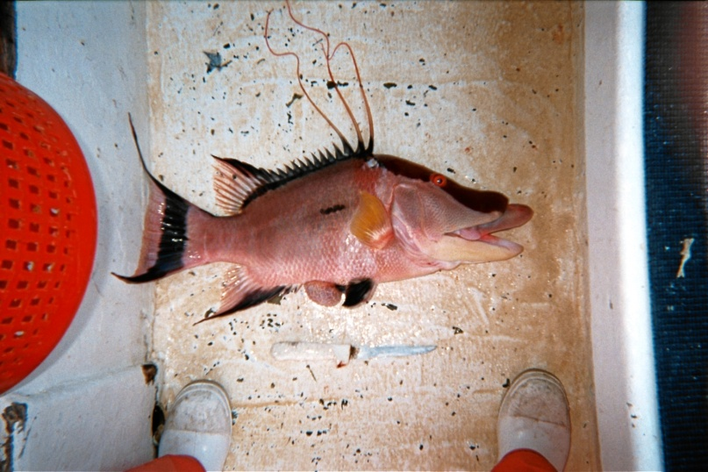
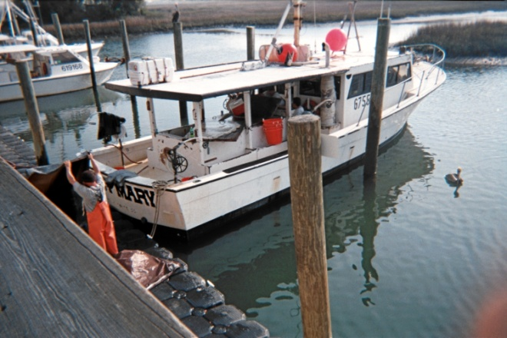
Objectives
Characterize catch and discards in South Atlantic bandit reel snapper-grouper fishery
Investigate the influences on condition of discards

Slide 5
Study Design
Vessel participation was voluntary and therefore non-random
Observer placement for each sampling trip was randomized among participating vessels
All observers underwent detailed training prior to deployment
Vessels were asked to fish under “normal” conditions
Onboard data collection conducted from January 2007 to present
50 trips comprising ~300 sea days to date

Slide 6
Information Recorded Included:
Variables to characterize effort—trip number, station number, fishing time, and number of hooks set and sampled
Date and statistical zone of each set
Species
Length of randomly sampled individuals
Condition of each sampled individual when brought on board—normal versus protruding stomach or eyes
Fate of each sampled individual—kept versus discarded

Slide 7
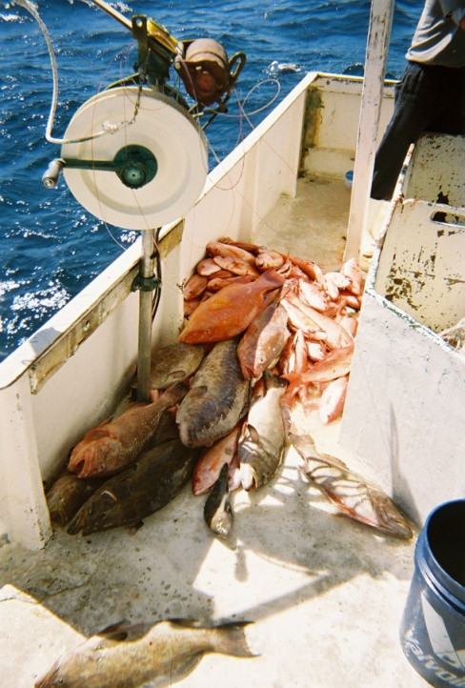
Data Analysis
Total catch by species and hook hours were tabulated for each station within a trip number
Catch per unit effort (CPUE) was given in units of individuals per 100 hook hours

Slide 8
Observer coverage
From 2003 to 2007 there were on average 890 vessels per year where at least one pound of snapper-grouper species was landed
397 vessels landed at least 1,000 pounds
We sampled 24 vessels (2007-2009)
Coverage ≈ 3% (24/890) to 6% (24/397)

Slide 9
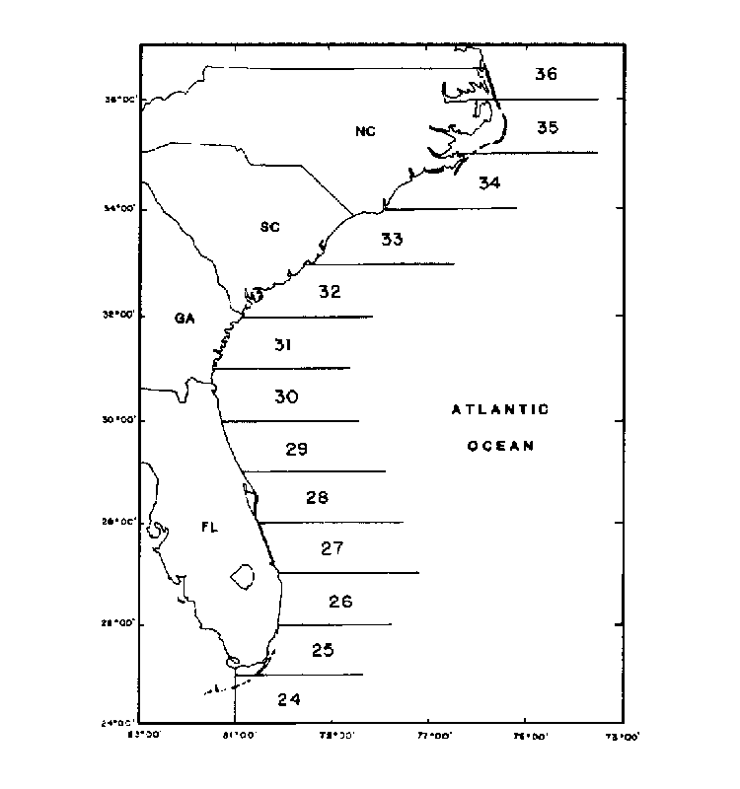

Slide 10
Number of stations sampled
 |  | Statistical zone
Year | Trimester | 30 | 31 | 32 | 33 | 34 | Total
2007 | 1 | 78 | 58 | 330 | 44 | 18 | 528
 | 2 | 138 | 58 | 79 | 245 |  | 520
 | 3 | 245 | 38 | 135 | 163 |  | 581
Subtotal |  | 461 | 154 | 544 | 452 | 18 | 1629
2008 | 1 | 1 | 1 | 74 |  |  | 76
 | 2
 | 3 |  | 3 | 240 |  |  | 243
Subtotal |  | 1 | 4 | 314 |  |  | 319
2009 | 1 | 99 | 39 |  | 67 |  | 205
 | 2 | 23 |  | 113 | 123 |  | 259
 | 3 |  |  |  | 256 |  | 256
Subtotal |  | 122 | 39 | 113 | 446 |  | 720
Total |  | 584 | 197 | 971 | 898 | 18 | 2668
Mean number of stations per trip = 67

Slide 11
Mean effort (hook hours) per station
 |  |  | Statistical zone
Year |  | Trimester | 30 | 31 | 32 | 33 | 34 | Total
2007 |  | 1 | 4.5 | 7.3 | 3.5 | 2.5 | 2.8 | 4.0
 |  | 2 | 4.6 | 6.2 | 4.6 | 3.3 |  | 4.2
 |  | 3 | 3.2 | 4.1 | 4.2 | 2.9 |  | 3.4
Subtotal |  |  | 3.9 | 6.1 | 3.8 | 3.1 | 2.8 | 3.8
2008 |  | 1 | 4.1 | 1.3 | 3.8 |  |  | 3.7
 |  | 3 |  | 6.6 | 4.3 |  |  | 4.3
Subtotal |  |  | 4.1 | 5.3 | 4.1 |  |  | 4.2
2009 |  | 1 | 3.3 | 3.5 |  | 1.6 |  | 2.8
 |  | 2 | 6.6 |  | 4.2 | 3.1 |  | 3.9
 |  | 3 |  |  |  | 2.3 |  | 2.3
Subtotal |  |  | 3.9 | 3.5 | 4.2 | 2.4 |  | 3.0
Total |  |  | 3.9 | 5.6 | 4.0 | 2.8 | 2.8 | 3.7
Mean effort (hook hours) per trip = 244
Mean fishing time (hours) per trip = 40

Slide 12
Mean kept catch (individuals per 100 hook hours)
Snapper, Vermilion | 114.4 | Hogfish | 0.3
Triggerfish, Gray | 25.1 | Creole-Fish | 0.2
Porgy, Red | 20.7 | Snapper, Mutton | 0.2
Scamp | 15.3 | Amberjack, Lesser | 0.2
Grouper, Red | 10.1 | Grouper, Black | 0.2
Grunt, White | 6.7 | Grouper, Yellowedge | 0.2
Gag | 5.1 | Mackerel, King | 0.2
Jack, Almaco | 4.9 | Pinfish, Spottail | 0.2
Sea bass, Black | 4.1 | Pinfish | 0.2
Snapper, Red | 2.6 | Coney | 0.1
Porgy, Knobbed | 2.1 | Seabass, Bank | 0.1
Hind, Rock | 2.0 | Snapper, Blackfin | 0.1
Hind, Speckled | 1.6 | Runner, Blue | 0.1
Amberjack, Greater | 1.5 | Perch, Dwarf Sand | 0.1
Hind, Red (Strawberry Grouper) | 1.3 | Bluefish | 0.1
Rudderfish, Banded | 0.9 | Cottonwick | 0.1
Triggerfish, Queen | 0.8 | Perch, Sand | 0.1
Tomtate | 0.7 | Snapper, Gray | 0.1
Grouper, Snowy | 0.7 | Grouper, Warsaw | 0.1
Dolphin | 0.6 | Snapper, Silk | 0.1
Graysby | 0.5 | Tilefish, Blueline | 0.1
Shark, Atlantic Sharpnose | 0.5 | Cobia, Ling | 0.1
Grouper, Yellowmouth | 0.4 | Triggerfish/Filefish (Family) | 0.1
Pigfish | 0.4 | Shark, Spinner | 0.1
Grouper, Yellowfin | 0.4 | Bigeye | 0.1
Tilefish, Sand | 0.4 | Bonito | 0.1
Snapper, Yellowtail | 0.3 | Sailor's Choice | 0.1
Porgy, Whitebone | 0.3 | Barracuda, Great | 0.1
Squirrelfish | 0.3

Slide 13
Mean discarded catch (individuals per 100 hook hours)
Porgy, Red | 16.9 | Tilefish, Sand | 0.2
Snapper, Vermilion | 11.3 | Sharks Grouped | 0.2
Scamp | 5.3 | Moray, Reticulate | 0.2
Shark, Atlantic Sharpnose | 4.0 | Perch, Dwarf Sand | 0.2
Snapper, Red | 4.0 | Shark, Smooth Dogfish | 0.1
Hind, Speckled | 1.8 | Grunt, White | 0.1
Tomtate | 1.6 | Remora | 0.1
Amberjack, Greater | 1.1 | Seabass, Bank | 0.1
Sea bass, Black | 1.1 | Eel, Snapper | 0.1
Squirrelfish | 0.8 | Shark, Nurse | 0.1
Moray, Spotted | 0.7 | Moray (Genus) | 0.1
Gag | 0.6 | Shark, Blacktip | 0.1
Sharksucker | 0.5 | Shark, Sandbar | 0.1
Shark, Tiger | 0.5 | Moray, Green | 0.1
Jack, Almaco | 0.4 | Perch, Sand | 0.1
Grouper, Red | 0.4 | Barracuda, Great | 0.1
Pinfish, Spottail | 0.3 | Grouper, Yellowmouth | 0.1
Triggerfish, Gray | 0.3 | Lionfish, Banded | 0.1
Dogfish, Spiny | 0.3 | Shark, Dusky | 0.1
Rudderfish, Banded | 0.3 | Shark, Spinner | 0.1
Amberjack, Lesser | 0.2

Slide 14
All Species
(individuals per 100 Hook Hours)
 |  |  | Stat Zone
Year | Trimester | Mean | 30 | 31 | 32 | 33 | 34 | Overall mean
2007 | 1 | Kept catch | 288 | 158 | 214 | 562 | 191 | 233
 |  | Discarded catch | 126 | 49 | 65 | 232 | 20 | 80
 |  | % Discarded | 30% | 24% | 23% | 29% | 9% | 26%
 | 2 | Kept catch | 185 | 108 | 125 | 234 |  | 180
 |  | Discarded catch | 61 | 36 | 118 | 52 |  | 63
 |  | % Discarded | 25% | 25% | 49% | 18% |  | 26%
 | 3 | Kept catch | 571 | 415 | 92 | 209 |  | 337
 |  | Discarded catch | 81 | 88 | 24 | 11 |  | 49
 |  | % Discarded | 12% | 18% | 21% | 5% |  | 13%
2008 | 1 | Kept catch | 122 |  | 38 |  |  | 161
 |  | Discarded catch | 49 |  | 6 |  |  | 55
 |  | % Discarded | 29% |  | 14% |  |  | 26%
 | 2 | Kept catch
 |  | Discarded catch
 |  | % Discarded
 | 3 | Kept catch |  | 96 | 165 |  |  | 261
 |  | Discarded catch |  | 30 | 27 |  |  | 57
 |  | % Discarded |  | 24% | 14% |  |  | 18%
2009 | 1 | Kept catch | 355 | 256 |  | 326 |  | 326
 |  | Discarded catch | 113 | 69 |  | 272 |  | 133
 |  | % Discarded | 24% | 21% |  | 45% |  | 29%
 | 2 | Kept catch | 757 |  | 199 | 147 |  | 262
 |  | Discarded catch | 102 |  | 14 | 16 |  | 28
 |  | % Discarded | 12% |  | 7% | 10% |  | 10%
 | 3 | Kept catch |  |  |  | 90 |  | 90
 |  | Discarded catch |  |  |  | 5 |  | 5
 |  | % Discarded |  |  |  | 5% |  | 5%
Overall Kept catch |  |  | 399 | 189 | 160 | 199 | 191 | 229
Overall discarded catch |  |  | 88 | 53 | 43 | 45 | 20 | 55
Overall % discarded |  |  | 18% | 22% | 21% | 18% | 9% | 19%

Slide 15
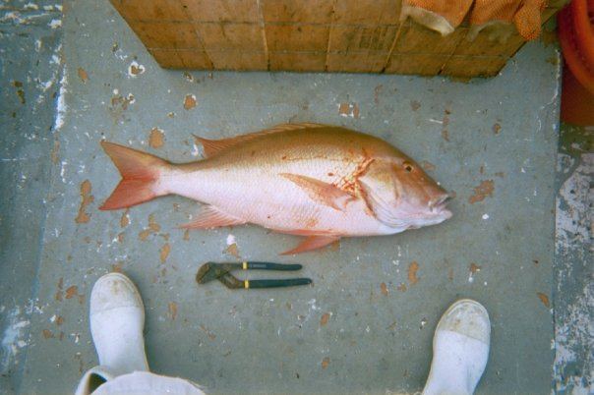

Slide 16
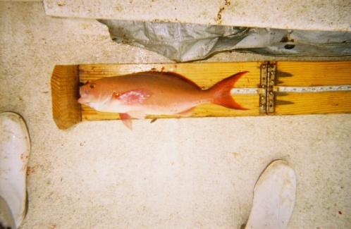

Slide 18
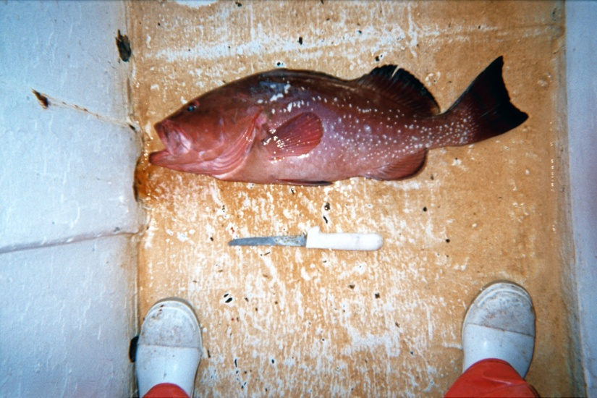

Slide 19
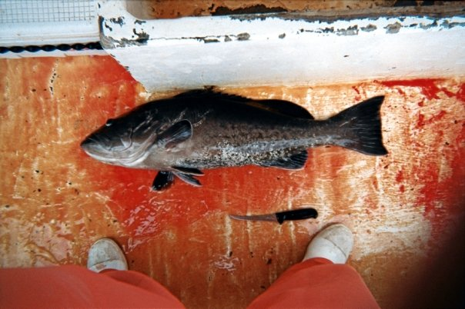

Slide 20
Condition of discarded catch (continued)
Common name |  | Normal | Stomach protruding | Eyes protruding | Combination of stomach and eyes
Gag | Frequency | 12 | 50 |  | 1
 | % | 19 | 79 |  | 2
Grouper, Red | Frequency | 6 | 33
 | % | 15 | 85
Porgy, Red | Frequency | 1612 | 28
 | % | 98 | 2
Snapper, Red | Frequency | 238 | 144 | 1 | 2
 | % | 62 | 37 | 0 | 1
Snapper, Vermilion | Frequency | 1092 | 12
 | % | 99 | 1
All bycatch species | Frequency | 4821 | 501 | 8 | 20
 | % | 90 | 9 | 0 | 0

Slide 21
Costs and Coverage
Costs
  Observer training
  Observer compensation and travel
  Supplies
  Vessel insurance
  Vessel compensation (variable)
Coverage
  Ideally want to include as much of fishery as possible
  Our programs are voluntary

Slide 22
Pros and Cons
Ability to augment and verify landings data
Third party data collection
Ability to collect accurate length, weight, depth data that is not included in landings data
Increase industry cooperation in data collection
Cost vs. coverage
At-sea safety concerns
Limited space on some vessels, need to ensure observer avoids interfering with fishing operations

Slide 23
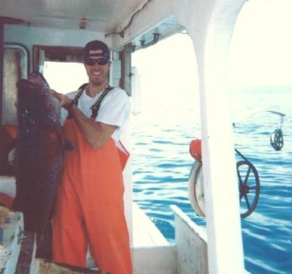
Questions?

