Slide 1
South Atlantic Recreational Landings Update Dolphin-Wahoo
Southeast Regional Office &
Southeast Fisheries Science Center
SAFMC Meeting
Atlantic Beach, N.C.
December 5-9, 2016

Slide 2
Notes on Landings Data
Landings are summarized using MRIP.
Landings estimates include data through wave 4, 2016
All 2016 landings are preliminary.
All landings include MRIP and Headboat landings.

Slide 3
2015 Landings and ACLs
Species Complex | Landings (lbs) | ACL | Units | Percent of ACL | Closure Date
Dolphin | 7,556,535 | 14,187,845 | ww | 53%
Wahoo | 1,023,049 | 1,724,418 | ww | 59%
Area: New England to east Florida
MRFSS data from 2004 to 2013; MRIP data for 2014 and earlier

Slide 4
Preliminary 2016 Landings and ACLs
Species Complex | Landings (lbs) | ACL | Units | Percent of ACL | Closure Date
Dolphin | 5,514,085 | 14,187,845 | ww | 39%
Wahoo | 234,916 | 1,724,418 | ww | 14%
Area: New England to east Florida
MRFSS data from 2004 to 2013; MRIP data for 2014 and earlier

Slide 5
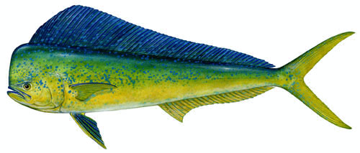
Dolphin Rec Landings (lbs ww)
Area: New England to eFL
MRFSS data from 2007 to 2013; MRIP data for 2014 and earlier

Slide 6
Dolphin

Slide 7
Wahoo Rec Landings (lbs ww)
Area: New England to eFL
MRFSS data from 2007 to 2013; MRIP data for 2014 and earlier

Slide 8
Wahoo

Slide 9
Questions?
All illustrations © Diane Rome Peebles

