Slide 1
South Atlantic Recreational
Landings Update
Coastal Migratory Pelagics
Southeast Regional Office &
Southeast Fisheries Science Center
SAFMC Meeting
Atlantic Beach, N.C.
December 5-9, 2016

Slide 2

Notes on Landings Data
Landings are summarized using MRIP or MRFSS (calibrated from MRIP) depending on how the ACL is calculated.
Landings estimates were updated by NMFS SERO to be consistent with ACL monitoring (e.g., post-stratification of estimates) and include data through wave 4, 2016
All 2016 landings are preliminary
All landings include MRFSS/MRIP and also Headboat landings.

Slide 3
2014/15 Recreational Landings and ACLs
Species Complex | Fishing Year | Landings (lbs)* | ACL | Units | Percent of ACL | Closure Date
Cobia: NY to GA | Jan 1-Dec 31, 2015 | 1,554,395 | 630,000 | ww | 247%
Cobia: East FL | Jan 1-Dec 31, 2015 | 351,829 | 830,000 | ww | 42%
King Mackerel | Mar 1-Feb 28 | 1,228,752 | 6,580,000 | ww | 19%
Spanish Mackerel | Mar 1-Feb 28 | 859,996 | 2,727,000 | ww | 32%
* Landings from both Mid-Atlantic and South Atlantic for Cobia. Landings are from North, Mid, and South Atlantic for King Mackerel and Spanish Mackerel
Notes:
In 2014 the cobia landings for the entire coast (New York to Florida) for the entire year was only 1,179,031 pounds. However, in 2015 the landings from only New York to Georgia (no east Florida landings) for waves 1-5 are 1,520,130 pounds. The wave 3 landings for 2015 were very high. The majority of these wave 3 landings came from North Carolina (586,857 pounds) and another 193,478 pounds from Virginia
Here are the cobia NY to GA PSE values by wave:
NY to GA Cobia for 2015:
Wave 1 Wave 2 Wave 3 Wave 4
PSE 57% 62% 22% 42%
Following the AM, Predicted to close around mid-June in 2016

Slide 4
2015/16 Preliminary Landings and ACLs
Species Complex | Fishing Year | Landings (lbs)* | ACL | Units | Percent of ACL | Closure Date
Cobia: NY to GA | Jan 1-Dec 31, 2016 | 1,336,012 | 620,000 | ww | 215% | 6/20/2016
Cobia: East FL | Jan 1-Dec 31, 2016 | 334,804 | 830,000 | ww | 40%
King Mackerel | Mar 1-Feb 28 | 1,069,198 | 6,580,000 | ww | 16%
Spanish Mackerel | Mar 1-Feb 28 | 809,180 | 2,727,000 | ww | 30%
* Landings from both Mid-Atlantic and South Atlantic for Cobia. Landings are from North, Mid, and South Atlantic for King Mackerel and Spanish Mackerel
Notes:
830,151 lbs caught in wave 4 (July/August). This was after the federal waters June closure.

Slide 5
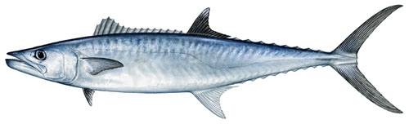
South Atlantic King Mackerel
Rec Landings (lbs ww)
* Area: NY to eFL
* Fishing year - Mar 1-Feb 28
* All landings are in MRFSS

Slide 6
SA King Mackerel

Slide 7
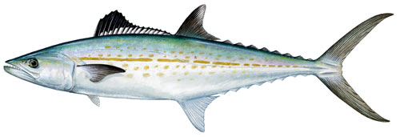
South Atlantic Spanish Mackerel
Rec Landings (lbs ww)
* Area: NY to eFL
* Fishing year - Mar 1-Feb 28
* MRFSS data from 2007/08 to 2013/14; MRIP data for 2014/15
through 2016/17

Slide 8
SA Spanish Mackerel

Slide 9
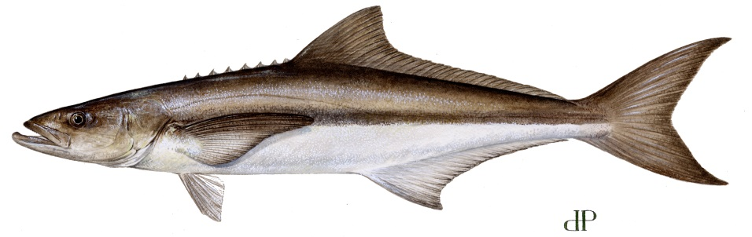
Atlantic Cobia
Rec Landings (lbs ww)
* Area: NY through Georgia
* MRFSS data from 2007 to 2014; MRIP data for 2015 and earlier

Slide 10

Atlantic Cobia

Slide 11
Atlantic Cobia Intercepts, Landings, and PSE by Wave and State for 2015

Slide 12
Atlantic Cobia Intercepts, Landings, and PSE by Wave and State for 2016
Notes:
Less than 1% of landings are from headboat

Slide 13
QUESTIONS?

