Slide 1

South Atlantic Recreational
Landings Update
Snapper-Grouper
Southeast Regional Office &
Southeast Fisheries Science Center
SAFMC Meeting
Atlantic Beach, N.C
December 5-9, 2016

Slide 2
Notes on Landings Data
Landings are summarized using MRIP or MRFSS (calibrated from MRIP) depending on how the ACL is calculated.
Landings estimates were updated by NMFS SERO to be consistent with ACL monitoring (e.g., post-stratification of estimates) and include data through wave 4, 2016
All 2016 landings are preliminary.
All landings include MRFSS/MRIP and also Headboat landings.

Slide 3

2015 Landings and ACLs
Species Complex | Landings (lbs) | ACL | Units | Percent of ACL | Closure Date
Atlantic spadefish | 223,143 | 661,926 | ww | 34%
Bar Jack | 4,489 | 49,021 | ww | 9%
Black Grouper | 117,866 | 165,750 | ww | 71%
Blueline tilefish | 64,305 | 111,893 | ww | 57%
 |  | 17,791 | ww | 361% | 6/10/2015
Deepwater complexª | 14,530 | 38,644 | ww | 38%
Gag | 44,082 | 310,023 | gw | 14%
Golden tilefish | 3,872 | 3,019 | numbers | 128% | 8/11/2015
Gray triggerfish | 298,079 | 404,675 | ww | 74%
Grunts^{b} | 260,289 | 618,122 | ww | 42%
Hogfish | 281,956 | 85,355 | ww | 330% | 8/24/2015
Jacks^{c} | 107,084 | 267,799 | ww | 40%
* Deepwater complexª - Yellowedge and misty grouper; sand tilefish; queen, silk, black and blackfin snapper
* Grunts^{b} - White grunt, margate, sailor's choice, tomtate
* Jacks^{c} - Almaco jack, banded rudderfish, lesser amberjack
* Landings for gag and black grouper were post-stratified to include landings from the Florida Keys
Notes:
On March 30, 2015 Amendment 32 reduced the blueline tilefish recreational ACL from 111,893 to 17,791 pounds whole weight.
Effective Feb 22, there will be in-season closure for snapper-grouper species.
Someone might ask you when you think the blueline tilefish or hogfish ACL might be met. For blueline tilefish, the ACL is going to increase when Reg 25 goes into place later this year but we might have to close blueline and then reopen when new ACL is effective.
Hogfish closure depends on landings. In 2014 we had a large spike of landings in wave In 2015 we had a large spike of landings in 2015. No large spikes then no closure.
Same with blueline tilefish.
So the plan is to wait until wave 1 and see what the hogfish and blueline tilefish landings are going to be.

Slide 4
2015 Landings and ACLs
Species Complex | Landings (lbs) | ACL | Units | Percent of ACL | Closure Date
Mutton snapper | 646,447 | 768,857 | ww | 84%
Porgies^{d} | 96,600 | 106,914 | ww | 90%
Red Grouper | 19,135 | 436,800 | ww | 4%
Red Porgy | 96,792 | 164,000 | ww | 59%
Scamp | 17,586 | 116,369 | ww | 15%
Shallow water grouper^{e} | 18,718 | 48,648 | ww | 38%
Snappers^{f} | 480,942 | 1,172,832 | ww | 41%
Snowy grouper | 1,616 | 4,152 | numbers | 39%
Vermilion snapper | 312,858 | 412,480 | ww | 76%
Wreckfish | 0 | 21,650 | ww | 0%
Yellowtail snapper | 701,253 | 1,440,990 | ww | 49%
* Porgies^{d} Scup, jolthead, knobbed, saucereye, and whitebone porgy
* Shallow water grouper^{e} - Red and rock hind; coney, graysby; yellowfin and yellowmouth grouper
* Snappers^{f} - Gray, lane, cubera, dog, mahogany
Landings for mutton snapper and yellowtail snapper were post-stratified to include landings from the Florida Keys

Slide 5
2016 Preliminary Landings and ACLs
Species Complex | Landings (lbs) | ACL | Units | Percent of ACL | Closure Date
Atlantic spadefish | 16,566 | 661,926 | ww | 3%
Bar Jack | 1,967 | 49,021 | ww | 4%
Black Grouper | 109,729 | 165,750 | ww | 66%
Blueline tilefish | 171,962 | 87,277 | ww | 197% | 9/1/16 - F
Deepwater complexª | 14,916 | 38,628 | ww | 39%
Gag | 96,789 | 312,351 | gw | 31%
Golden tilefish | 12,208 | 3,019 | Numbers | 404% | 8/27/16
Gray triggerfish | 215,291 | 404,675 | ww | 53%
Grunts^{b} | 219,718 | 618,122 | ww | 36%
Hogfish | 89,781 | 85,355 | ww | 105% | 11/30/16
Jacks^{c} | 207,752 | 267,799 | ww | 78% | 8/9/16 Re-open 12/2/16
* Deepwater complexª - Yellowedge and misty grouper; sand tilefish; queen, silk, and blackfin snapper
* Grunts^{b} - White grunt, margate, sailor's choice, tomtate
* Jacks^{c} - Almaco jack, banded rudderfish, lesser amberjack
* Landings for gag and black grouper were post-stratified to include landings from the Florida Keys
Notes:
Jacks had very high landings in wave 1 of 2016. The high wave 1 landings and the predicted landings for the rest of the 2016 wave landings is what caused the closure.

Slide 6
2016 Preliminary Landings and ACLs
Species Complex | Landings (lbs) | ACL | Units | Percent of ACL | Closure Date
Mutton snapper | 509,375 | 768,857 | ww | 66%
Porgies^{d} | 116,231 | 106,914 | ww | 109% | 9/3/16
Red Grouper | 39,059 | 436,800 | ww | 9%
Red Porgy | 87,788 | 164,000 | ww | 54%
Scamp | 27,514 | 116,369 | ww | 24%
Shallow water grouper^{e} | 12,731 | 48,648 | ww | 26%
Snappers^{f} | 517,382 | 1,169,308 | ww | 44%
Snowy grouper | 1,427 | 4,483 | numbers | 32% | 9/1/16 - F
Vermilion snapper | 286,333 | 406,080 | ww | 71%
Wreckfish | 0 | 21,650 | ww | 0%
Yellowtail snapper | 596,143 | 1,440,990 | ww | 41%
* Porgies^{d} Scup, jolthead, knobbed, saucereye, and whitebone porgy
* Shallow water grouper^{e} - Red and rock hind; coney, graysby; yellowfin and yellowmouth grouper
* Snappers^{f} - Gray, lane, and cubera
Landings for mutton snapper and yellowtail snapper were post-stratified to include landings from the Florida Keys

Slide 7
2014/15 Landings and ACLs
Species Complex | Fishing Year | Landings (lbs) | ACL | Units | Percent of ACL | Closure Date
Greater Amberjack* | May 1-Feb 28** | 868,743 | 1,167,837 | ww | 74%
Black Sea Bass*** | Jun 1-March 31** | 402,479 | 1,033,980 | ww | 39%
* Greater amberjack landings include post-stratified MRFSS landings from Florida Keys.
**Fishing seasons were modified in Regulatory Amendment 14 for black sea bass and greater amberjack
***Black sea bass landings exclude post-stratified MRIP landings from north of Cape Hatteras

Slide 8
2015/16 Preliminary Landings and ACLs
Species Complex | Fishing Year | Landings (lbs) | ACL | Units | Percent of ACL | Closure Date
Greater Amberjack* | Mar 1-Feb 28** | 892,150 | 1,167,837 | ww | 76%
Black Sea Bass*** | Apr 1-Mar 31** | 374,232 | 1,033,980 | ww | 29%
* Greater amberjack landings include post-stratified MRFSS landings from Florida Keys.
**Fishing seasons were modified in Regulatory Amendment 14 for black sea bass and greater amberjack
***Black sea bass landings exclude post-stratified MRIP landings from north of Cape Hatteras

Slide 9
2016/17 Preliminary Landings and ACLs
Species Complex | Fishing Year | Landings (lbs) | ACL | Units | Percent of ACL | Closure Date
Greater Amberjack* | Mar 1-Feb 28** | 1,150,280 | 1,167,837 | ww | 98% | 11/30/16
Black Sea Bass*** | Apr 1-Mar 31** | 134,381 | 1,033,980 | ww | 13%
* Greater amberjack landings include post-stratified MRFSS landings from Florida Keys.
**Fishing seasons were modified in Regulatory Amendment 14 for black sea bass and greater amberjack
***Black sea bass landings exclude post-stratified MRIP landings from north of Cape Hatteras

Slide 10
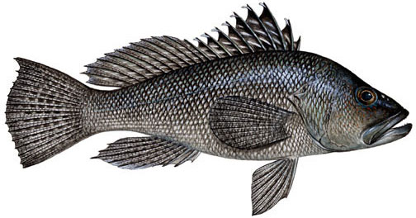
Black Sea Bass Rec Landings (lbs ww)
Fishing Year | Charter | Headboat | Private | Shore | Total
07/08 | 62,365 | 120,436 | 418,083 | 5,125 | 606,009
08/09 | 45,941 | 104,666 | 321,749 | 1,524 | 473,880
09/10 | 102,970 | 209,513 | 301,492 | 5,034 | 619,010
10/11 | 71,460 | 216,893 | 291,027 | 1,774 | 581,154
11/12 | 92,566 | 211,443 | 273,541 | 2,628 | 580,177
12/13 | 55,894 | 129,201 | 320,219 | 654 | 505,967
13/14 | 62,089 | 157,458 | 360,930 | 4,880 | 585,537
14/15 | 105,305 | 68,194 | 222,291 | 6,689 | 402,479
15/16 | 72,502 | 86,139 | 215,682 | 0 | 374,323
16/17 | 20,306 | 45,157 | 68,918 | 0 | 134,381
Fishing year June 1-May 31 for 04/05 to 13/14, but changed to June 1 to March 31 in 14/15 due to Regulatory Amendment 14
Area: NC to FLE (excludes post-stratified MRFSS/MRIP landings north of Cape Hatteras)
MRFSS data from 2004/05 to 2012/13 (gray cells); MRIP data for 2013/14
through 2016/17
2015/16 and 2016/17 landings are preliminary.
Notes:
All landings are in whole weight
For black sea bass, we are supposed to project the length of the season before the April 1 start date.
Here is what it says in 622.193: "NMFS will project the length of the recreational fishing season based on when NMFS projects the recreational ACL specified in this paragraph is expected to be met and announce the recreational fishing season end date in the Federal Register prior to the start of the recreational fishing year on April 1." It does not look like the ACL will be met in the next fishing year for BSB but someone might ask you that questions.

Slide 11
Black Sea Bass
Notes:
Updated with 2013 MRIP landings

Slide 12
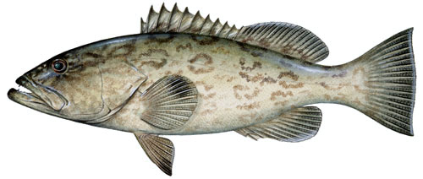
Gag Grouper Rec Landings (lbs gw)
Fishing Year | Charter | Headboat | Private | Shore | Total
2007 | 94,607 | 66,782 | 334,173 | 11,735 | 507,298
2008 | 58,671 | 33,140 | 435,252 | 23,453 | 550,516
2009 | 48,350 | 26,742 | 188,883 | 5,948 | 269,924
2010 | 23,263 | 27,428 | 121,149 | 0 | 171,841
2011 | 11,174 | 25,522 | 133,158 | 0 | 169,854
2012 | 17,867 | 16,868 | 143,331 | 0 | 178,066
2013 | 3,807 | 13,077 | 61,587 | 0 | 78,471
2014 | 53,171 | 9,832 | 106,445 | 0 | 169,447
2015 | 16,037 | 9,413 | 18,633 | 0 | 44,083
2016 | 10,811 | 4,988 | 80,991 | 0 | 96,789
* Area: NC to FLE (includes post-stratified MRFSS/MRIP landings from Florida Keys)
MRFSS from 2007 through 2014 (gray cells) then MRIP for 2015 through 2016

Slide 13
Gag

Slide 14
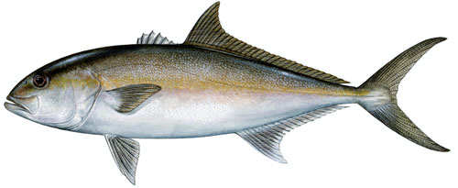
Greater Amberjack Rec Landings (lbs ww)
Fishing Year | Charter | Headboat | Private | Shore | Total
07/08 | 480,781 | 110,915 | 511,473 | 0 | 1,103,169
08/09 | 654,052 | 74,284 | 559,358 | 0 | 1,287,694
09/10 | 583,288 | 86,987 | 666,726 | 0 | 1,337,001
10/11 | 482,073 | 75,268 | 509,443 | 0 | 1,012,784
11/12 | 293,926 | 37,577 | 248,161 | 28,891 | 608,556
12/13 | 1,157,984 | 37,941 | 268,847 | 0 | 1,464,773
13/14 | 340,715 | 84,685 | 386,480 | 0 | 811,880
14/15 | 401,150 | 71,793 | 395,800 | 0 | 868,743
15/16 | 476,727 | 96,409 | 319,015 | 0 | 892,150
16/17 | 431,832 | 82,693 | 635,754 | 0 | 1,150,280
* Fishing year is May1-April 30 for 04/05 to 13/14, but changed to May 1 to February 28 in 14/15 due to Regulatory Amendment 14
* Area: NC to FLE (includes post-stratified MRFSS landings from Florida Keys)
* 2015/16 and 2016/17 landings are preliminary
* All landings are in MRFSS
Notes:
Landings in 2012/13 exceeded the ACL so AM was triggerd. Therefore, the 2013/14 landings need to be monitored to see because the season may need to be closed early.
Currently the 2013/2014 landings are 35% of the ACL

Slide 15
Greater Amberjack

Slide 16
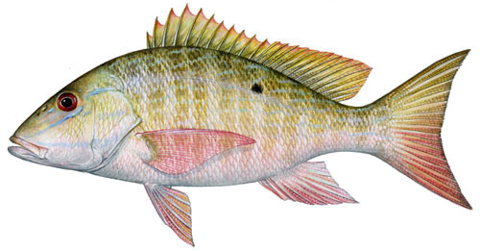
Mutton Snapper Rec Landings (lbs ww)
Fishing Year | Charter | Headboat | Private | Shore | Total
2007 | 74,996 | 46,974 | 555,279 | 70,869 | 748,118
2008 | 62,337 | 42,220 | 414,994 | 302,969 | 822,250
2009 | 70,382 | 72,386 | 277,857 | 15,490 | 436,116
2010 | 60,230 | 49,645 | 420,655 | 38,942 | 569,471
2011 | 79,066 | 53,171 | 129,696 | 19,313 | 281,247
2012 | 184,174 | 74,640 | 212,602 | 5,606 | 477,022
2013 | 96,018 | 51,972 | 315,462 | 18,279 | 481,731
2014 | 57,425 | 83,648 | 265,380 | 111,866 | 518,319
2015 | 169,159 | 73,369 | 307,411 | 96,509 | 646,447
2016 | 109,016 | 63,056 | 200,248 | 137,054 | 509,374
* Area: NC to FLE (includes post-stratified MRFSS landings from Florida Keys)
All landings are in MRFSS

Slide 17
Mutton Snapper

Slide 18
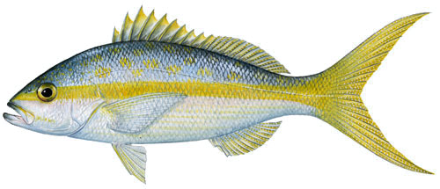
Yellowtail Snapper Rec Landings (lbs ww)
Fishing Year | Charter | Headboat | Private | Shore | Total
2007 | 179,985 | 81,889 | 515,494 | 9,031 | 786,399
2008 | 125,889 | 91,142 | 521,504 | 7,778 | 746,313
2009 | 97,299 | 75,073 | 174,821 | 1,343 | 348,536
2010 | 138,801 | 85,552 | 208,675 | 1,231 | 434,259
2011 | 115,057 | 85,024 | 190,916 | 0 | 390,998
2012 | 170,242 | 116,524 | 158,662 | 3,609 | 449,037
2013 | 308,458 | 108,882 | 238,067 | 10,619 | 666,027
2014 | 286,975 | 159,307 | 410,939 | 76,058 | 933,279
2015 | 311,700 | 141,705 | 244,235 | 3,613 | 701,252
2016 | 260,989 | 123,969 | 205,267 | 5,918 | 596,143
* Area: NC to FLE (includes post-stratified MRFSS landings from Florida Keys)
All landings are in MRFSS

Slide 19
Yellowtail Snapper

Slide 20
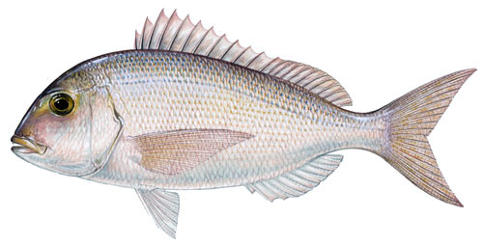
Red Porgy Rec Landings (lbs ww)
Fishing Year | Charter | Headboat | Private | Shore | Total
2007 | 42,452 | 117,254 | 16,473 | 0 | 176,180
2008 | 34,806 | 52,598 | 54,961 | 0 | 142,365
2009 | 12,720 | 33,752 | 49,300 | 0 | 95,772
2010 | 16,848 | 37,413 | 11,291 | 0 | 65,553
2011 | 11,685 | 39,191 | 21,421 | 0 | 72,297
2012 | 25,686 | 41,086 | 34,527 | 0 | 101,299
2013 | 20,217 | 31,716 | 20,276 | 1,969 | 74,178
2014 | 14,198 | 30,041 | 15,548 | 0 | 59,788
2015 | 59,027 | 26,916 | 10,848 | 0 | 96,791
2016 | 11,976 | 20,133 | 55,680 | 0 | 87,789
* Area: NC to FLE
* MRFSS data from 2007 to 2012; MRIP data for 2013 to 2016.
Notes:
Updated with final 2013 MRIP landings

Slide 21
Red Porgy
Notes:
Updated with final 2013 MRIP landings

Slide 22
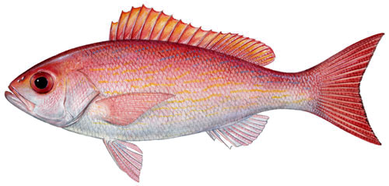
Vermilion Snapper Rec Landings (lbs ww)
Fishing Year | Charter | Headboat | Private | Shore | Total
2007 | 107,096 | 613,765 | 122,041 | 873 | 843,775
2008 | 76,672 | 301,175 | 149,673 | 0 | 527,520
2009 | 150,941 | 261,107 | 149,980 | 0 | 562,027
2010 | 51,950 | 169,859 | 64,897 | 0 | 286,706
2011 | 22,214 | 151,075 | 46,106 | 0 | 219,395
2012 | 29,025 | 147,059 | 39,811 | 0 | 215,894
2013 | 34,577 | 134,834 | 52,548 | 0 | 221,960
2014 | 47,179 | 169,801 | 189,090 | 0 | 406,070
2015 | 100,433 | 142,800 | 69,624 | 0 | 312,857
2016 | 55,147 | 110,466 | 120,720 | 0 | 286,333
* Area: NC to FLE
* MRFSS data from 2007 to 2012; MRIP data for 2013 to 2016.
Notes:
Updated with 2013 final MRIP landings

Slide 23
Vermilion Snapper
Notes:
Updated with 2013 final MRIP landings

Slide 24
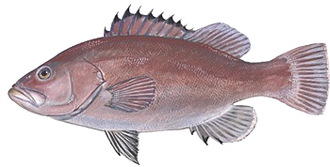
Snowy Grouper Rec Landings (numbers)
Fishing Year | Charter | Headboat | Private | Shore | Total
2007 | 1,933 | 173 | 1,838 | 0 | 3,944
2008 | 1,770 | 53 | 0 | 0 | 1,823
2009 | 1,347 | 108 | 2,478 | 0 | 3,933
2010 | 1,582 | 77 | 407 | 0 | 2,066
2011 | 88 | 63 | 0 | 0 | 151
2012 | 450 | 60 | 1,555 | 0 | 2,065
2013 | 174 | 449 | 1,425 | 0 | 2,048
2014 | 76 | 1,138 | 0 | 0 | 1,214
2015 | 393 | 778 | 446 | 0 | 1,617
2016 | 527 | 476 | 424 | 0 | 1,427
* Area: NC to FLE
* MRFSS data from 2007 to 2014; MRIP data 2015 through 2016.
Notes:
This table is updated

Slide 25
Snowy Grouper
Notes:
This figure was updated

Slide 26
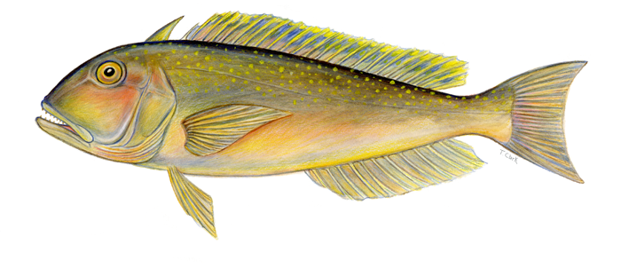
Golden Tilefish Rec Landings (numbers)
Fishing Year | Charter | Headboat | Private | Shore | Total
2007 | 1,222 | 0 | 943 | 0 | 2,165
2008 | 0 | 0 | 0 | 0 | 0
2009 | 1,678 | 0 | 6,454 | 0 | 8,132
2010 | 503 | 0 | 3,880 | 0 | 4,383
2011 | 134 | 0 | 9,729 | 0 | 9,864
2012 | 649 | 0 | 2,979 | 0 | 3,628
2013 | 2,309 | 55 | 1,779 | 0 | 4,143
2014 | 254 | 200 | 903 | 0 | 1,357
2015 | 3,391 | 142 | 339 | 0 | 3,872
2016 | 4,495 | 92 | 7,593 | 0 | 12,181
* Area: NC to FLE
All landings are in MRFSS
Notes:
This one is updated, got data from closure memo.

Slide 27
Golden Tilefish
Notes:
This one is updated, got data from closure memo.

Slide 28
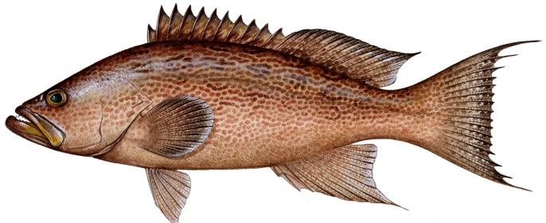
Scamp Rec Landings (lbs ww)
Fishing Year | Charter | Headboat | Private | Shore | Total
2007 | 32,349 | 98,984 | 95,426 | 0 | 226,759
2008 | 16,295 | 28,729 | 48,061 | 0 | 93,085
2009 | 8,749 | 24,605 | 73,807 | 0 | 107,162
2010 | 16,778 | 20,706 | 18,646 | 0 | 56,129
2011 | 11,356 | 21,895 | 23,141 | 0 | 56,392
2012 | 9,282 | 13,199 | 55,965 | 0 | 78,445
2013 | 15,036 | 15,355 | 15,721 | 0 | 46,112
2014 | 3,729 | 15,363 | 51,309 | 0 | 70,401
2015 | 4,491 | 12,482 | 1,687 | 0 | 18,660
2016 | 7,554 | 7,760 | 12,200 | 0 | 27,514
* Area: NC to FLE
* MRFSS data from 2007 to 2012; MRIP data for 2013 to 2016.

Slide 29
Scamp

Slide 30
QUESTIONS?
All illustrations © Diane Rome Peebles

