Slide 1

South Atlantic Recreational
Landings Update
Snapper-Grouper & Dolphin-Wahoo
Southeast Regional Office &
Southeast Fisheries Science Center
SAFMC Meeting
Key West, Florida
June 8-12, 2015

Slide 2
Notes on Landings Data
Landings are summarized using MRIP or MRFSS (calibrated from MRIP) depending on how the ACL is calculated.
Landings estimates were updated by NMFS SERO to be consistent with ACL monitoring (e.g., post-stratification of estimates) and include data through wave 1, 2015
All landings include MRFSS/MRIP and also Headboat landings.

Slide 3

2014 Landings and ACLs
Species Complex | Landings (lbs) | ACL | Units | Percent of ACL | Closure Date
Atlantic spadefish | 702,011 | 154,352 | ww | 455%
Bar Jack | 1,979 | 19,515 | ww | 10%
Black Grouper | 57,031 | 165,750 | ww | 34%
Blueline tilefish | 95,712 | 111,893 | ww | 86%
Cobia | 1,174,196 | 1,445,687 | ww | 81%
Deepwater complexª | 14,489 | 19,313 | ww | 75%
Dolphin | 5,227,644 | 14,187,845 | ww | 37%
Gag | 169,447 | 340,060 | gw | 50%
Golden tilefish | 1,357 | 3,019 | numbers | 45% | 6/7/14
Gray triggerfish | 431,516 | 353,638 | ww | 122% | 11/26/14
Grunts^{b} | 354,543 | 588,113 | ww | 60%
Hogfish | 111,803 | 85,355 | ww | 131%
Jacks^{c} | 226,004 | 267,799 | ww | 84%
* Deepwater complexª - Yellowedge and misty grouper; sand tilefish; queen, silk, black and blackfin snapper
* Grunts^{b} - White grunt, margate, sailor's choice, tomtate
* Jacks^{c} - Almaco jack, banded rudderfish, lesser amberjack
* MRFSS landings for gag and black grouper were post-stratified to include landings from the Florida Keys

Slide 4
2014 Landings and ACLs
Species Complex | Landings (lbs) | ACL | Units | Percent of ACL | Closure Date
Mutton snapper | 518,320 | 768,857 | ww | 67%
Porgies^{d} | 128,231 | 106,914 | ww | 120% | 9/17/2014
Red Grouper | 38,756 | 436,800 | ww | 9%
Red Porgy | 59,788 | 154,500 | ww | 39%
Scamp | 70,157 | 176,688 | ww | 40%
Shallow water grouper^{e} | 11,940 | 46,656 | ww | 26%
Snappers^{f} | 830,700 | 728,577 | ww | 114%
Snowy grouper | 1,214 | 523 | numbers | 232% | 6/7/2014
Vermilion snapper | 406,070 | 419,840 | ww | 97%
Wahoo | 656,871 | 1,724,418 | ww | 38%
Wreckfish | 0 | 11,750 | ww | 0%
Yellowtail snapper | 933,279 | 1,440,990 | ww | 65%
* Porgies^{d} Scup, jolthead, knobbed, saucereye, and whitebone, porgy
* Shallow water grouper^{e} - Red and rock hind; coney, graysby; yellowfin and yellowmouth grouper
* Snappers^{f} - Gray, lane, cubera, dog, and mahogany snapper
MRFSS landings for mutton snapper and yellowtail snapper were post-stratified to include landings from the Florida Keys

Slide 5
2015 Preliminary Landings and ACLs
Species Complex | Landings (lbs) | ACL | Units | Percent of ACL | Closure Date
Atlantic spadefish | 6 | 154,352 | ww | 1%
Bar Jack | 37 | 19,515 | ww | 1%
Black Grouper | 257 | 165,750 | ww | 1%
Blueline tilefish | 32,722 | 17,791 | ww | 184%
Cobia | 3,480 | 1,445,687 | ww | 1%
Deepwater complexª | 419 | 38,644 | ww | 1%
Dolphin | 38,504 | 14,187,845 | ww | 1%
Gag | 7,488 | 340,060 | gw | 2%
Golden tilefish | 309 | 3,019 | numbers | 10%
Gray triggerfish | 11,769 | 353,638 | ww | 3%
Grunts^{b} | 21,969 | 588,113 | ww | 4%
Hogfish | 4,497 | 85,355 | ww | 5%
Jacks^{c} | 2,187 | 267,799 | ww | 1%
* Deepwater complexª - Yellowedge and misty grouper; sand tilefish; queen, silk, black and blackfin snapper
* Grunts^{b} - White grunt, margate, sailor's choice, tomtate
* Jacks^{c} - Almaco jack, banded rudderfish, lesser amberjack
* MRFSS landings for gag and black grouper were post-stratified to include landings from the Florida Keys

Slide 6
2015 Preliminary Landings and ACLs
Species Complex | Landings (lbs) | ACL | Units | Percent of ACL | Closure Date
Mutton snapper | 83,416 | 768,857 | ww | 11%
Porgies^{d} | 21,485 | 106,914 | ww | 20%
Red Grouper | 507 | 436,800 | ww | 1%
Red Porgy | 93 | 164,000 | ww | 1%
Scamp | 54 | 176,688 | ww | 1%
Shallow water grouper^{e} | 36 | 46,656 | ww | 1%
Snappers^{f} | 54,763 | 728,577 | ww | 8%
Snowy grouper | 13 | 523 | numbers | 2%
Vermilion snapper | 3,015 | 412,480 | ww | 1%
Wahoo | 55,553 | 1,724,418 | ww | 3%
Wreckfish | 0 | 11,750 | ww | 0%
Yellowtail snapper | 111,996 | 1,440,990 | ww | 8%
* Porgies^{d} Scup, jolthead, knobbed, saucereye, and whitebone porgy
* Shallow water grouper^{e} - Red and rock hind; coney, graysby; yellowfin and yellowmouth grouper
* Snappers^{f} - Gray, lane, cubera, dog, mahogany
MRFSS landings for mutton snapper and yellowtail snapper were post-stratified to include landings from the Florida Keys

Slide 7
2013/14 Landings and ACLs
Species Complex | Fishing Year | Landings (lbs) | ACL | Units | Percent of ACL | Closure Date
Greater Amberjack | May 1-Apr 30 | 811,880 | 1,167,837 | ww | 70%
Black Sea Bass | Jun 1-May 31 | 585,357 | 1,033,980 | ww | 57%
* Greater amberjack landings include post-stratified MRFSS landings from Florida Keys.
Black sea bass landings exclude post-stratified MRFSS landings from north of Cape Hatteras

Slide 8
2014/15 Preliminary Landings and ACLs
Species Complex | Fishing Year | Landings (lbs) | ACL | Units | Percent of ACL | Closure Date
Greater Amberjack* | May 1-Feb 28** | 859,389 | 1,167,837 | ww | 74%
Black Sea Bass*** | Jun 1-March 31** | 347,913 | 1,033,980 | ww | 34%
* Greater amberjack landings include post-stratified MRFSS landings from Florida Keys.
**Fishing seasons were modified in Regulatory Amendment 14 for black sea bass and greater amberjack
***Black sea bass landings exclude post-stratified MRFSS landings from north of Cape Hatteras

Slide 9
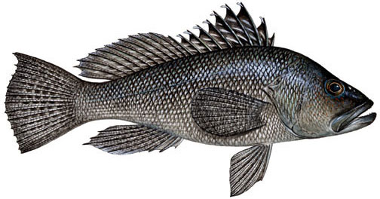
Black Sea Bass Rec Landings (lbs ww)
Fishing year June 1-May 31 for 04/05 to 13/14, but changed to June 1 to Mach 31 in 14/15 due to Regulatory Amendment 14
Area: NC to FLE (excludes post-stratified MRFSS/MRIP landings north of Cape Hatteras)
MRFSS data from 2004/05 to 2012/13; MRIP data for 2013/14 and 2014/15
2014/15 landings are preliminary.
Notes:
All landings are in whole weight
Updated 2013 with final MRIP landings

Slide 10
Black Sea Bass
Notes:
Updated with 2013 MRIP landings

Slide 11
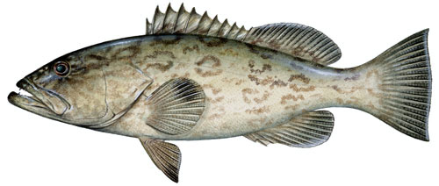
Gag Grouper Rec Landings (lbs gw)
* Area: NC to FLE (includes post-stratified MRFSS landings from Florida Keys)

Slide 12
Gag

Slide 13
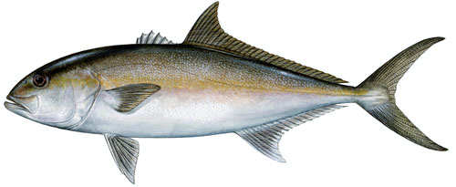
Greater Amberjack Rec Landings (lbs ww)
* Fishing year is May1-April 30 for 04/05 to 13/14, but changed to May 1 to February 28 in 14/15 due to Regulatory Amendment 14
* Area: NC to FLE (includes post-stratified MRFSS landings from Florida Keys)
* 2014/15 landings are preliminary
Notes:
Landings in 2012/13 exceeded the ACL so AM was triggerd. Therefore, the 2013/14 landings need to be monitored to see because the season may need to be closed early.
Currently the 2013/2014 landings are 35% of the ACL

Slide 14
Greater Amberjack

Slide 15
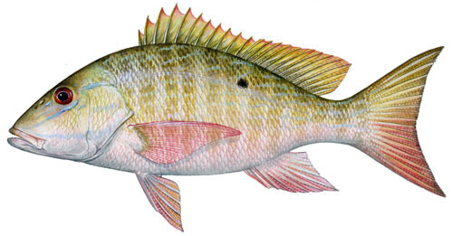
Mutton Snapper Rec Landings (lbs ww)
* Area: NC to FLE (includes post-stratified MRFSS landings from Florida Keys)

Slide 16
Mutton Snapper

Slide 17
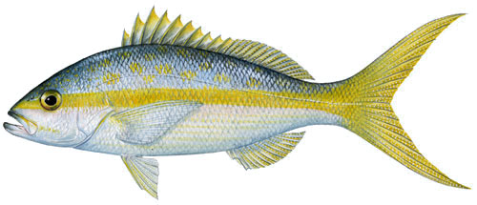
Yellowtail Snapper Rec Landings (lbs ww)
* Area: NC to FLE (includes post-stratified MRFSS landings from Florida Keys)

Slide 18
Yellowtail Snapper

Slide 19
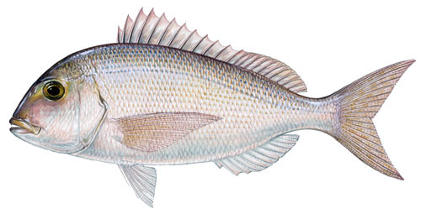
Red Porgy Rec Landings (lbs ww)
* Area: NC to FLE
* MRFSS data from 2004 to 2012; MRIP data for 2013 to 2015.
Notes:
Updated with final 2013 MRIP landings

Slide 20
Red Porgy
Notes:
Updated with final 2013 MRIP landings

Slide 21
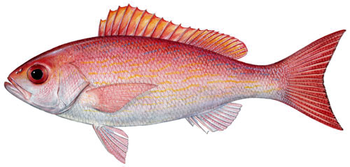
Vermilion Snapper Rec Landings (lbs ww)
* Area: NC to FLE
* MRFSS data from 2004 to 2012; MRIP data for 2013 to 2015.
Notes:
Updated with 2013 final MRIP landings

Slide 22
Vermilion Snapper
Notes:
Updated with 2013 final MRIP landings

Slide 23
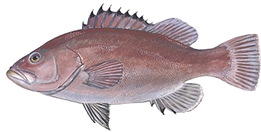
Snowy Grouper Rec Landings (numbers)
* Area: NC to FLE
Notes:
This table is updated

Slide 24
Snowy Grouper
Notes:
This figure was updated

Slide 25
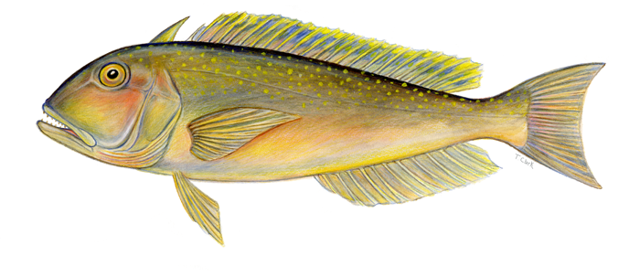
Golden Tilefish Rec Landings (numbers)
* Area: NC to FLE
Notes:
This one is updated, got data from closure memo.

Slide 26
Golden Tilefish
Notes:
This one is updated, got data from closure memo.

Slide 27
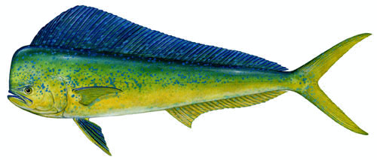
Dolphin Rec Landings (lbs ww)
Area: New England to eFL
MRFSS data from 2004 to 2013; MRIP data for 2014 and 2015

Slide 28
Dolphin

Slide 29
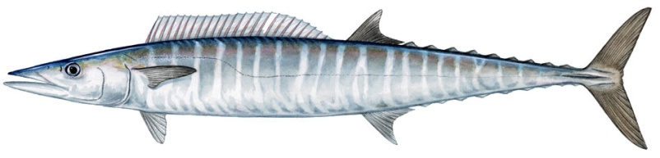
Wahoo Rec Landings (lbs ww)
Area: New England to eFL
MRFSS data from 2004 to 2013; MRIP data for 2014 and 2015

Slide 30
Wahoo

Slide 31
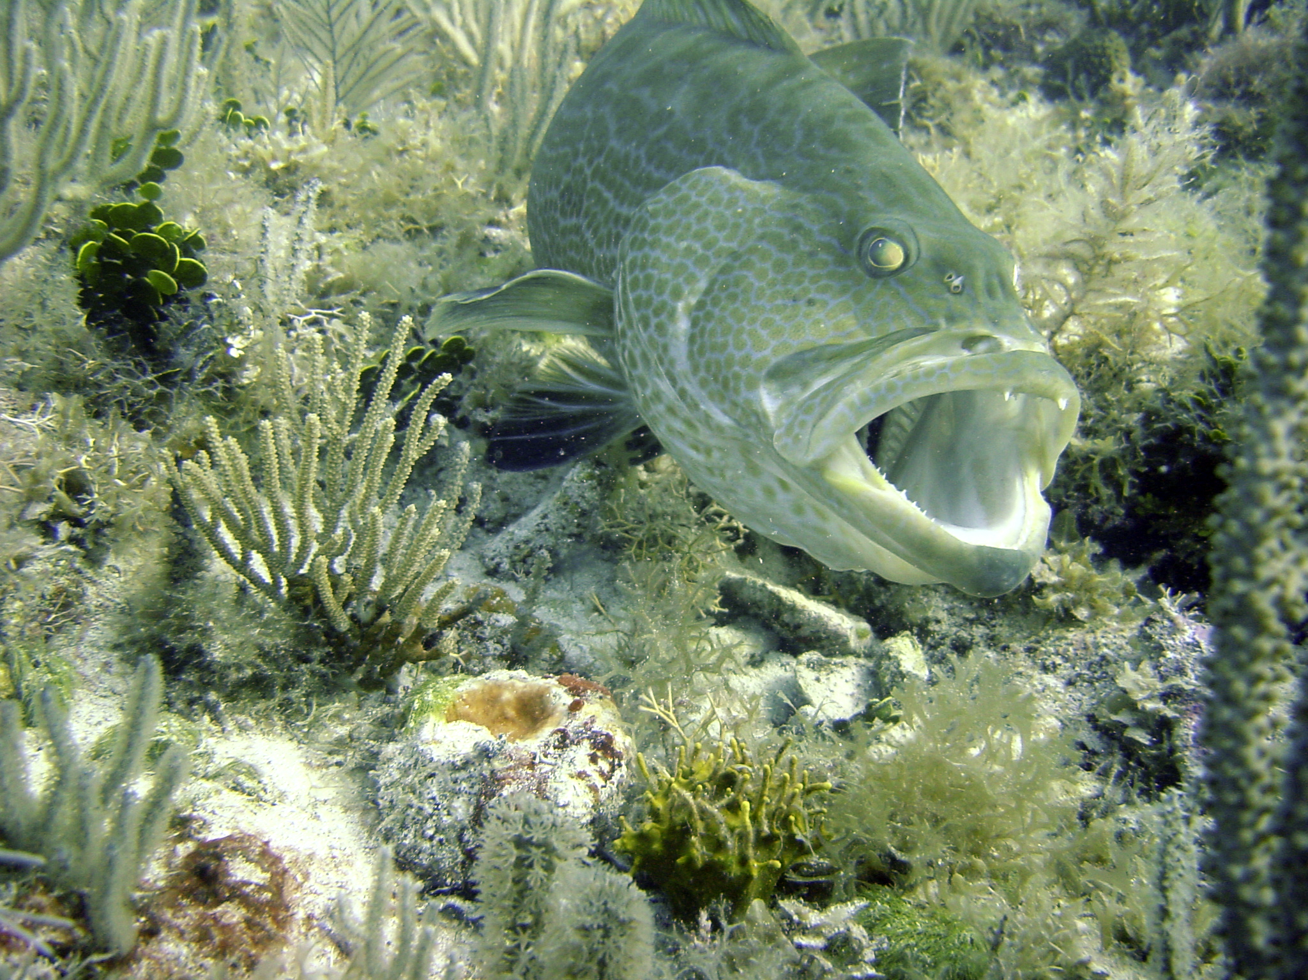
QUESTIONS?
All illustrations © Diane Rome Peebles
Photo © Nick Farmer

