Slide 1
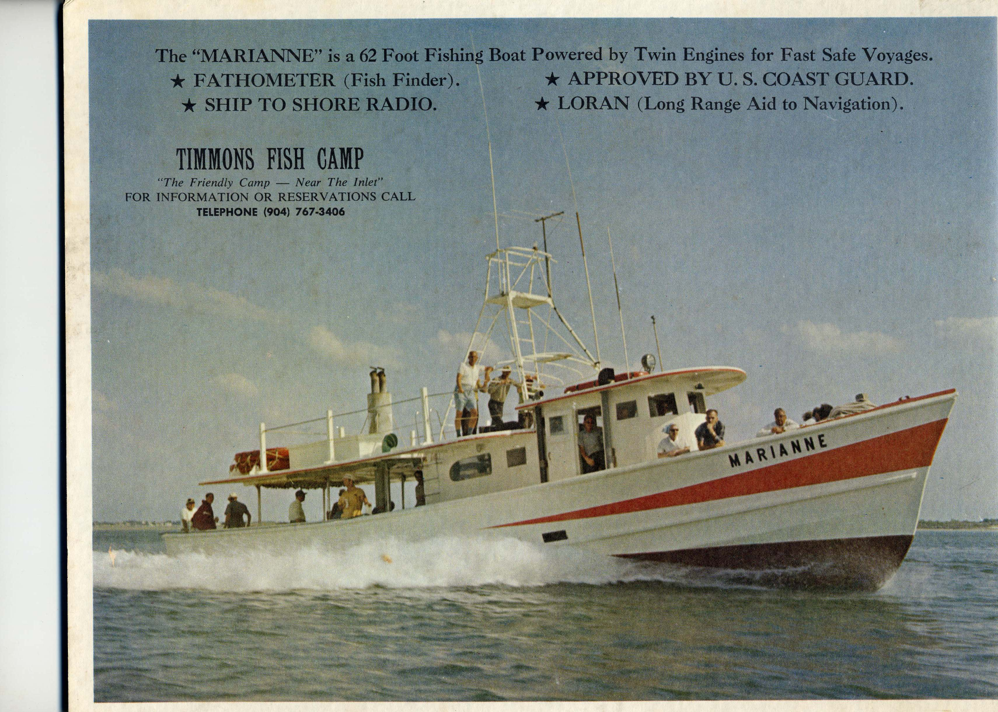
Southeast Region Headboat Survey (SRHS)
Annual Report
South East Fisheries Science Center
SAFMC
Meeting
Dec 2016

Slide 2
Southeast Regional Headboat Survey
Annual Report
Introduction
Acknowledge authors
Purpose – trends in data
  Intended audience (headboat operators, Councils, SEDARS, etc.)
Draft – 2015 data
Presentation to solicit feedback on format and content

Slide 3
Report format and content
Introduction and metadata
Tables
  Total landings by species numbers and weight
  Effort – angler days 1981 to present
  Summary of dockside sampling
Species summary (1 page per species)
  Top 28 federally managed species

Slide 4
Current list of South Atlantic species
Almaco Jack
Black Grouper
Black Sea Bass
Blueline Tilefish
Cobia
Dolphin
Hogfish
Gag
Gray Triggerfish
Greater Amberjack
King Mackerel
Knobbed Porgy
Lane Snapper
Mutton Snapper
Red Grouper
Red Hind
Red Porgy
Red Snapper
Scamp
Silk Snapper
Snowy Grouper
Spanish Mackerel
Speckled Hind
Tilefish
Vermilion Snapper
Warsaw Grouper
White Grunt
Yellowtail Snapper

Slide 5
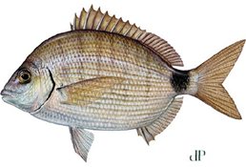
Species example – spottail pinfish landings and discards
Annual landings in number and weight (lb).
Annual discards in number by region.

Slide 6
Species example – Spottail pinfish
(Dockside sampling, Effort Summary and CPUE)
Dockside intercept sampling program summary by region and 5 year and 10 year cumulative averages.
Regional summary of all positive (caught and discarded) headboat trips for last ten years.

Slide 8
Questions or comments
Feedback – format and content
Scheduled rollout
  Updated draft version – March Council meeting
  Annual release date – May of following year
    2016 estimated landings and effort

