Slide 1
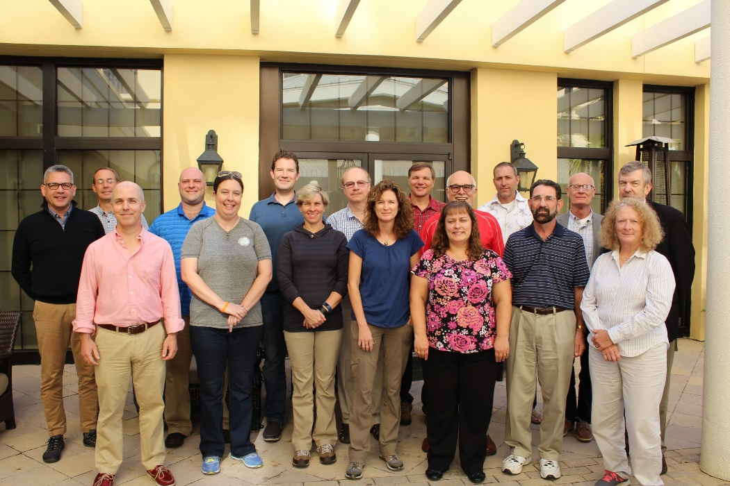
SSC Report
SSC meeting October 18 – 20
SSC Selection Committee Report
December 6

Slide 2
SSC Workgroup Process
Consult SEP chair and include SEP.
Open workgroups to outside experts.
Appropriate time for thorough review.
Concerns with SSC workload.
Public comment taken at SSC meetings,
not during the workgroup meetings.
SSC recommendation:
Council approve process in December and
implement as soon as appropriate.

Slide 3
Public comment
History of inviting attending public to provide input.
Format followed during October meeting was beneficial.
SSC supports taking public comment on each agenda topic.
SSC recommendation:
Comment be taken after initial topic introduction and presentation, but before developing consensus recommendations.
Notes:
But we will continue to ask attending public and other to provide input where appropriate.

Slide 5
SSC Report
SSC meeting October 18 – 20
SEDAR Committee Report
December 6

Slide 6
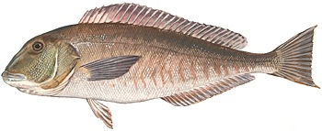
Blueline Tilefish stock ID workshop
Accepted report findings, but further review on Oct. 28.
Caveat:
Genetic analysis of stock structure is essentially 1-way test.
Small percentage of gene flow will result in homogeneity when regions may still be quite distinct.
Meaning:
Impact of fishing may be largely imposed on fish in each region which could justify managing fish in regions as distinct stocks.
BLTF 1

Slide 7
Blueline Tilefish stock ID workshop
Research recommendations:
Analysis of variables (e.g. recruitment and growth) on ecological timescales relevant to management within regions.
Tagging studies, otolith micro-chemistry, and otolith shape analysis to estimate mixing rates between regions.
BLTF 2

Slide 8
Stock assessment prioritization
Provided scoring recommendations.
Values in spreadsheet (prep. Dr. Williams), will add text.
Information in FMPs, funded research project descriptions, and project reports can aid in scoring refinement.
Continue recommendations and adjustment to scoring.
Evaluation:
Compare prioritized species list based on scoring with realized (SEDAR) assessment schedule (also retroactively).
Discuss Stocks for data limited SEDAR project
at future meeting.

Slide 9
Landings
No specific ABC recommendations.
If ABC is exceeded by a large amount =>
increase assessment priority.
Development of rumble strip approach to address
inappropriate ABC and adjustments.
When underages or overages consistently occur,
industry representatives should be consulted to provide input.
(market, population driven signals, or both)
SEDAR Schedule
Concerns piloting Research Track on 2 different species concurrently:
Lessons learned from first Research Track cannot be used to
improve concurrent second assessment.

Slide 11
SSC Report
SSC meeting October 18 – 20
ABC control rule

Slide 12
ABC Control Rule
Stock status is determined by NMFS.
Stock status and Productivity and Susceptibility Assessment (PSA)
appropriate for the Council to consider when determining acceptable risk of overfishing.
SSC recommendation:
Remove stock status and PSA from ABC CR.
Current PSA information should be updated and reviewed by SSC.
Will require modifications to overall scoring system of ABC CR.
SSC requests staff and SSC leadership develop options.

Slide 13
ABC Control Rule
Next SSC meeting:
Discuss changes to ABC control rule.
Further refinement of ABC control rule.
Comparison of “old” and “new” recommendations.
Use of economic and social indicators of stock abundance.
New National Standard Guidelines.

Slide 15
Spiny Lobster Committee December 6
Report SSC Meeting October 18 – 20
and
Webinar November 21
SL 1

Slide 16
Spiny Lobster
Oct. Meeting
Discussion about data and stock dynamics,
but insufficient information.
Unable to make consensus recommendation =>
Webinar on November chaired by Dr. Barbieri.
Webinar Nov. 21
Fishery may have little effect on productivity or sustainability
of stock in US waters
=> large portion of recruitment from outside system.
High uncertainty in degree of self-recruitment
and actual productivity
(self-recruitment not sufficient to sustain productivity).
SL 2

Slide 17
Spiny Lobster
SSC recommendations:
Endorse Gulf SSC ABC Control Rule and recommend to extend the reference period to include fishing years 1991/92 – 2015/16 (see table 1 in SSC report).
Rationale:
Sources of recruitment for US population.
Population seems to be in state of equilibrium, with catch levels.
Revisit this OFL/ABC recommendation after several years.
Research to further examine recruitment in US population.
Better metric for effort over time and improved CPUE indices should be developed for the Spiny Lobster fishery.
SL 3

Slide 19
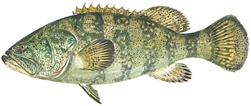
Snapper Grouper Committee
SSC Report - Meeting October 18 - 20

Slide 20
Goliath Grouper assessment
SSC accepted the recommendation of the Review Panel:
Assessment is not best scientific information available (BSIA)
Should not be used for management advice.
Agreed with the Review Panel’s research recommendations,
in particularly alternative assessment models
and addressing critical data needs.

Slide 21
BLACK SEA BASS POT MESH SIZE STUDY
Study was well designed and executed.
All major sources of uncertainty adequately addressed.
Model fits observed data very well.
SSC recommendations:
Considered BSIA and appropriate for use in management.
SNAPPER GROUPER AMENDMENT 41
No additional comments.

Slide 22
Tilefish
TF 1

Slide 23
Tilefish
Unusually strong year class close to the terminal year in S25 was influential to stock status.
Associated high uncertainty was extensively discussed.
Uncertainty was carried forward in the ABC control rule.
Council recognized uncertainty and associated risk in ACL level.
Most influential update modifications:
Robust multinomial likelihood function (RMLF)
Age and length composition data
Many other key parameters (e.g. M, h) were same as S25.
TF 2

Slide 24
Tilefish
Robust multinomial likelihood function
Dr. Williams provided overview of RMLF.
Applying the RMLF provides more robust results in the
Tilefish assessment and is considered BSIA.*
* Red grouper webinar (Nov. 30):
New likelihood method was presented and accepted
by the Panel for use in red grouper assessment.
SSC has not had opportunity to evaluate new methods,
or possible consequences for Tilefish assessment.
TF 3

Slide 25
Tilefish
Age and length composition
Data from years following S25 (2012-2015) did not support
strong year class.
Additional age data changed selectivity of handline gears to
greater selectivity for older fish.
Increased age sample size =>
increased confidence in selectivity estimates in update.
Assuming that selectivity remained constant across time =>
selectivity applied to entire assessment period.
Change in selectivity =>
increased estimate F,
decreased estimate MSY and projected catch levels.
TF 4

Slide 26
Tilefish
Model predicted very high increase in F/F_{MSY} in early 1990s,
(<1 to > 8, 700%), although change in SSB/SSB_{MSY} was ~30%.
SSC noted:
F is reported as apical F
(Apical F: highest F across all ages in a given year)
Both apical F and abundance at age expanded in early 1990s and then declined.
Severity of overfishing experienced by full stock (F/F_{MSY} approaching 8) may be exaggerated by use of apical F as the reference metric F.
SSC recommendation:
Exploring other F metrics to better characterize F.
TF 6

Slide 27
Tilefish
Productivity
Given the acknowledged overall uncertainty in assessment,
the stock productivity is not well estimated.
TF 7

Slide 28
Tilefish
Buffer between OFL and ABC
Large buffer not surprising given uncertainty and
low age sample size.
ABC CR design: High uncertainty => large buffer.
Buffer magnitude of update similar to S25.
Tilefish does not appear to be different from other species in SA.
Species with lower buffers have
larger sample sizes (e.g. ages)
more informative fisheries independent survey
with higher n and greater geographic coverage
TF 8

Slide 29
Tilefish
Buffer between OFL and ABC
P* approach intended to reduce probability rebuilding
and is therefore precautionary, especially when
stock is near target levels, and
uncertainty in the assessment is high.
SSC recommendation:
P* approach appropriate for assessment,
and does not consider it necessary to base
ABC on yield at 75% of F_{MSY}, and
OFL on yield at F_{MSY}.
TF 9

Slide 30
Tilefish
Market categories
Uncertainty and lack of data in classifications over time and between regions.
May not be possible to use market categories across
entire stock, but may be informative in geographically
localized areas.
If consistency and size resolution is sufficient,
cohorts could be tracked.
Information useful in rumble strip-like approach.
Annual updates (like in Mid-Atlantic) could aid in formulating recommendations in SA.
TF 10

Slide 31
Tilefish
Phased-in implementation approach
Phase-in may moderate socio-economic impacts.
Revised NS1 allows for phased-in approach over three years in cases where there is a high level of uncertainty.
SSC did not review and discuss revised NS1.
Clarification from Mr. Shepherd Grimes (General Council):
Requirement that Councils cannot exceed SSC’s ABC recommendations not overruled.
Phase-in needs to be part of FMP and ABC CR, which will specify conditions under which phase-in would occur.
TF 11

Slide 32
Tilefish
Phased-in implementation approach
Phase-in that reduces buffer between OF level and ACL increases risk of overfished situation and rebuilding plan.
(overages have occurred in recent (3-4) years).
SSC recommendations if council chooses phase-in,
Consider management uncertainty and recent overages.
ACL should not exceed 90% of the OFL in year one
(because ACL was exceeded in recent years).
New projection estimates are needed
ABC in 3-year blocks
Consistency in ACL will make it easier to adjust business models.
TF 12

Slide 33
Tilefish
Research Recommendations:
Increase age sample size
Explore time blocks with different selectivity
Alternative models and multi-modelling approaches.
Comprehensive regional fishery independent survey.
Surveys should collect life history samples.
Spatial distribution of fleets relative to population distribution should be investigated.
Work towards a finer spatial scale for catch reporting.
Investigate and establish consistency in market categories.
TF 13

Slide 34
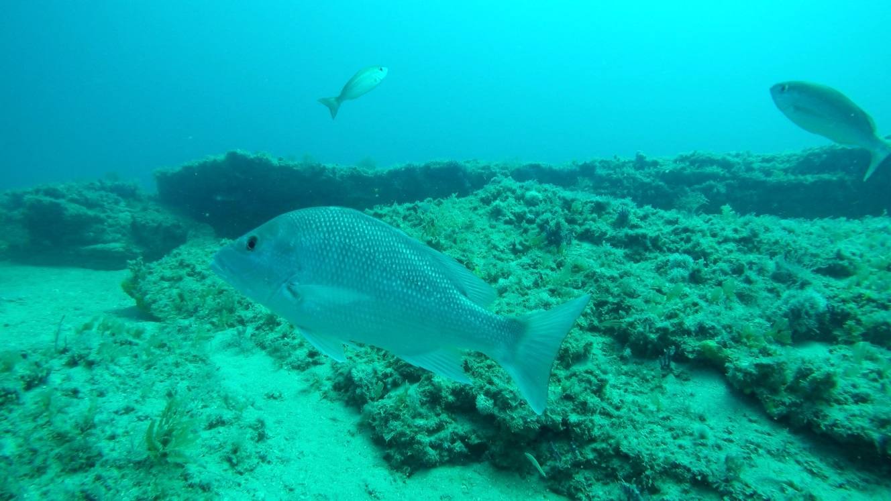
Red Snapper
RS 1

Slide 35
Red Snapper
MRIP estimates
Number of intercepts is relatively low
=> expansion factors high.
By design, 90% of effort is “inshore”, 10% “off-shore”.
Better data would be ideal, but MRIP is currently “all we have” and BSIA.
PSE could be informative in determining adequacy of estimates. PSEs higher than 40% to 60% may not be usable (see ACCSP Workshop report).
RS 2

Slide 36
Red Snapper
SSC Recommendations:
Survey (efforts) more focused on off-shore trips.
Simulation evaluation to determine effect of PSE values on reference points.
Explore effort-based assessments or a Bayesian framework would allow fitting to catch and better incorporate estimates of uncertainty (incl. PSEs).
Improvement (validation) of discard estimates.
Studies to reduce discard mortality.
Studies of other data collection approaches (e.g. stamps).
ABC should be specified in total yield (landings + discards).
RS 3

Slide 37
Red Snapper
Alternative SPR metrics
By definition, F_{MAX} and _{F20%} have higher risk than F_{30%} or F_{40%}.
Alternatives have very similar results and
differences in yield were minimal.
SSC recommendation:
No compelling reason to change the proxy.
Fishing level recommendations
SSC recommendation:
No new data to justify a revision of fishing level recommendations.
RS 4

Slide 38
Red Snapper
ACT
SSC recommendation:
Use of ACT is preferable over not having one:
Using % of ACL recognizes landings are not known precisely.
Could be used for in-season monitoring,
Can be adjusted as time progresses, management changes, and data collection improves,
Alt 6 consistent with Gulf methodology
(based on evaluation of proportional overages over time).
However, Alt 6 does not explicitly consider uncertainty in point estimate of landings as Alt 2 does (i.e. use of PSE).
RS 5

Slide 39
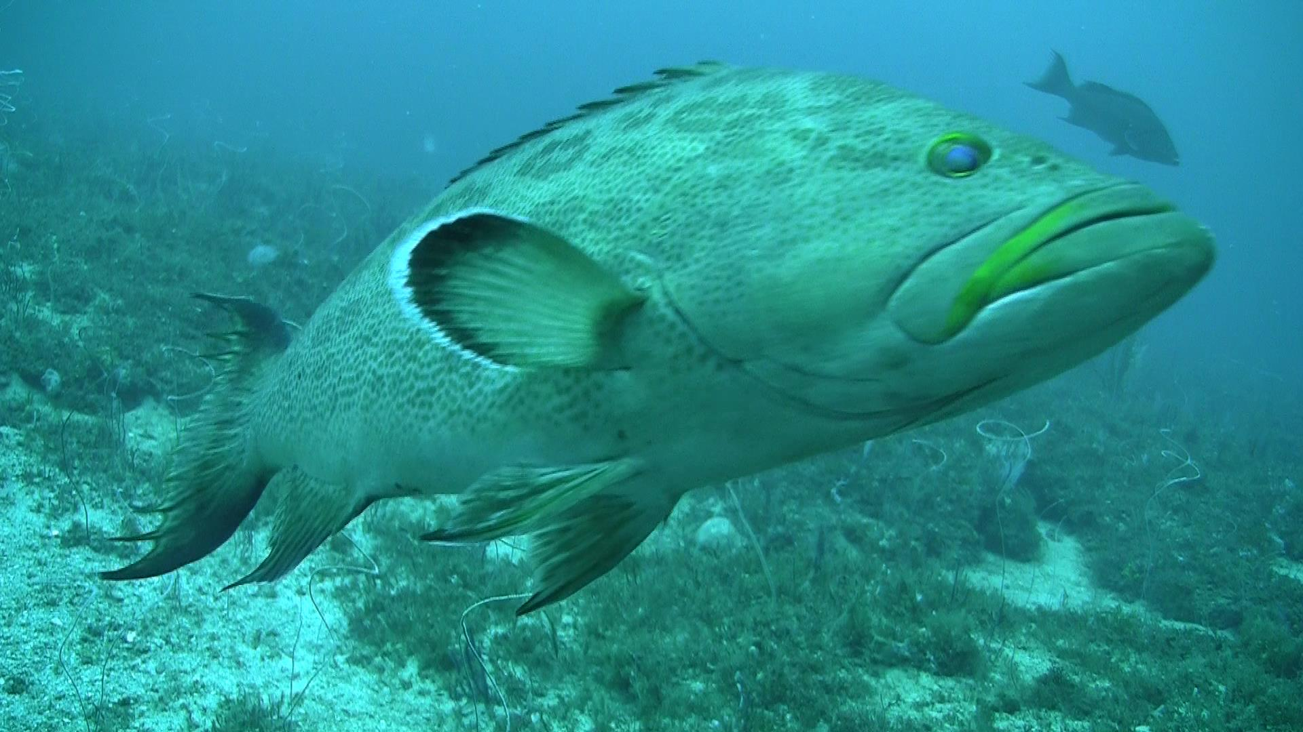
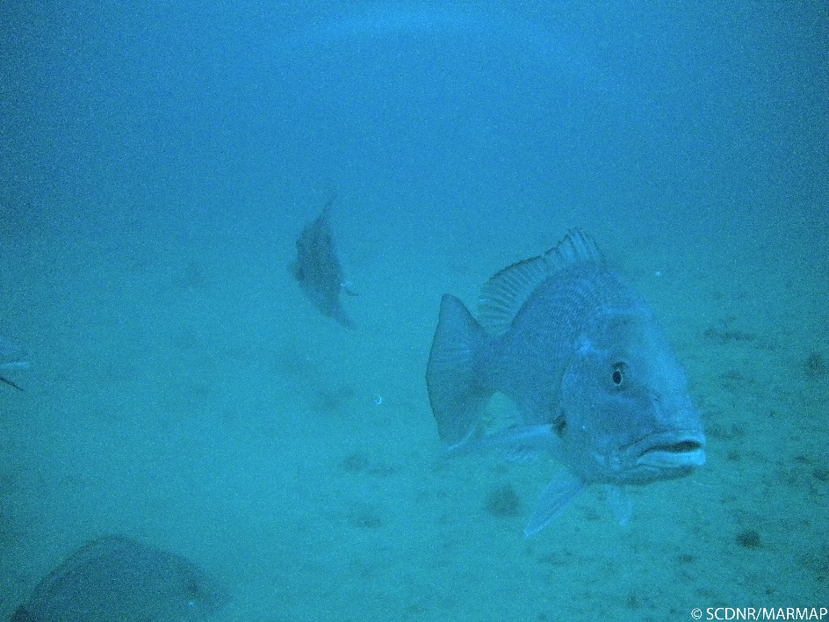

Slide 40
Red Grouper webinar

Slide 41
Tilefish
F_{MSY} distributions from MCB in S25 and update were very similar
=>
Unlikely that differences in models were due to observation error and process error parameters included in the MCB analysis.
SSC recommendation:
Consider observation error vs process error to help tease out differences in two models.
TF 5

