Slide 1
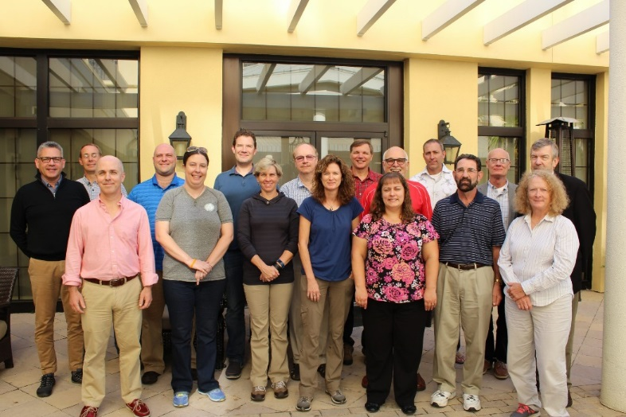
SSC Report
SSC meeting October 18 - 20

Slide 2
SSC Workgroup Process
Consult SEP chair and include SEP.
Open workgroups to outside experts.
Appropriate time for thorough review.
Concerns with SSC workload.
Public comment taken at SSC meetings,
not during the workgroup meetings.
SSC recommendation:
Council approve process in December and
implement as soon as appropriate.

Slide 3
Public comment
History of inviting attending public to provide input.
Format followed during October meeting was beneficial.
SSC supports taking public comment on each agenda topic.
SSC recommendation:
Comment be taken after initial topic introduction and presentation, but before developing consensus recommendations.
Notes:
But we will continue to ask attending public and other to provide input where appropriate.

