Slide 1
SSC Reports
June 2020 SAFMC Meeting
SSC_Apr2020Report_FINAL.pdf
Report of SSC Meeting
April 28-30, 2020

Slide 2
SSC Report To the Dolphin Wahoo Committee
June 2020 SAFMC Meeting
Report of SSC meeting
April 28-30, 2020

Slide 3
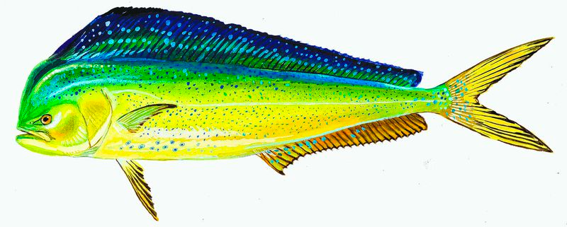
SSC Catch Level Recommendations for Dolphin & Wahoo
In Oct 2019, SSC recommended setting ABCs at the 3rd highest landings from 1994-1997
Council noted this resulted in an ABC that was the 2nd lowest value in the time series
In April 2020, SSC reconsidered the ABC

Slide 4
SSC Catch Level Recommendations for Dolphin & Wahoo
Revised SSC recommendations:
  Expand time frame for ABC-setting
  Select the 3rd highest landings from 1994-2007
Dolphin ABC recommendation revised upward from 18,354,469 lbs to 24,570,764 lbs
Wahoo ABC recommendation revised upward from 1,950,582 lbs to 2,885,303 lbs
Both ABCs include new SEFSC weight estimation procedure and catch data from Monroe Co. FL

Slide 5

SSC Recommendations Regarding Dolphin Wahoo ABC-setting
SSC considered ORCS, but concerned method does not perform well in Management Strategy Evaluations
SSC recommends reviewing ORCS methodology as the ABC Control Rule is developed for Dolphin and Wahoo and Snapper Grouper species
  Review “risk of overexploitation” scalar
  Consider new research on data-limited approaches
  Review applicability to stocks for which ABC is > historical weight-based catches (e.g., Jacks complex)

Slide 6


Slide 7
SSC Report To the Snapper Grouper Committee
June 2020 SAFMC Meeting
Report of SSC meeting
April 28-30, 2020

Slide 8
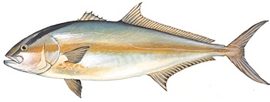
SSC Review of the Greater Amberjack Standard Assessment
SSC agrees that:
  assessment appropriately addresses ToRs
  is BSIA
  is an adequate basis for determining stock status and supporting fishing level recommendations, and
  methods of addressing uncertainty consistent with expectations and available information

Slide 9
SSC Review of the Greater Amberjack Standard Assessment
Factors affecting reliability of stock status estimates and fishing level recommendations:
  Model was most sensitive to natural mortality
  Choice of method for estimating natural mortality (new Charnov vs previous Lorenzen) had a large impact on stock status

Slide 10
SSC Review of the Greater Amberjack Standard Assessment
Risks and consequences of assessment uncertainties:
  Biomass and exploitation status much closer to or beyond benchmarks for much of the time series if (previous) Lorenzen-based natural mortality (M) estimate is assumed
  However, SSC agreed new Charnov method is appropriate
  Diagnostics suggest M is likely higher than previous Lorenzen estimate and perhaps higher than new Charnov estimate

Slide 11
SSC Review of the Greater Amberjack Standard Assessment
Are methods of addressing uncertainty consistent with SSC expectations and the available information?
  SSC considers the methods of addressing uncertainty consistent with their expectations and the available information

Slide 12
SSC Review of the Greater Amberjack Standard Assessment
Factors that most contribute to risk and impact status determinations and future yield predictions:
  M estimation method had significant impact on stock status determination and future yield projections
  Projected catch and ABC values dependent on assumption about future recruitment
  If recent recruitment decline continues, projections may be overly optimistic

Slide 13
SSC Review of the Greater Amberjack Standard Assessment
Difficulties encountered in applying Control Rule:
  New life history estimation techniques and additional sampling suggest productivity of Greater Amberjack greater than previously thought
  Therefore, SSC decreased the PSA risk score from medium to low

Slide 14
SSC Catch Level Recommendations for Greater Amberjack
SSC control rule determinations:
  ➢ Tier I: 2 (2.5%)
  ➢ Tier II: 2 (2.5%)
  ➢ Tier III: 1 (0%)
  ➢ Tier IV: 1 (0%)
  ➢ Adjustment: 5%
  ➢ P* = 45%
SSC recommends projections at P*=50% be used to set the OFL and P*=45% be used to set the ABC

Slide 15
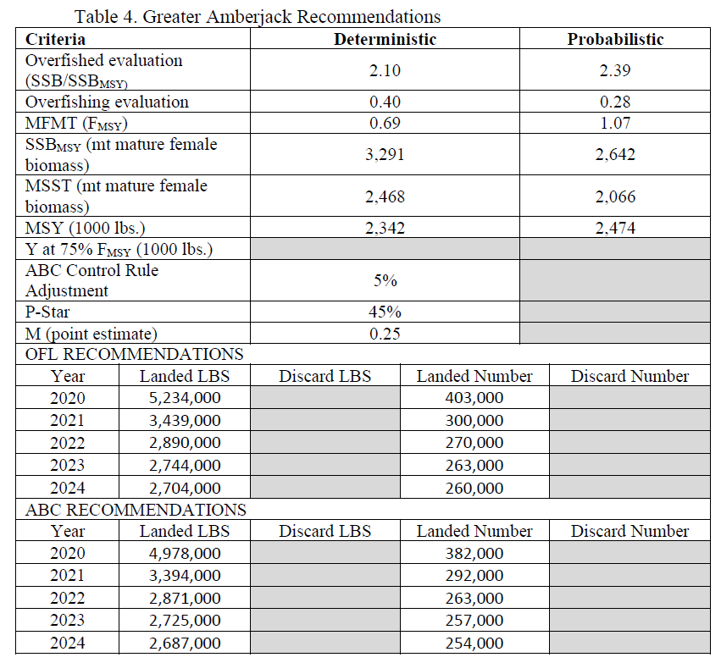
SSC Catch Level Recommendations for Greater Amberjack
Page 20

Slide 16
SSC Review of the Greater Amberjack Standard Assessment
Indicators or metrics to monitor:
  Measure and monitor Greater Amberjack lengths in SERFS video survey
  Strengthen support for fishery independent surveys that collect data on Greater Amberjack (SERFS video survey, short and long bottom longline surveys)

Slide 17
SSC Review of the Greater Amberjack Standard Assessment
SSC concurred with research recs provided in assessment
SSC added:
  Investigate use of Sargassum spp. by juveniles as nursery habitat and relationship between areal extent of Sargassum and Greater Amberjack recruitment
  Investigate association between Greater Amberjack and reef habitat (natural or man-made) and dependency on reefs for spawning, shelter, and foraging use

Slide 18
SSC Review of the Greater Amberjack Standard Assessment
SSC research recommendations (cont’d):
  Based on results #1+2 above, develop a habitat-production relationship during next assessment
  Consider South Atlantic Climate Vulnerability Assessment during next assessment:
    anticipated climate change impacts on recruitment
    timing of migration, and
    distribution of all life stages in South Atlantic and beyond
SSC recommends Operational Assessment in 3-5 years

Slide 19
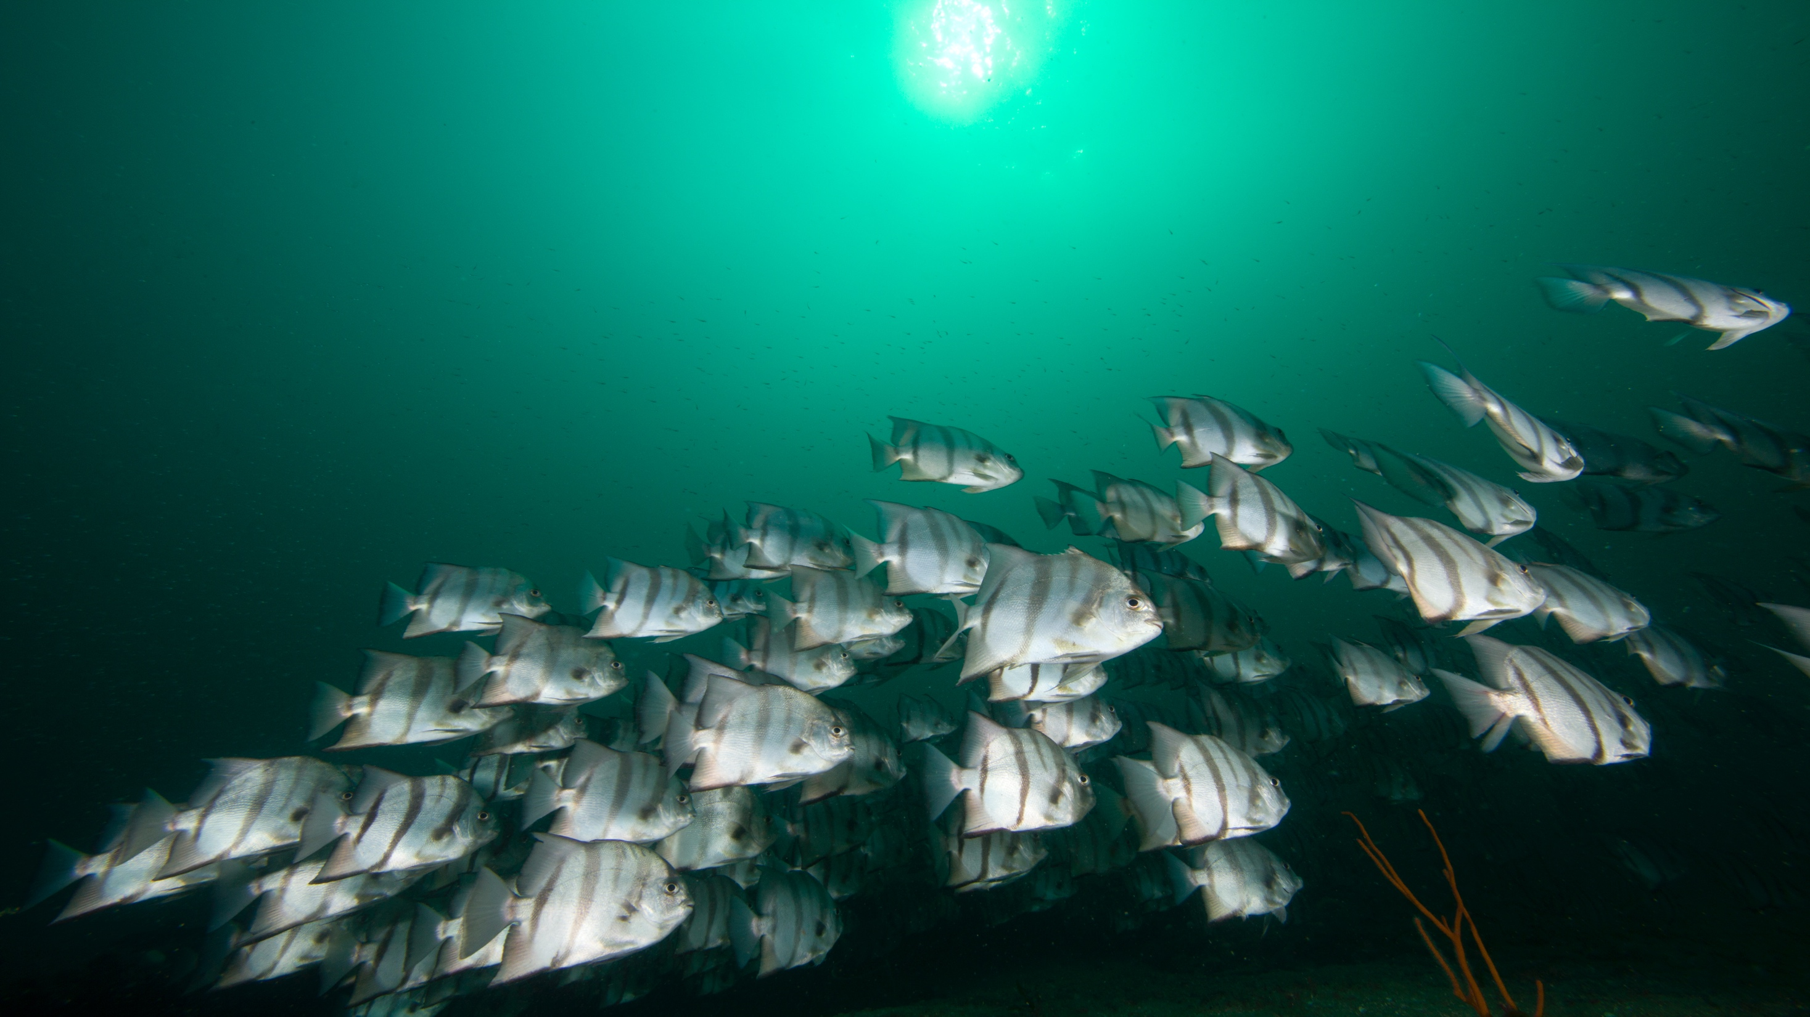

Slide 20
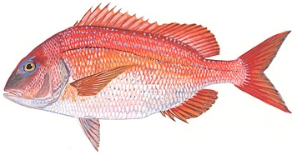
SSC Review of the Red Porgy Standard Assessment
SSC agrees that:
  assessment appropriately addresses ToRs
  is BSIA
  is an adequate basis for determining stock status and supporting fishing level recommendations, and
  methods of addressing uncertainty consistent with expectations and available information

Slide 21
SSC Review of the Red Porgy Standard Assessment
Factors that affect reliability of stock status estimates and fishing level recommendations:
  Recruitment pattern has large effect on projected catches and rebuilding status
  Fishery-dependent and -independent data show fluctuations in age/size at maturity and growth rate, which can constrain ability of the stock to rebuild
  Assessment is robust to uncertainties explored in sensitivity analyses

Slide 22
SSC Review of the Red Porgy Standard Assessment
Risks and consequences of assessment uncertainties with regard to status and fishing level recommendations:
  Status of terminal recruitment (lowest on record), terminal SSB (lowest on record), and current F (above F_{MSY}) are robust to all uncertainties explored
Are methods of addressing uncertainty consistent with SSC expectations and the available information?
  SSC considers methods of addressing uncertainty consistent with expectations and available information

Slide 23
SSC Review of the Red Porgy Standard Assessment
Factors that most contribute to risk and impact status determinations and future yield predictions:
  Greatest contributor to risk is recruitment and uncertainty surrounding future recruitment values
  Status determination is unlikely to be affected by this recruitment uncertainty (i.e., still likely to be overfished)
  Future yield will be impacted by recruitment time series

Slide 24
SSC Review of the Red Porgy Standard Assessment
Is adequate rebuilding progress being made? Comment on reasons why progress differs from projections.
  Rebuilding progress stifled by steady decline in recruitment since early 1990’s
  Projections using recent (2015-2017) mean recruitment suggest probability of rebuilding is zero even if F=0
  Although reducing directed fishing and minimizing discards may not guarantee rebuilding, it would allow the stock maximum rebuilding potential should conditions improve

Slide 25
SSC Review of the Red Porgy Standard Assessment
Rebuilding progress (cont’d):
  Although SSC recommends an ABC based on F=75%F_{MSY} to end overfishing, projections indicate this ABC will have only a very minor impact on stock rebuilding
  If recruitment continues to be low, we will need to reevaluate stock productivity and benchmark reference points

Slide 26
SSC Review of the Red Porgy Standard Assessment
Difficulties encountered in applying Control Rule:
  Red Porgy is under a rebuilding plan, which has made little to no progress given low recruitment in recent years
  SSC recommends
    Use of projections with average recruitment 2015-2017
    F = F_{MSY} to set OFL
    F = 75% F_{MSY} to set ABC

Slide 27
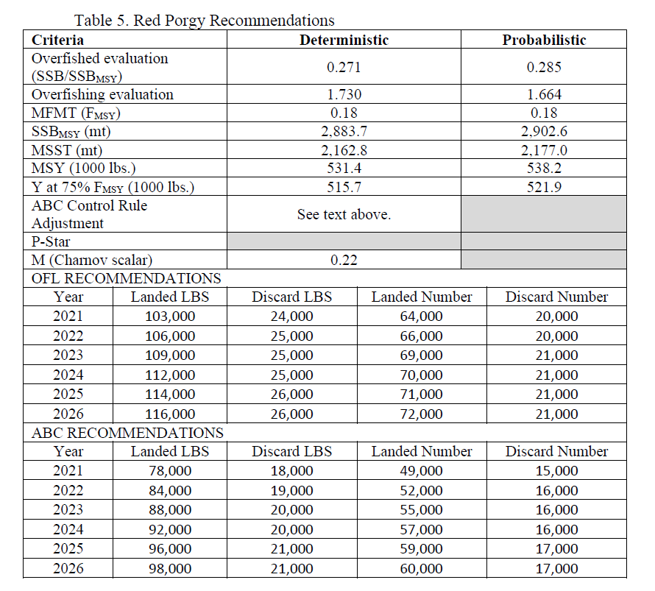
SSC Catch Level Recommendations for Red Porgy
Page 25

Slide 28
SSC Review of the Red Porgy Standard Assessment
Indicators or metrics to monitor:
  Monitor SERFS video/trap survey index and age composition annually
  Change in recruitment could be trigger for a new assessment
SSC recommends an Operational Assessment within the next 5 years

Slide 29
SSC Review of the Red Porgy Standard Assessment
Research recommendations most likely to reduce risk and uncertainty in the next assessment:
  Investigate temporal trends in growth, sex at age, and female maturity at age.
Additional SSC research recommendations:
  Investigate potential factors that may be contributing to continued low recruitment (e.g., egg production/quality, fertilization rate, juvenile survival, sex ratio, and size/age of sex transition)
  Investigate if males establish and maintain territories as part of their spawning behavior

Slide 30
SSC Review of the Red Porgy Standard Assessment
Additional SSC research recommendations:
  Investigate potential impact(s) of increased abundance of Red Lionfish and Red Snapper (or other piscivores found to have recent increased abundance), including:
    predation of juvenile Red Porgy by Red Lionfish and Red Snapper and its potential impact on apparent recruitment failure of Red Porgy
    competition for prey between Red Snapper and Red Porgy (e.g., diet composition and size range overlaps)
    exploring to what extent resurgence in Red Snapper co-occurred with decline in Red Porgy

Slide 31
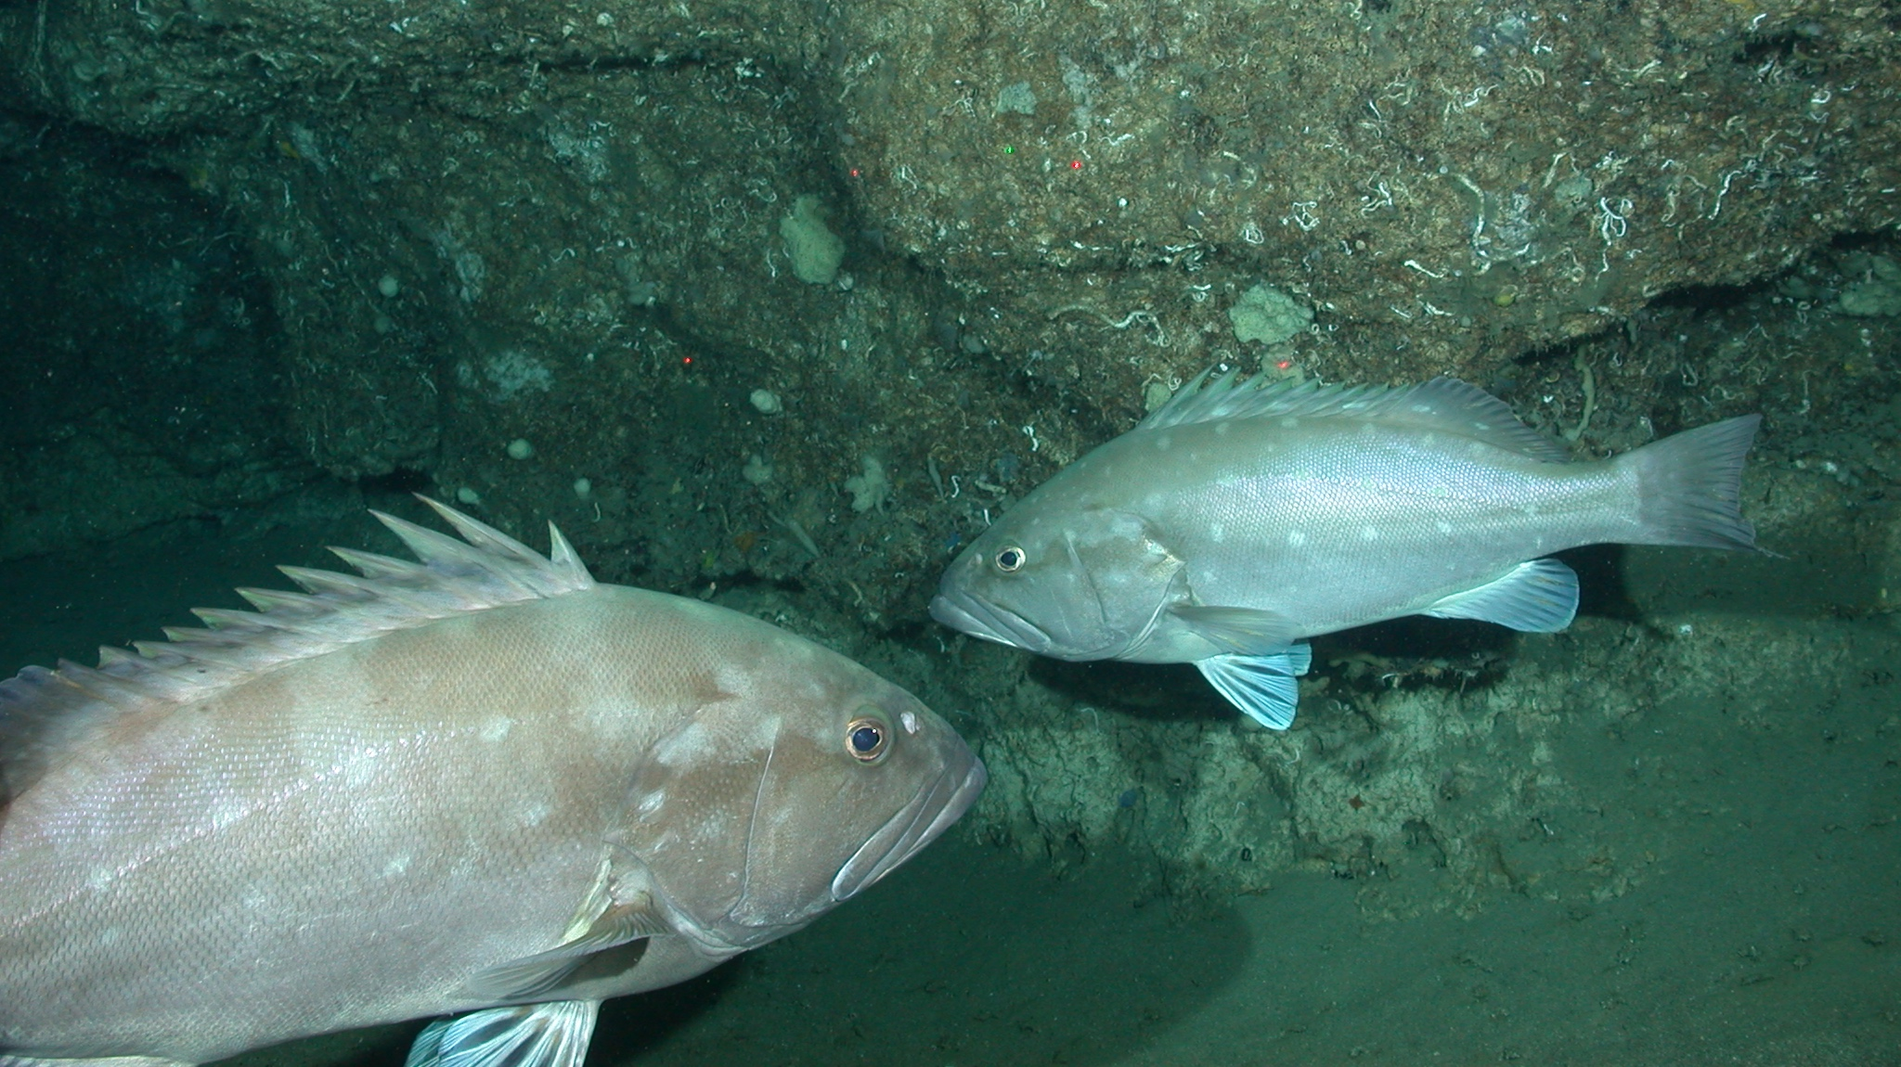

Slide 32
SSC Report To the Mackerel Cobia Committee
June 2020 SAFMC Meeting
Report of SSC meeting
April 28-30, 2020

Slide 33
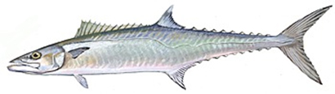
SSC Review of the King Mackerel Update Assessment
SSC agrees that:
  assessment appropriately addresses ToRs
  is BSIA given the update ToRs, and
  is an adequate basis for determining stock status and supporting fishing level recommendations

Slide 34
SSC Review of the King Mackerel Update Assessment
Factors that affect reliability of estimates of stock status and fishing level recommendations:
  Performance diagnostics indicated some parameters in the model are highly correlated and not well estimated
  Uncertainty in how winter mixing zone landings were assigned to Gulf and Atlantic stocks

Slide 35
SSC Review of the King Mackerel Update Assessment
Risks and consequences of assessment uncertainties with regard to status and fishing level recommendations:
  Diagnostics indicate model configuration may not be ideal given the available data
  Although impact could be minor, SSC cannot be more explicit about potential risks and consequences without knowing cause
Notes:
However, modifying the model's configuration was deemed outside the bounds of a SEDAR update assessment. Our research recommendation for addressing this issue can be found below.

Slide 36
SSC Review of the King Mackerel Update Assessment
Are methods of addressing uncertainty consistent with SSC expectations and the available information?
  Methods consistent with available information
  Parameter uncertainty not characterized as fully as in other SEFSC assessments
  Therefore, Tier II uncertainty score used in setting ABC lowered to medium

Slide 37
SSC Review of the King Mackerel Update Assessment
Factors that most contribute to risk and impact status determinations and future yield predictions:
  Model convergence issues
  Uncertainty surrounding how winter mixing zone landings assigned to Gulf and Atlantic stocks
Notes:
Model convergence issues could not be explored during an update assessment; therefore, the degree to which these factors impact status determination and future yield predictions is unknown at this time.

Slide 38
SSC Review of the King Mackerel Update Assessment
Difficulties encountered in applying Control Rule
  SSC did not concur with MRAG PSA findings that King Mackerel is a high risk stock given:
    Stock has never been overfished nor undergone overfishing
    No evidence of age or size truncation
    Species matures early (fully mature at age 2)
  SSC recommends Tier IV score of Low
    Productivity and Susceptibility considerations are being addressed during development of ABC Control Rule Amendment
    SSC recommends that work continue as expediently as possible

Slide 39
SSC Catch Level Recommendations for King Mackerel
SSC control rule determinations:
  ➢ Tier I: 2 (2.5%)
  ➢ Tier II: 3 (5%)
  ➢ Tier III: 1 (0%)
  ➢ Tier IV: 1 (0%)
  ➢ Adjustment: 7.5%
  ➢ P* = 42.5%
SSC recommends projections at P*=50% be used to set the OFL and P*=42.5% be used to set the ABC.

Slide 40
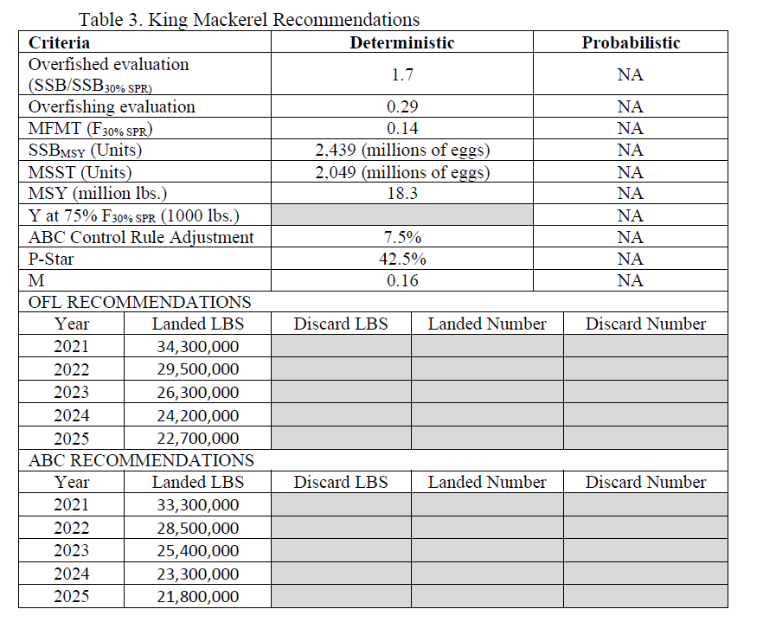
SSC Catch Level Recommendations for King Mackerel
Page 15
Notes:
Note that the stock is currently well above the biomass target (SPR30%) due in part to unusually high recent recruitment (2013-16). Fishing at the recommended OFL would result in a three-fold increase over current fishing mortality and higher landings. Thus, OFL recommendations listed in Table 2 begin at higher than current catches and decrease over time as recruitment returns to the long-term average and projected SSB displays a moderate decline toward the target as strong cohorts pass through the fishery.

Slide 41
SSC Review of the King Mackerel Update Assessment
Indicators or metrics to monitor:
  Identify if sampling of commercial handline fleet off NC can be brought back to sampling levels before recent years of frequent hurricanes
  If model is sensitive to mixing zone composition, monitor mixing zone for relative contribution of Atlantic vs Gulf of Mexico fish
  Monitor SEAMAP index for future recruitment signals

Slide 42
SSC Review of the King Mackerel Update Assessment
SSC concurred with research recs provided in assessment and added:
  Explore model sensitivity to the mixing zone catch ratio
  Identify source of poor model convergence (i.e., max gradient >0.001) be identified prior to next assessment and communicated to SSC
  Explore model sensitivity in start date, choice of natural mortality, index fitting
  Take into account findings of South Atlantic Climate Vulnerability Assessment for King Mackerel

Slide 43
SSC Review of the King Mackerel Update Assessment
Provide guidance on next assessment, addressing its timing and type:
  SSC recommends waiting to see results of model diagnostics/configuration exploration before deciding on type and timing of next assessment

Slide 44


