Slide 1

SAFMC – December 2015 Meeting
SSC Report
Oct 20-22, 2015 Meeting
Crowne Plaza
North Charleston, SC

Slide 2
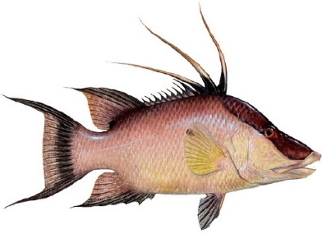
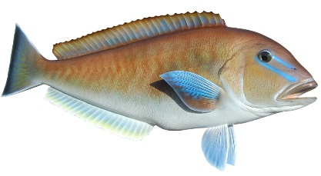
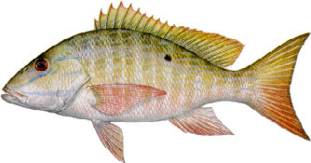
2014-2015 LANDINGS AND ACLS
SSC discussion and recommendations:
The SSC expressed concerns regarding discards. Difficult to evaluate the performance of current management measures without knowledge of total fishery removals
Request that future reports indicate total landings relative to the overall ABC and OFL for any stocks where sector landings exceed the sector ACL

Slide 3
UNITS FOR FISHING LEVEL RECOMMENDATIONS
Specifying recreational Fishing Levels (ABC, ACL) in numbers could be useful in some situations, but may not be always appropriate:
  Different impacts of using numbers or weights given changes in weight over time or space
  Need to continue focusing on adequate size monitoring of the fishery

Slide 4
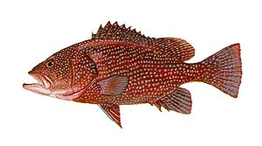
SNAPPER GROUPER AMENDMENT 36
SSC discussion and recommendations:
Proposed 5-year timeline for sunset may not be appropriate; might need longer timeframe to realize benefits of spawning in longer-lived, late-maturing species
Concerns regarding the fact that a few of the proposed areas are very small
  Need areas large enough to encompass the main spawning
  Areas that are too small are not likely to provide the spawning benefits envisioned

Slide 5

SNAPPER GROUPER AMENDMENT 37
Review the hogfish projections for East FL/FL Keys stock:
  Revised projections represent BSIA
  Some of the F values are very low; differences among these low-F projected rebuilding scenarios may not be realized or detectable statistically.
Review the GA-NC stock ABC:
    ORCS is applicable and appropriate for this stock
    A Moderately-High risk of overexploitation is still appropriate for this stock

Slide 6
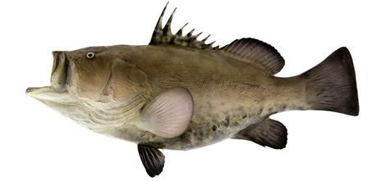
RECREATIONAL CATCH ESTIMATION FOR RARE SPECIES
The Council expressed concern over managing rare species using estimates from the standard MRIP survey
The SSC reviewed a presentation from MRIP discussing different ways of addressing this issue:
  The standard MRIP stratification method results in the lowest precision amongst the examples provided
  Alternative methods reasonable and appropriate but still require testing and refinenement

Slide 7

BLUELINE TILEFISH
The SSC recommended a Blueline Tilefish benchmark assessment -- run in parallel with Scamp and Gray Snapper, delaying Vermilion Snapper if necessary.
The SSC discussed the NMFS letter of October 15, 2005, to the Chairs of the SAFMC and MAFMC regarding Blueline Tilefish.
Comments noted the uncertainty and interim nature of the ABC recommendation from the prior meeting.
The MAFMC is considering applying data-limited methods to Blueline Tilefish within its area of jurisdiction during a meeting in March 2016.
SAFMC SSC is coordinating activities with MAFMC SSC regarding discussions on Blueline Tilefish.

