Slide 1

SAFMC Meeting – June 2015
SSC Report
April 28 - 30, 2015 Meeting
Crowne Plaza
North Charleston, SC

Slide 2
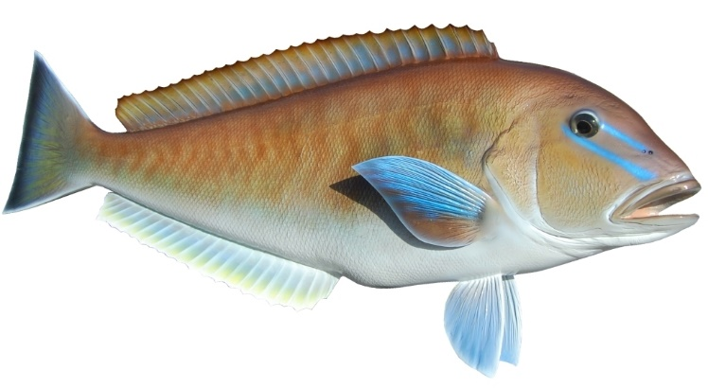
GEOGRAPHIC RANGE OF THE SEDAR 32 TILEFISH ASSESSMENT
Council Motion (March 2015):
DIRECT THAT THE SSC DETERMINE, AT ITS APRIL 2015 MEETING, THE GEOGRAPHIC RANGE COVERED BY THE SEDAR 32 ASSESSMENT. IF WARRANTED, REQUEST EMERGENCY ACTION TO EXTEND REGULATIONS PROPOSED IN AMENDMENT 32, ONCE THE AMENDMENT IS APPROVED, TO THE AREAS THAT THE SSC CONSIDERS ARE REPRESENTED BY THE STOCK ASSESSMENT.

Slide 3
GEOGRAPHIC RANGE OF THE SEDAR 32 TILEFISH ASSESSMENT
The SSC concluded that the SEDAR 32 assessment applies to the entire coast-wide blueline tilefish stock and that the assessment is considered the best available scientific information (BASI) at the time it was produced
However, the SSC decided to hold a webinar meeting on June 3rd to discuss concerns re. the projections

Slide 4

BLUELINE TILEFISH PROJECTIONS
SSC discussion and recommendations:
Projections were prepared using scientifically sound methodology and incorporating typical assumptions and uncertainties
However, given:
  Continued shifts in the fishery since the assessment was completed
  Potential spatial patterns to the population and impacts of such patterns on productivity
SSC did not consider current projections as BASI

Slide 5
BLUELINE TILEFISH PROJECTIONS
SSC discussion and recommendations:
SSC Requests that SEFSC revise the projections to include: observed landings through 2014 and the best estimate of landings for 2015 to provide OFL based on P*=50% and ABC based on fishing at P*=30%
Further exploratory projections are required to address productivity-spatial shift issues:
  SSC discussed developing alternatives based on varying recruitment levels, similar to the scenarios provided recently for king mackerel to address uncertainty in recent productivity trends

Slide 6
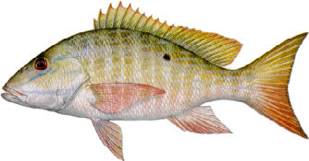
MUTTON SNAPPER ASSESSMENT REVIEW
Stock not overfished, not undergoing overfishing
Application of ABC control rule → P* = 30%
The SSC recommends using 5-year projections at P*=50% for OFL and at P*=30% for ABC

Slide 7
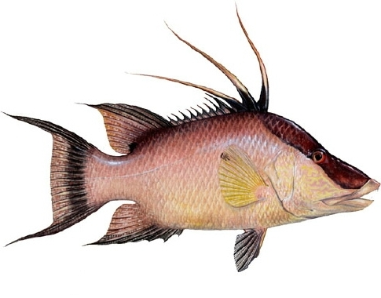
HOGFISH PROJECTIONS
East FL/FL Keys stock overfished, undergoing overfishing
The SSC reviewed projections at:
  F = 0
  F = F_{Current}
  F = 75%F_{MSY}
  F = F_{MSY}
  F = F_{Rebuild} (10 years, 50% probability of rebuilding)
  F = F_{Rebuild} (10 years, 72.5% probability of rebuilding)
  F = F_{Rebuild} (7 years, 50% probability of rebuilding)
  F = F_{Rebuild} (7 years, 72.5% probability of rebuilding)

