Slide 1

SAFMC Meeting – December 2013
SSC Report
Oct 22‐24, 2013 Meeting
Crowne Plaza
North Charleston, SC

Slide 2
Oct 2013 SSC Meeting Agenda
SEDAR Activities
Stock Assessment Recommendations
Spanish Mackerel Assessment Projections
SEFIS Update
ACCSP Biological Sampling Target Process
Assessment Reviews:
      Mutton Snapper update
      SEDAR 32 (Blueline Tilefish)
      SEDAR 36 (Snowy Grouper)
  Data Poor Assessment Approaches
ABC Control Rule PSA components
  Review Regulatory Amendments and Actions
  Council Workplan Update

Slide 3
Oct 2013 SSC Meeting Agenda
SEDAR Activities
Stock Assessment Recommendations
Spanish Mackerel Assessment Projections (Thursday AM)
SEFIS Update
ACCSP Biological Sampling Target Process
Assessment Reviews:
      Mutton Snapper update
      SEDAR 32 (Blueline Tilefish)
      SEDAR 36 (Snowy Grouper)
  Data Poor Assessment Approaches
ABC Control Rule PSA components
  Review Regulatory Amendments and Actions
  Council Workplan Update

Slide 4
Oct 2013 SSC Meeting Agenda
Stock Assessment Recommendations
SEFIS Update
Assessment Reviews: SEDAR 32 (Blueline Tilefish)
  Data Poor Assessment Approaches
ABC Control Rule PSA components

Slide 5
Stock Assessment Recommendations
  Guidance on the basis for MSST:
    SSC reviewed a thorough SEFSC document discussing pros and cons of various approaches:
    MSST = (1-M) SSB_{MSY}
    MSST = 75% SSB_{MSY}

Slide 6
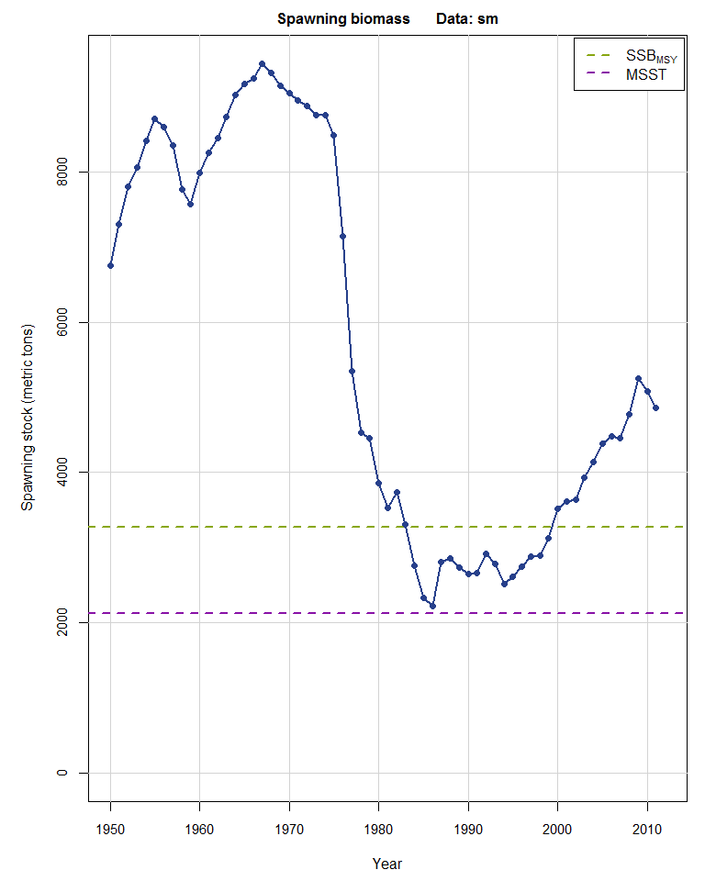

Biomass Status (MSST)
SSB_{MSY}
MSST

Slide 7
Stock Assessment Recommendations
  Guidance on the basis for MSST:
    SSC reviewed a thorough SEFSC document discussing pros and cons of various approaches:
    MSST = (1-M) SSB_{MSY}
    MSST = 75% SSB_{MSY}
    Council had indicated an interest in adopting MSST=75%SSB_{MSY}
    SSC expressed no concern with the use of this approach

Slide 8
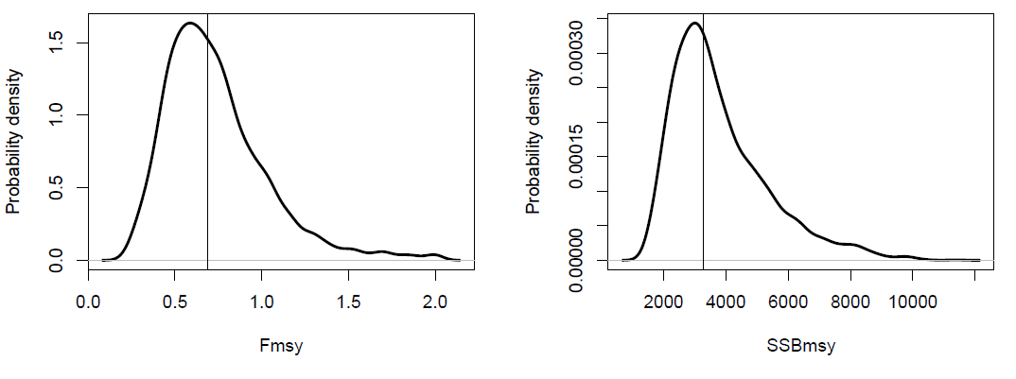
Stock Assessment Recommendations
  Deterministic vs. probabilistic fishing level recommendations:
    SSC had no concerns with the use of both approaches for presenting stock assessment results

Slide 9


SEFIS Update
  SSC requested that a workshop be held in the next 6 months to review methods for developing abundance indices from the SERFS video monitoring.
  Include SEFSC staff, SEDAR staff, SSC members as well as scientists involved in the Gulf of Mexico video survey.
  Ideally, ready for SEDAR 41 red snapper assessment.

Slide 10

Blueline Tilefish Assessment Review
Part of SEDAR 32 benchmark assessment
Exploitation status: overfishing is occurring (F_{CUR}/F_{MSY} = 2.37)
Biomass status:
  if MSST = 75%SSB_{MSY} stock not overfished (SSB₂₀₁₁/MSST=1.09)
  if MSST = (1-M)SSB_{MSY} stock overfished (SSB₂₀₁₁/MSST=0.83)
Steepness parameter not estimated (fixed at 0.84)
Application of ABC control rule → P* = 30%

Slide 11
Blueline Tilefish Assessment Review
Catch level recommendations (OFL and ABC):
  Projections provided by SEFSC according to SSC recommendations (P* = 50% for OFL; P* = 30% for ABC)
  High level of uncertainty
  Request that projections be reviewed by the SSC before new catch levels are adopted by the Council

Slide 12
Performance of Data-Poor Approaches
Group of international-level fishery scientists conducted a study evaluating data-poor methods of setting catch limits.
Take homes messages:
  Maximum catch rules (e.g., max. catch scalars, 3rd high. catch, etc.) lead to high probabilities of overfishing and low yields, particularly for stock levels below B_{MSY}
  ORCS WG Rule generally outperforms avg. catch rules, and may provide adequate short- to medium-term approaches, allowing additional data collection for use of other methods.
  Simulating a data-limited management system reveals that it may be difficult to manage stocks substantially below B_{MSY}

Slide 13
ABC Control Rule PSA components
SSC noted that an evaluation of the performance of the ABC control rule (P*) would be extremely helpful in assessing how the method has worked.
SSC recommends that a subcommittee be established to evaluate:
  Use of PSA (keep, remove, modify?)
  Revamping of the scoring system to be more Tier specific, allowing more refinement of the dimensions used to provide the adjustment in ABC for each tier.
  Weighting of each of the factors within control rule dimensions.
  Any other issues that might be deemed relevant for evaluation and improvement of the ABC control rule.

Slide 14
Oct 2013 SSC Meeting Report
Questions?

