Slide 1
Emergency Action for Red Snapper
Modify Annual Catch Limits for Red Snapper
Prepared by Chip Collier
September 2017

Slide 2
Why Emergency Action?
New information presented at the June Council meeting.
Letters from SEFSC and SERO on use of discards in management of red snapper and the uncertainty in the stock assessment that inhibits the ability to set an ABC that can be effectively monitored.
Request from public at each Council meeting and scoping meetings.

Slide 3
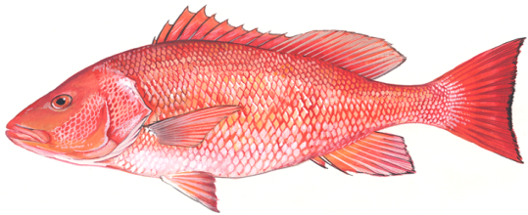
Background
Red snapper fishery has been closed since 2010 with mini-seasons in 2012, 2013, and 2014
Most recent assessment indicated stock was overfished and overfishing was occurring through 2014 (SEDAR 41 2017)
  Stock is continuing to rebuild from past levels
  Level of overfishing is unknown.

Slide 4
Chevron Trap Index
Declining trend in abundance
Increasing trend in abundance

Slide 5
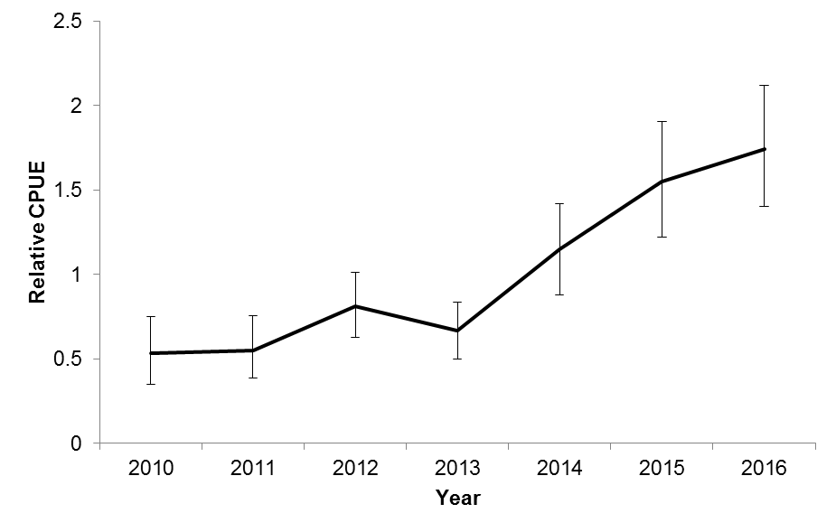
Chevron Trap Index
Years used to determine overfishing

Slide 6
What Would Emergency Action Do?
Establish an ACL for red snapper in 2017.
Allow a mini-season starting mid- to late- October 2017.
Recreational bag limit - 1-fish per person
Commercial trip limit - 75 pounds gutted weight
No minimum size limit.

Slide 7
Calculating ACL Alternatives
Year | Landings (Numbers of Fish)
2012 | 16,591
2013 | 11,767
2014 | 42,510
Alternative 2 =
average landings 2012-2014

Slide 8
Calculating ACL Alternatives
Year | Landings (Numbers of Fish)
2012 | 16,591
2013 | 11,767
2014 | 42,510
Alternative 2 =
average landings 2012-2014
X 1.88
Adjustment factor based on changes in scientific survey
Alternative 3 =
1.88 x Alternative 2

Slide 9
Calculating ACL Alternatives
Year | Landings (Numbers of Fish)
2012 | 16,591
2013 | 11,767
2014 | 42,510
average landings 2012-2014
Alternative 4 =
maximum landings 2012-2014
Alternative 2 =
X 1.88
Adjustment factor based on changes in scientific survey
X 1.88
Alternative 3 =
1.88 x Alternative 2

Slide 10
Calculating ACL Alternatives
Year | Landings (Numbers of Fish)
2012 | 16,591
2013 | 11,767
2014 | 42,510
average landings 2012-2014
Alternative 4 =
maximum landings 2012-2014
Alternative 2 =
X 1.88
Adjustment factor based on changes in scientific survey
X 1.88
1.88 x Alternative 2
Alternative 5 =
1.88 x Alternative 4
Alternative 3 =

Slide 11
Action 1. Revise the Process to Determine the Annual Catch Limit for Red Snapper
Alternative | Total ACL Number | Total ACL Weight (lbs ww) | Commercial ACL Weight (lbs ww) | Recreational ACL Number
Alt 1 | 0 | 0 | 0 | 0
Alt 2 | 23,623 | 247,097 | 69,360 | 16,480
Alt 3 | 44,411 | 464,539 | 130,396 | 30,982
Preferred Alt 4 | 42,510 | 444,655 | 124,815 | 29,656
Alt 5 | 79,919 | 835,953 | 234,652 | 55,753

Slide 12
ACLs Relative to Past
Recreational Landings
Notes:
Box indicates years included in ACL development

Slide 13
ACLs Relative to Past
Recreational Landings
Preferred Alt 4
29,656 fish
84%

Slide 14
Recreational Season
Closure dates (number of open days) for the recreational sector under the different proposed ACL alternatives for 2017. Assumed opening October 6.
 | Alternative 1 No Action | Alternative 2 | Alternative 3 | Preferred Alternative 4 | Alternative 5
ACL | 0 | 16,480 Fish | 30,982 Fish | 29,656 Fish | 55,753 Fish
Predicted Landings | No season | 20-Oct (7) | 4-Nov (13) | 30-Oct (12) | 25-Nov (23)
High Landings | No season | 9-Oct (3) | 20-Oct (7) | 16-Oct (6) | 30-Oct (12)

Slide 15
ACLs Relative to Past
Commercial Landings

Slide 16
ACLs Relative to Past
Commercial Landings
Preferred Alt 4
124,815 lbs
85%

Slide 17
Commercial Season
Closure dates for the commercial sector under the different proposed ACL alternatives for 2017. Assumed opening October 9.
 | Alternative 1 | Alternative 2 | Alternative 3 | Preferred Alternative 4 | Alternative 5
ACL | 0 | 69,360 lbs ww | 130,396 lbs ww | 124,815 lbs ww | 234,652 lbs ww
Predicted Landings | No season | No Closure | No Closure | No Closure | No Closure
High Landings | No season | No Closure | No Closure | No Closure | No Closure

Slide 18
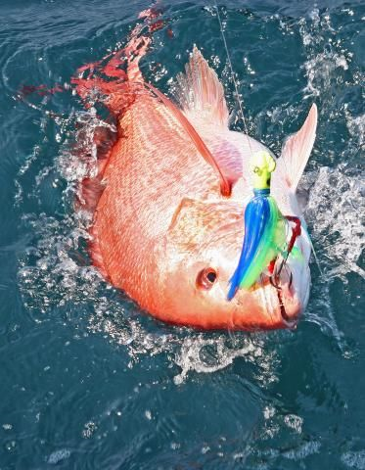
Questions?
David Rainer

