Slide 1
Amendment 43 to the Fishery Management Plan for the Snapper Grouper Fishery of the South Atlantic Region
Revise Annual Catch Limits for Red Snapper
Prepared by Chip Collier
September 2017

Slide 2

Background
Amendment 43
1 Action - Revise methods to calculate ACL to enable harvest beginning in 2018
Amendment 43
August 2017
March 2017
Potentially include previous actions from March 2017 including recreational reporting and best fishing practices. A longer timeframe is needed for these actions
Amendment 46
12 Actions Included
Coming Soon

Slide 3
Process to Calculate Previous Annual Catch Limits
Year | Total ABC from AM 28 (Numbers of Fish) | Landings (Numbers of Fish) | Landings + Dead Discards* (Numbers of Fish)
2012 | 86,000 | 16,591 | 80,516
2013 | 96,000 | 11,767 | 72,881
2014 | 106,000 | 42,510 | 205,859
2015 | 114,000 | 2,850 | 276,729
2016 | 121,000 | 830 | 407,025
2017 | 128,000

Slide 4
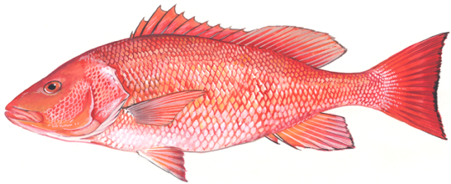
Chevron Trap Index
Declining trend in abundance
Increasing trend in abundance

Slide 5
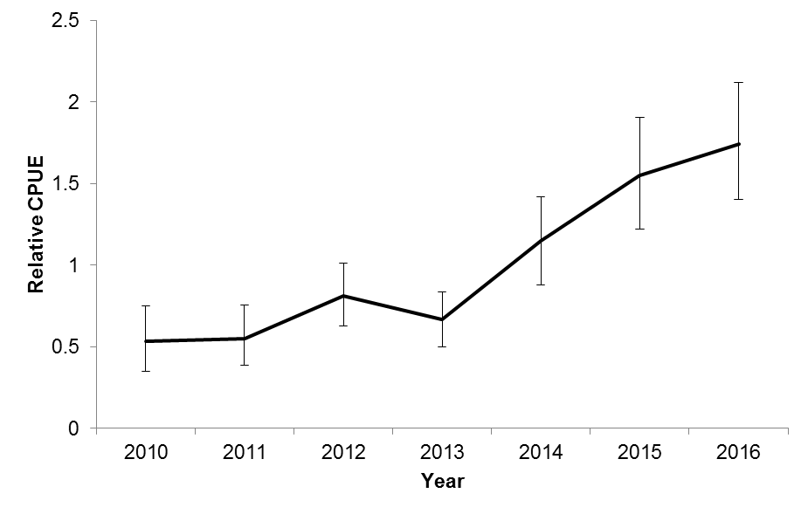
Chevron Trap Index
Years used to determine overfishing

Slide 6
What Would Amendment 43 Do?
Revise the process to calculate the annual catch limits.
Potentially enable mini-seasons for red snapper with recreational start date on second Friday in July and commercial start date on second Monday in July.
Recreational bag limit - 1-fish per person
Commercial trip limit - 75 pounds gutted weight
No minimum size limit.

Slide 7
Calculating ACL Alternatives
Year | Landings (Numbers of Fish)
2012 | 16,591
2013 | 11,767
2014 | 42,510
Alternative 2 =
average landings 2012-2014

Slide 8
Calculating ACL Alternatives
Year | Landings (Numbers of Fish)
2012 | 16,591
2013 | 11,767
2014 | 42,510
Alternative 2 =
average landings 2012-2014
X 1.88
Adjustment factor based on changes in scientific survey
Alternative 3 =
1.88 x Alternative 2

Slide 9
Calculating ACL Alternatives
Year | Landings (Numbers of Fish)
2012 | 16,591
2013 | 11,767
2014 | 42,510
average landings 2012-2014
Alternative 4 =
maximum landings 2012-2014
Alternative 2 =
X 1.88
Adjustment factor based on changes in scientific survey
X 1.88
Alternative 3 =
1.88 x Alternative 2

Slide 10
Calculating ACL Alternatives
Year | Landings (Numbers of Fish)
2012 | 16,591
2013 | 11,767
2014 | 42,510
average landings 2012-2014
Alternative 4 =
maximum landings 2012-2014
Alternative 2 =
X 1.88
Adjustment factor based on changes in scientific survey
X 1.88
1.88 x Alternative 2
Alternative 5 =
1.88 x Alternative 4
Alternative 3 =

Slide 11
Action 1. Revise the Process to Determine the Annual Catch Limit for Red Snapper
Alternative | Total ACL Number | Total ACL Weight (lbs ww) | Commercial ACL Weight (lbs ww) | Recreational ACL Number
Alt 1 | 0 | 0 | 0 | 0
Alt 2 | 23,623 | 247,097 | 69,360 | 16,480
Alt 3 | 44,411 | 464,539 | 130,396 | 30,982
Alt 4 | 42,510 | 444,655 | 124,815 | 29,656
Alt 5 | 79,919 | 835,953 | 234,652 | 55,753

Slide 12
ACLs Relative to Past
Recreational Landings
Notes:
Box is the years used for comparison of ACL to avg landings

Slide 13
ACLs Relative to Past
Recreational Landings

Slide 14
Recreational Season
Predicted closure dates (number of open days) for the recreational sector under the different proposed ACL alternatives for 2018.

Slide 15
ACLs Relative to Past
Commercial Landings

Slide 16
ACLs Relative to Past
Commercial Landings

Slide 17
Commercial Season
Predicted closure dates for the commercial sector under the different proposed ACL alternatives for 2018.
 | Alternative 1 | Alternative 2 | Alternative 3 | Alternative 4 | Alternative 5
ACL |  | 69,360 lbs ww | 130,396 lbs ww | 124,815 lbs ww | 234,652 lbs ww
Predicted Landings | TBD | 17-Sep | No Closure | No Closure | No Closure
High Landings | TBD | 23-Aug | 26-Nov | 21-Oct | No Closure

Slide 18
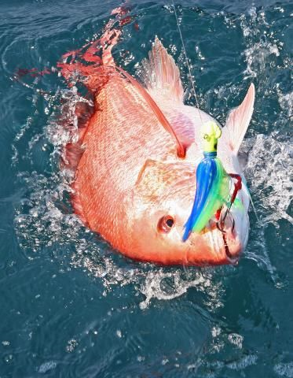
Questions?
David Rainer

