Slide 1
Snapper Grouper Amendment 43 (Revise ACLs for Red Snapper)
September 2017

Slide 2
Agenda Item 5:
Amendment 43
Last meeting
  Revised alternatives.
  Moved several actions into new amendment.
  Approved for public hearings.

Slide 3
Agenda Item 5:
Amendment 43
Amendment 43 public hearing webinars completed.
Changes to document:
  Provided additional analysis for action 1.
  Revised the purpose and need and alternative language (Alts 3 and 5).
  Completed most chapters but will need to complete some sections after preferred is selected.
  Included comments from public hearings.

Slide 4
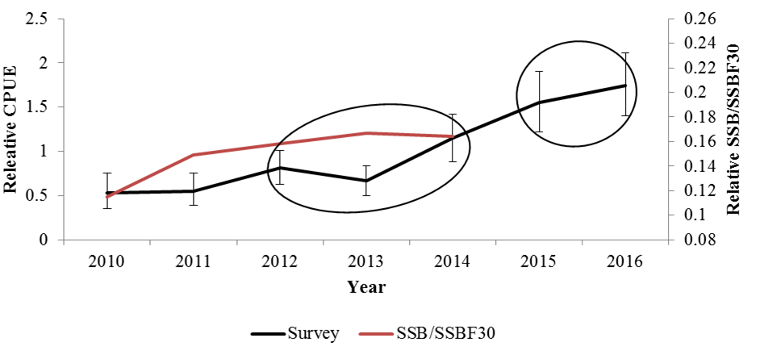
How is this amendment preventing overfishing?
  NMFS : “adequate management action has been taken to address overfishing and continue to rebuild the stock through a harvest prohibition in 2015 & 2016.”

Slide 5
ABC and ACL
ACL can’t exceed the ABC.
SEFSC unable to provide updated projections.
SSC stated (April 2017): they cannot provide an updated ABC.
ACL is a council decision.
ACL selected must prevent overfishing and continue to rebuild the stock.
In addition to ACL biological effects, the social and economics effects should also be considered.

Slide 6
ACLs Relative to Past
Recreational Landings
Notes:
Box indicates years included in ACL development

Slide 7
ACLs Relative to Past
Recreational Landings
Notes:
Box indicates year with substantial change

Slide 8
ACLs Relative to Past
Recreational Landings
Notes:
Box is the years used for comparison of ACL to avg landings

Slide 9
ACLs Relative to Past
Recreational Landings
16,480 fish
47%

Slide 10
ACLs Relative to Past
Recreational Landings
30,982 fish
87%

Slide 11
ACLs Relative to Past
Recreational Landings
29,646 fish
84%

Slide 12
ACLs Relative to Past
Recreational Landings
55,753 fish
157%

Slide 13
ACLs Relative to Past
Commercial Landings

Slide 14
ACLs Relative to Past
Commercial Landings
69,360 lbs
47%

Slide 15
ACLs Relative to Past
Commercial Landings
130,396 lbs
89%

Slide 16
ACLs Relative to Past
Commercial Landings
124,815 lbs
85%

Slide 17
ACLs Relative to Past
Commercial Landings
234,652 lbs
160%

Slide 18
Best Fishing Practices
Best fishing practices have been removed from current amendment (moved to AM 46).
Encourage fishermen to avoid red snapper if they have caught their limit.
Encourage use single hook rigs.
Encourage fishermen to return fish back to water as quickly as possible.
Encourage fishermen to use descending device if releasing red snapper with signs of barotrauma.
Staff is working on a webpage.

Slide 19
Recreational Reporting
Recreational permitting and reporting removed from this amendment (moved to AM 46).
Pilot project is developing to enable recreational permitting and reporting.
Recreational permitting and reporting will take significant time to analyze the impact of the action.

Slide 20
Agenda Item 5:
Amendment 43
Actions needed at this meeting:
  Select preferred and approve codified text.
  Approve for formal review.
  Adding additional actions (or alternatives) at this meeting may delay the amendment, and possibly reduce the chances of a season for 2018.

