Slide 1
2017/2018 Wreckfish ITQ Review
Wreckfish IPT & Brian Cheuvront
SAFMC – December 2017
Atlantic Beach, North Carolina

Slide 2
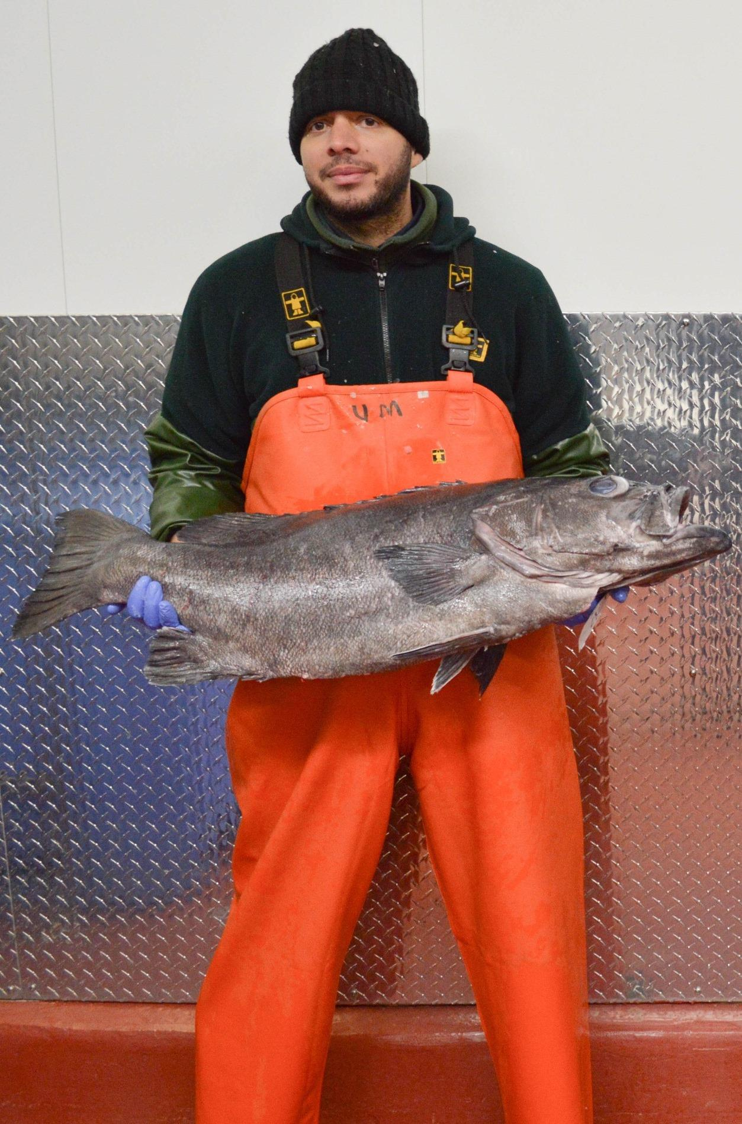
Wreckfish History
Wreckfish discovered on Blake Plateau in late 1980s, transatlantic stock (Sedberry et al 1994).
Very quick expansion, from 2 vessels landing 300K lbs in 1987 to 25 vessels landing 2M lbs in 1989
IFQ starting in 1992, the oldest finfish ITQ in the US. Because of its age, this ITQ is exempted from some later requirements.

Slide 3
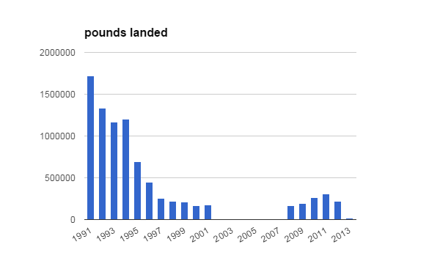
Decline in landings

Slide 4
Stock Status of Wreckfish in the South Atlantic Region
According to Status of Stocks, 3rd quarter 2017 update:
Overfished? No
Undergoing overfishing? No
Most recent stock assessment: Rademeyer and Butterworth, 2014. (Based on recommendations from SAFMC SSC workshop in 2013)

Slide 5
Why they said they stopped harvesting (Yandle and Crosson, 2015)
Council records (1992-2005)
other fisheries were more lucrative
developing catch history in other fisheries
waiting for share prices to go up before selling
2013 survey results from former shareholders:
better alternatives
health/safety
not enough allocation to be worth it

Slide 6
Wreckfish Management Timeline
1990: 2M lbs TAC introduced
1991: Banned bottom longlines, started permits
1992: Price declines, Council works on ITQ plan
1993: ITQ starts with 49 shareholders and a 2M lbs quota
2011: SSC sets ABC to 235,000 lbs in response to MSA requirement to establish ABC
2012/2014: Independent stock assessment reviewed by SSC and reset ABC to 433,000 lbs

Slide 7
Current Catch Levels
Regulatory Amendment 22 to the Snapper Grouper FMP implemented the following catch levels in 2015. 2020 catch levels will remain in place until modified.
Year | ABC lbs ww | ACL lbs ww | Commercial ACL (95%) | Recreational ACL (5%)
2015 | 433,000 | 433,000 | 411,350 | 21,650
2016 | 423,700 | 423,700 | 402,515 | 21,185
2017 | 414,200 | 414,200 | 393,490 | 20,710
2018 | 406,300 | 406,300 | 385,985 | 20,315
2019 | 396,800 | 396,800 | 376,960 | 19,840
2020 | 389,100 | 389,100 | 369,645 | 19,455

Slide 8
Wreckfish ITQ Review
Council staff conducted an initial ITQ review in 2009.
Since then, NOAA has issued several policies to assist Councils and RAs in reviewing ITQs.
Subsequent reviews should be every 5-7 years.
This is the first subsequent review.

Slide 9
Administration
SERO
Manages permits and shareholdings
Creates and distributes coupons
Share transfers
SEFSC
Manages logbook and dealer reporting
Receives coupons
OLE
Enforcement of program

Slide 10
Issues encountered so far…
Confidentiality
Data from fishers/dealers for some years might be confidential
Waivers ?
SSC recommendations
If still confidential after waivers
Use standard scores for the data
Can use rolling averages
Review Butterworth assessment & how they handled it

Slide 11
Wreckfish Data Collection
4 separate but related data collection systems have been used to manage the program
Wreckfish Vessel Logbook (monthly)
Landings, effort, participation
Wreckfish dealer report (monthly)
Partial verification of logbooks, plus price and sale data
Two part coupon system
Additional verification, enforcement aid, management, & quota transfers

Slide 12
Wreckfish Logbooks
Monthly submission
Coupons submitted with logbooks
Primary data captured
Total landings
Number of wreckfish
Departure and return dates
Trip duration
Vessel identifier
Dealer identifier
Secondary data captured
Bycatch
Gear
Fishing time
Fishing location
Fishing depth
* These data may be missing or not reported

Slide 13
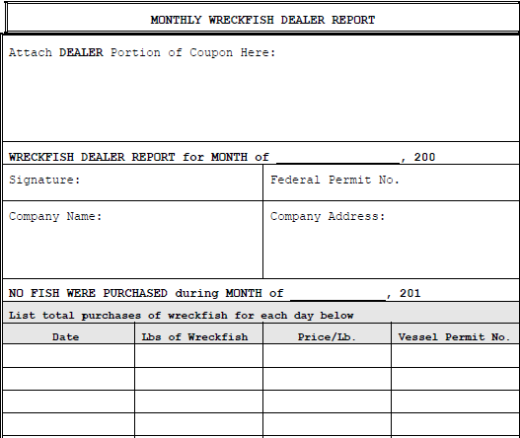
Dealer Reports
Monthly submission
Coupons must be submitted with report

Slide 14
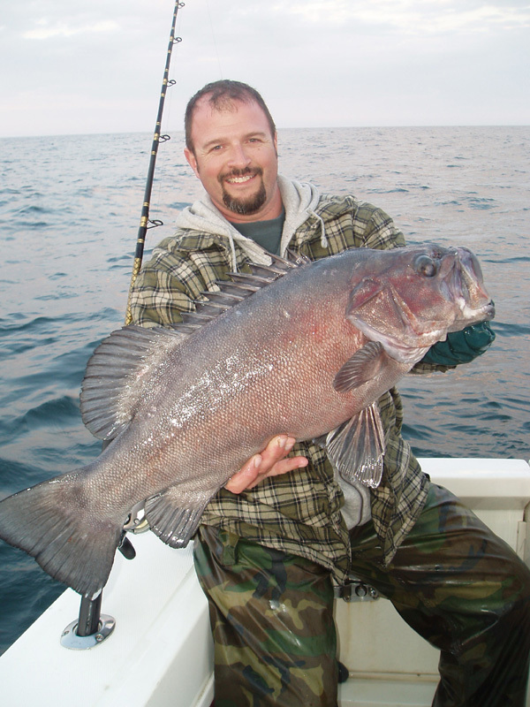
Dealer Data Collected
Schedule number
Date received
Month and year landed
Dealer permit number
State landed
Month, day, and year purchased
Pounds landed (gw)
Price/lb to fishermen
Vessel permit number

Slide 15
Coupons
Issued in 100 and 500 lb increments
Two portions to coupons
One portion submitted by vessel with logbook
Other portion submitted with dealer reports
Barcoded to shareholder/permit holder
Vessel and dealer permit number on portions
Month of landing
Date received recorded

Slide 17
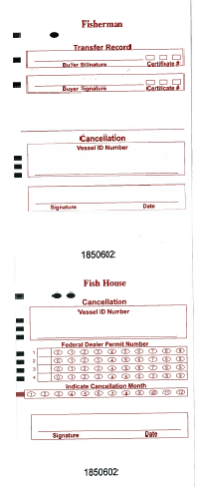

Slide 18
Additional SSC recommendations
Find out how much of the data provide clear records vs. how much is unclear and include in the data discussion
If there are enough clear records, a model could be constructed to infer the missing values
Evaluate each data source separately

Slide 19
Where we are now…
Data and confidentiality issues were more difficult that initially anticipated
IPT is starting to receive datasets
SERO is collecting confidentiality waivers
SEP will meet in February to discuss the review
Still plan to bring a draft review document to the Council in March 2018

