Slide 1
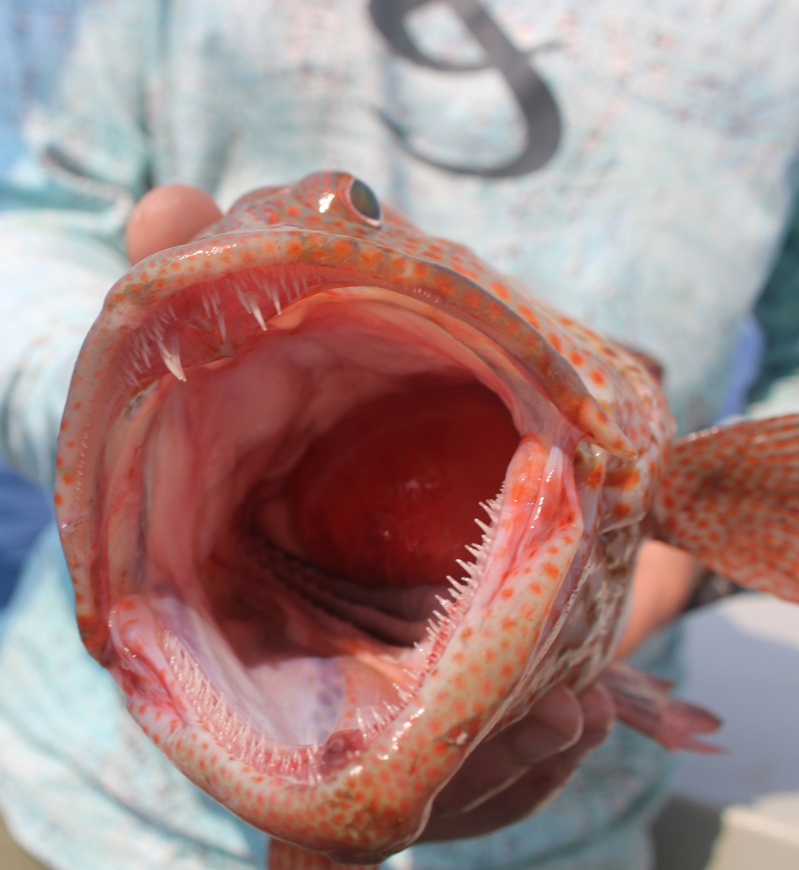
Snapper Grouper FMU Composition, Key Stocks, and Developing Amendments
SOUTH ATLANTIC FISHERY MANAGEMENT COUNCIL
March Council Meeting
2025

Slide 2
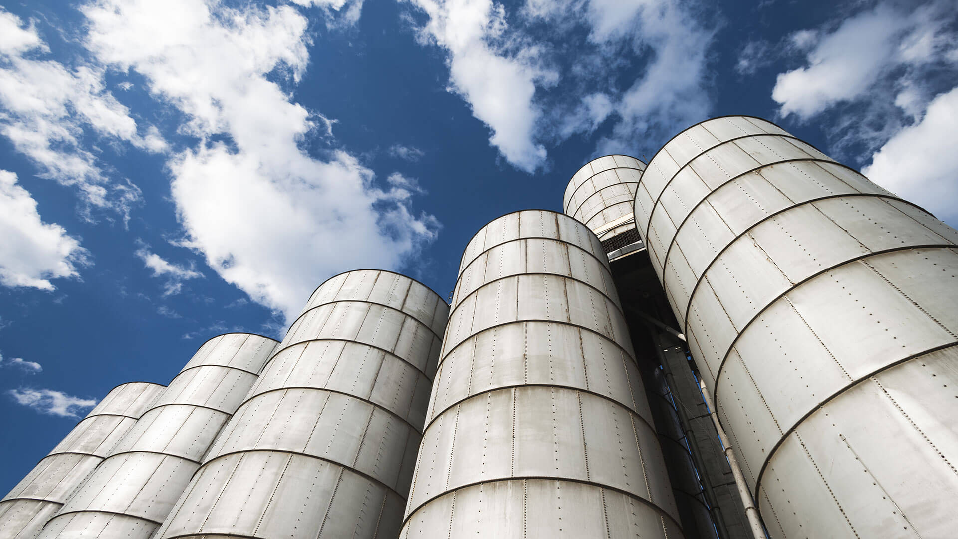
CHALLENGE: The Council is considering changing the species composition in the snapper grouper management unit. The outcome of this process directly affects amendments under development.

Slide 3
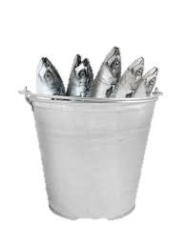
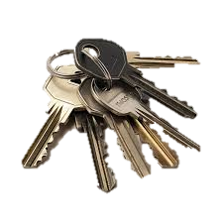
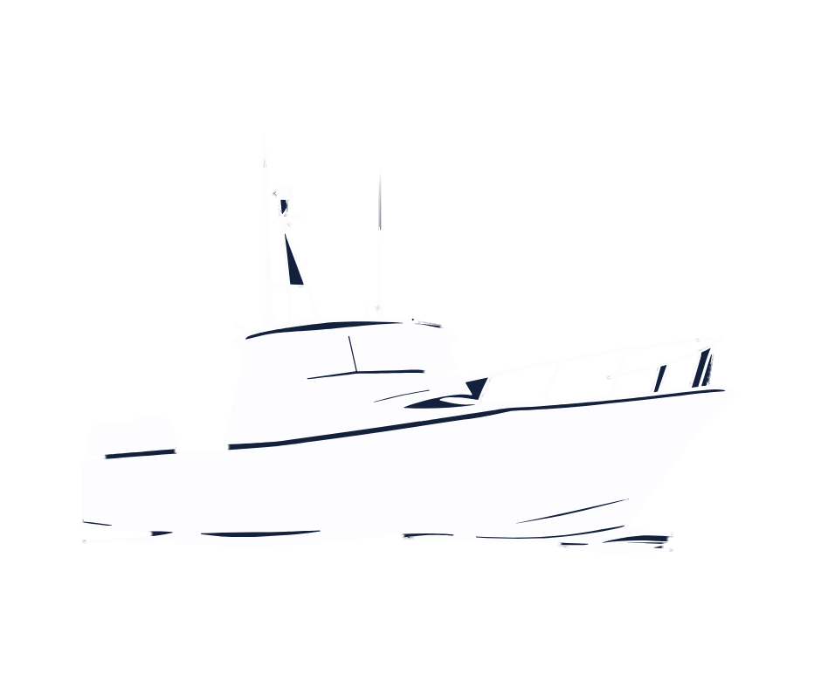
Which species need federal conservation and management under the FMP?
Which species need to be prioritized for stock assessments?
Key Stocks
FMU Composition
Which species could be removed and which designated as EC species?
ALL species are required to be reported regardless of where they are caught
Private Recreational Permit and Education
For-Hire Reporting
Includes DW, CMP, HMS, Other Council, state managed, unmanaged species
Which species would be covered under federal permit?

Slide 4
POSSIBLE WORKFLOW SHORT TERM
FMU Composition
Key Stocks
Rec Permit & education
For-Hire Reporting
Actions in these amendments are directly tied to the SG FMU composition.
Both being discussed at this meeting.

Slide 5
POSSIBLE WORKFLOW LONG TERM
The Council should consider the timing of amendment development to optimize efficiency
Reduced FMU in place
Amendment to implement results of Snapper Grouper MSE
For-Hire Limited Access
Would include SG, DW and CMP

Slide 6
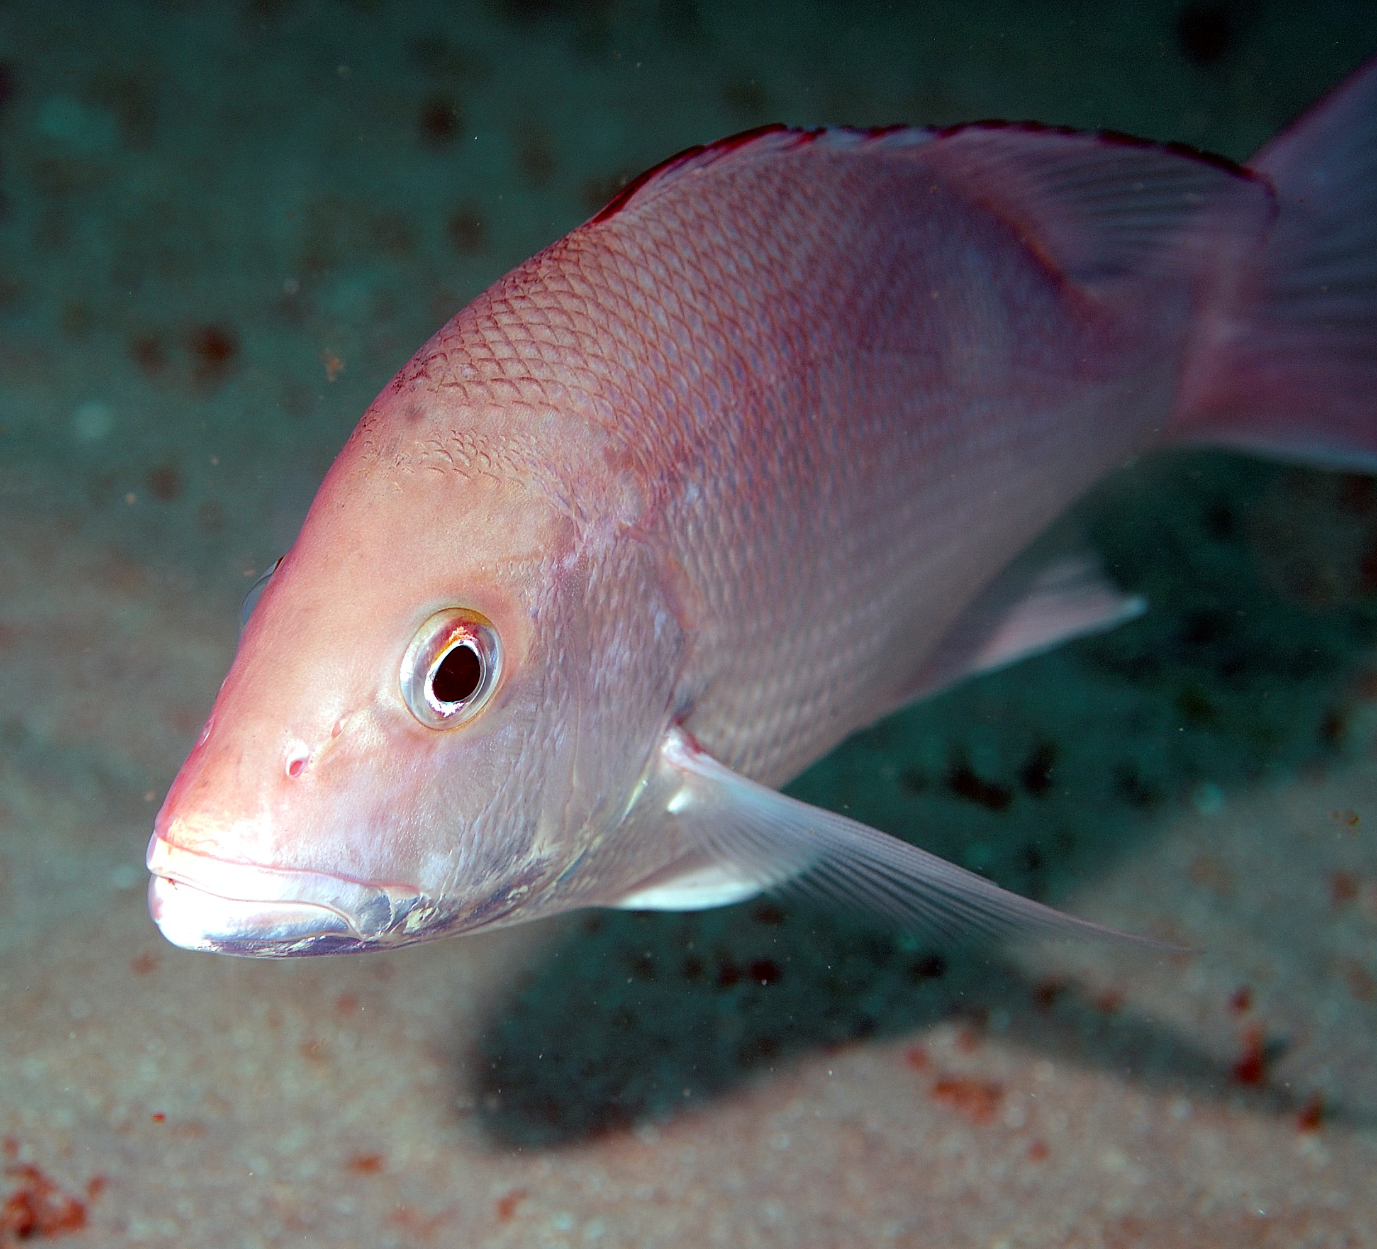
QUESTIONS?

Slide 7
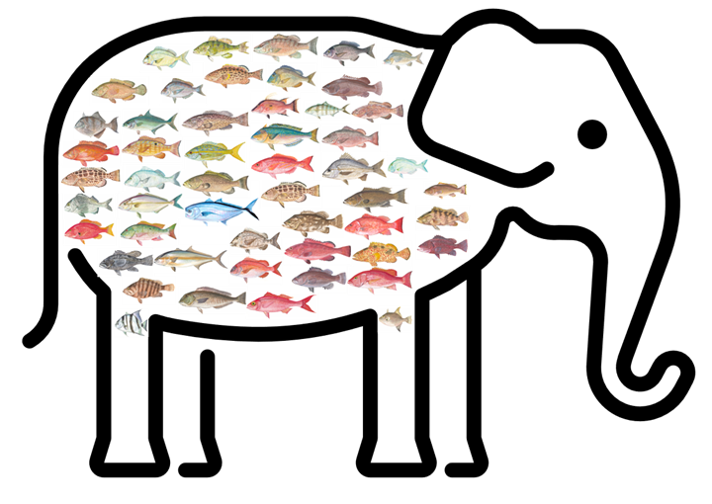
CHANGES TO THE SG FMU
Beginning with 55 stocks
What does NOT need to be evaluated?

Slide 8
Species to be Evaluated: 45
CHANGES TO THE SG FMU
Stocks that are overfished or experiencing overfishing must stay in the FMU (see Table 3)
Removes 10 species from consideration
Snapper Grouper Species | Most Recent Operational Stock Assessment | Biomass Status | Exploitation Status
Black Sea Bass | SEDAR 76 (2023) | Not Overfished* | Not Overfishing
Blueline Tilefish | SEDAR 50 (2016) | Not Overfished | Overfishing**
Gag | SEDAR 71 (2020) | Overfished | Overfishing
Hogfish (FLK/EFL) | SEDAR 37 (2014) | Overfished | Overfishing
Red Grouper | SEDAR 53 (2016) | Overfished | Overfishing
Red Porgy | SEDAR 60 (2018) | Overfished | Overfishing
Red Snapper | SEDAR 73 (2020) | Overfished | Overfishing
Scamp & Yellowmouth Grouper | SEDAR 68 (2022) | Overfished | Not Overfishing
Snowy Grouper | SEDAR 36 Update (2019) | Overfished | Overfishing

Slide 9
Species to be Evaluated: 39?
CHANGES TO THE SG FMU
Assessed stocks have typically been viewed as high priorities for management (see Table 3)
Removes up to 6 species from consideration
Snapper Grouper Species | Most Recent Operational Stock Assessment | Biomass Status | Exploitation Status
Black Grouper | SEDAR 19 (2009) | Not Overfished | Not Overfishing
Golden Tilefish | SEDAR 89 (2024) | Not Overfished | Not Overfishing
Greater Amberjack | SEDAR 59 (2018) | Not Overfished | Not Overfishing
Vermilion Snapper | SEDAR 55 (2017) | Not Overfished | Not Overfishing
Wreckfish | 2014 | Not Overfished | Not Overfishing
Yellowtail Snapper | SEDAR 64 Interim Analysis (2022) | Not Overfished | Not Overfishing
*Hogfish (GA-NC) are not overfished or overfishing, but the species is already counted among overfished stocks due to the status of the FLK/EFL stock

Slide 10
Species to be Evaluated: 32?
CHANGES TO THE SG FMU
Stocks with species-specific ACLs (see Table 1) that have not had operational assessments
Removes up to 7 species from consideration
Snapper Grouper Species | Commercial ACL | Commercial Unit | Recreational ACL | Recreational Unit
Atlantic Spadefish | 150,552 | lbs ww | 661,926 | CHTS lbs ww
Bar Jack | 13,228 | lbs ww | 49,021 | CHTS lbs ww
Goliath Grouper | 0 | lbs ww | 0 | MRFSS lbs ww
Gray Triggerfish | 312,324 | lbs ww | 404,675 | CHTS lbs ww
Nassau Grouper | 0 | lbs ww | 0 | MRFSS lbs gw
Speckled Hind | 0 | lbs ww | 0 | MRFSS lbs ww
Warsaw Grouper | 0 | lbs ww | 0 | MRFSS lbs ww

Slide 11
Species to be Evaluated: ?
CHANGES TO THE SG FMU
Stocks in Complexes (Table 2; part 1)
Italicized numbers are not effective ACLs
Snapper Grouper Complex/Species | Commercial ACL | Commercial Unit | Recreational ACL | Recreational Unit
Deep-water Complex | 131,268 | lbs ww | 38,628 | CHTS lbs ww
Silk Snapper | 66,794 |  | 23,529
Yellowedge Grouper | 50,464 |  | 5,132
Queen Snapper | 8,756 |  | 710
Sand Tilefish | 1,770 |  | 6,213
Blackfin Snapper | 1,096 |  | 2,569
Misty Grouper | 2,388 |  | 475
Other Shallow Water Grouper Complex | 55,542 | lbs ww | 48,648 | CHTS lbs ww
Rock Hind | 22,833 |  | 14,660
Red Hind | 24,350 |  | 8,734
Graysby | 2,771 |  | 14,827
Yellowfin Grouper | 4,879 |  | 4,379
Yellowmouth Grouper | 44 |  | 3,995
Coney | 665 |  | 2,053

Slide 12
Species to be Evaluated: ?
CHANGES TO THE SG FMU
Stocks in Complexes (Table 2; part 2)
Italicized numbers are not effective ACLs
Snapper Grouper Complex/Species | Commercial ACL | Commercial Unit | Recreational ACL | Recreational Unit
Other Jacks Complex | 189,422 | lbs ww | 267,799 | CHTS lbs ww
Almaco Jack | 147,322 |  | 155,195
Lesser Amberjack | 37,829 |  | 107,605
Banded Rudderfish | 4,270 |  | 5,000
Other Snappers Complex | 344,575 | lbs ww | 1,169,308 | CHTS lbs ww
Gray Snapper | 302,180 |  | 944,952
Lane Snapper | 30,014 |  | 173,472
Cubera Snapper | 12,381 |  | 50,884
Other Porgies Complex | 36,348 | lbs ww | 106,914 | CHTS lbs ww
Knobbed Porgy | 34,515 |  | 32,926
Jolthead Porgy | 1,571 |  | 36,315
Whitebone Porgy | 262 |  | 24,762
Scup | 0 |  | 9,306
Saucereye Porgy | 0 |  | 3,606

Slide 13
Species to be Evaluated: ?
CHANGES TO THE SG FMU
Stocks in Complexes (Table 2; part 3)
Italicized numbers are not effective ACLs
Snapper Grouper Complex/Species | Commercial ACL | Commercial Unit | Recreational ACL | Recreational Unit
Grunts Complex | 217,903 | lbs ww | 618,122 | CHTS lbs ww
White Grunt | 203,405 |  | 440,484
Tomtate | 0 |  | 92,670
Margate | 14,498 |  | 62,294
Sailor's Choice | 0 |  | 22,674
Ecosystem Component Species | No ACL |  | No ACL
Cottonwick, Longspine Porgy, Bank Sea Bass, Rock Sea Bass, Ocean Triggerfish

