Slide 1
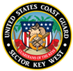
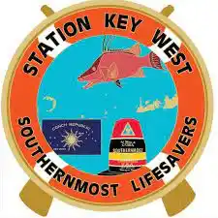
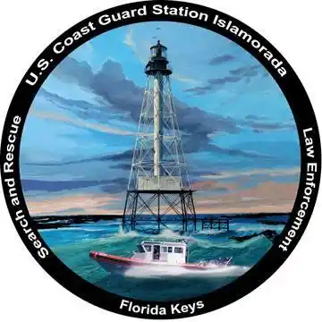
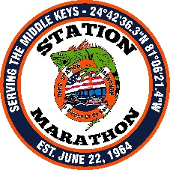
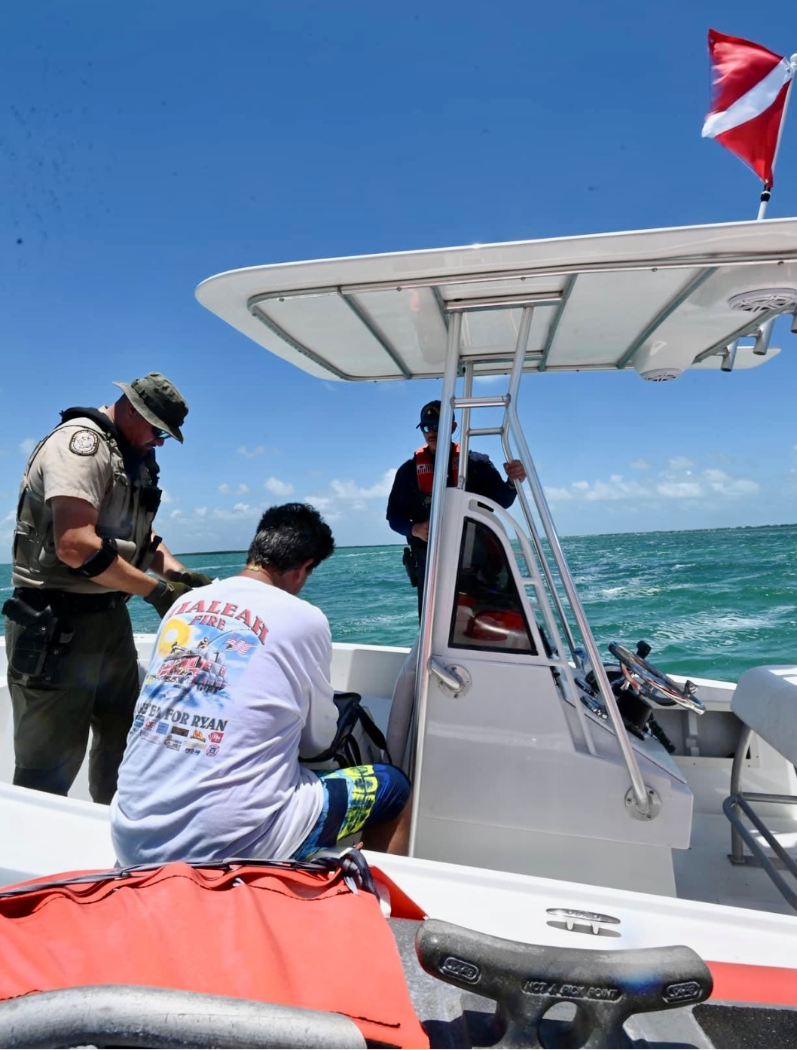
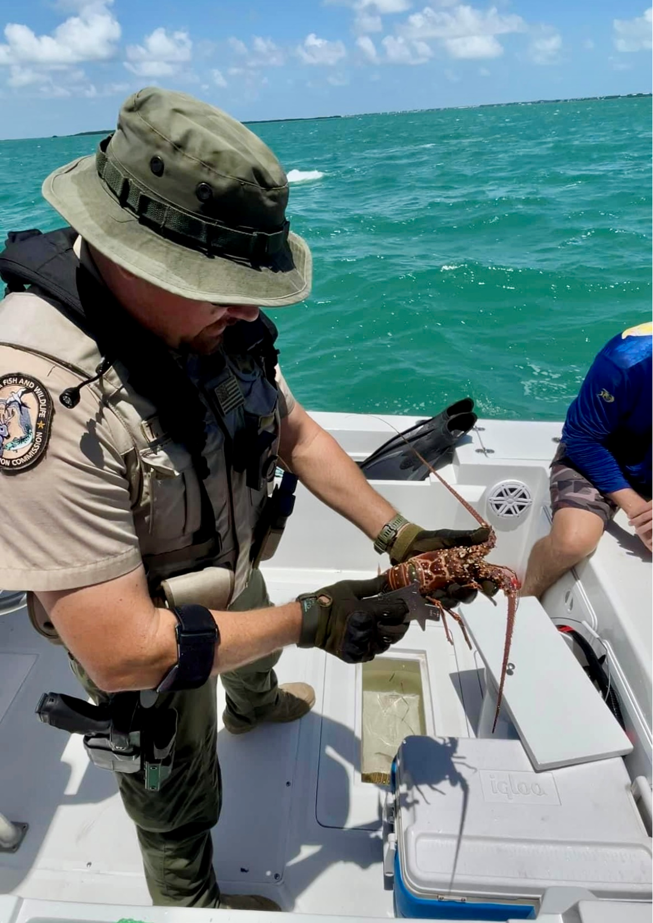
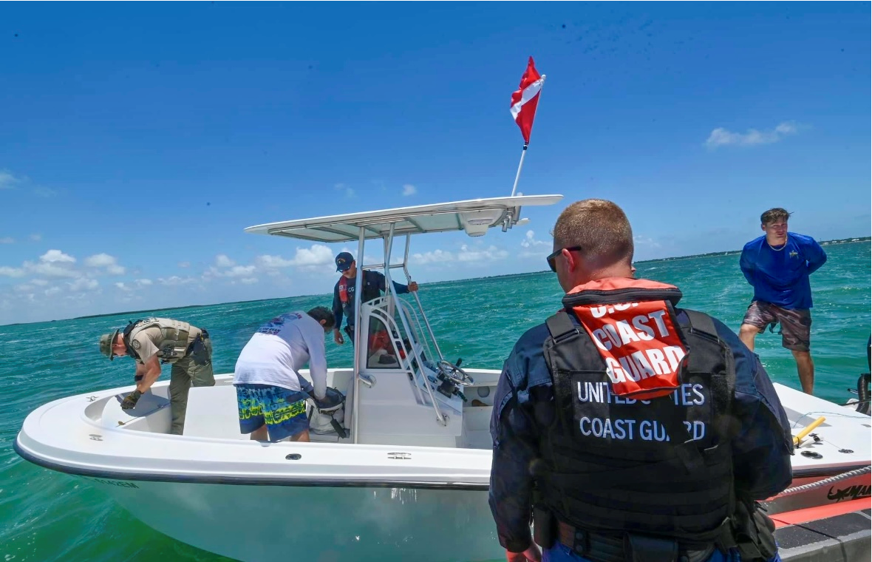
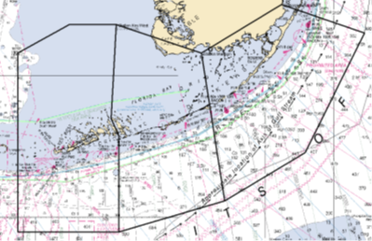
UNCLASSIFIED//FOR OFFICIAL USE ONLY
USCG Sector Key West
Operation Carapace 2024
01 JUL – 03 JUL 2023
Operational Overview
Coast Guards units partnered with Florida Fish and Wildlife agencies in a joint surge operation targeting recreational vessels during 14JUL, 24JUL, and 25JUL for mini spiny lobster season.
Sector Key West sub-units, including Station Key West, Station Marathon, and Station Islamorada integrated with FWC and utilized 56 boarding team members to conduct 92 boardings that resulted in 21 safety violations, 10 recreational vessel terminations, 5 FWC violations, with a total of 836 lobster inspected.
*NOTE: STA Isla spotted rec vessel via UAS engaged in lobstering inside Everglades National Park. FWC and USCG conducted boarding and transferred case to National Park Service where 01 violation was issued for illegal possession of spiny lobster within Everglades National Park and a $500 fine.
Key Areas by Vessel Traffic
 | Boardings | Safety Violations/ Terminations | FWC Violations | Lobster Inspected
STA KW | 29 | 02/00 | 01 | 378
STA MAR | 48 | 11/07 | 04 | 431
STA ISLA | 15 | 08/00 | 03 | 27
UNCLASSIFIED//FOR OFFICIAL USE ONLY

