Slide 1
SAFMC Vision Workshop #2
March 2013
Notes:
Title slide

Slide 2
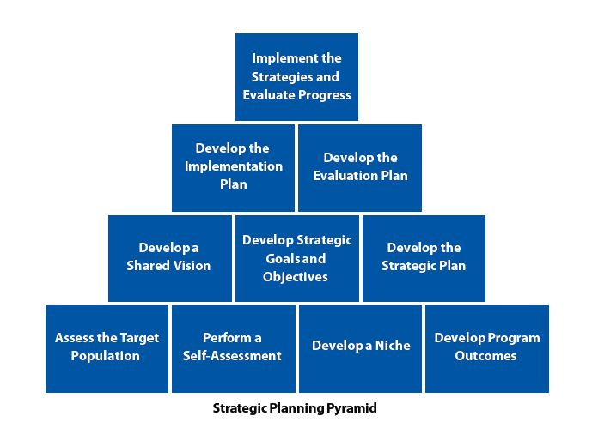
Strategic Plan: a long-term plan to guide an organization towards a clearly articulated mission, goals and objectives. It is a process of assessing where an organization is presently, ascertaining the challenges and opportunities that present themselves, and determining what destination is most desirable and how to get there. (Young 2001, Perspectives on Strategic Planning in the Public Sector)
Notes:
Running slide

Slide 3
Aim | Definition
Provide Strategic Direction | In setting direction, three purposes stand out: 1) strategic planning\sets goals on where an organization wants to go; 2) it indicates where resources are to be concentrated; and 3) it gives top priority and attention to strategic goals.
Guide Priority Use of Resources | Resources are scarce or limited. Strategic planning allows for sound and pointed allocation of resources—human, financial, and material.
Set Standards of Excellence | Strategic planning allows an organization to establish shared values and standards of excellence.
Cope with Environmental Uncertainty and Change | Strategic planning aims to be flexible and provide contingencies for uncertainty and change.
Provide Objective Basis for Control and Evaluation | Strategic planning allows for marking success and failure. Performance measurement or tracking of strategic objectives and action plans are of significance and serve as a basis for control. Source: Jack Koteen (1989). Strategic management in public and nonprofit organizations. New York, NY: Praeger Publishers, pp. 25-26.
Notes:
Running slide

Slide 4
Vision
How do you want the fishery to look?
Goals
Big picture
Ultimate impact of Council work
Difficult or impossible to measure, but you know it when you see it
What will the South Atlantic fisheries look like in 5/10/15 years?
Objectives
Specific with an observable outcome
Should describe the intended impacts or results
Measurable and realistic
Can be linked to an identified problem
Notes:
Running slide

Slide 5
Problem: I have no energy, I’m grumpy, and
my pants don’t fit
Vision: I look and feel awesome
Goal: Get healthy
Objectives
Exercise more
Eat better
Lower stress
Strategies
Jog 3x week
Make dinner at home 5x week
Yoga 2x week
Yoga 2x week
Reduce
commitments
Take the stairs
Reduce meat
Increase
vegetables
Notes:
Running slide

Slide 6
Vision
Example: Sustainable profitable consistent fishing opportunities
Goals
Example 1: Improve social and economic contribution of commercial and for-hire sectors to local economies and community sustainability.
Example 2: Enhance fishing opportunities for private recreational anglers.
Example 3: Efficient, clear, and streamlined management process
Notes:
Running slide

Slide 7
Goal
Example 1: Improve social and economic contribution of commercial and for-hire sectors to local economies and community sustainability.
Objectives
Promote sustainability and facilitate long-run planning.
Create market-driven harvest pace and increase product
continuity.
3) Maintain/increase employment in commercial and for-hire sectors.
4) Development a management system to allow for year-round fishing.
5) Others?
Existing SG
objectives
Notes:
Running slide

Slide 8
Goal
Example 2: Enhance fishing opportunities for private recreational anglers.
Objectives
Improve ability of recreational sector to reach the recreational ACL for underutilized species.
Development a management system to allow for year-round fishing.
Others?
Notes:
Running slide

Slide 9
Goal
Example 3: Efficient, clear, and streamlined management process.
Objectives
Provide for a flexible management system.
Develop management goals and objectives that are used in the decision-making process.
Create a system to allow the most streamlined method of updating ACLs when the SSC recommends a new ABC.
Others?
Existing SG objective
Notes:
Running slide

Slide 10
Current FMP Objectives for the Snapper Grouper Fishery
Prevent overfishing.
Collect necessary data.
Promote orderly utilization of the resource.
Provide for a flexible management system.
Minimize habitat damage.
Promote public compliance and enforcement.
Mechanism to vest participants.
Promote stability and facilitate long-run planning.
Create market-driven harvest pace and increase product continuity.
Minimize gear and area conflicts among fishermen.
Decrease incentives for overcapitalization.
Prevent continual dissipation of returns from fishing through open access.
Evaluate and minimize localized depletion.
End overfishing of snapper grouper stocks undergoing overfishing.
Rebuild stocks declared overfished.

